Slide 1

Sparse Representations and the Basis Pursuit Algorithm*
Michael Elad
The Computer Science Department –
Scientific Computing & Computational mathematics (SCCM) program
Stanford University
November 2002
* Joint work with: Alfred M. Bruckstein – CS, Technion
David L. Donoho – Statistics, Stanford
Peyman Milanfar – EE, UCSC

Slide 2


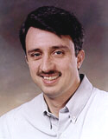
Collaborators
Freddy Bruckstein
Computer Science Department – Technion
Dave Donoho
Statistics Department Stanford
Peyman Milanfar
EE - University of California Santa-Cruz

Slide 3
General
Basis Pursuit algorithm [Chen, Donoho and Saunders, 1995]:
  Effective for finding sparse over-complete representations,
  Effective for non-linear filtering of signals.
Our work (in progress) – better understanding BP and deploying it in signal/image processing and computer vision applications.
We believe that over-completeness has an important role!
Today we discuss:
  Understanding the BP: why successful? conditions?
  Deploying the BP: through its relation to Bayesian (PDE) filtering.

Slide 4
Agenda
Introduction
  Previous and current work
2. Two Ortho-Bases
  Uncertainty → Uniqueness → Equivalence
3. Arbitrary dictionary
Uniqueness → Equivalence
4. Basis Pursuit for Inverse Problems
  Basis Pursuit Denoising → Bayesian (PDE) methods
5. Discussion
Understanding the BP
Using the BP for denoising

Slide 5
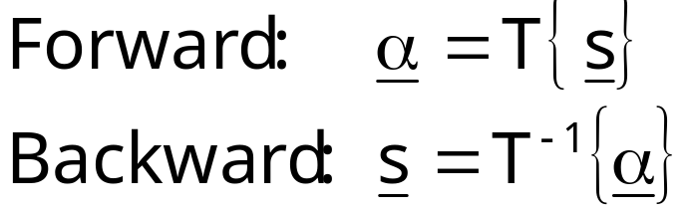
Transforms
Define the forward and backward transforms by (assume one-to-one mapping)
s – Signal (in the signal space C^{N})
α – Representation (in the transform domain C^{L}, L≥N)
Transforms T in signal and image processing used for coding, analysis, speed-up processing, feature extraction, filtering, …

Slide 6

The Linear Transforms
Special interest - linear transforms (inverse)
General transforms
L
Linear
Φ
=
Square
N
s
Unitary
Atoms from a Dictionary
α
In square linear transforms, Φ is an N-by-N & non-singular.

Slide 7
Lack Of Universality
Many available square linear transforms – sinusoids, wavelets, packets, ridgelets, curvelets, …
Successful transform – one which leads to sparse representations.
Observation: Lack of universality - Different bases good for different purposes.
  Sound = harmonic music (Fourier) + click noise (Wavelet),
  Image = lines (Ridgelets) + points (Wavelets).
Proposed solution: Over-complete dictionaries, and possibly combination of bases.

Slide 8
Example – Composed Signal
0.1
0.05
φ₁
0
-0.05
×1.0
-0.1
0.1
×0.3
0
0.05
φ₂
0.1
10
0
0
-2
-0.05
10
-0.1
+
-0.1
1
10
-4
|T{φ₁+0.3φ₂-0.5φ₃-0.05φ₄}|
-0.2
φ₃
10
-6
0.5
-0.3
×(-0.5)
-0.4
-8
|T{φ₁+0.3φ₂}|
10
0
-0.5
1
10
-10
-0.6
0
20
40
60
80
100
120
φ₄
0.5
DCT Coefficients
×0.05
0
0
64
128

Slide 9
Example – Desired Decomposition
10
0
10
-2
10
-4
10
-6
10
-8
10
-10
0
40
80
120
160
200
240
DCT Coefficients
Spike (Identity) Coefficients

Slide 10
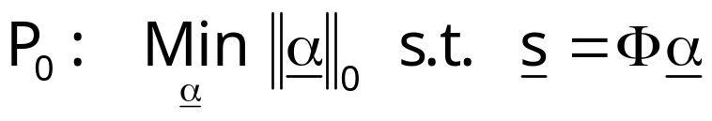
Matching Pursuit
Given d unitary matrices {Φ_{k}, 1≤k≤d}, define a dictionary Φ = [Φ₁, Φ₂ , … Φ_{d}] [Mallat & Zhang (1993)].
Combined representation per a signal s by
Non-unique solution α - Solve for maximal sparsity
Hard to solve – a sub-optimal greedy sequential solver: “Matching Pursuit algorithm” .

Slide 11
Example – Matching Pursuit
10
0
10
-2
10
-4
10
-6
10
-8
10
-10
0
50
100
150
200
250
Dictionary Coefficients

Slide 12

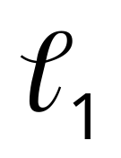
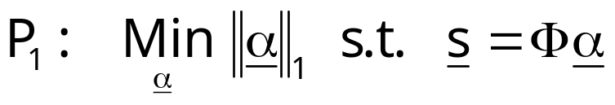
Basis Pursuit (BP)
Facing the same problem, and the same optimization task [Chen, Donoho, Saunders (1995)]
Hard to solve – replace the norm by an : “Basis Pursuit algorithm”
Interesting observation: In many cases it successfully finds the sparsest representation.

Slide 13
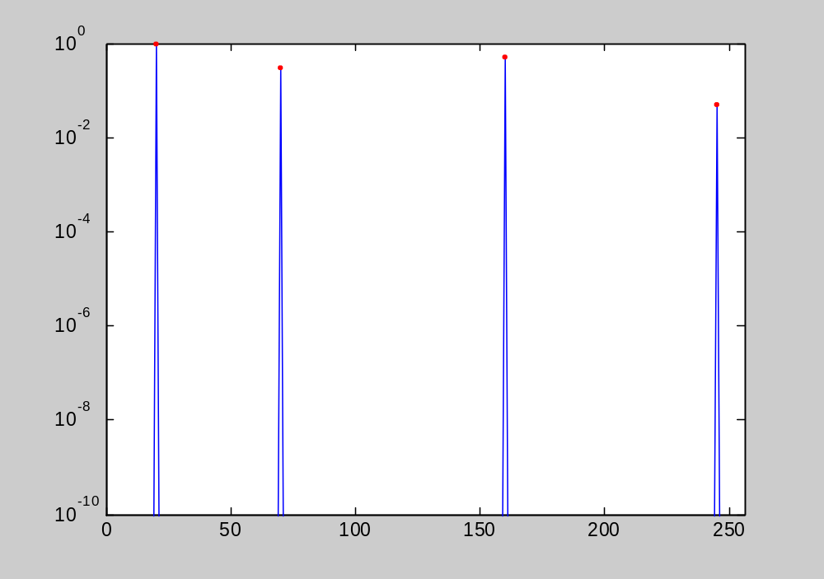
Example – Basis Pursuit
Dictionary Coefficients

Slide 14
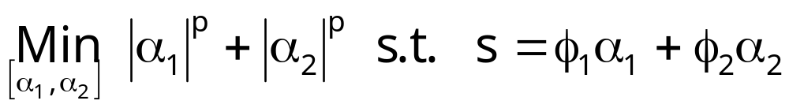



Why ? 2D-Example
0≤P<1
P=1
P>1

Slide 15
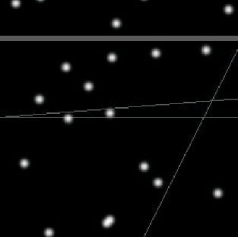

Example – Lines and Points*
Original image
Wavelet part of the noisy image
Ridgelets part of the image
* Experiments from Starck, Donoho, and Candes - Astronomy & Astrophysics 2002.

Slide 16





Example – Galaxy SBS 0335-052*
Original
Residual
=
+
Wavelet
Ridgelets
Curvelets
+
+
* Experiments from Starck, Donoho, and Candes - Astronomy & Astrophysics 2002.

Slide 17
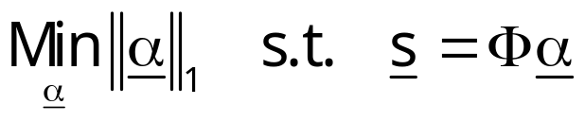
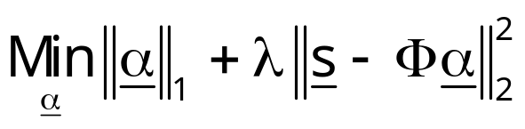
Non-Linear Filtering via BP
Through the previous example – Basis Pursuit can be used for non-linear filtering.
From Transforming to Filtering
What is the relation to alternative non-linear filtering methods, such as PDE based methods (TV, anisotropic diffusion …), Wavelet denoising?
What is the role of over-completeness in inverse problems?

Slide 18

(Our) Recent Work
Proving tightness of E-B bounds [Feuer & Nemirovski]
Proven equivalence between P₀ and P₁ under some conditions on the sparsity of the representation, and for dictionaries built of two ortho-bases [Donoho and Huo]
Improving previous results – tightening the bounds [Elad and Bruckstein]
Relaxing the notion of sparsity from to norm
[Elad and Donoho]
1998
1999
2000
2001
2002
time
Generalized all previous results to any dictionary [Elad and Donoho]
Generalized to the multi-signal case [Elad and Donoho]
BP for Inverse Problems [Elad, Milanfar, Donoho]

Slide 19
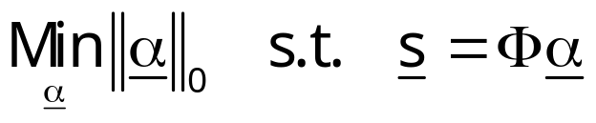
Before we dive …
Given a dictionary  and a signal s, we want to find the sparse “atom decomposition” of the signal.
Our goal is the solution of
Basis Pursuit alternative is to solve instead
Our focus for now: Why should this work?

Slide 20

Agenda
1. Introduction
  Previous and current work
2. Two Ortho-Bases
  Uncertainty → Uniqueness → Equivalence
3. Arbitrary dictionary
Uniqueness → Equivalence
4. BP Inverse Problems
  Basis Pursuit → PDE methods
5. Discussion
N
N
N

Slide 21
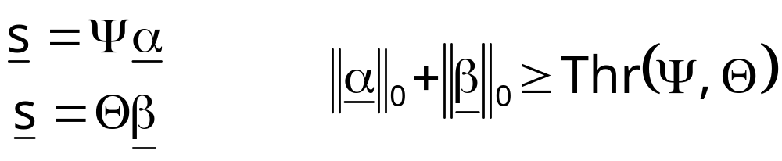
Our Objective
Given a signal s, and its two representations using Ψ and Θ, what is the lower bound on the sparsity of both?
Our Objective is
We will show that such rule immediately leads to a practical result regarding the solution of the P₀ problem.

Slide 22
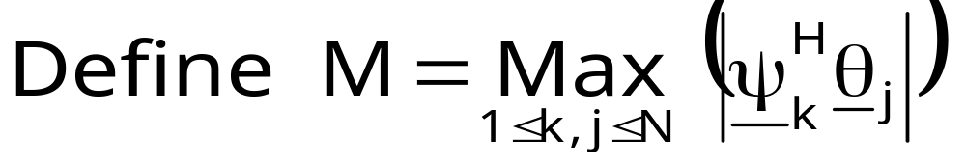



Mutual Incoherence
M – mutual incoherence between Ψ and Θ.
M plays an important role in the desired uncertainty rule.
Properties
  Generally, .
  For Fourier+Trivial (identity) matrices .
  For random pairs of ortho-matrices .

Slide 23
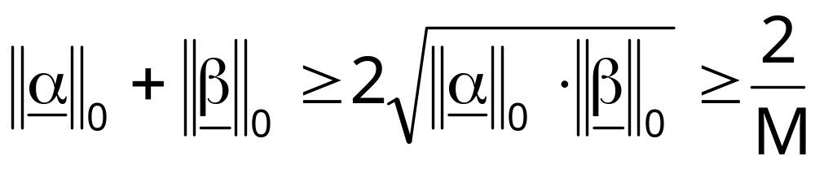


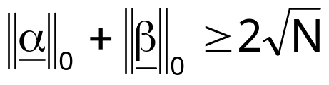

Uncertainty Rule
*
Theorem 1
Examples:
  Ψ=Θ: M=1, leading to .
  Ψ=I, Θ=F_{N} (DFT): , leading to .
* Donoho & Huo obtained a weaker bound

Slide 24

Example
Ψ=I, Θ=F_{N} (DFT)
For N=1024, .
The signal satisfying this bound: Picket-fence
1
0.9
0.8
0.7
0.6
0.5
0.4
0.3
0.2
0.1
0
0
200
400
600
800
1000

Slide 25
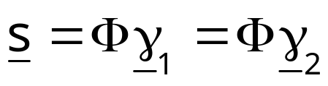
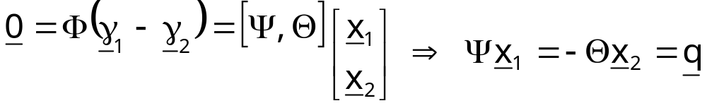

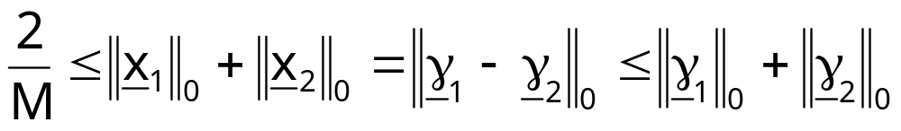
Towards Uniqueness
Given a unit norm signal s, assume we hold two different representations for it using Φ
Thus
Based on the uncertainty theorem we just got:

Slide 26
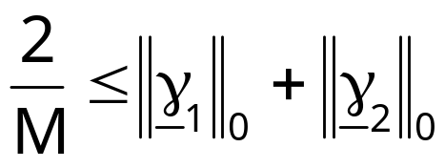
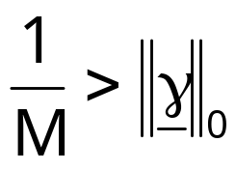

Uniqueness Rule
In words: Any two different representations of the same
signal CANNOT BE JOINTLY TOO SPARSE.
*
If we found a representation that satisfy
Then necessarily it is unique (the sparsest).
Theorem 2
* Donoho & Huo obtained a weaker bound

Slide 27
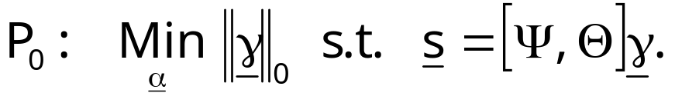

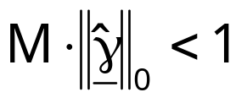
Uniqueness Implication
We are interested in solving
Somehow we obtain a candidate solution .
The uniqueness theorem tells us that a simple test on
( ) could tell us if it is the solution of P₀.
However:
  If the test is negative, it says nothing.
  This does not help in solving P₀.
  This does not explain why P₁ may be a good replacement.

Slide 28
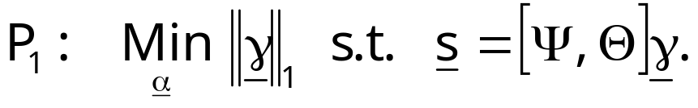
Equivalence - Goal
We are going to solve the following problem
The questions we ask are:
  Will the P₁ solution coincide with the P₀ one?
  What are the conditions for such success?
We show that if indeed the P₀ solution is sparse enough, then P₁ solver finds it exactly.

Slide 29
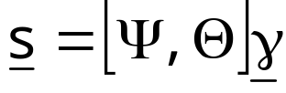
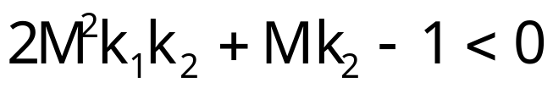
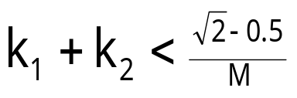
Equivalence - Result
Given a signal s with a representation ,
Assuming a sparsity on γ such that (assume k₁<k₂)
k₁ non-zeros
k₂ non-zeros
If k₁ and k₂ satisfy
then P₁ will find the correct solution.
Theorem 3
*
A weaker requirement is given by
* Donoho & Huo obtained a weaker bound

Slide 30
The Various Bounds
Signal dimension: N=1024,
Dictionary: Ψ=I, Θ=F_{N} ,
Mutual incoherence M=1/32.
32
28
K
1
+K
= 0.9142/M
2
2M
2
K
1
K
2
+MK
2
-1=0
24
K
1
+K
=1/M
2
20
Results
Uniqueness: 32 entries and below,
Equivalence:
  16 entries and below (D-H),
  29 entries and below (E-B).
2
K
+K =
K
>K
K
1
2
1
2
16
= 0.5(1+1/M)
12
8
4
0
4
8
12
16
20
24
28
32
K
1

Slide 31
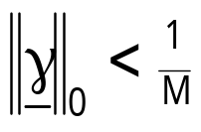
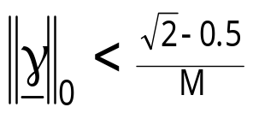
Equivalence – Uniqueness Gap
For uniqueness we got the requirement
For equivalence we got the requirement
Is this gap due to careless bounding?
Answer [by Feuer and Nemirovski, to appear in IEEE Transactions On Information Theory]: No, both bounds are indeed tight.

Slide 32

Agenda
1. Introduction
  Previous and current work
2. Two Ortho-Bases
  Uncertainty → Uniqueness → Equivalence
3. Arbitrary dictionary
Uniqueness → Equivalence
4. Basis Pursuit for Inverse Problems
  Basis Pursuit Denoising → Bayesian (PDE) methods
5. Discussion
L
Every column is normalized to have an l₂ unit norm
N

Slide 33
Why General Dictionaries?
Because in many situations
  We would like to use more than just two ortho-bases (e.g. Wavelet, Fourier, and ridgelets);
  We would like to use non-ortho bases (pseudo-polar FFT, Gabor transform, … ),
  In many situations we would like to use non-square transforms as our building blocks (Laplacian pyramid, shift-invariant Wavelet, …).
In the following analysis we assume ARBITRARY DICTIONARY (frame). We show that BP is successful over such dictionaries as well.

Slide 34
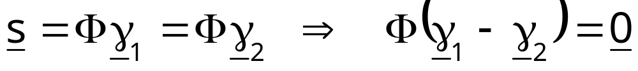

Uniqueness - Basics
Given a unit norm signal s, assume we hold two different representations for it using Φ
In the two-ortho case - simple splitting and use of the uncertainty rule – here there is no such splitting !!
The equation implies a linear combination of columns from Φ that are linearly dependent. What is the smallest such group?
Φ
=
0
v

Slide 35
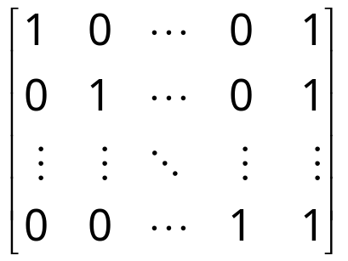
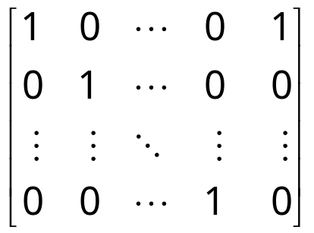
Uniqueness – Matrix “Spark”
Definition: Given a matrix Φ, define σ=Spark{Φ} as the smallest integer such that there exists at least one group of σ columns from Φ that is linearly dependent. The group realizing σ is defined as the “Critical Group”.
Examples:
Spark =N+1;
Spark =2

Slide 36
“Spark” versus “Rank”
The notion of spark is confusing – here is an attempt to compare it to the notion of rank
Rank
Definition: Maximal # of columns that are linearly independent
Computation: Sequential - Take the first column, and add one column at a time, performing Gram-Schmidt orthogonalization. After L steps, count the number of non-zero vectors – This is the rank.
Spark
Definition: Minimal # of columns that are linearly dependent
Computation: Combinatorial - sweep through 2^{L} combinations of columns to check linear dependence - the smallest group of linearly dependent vectors is the Spark.
Generally: 2 ≤ σ=Spark{Φ} ≤ Rank{Φ}+1.

Slide 37

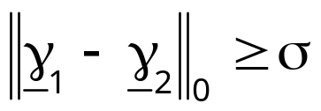
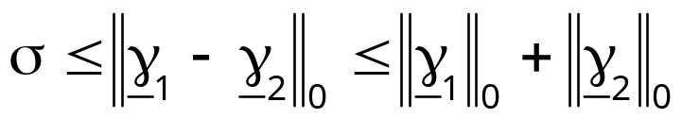
Uniqueness – Using the “Spark”
Assume that we know the spark of Φ, denoted by σ.
For any pair of representations of s we have
By the definition of the spark we know that if Φv=0 then . Thus
From here we obtain the relationship

Slide 38
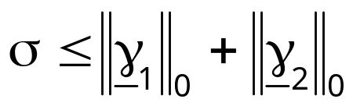
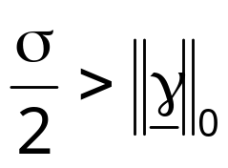
Uniqueness Rule – 1
Any two different representations of the same signal using an arbitrary dictionary cannot be jointly sparse.
If we found a representation that satisfy
Then necessarily it is unique (the sparsest).
Theorem 4

Slide 39
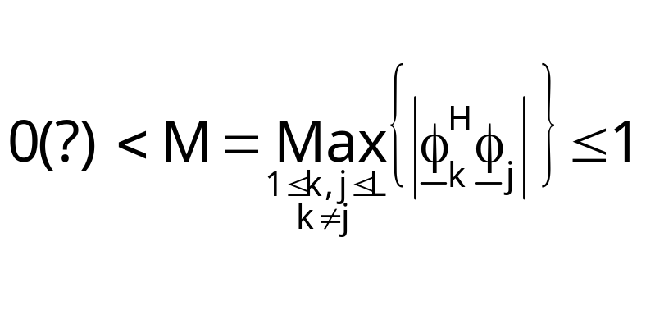
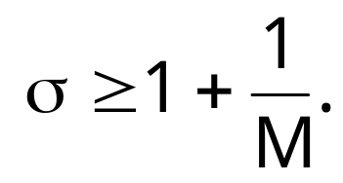
Lower bound on the “Spark”
Define
(notice the resemblance to the previous definition of M).
We can show (based on Gerśgorin disks theorem) that a lower-bound on the spark is obtained by
Since the Gerśgorin theorem is un-tight, this lower bound on the Spark is too pessimistic.

Slide 40
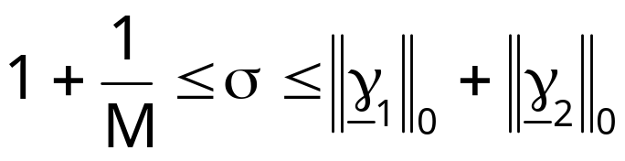
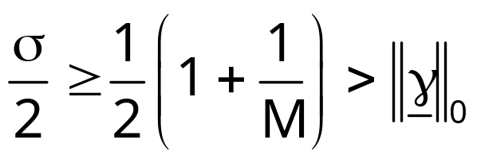
Uniqueness Rule – 2
Any two different representations of the same signal using an arbitrary dictionary cannot be jointly sparse.
*
If we found a representation that satisfy
Then necessarily it is unique (the sparsest).
Theorem 5
* This is the same as Donoho and Huo’s bound! Have we lost tightness?

Slide 41
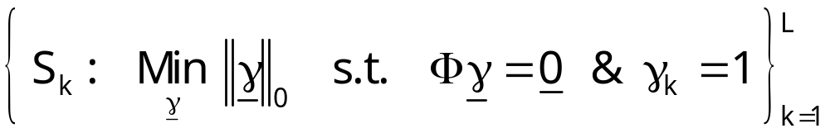
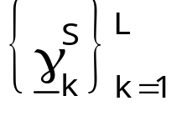
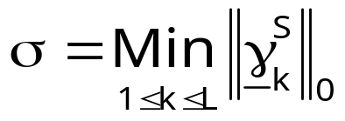
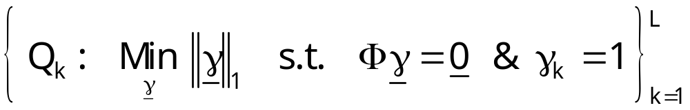
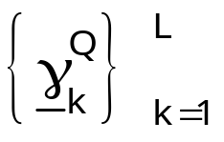

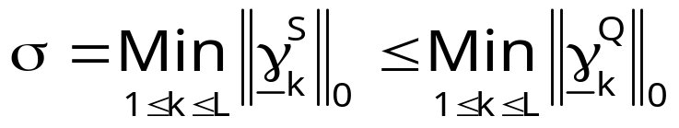
“Spark” Upper bound
The Spark can be found by solving
Use Basis Pursuit
Clearly .
Thus .

Slide 42
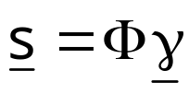
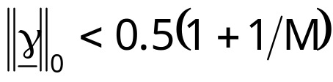
Equivalence – The Result
Following the same path as shown before for the equivalence theorem in the two-ortho case, and adopting the new definition of M we obtain the following result:
Given a signal s with a representation ,
Assuming that , P₁ (BP) is
Guaranteed to find the sparsest solution.
*
Theorem 6
* This is the same as Donoho and Huo’s bound! Is it non-tight?

Slide 43
To Summarize so far …
Over-complete linear transforms – great for sparse representations
forward transform?
Basis Pursuit Algorithm
Why works so well?
We give explanations (uniqueness and equivalence) true for any dictionary
(a) Design of dictionaries,
(b) Test of solution for optimality,
(c) Applications of BP for
scrambling, signal separation,
inverse problems, …
Practical Implications?

Slide 44
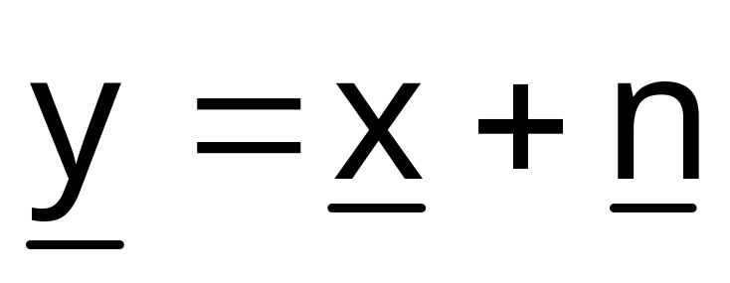
Agenda
1. Introduction
  Previous and current work
2. Two Ortho-Bases
  Uncertainty → Uniqueness → Equivalence
3. Arbitrary dictionary
Uniqueness → Equivalence
4. Basis Pursuit for Inverse Problems
  Basis Pursuit Denoising → Bayesian (PDE) methods
5. Discussion

Slide 45
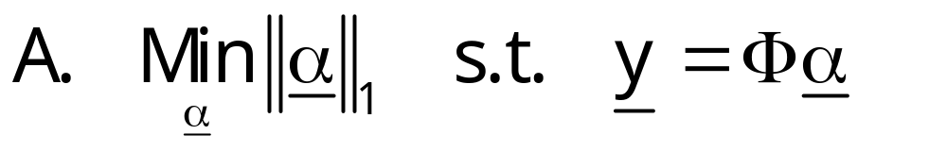
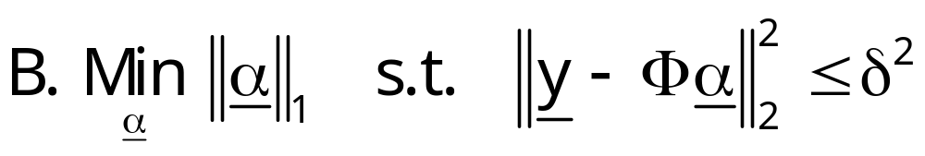

From Exact to Approximate BP

Slide 46


Wavelet Denoising
Wavelet denoising by Donoho and Johnston (1994) –
where W is an orthonormal matrix, and p=0 or 1.
The result is very simple - hard (p=0) or soft (p=1) thresholding.
Thresholding
Image
In
Image
Out
Inverse Wavelet Transform
Wavelet Transform

Slide 47

Shift Invariance Wavelet Denoising
Major problem with Wavelet denoising – A shifted signal results with a different output - “shift-dependence”.
Proposed solution (Donoho and Coifman, 1995): Apply the Wavelet denoising for all shifted version of the W matrix and average – results very promising.
In our language .
Can be applied in the Bayesian approach – variant of the Bilateral filter.

Slide 48

Basis Pursuit Denoising
A denoising algorithm is proposed for non-square dictionaries [Chen, Donoho & Saunders 1995]
The solution now is not as simple as in the ortho-case, but the results are far better due to over-completeness!
Interesting questions:
  Which dictionary to choose?
  Relation to other classic non-linear denoising algorithms?

Slide 49



BP Denoising & Total Variation
Relation between BP and the Total-Variation denoising algorithm [Rudin, Osher & Fatemi, 1992]? Answer is given by [Chen, Donoho & Saunders 1995]:
We have that
H is the Heaviside basis vectors.

Slide 50




A General Bayesian Approach
Our distributions are
Using the Maximum A-Posteriori Probability (MAP) we get

Slide 51




Generalized Result
Bayesian denoising formulation
*
Using and thus
we obtain
Thus, we have a general relationship between Ω (Bayesian Prior operator) and Φ (dictionary).
* The case of non-full-rank Ω can be dealt-with using sub-space projection as a pre-stage, and using Economy SVD for pseudo-inverse.

Slide 52


Example 1 – Total Variation
Looking back at the TV approach we have (D – shift-right)
Based on our result we have
Indeed we get a Heaviside basis. Moreover, finite support effects and singularity are taken into account properly.
1
0.8
0.6
0.4
0.2
0
-0.2
-0.4
-0.6
-0.8
-1
0
5
10
15
20
25

Slide 53

Example 2 – Bilateral Filter
ONE recent denoising algorithm of great impact:
  Bilateral filter [Tomasi and Manduchi, 1998],
  Digital TV [Chan, Osher and Shen, 2001],
  Mean-Shift [Comaniciu and Meer, 2002].
Recent work [Elad, 2001] show that these filters are essentially the same, being one Jacobi iteration minimizing
In [Elad, 2001] we give speed-up and other extensions for the above minimization – Implication: Speed-up the BP.

Slide 54

Example 2 – Bilateral Dictionary
The dictionary Φ has truncated (not all scales) multi-scaled and shift-invariant (all locations) ‘derive-lets’ :
0.6
0.4
0.2
0
-0.2
-0.4
-0.6
-0.8

Slide 55

Results
Original and noisy ( σ²=900) images

Slide 56

TV filtering:
50 iterations 10 iterations
(MSE=146.3339) (MSE=131.5013)

Slide 57

Wavelet Denoising (hard)
Using DB5 Using DB3
(MSE=154.1742) (MSE=161.086)

Slide 58

Wavelet Denoising (soft)
Using DB5 Using DB3
(MSE=144.7436) (MSE=150.7006)

Slide 59

Filtering via the Bilateral (BP equivalent):
2 iterations with 11×11 Sub-gradient based 5×5
(MSE=89.2516) (MSE=93.4024)
Filtering via the Bilateral (BP equivalent):
2 iterations with 11×11 Sub-gradient based 5×5
(MSE=89.2516) (MSE=93.4024)

Slide 60
Agenda
1. Introduction
  Previous and current work
2. Two Ortho-Bases
  Uncertainty → Uniqueness → Equivalence
3. Arbitrary dictionary
Uniqueness → Equivalence
4. Basis Pursuit for Inverse Problems
  Basis Pursuit Denoising → Bayesian (PDE) methods
5. Discussion

Slide 61
Part 5
Discussion

Slide 62
Summary
Basis Pursuit is successful for
  Forward transform – we shed light on this behavior.
  Regularization scheme – we have shown relation to Bayesian non-linear filtering, and demonstrated the bilateral filter speed-up.
The dream: the over-completeness idea is highly effective, and should replace existing methods in representation and inverse-problems.
We would like to contribute to this change by
  Supplying clear(er) explanations about the BP behavior,
  Improve the involved numerical tools, and then
  Deploy it to applications.

Slide 63
Future Work
What dictionary to use? Relation to learning?
BP beyond the bounds – Can we say more?
Relaxed notion of sparsity? When zero is really zero?
How to speed-up BP solver (both accurate and approximate)?
Theory behind approximate BP?
Applications – Demonstrating the concept for practical problems beyond denoising: Coding? Restoration? Signal separation? …

