Slide 1

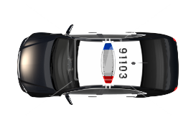




Mobile Application for smart parking
Name : Shravan Kumar Reddy Pochampally
Graduate Student
Central Michigan University

Slide 2
Outline
Introduction
Needs and Benefits of Parking Application
Modules
User Interface
Work Flow
Future Work
References

Slide 3

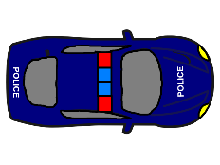
Introduction
Parking a vehicle has become a difficult task to the people living in a densely populated cities. The parkers used to roam around the streets to find a space for parking, it consumes lot of time and gas.
According to a report, by using the parking applications can save 220,000 gallons of gas till 2030.
The mobile application for finding an available parking spot, park and pay using mobile can become an important asset to the users.

Slide 4
Need and Benefits of parking application
This smart parking application provides the feature to easy ‘park and pay’ using mobile.
Provides available parking spots to users.
It enables real time monitoring and managing of available parking space.

Slide 5
Need and Benefits of parking application
Recognizing the spot by reading QR Code and tracking the parked vehicle helps user to more comfortable and faster parking.
Low cost and efficient system.

Slide 6
Technologies
Software Requirements for Development:-
Operating System : Windows/linux any flavors
Technology : Android
IDE : Eclipse ADT /Android studio
Database : Sqlite 3.0 or above

Slide 7
Technologies
Hardware Requirements:-
Processor : i3 and above
RAM : 4GB and above
Hard Disk : 20 GB
Phone/tab : Android based Phone /Tab(version2.3 or above)

Slide 8
modules
Authentication Module:
This module allows the Registered user and admin to login with authorized credentials.
It also allows new users to register by filling registration form.

Slide 9
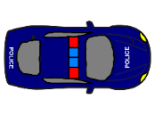
modules
Parking module:
This module provides the availability of parking lots and allows the user to park the vehicle in the available lot.
It has feature to read barcode through the camera of the smart phone to recognize the parking lot and estimates cost for the parking session.
Location of the car can also be tracked using GPS.

Slide 10
modules
Administrator module:
In this module administrator can extend the application support to various locations, by adding/editing the specific parking locations to cater the needs of their users.
Admin can also restrict user access to application in specific scenarios like payment defaults, violations to terms & conditions.

Slide 11
modules
Reports module:
Reports of daily, weekly or monthly parking sessions can be generated using mobile application. This includes payment activity as well.

Slide 12
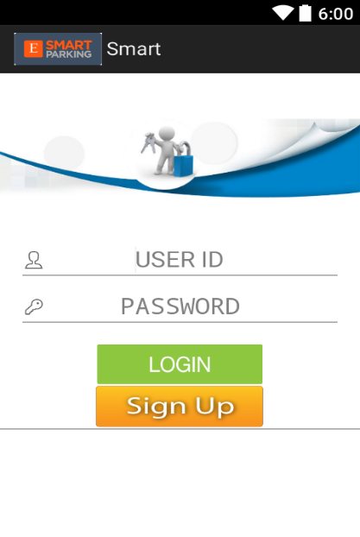
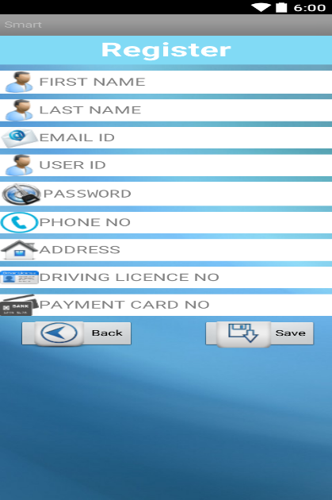
User interface screen
Authentication Module:
Figure 1: Login Screen
Figure 2: New Registration

Slide 13
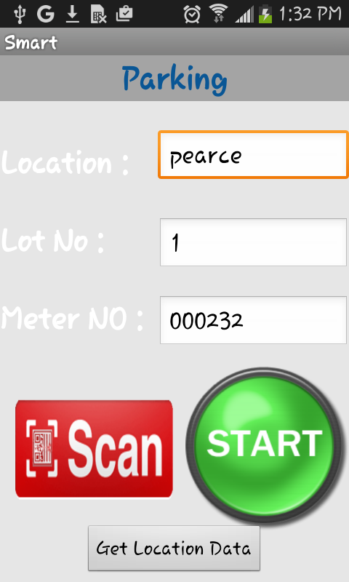
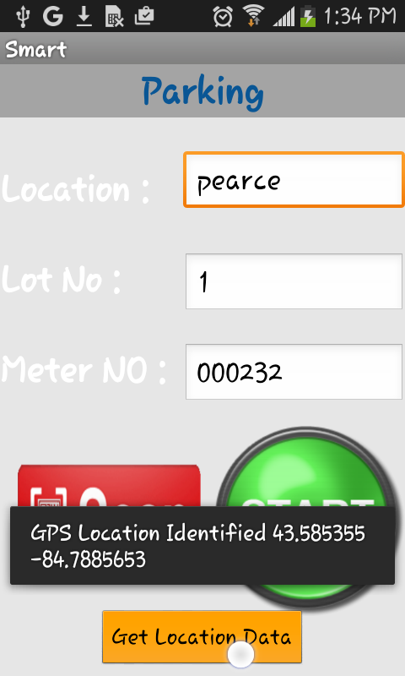
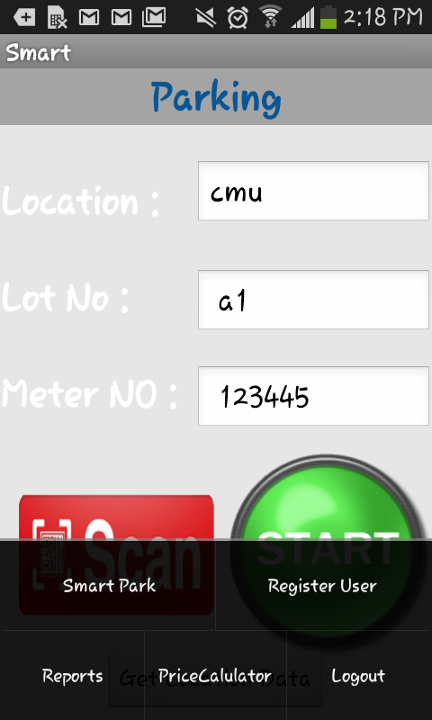
User interface screen
Parking Module:
Figure 3: Parking lot selection
Figure 4: GPS location of parking
Figure 5: Menu for selecting other features

Slide 14
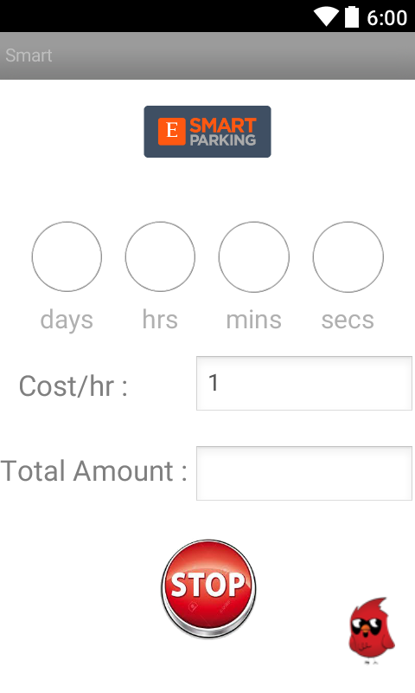
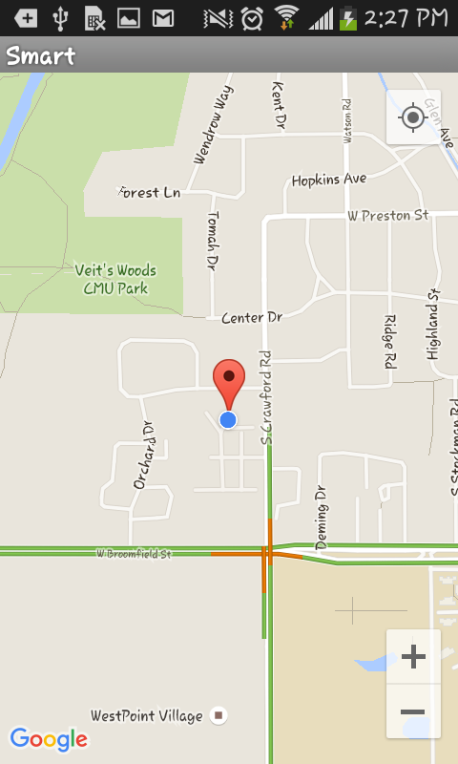
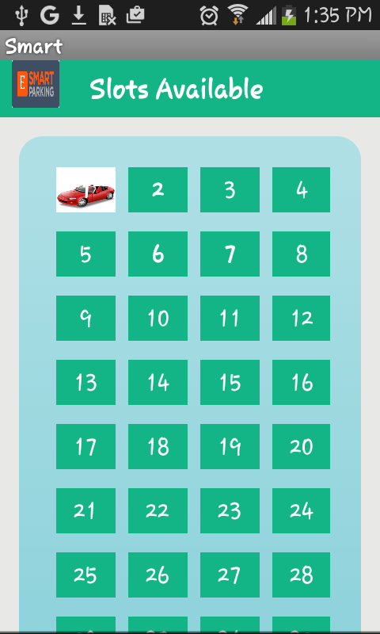
User interface screen
Figure 6: Parking session timer
Figure 7: Tracking parking spot
Figure 9: Availability of slots

Slide 15
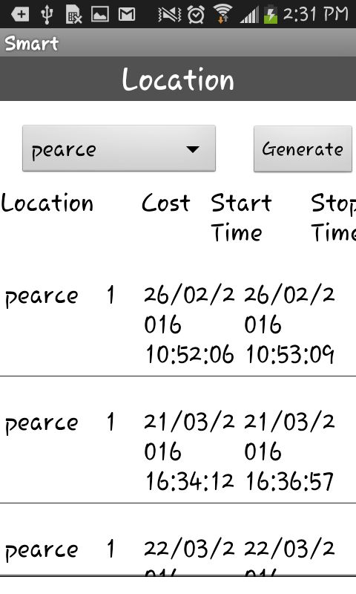
User interface screen
Figure 8: User reports by Location

Slide 16




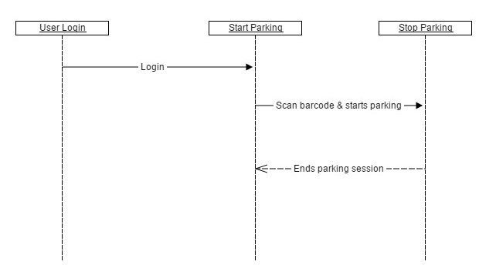
Implementation
The smart parking application has two components, the application and database. The application has two types of users they are the User and the Admin.
User Login:

Slide 17
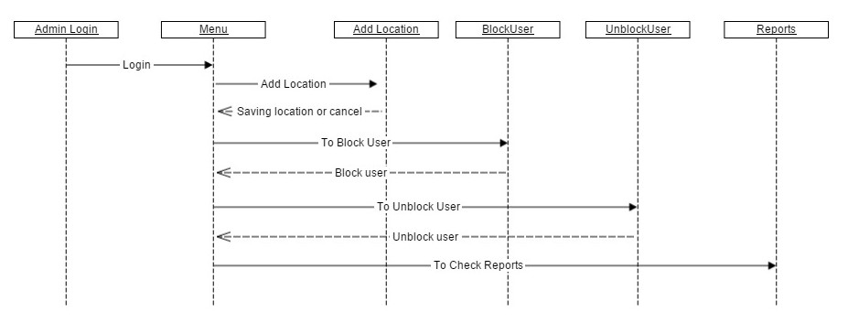
Implementation
Admin login:
Add Location:
The administrator can add new parking location by specifying price per hour.
Block User:
The users can be restricted to access the application, if he/she violates the terms and conditions like payment failures etc.
Un-Block User:
This is to unblock the blocked users to allow access to the application.
Reports:
The transactions of all the users can be generated by daily figures, weekly, monthly and between From date and To date period.

Slide 18
Implementation
User Menu:
Availability:
Can view available slots anytime.
Price Calculator:
Estimates the fare for the selected location.
Reports:
The parking sessions in daily figures, weekly, monthly and between From date and To date period of the user can be tracked in anytime by selecting reports from the menu.

Slide 19
Application Demo

Slide 20

Future work
For the accurate availability information of parking lots, sensors need to be placed at the parking meters to recognize manual parker.
Admin can update the availability layouts for all locations.
Suggesting nearest and cheaper parking lots for the user.
A feature for reserving parking lot. It is very useful for physically disabled people.
Providing security feature by validating user.

Slide 21
references
[1]. Getting Started. (n.d.). Retrieved January 23, 2016, from http://developer.android.com/training/index.html[2].
[2]. Darwin, I. F. (2012). Android cookbook. Sebastopol, CA: O'Reilly Media.
[3]. A. Grazioli, M. Picone, F. Zanichelli and M. Amoretti, "Collaborative Mobile Application and Advanced Services for Smart Parking," 2013 IEEE 14th International Conference on Mobile Data Management, Milan, 2013, pp. 39-44. doi: 10.1109/MDM.2013.63

Slide 22
Queries?

Slide 23
Thank You

