Slide 1
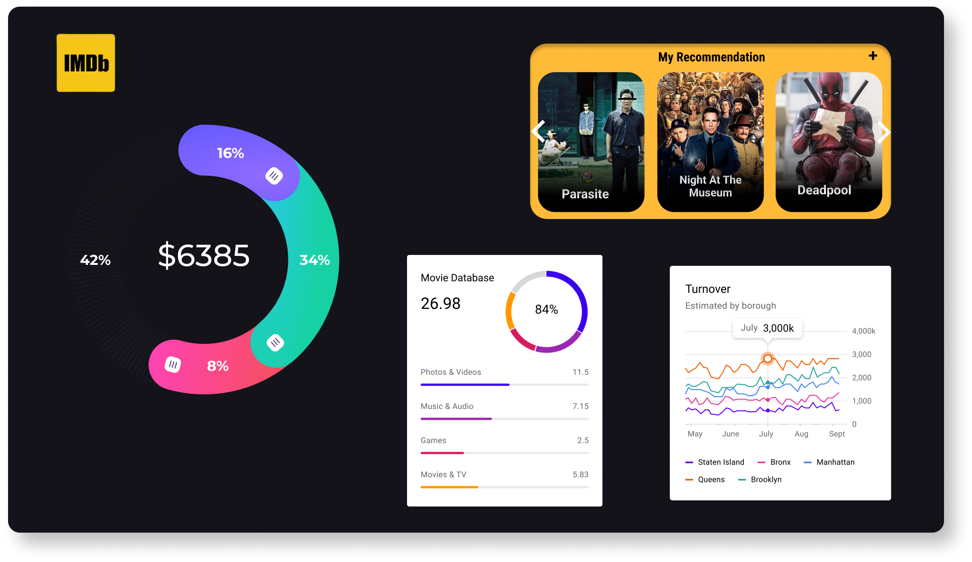
IMDb Movie Analysis
By - Raj Rathod

Slide 2
Project Description
IMDb, short for Internet Movie Database, stands as a comprehensive website housing an extensive collection of movies, web-series, TV shows, and more. It serves as a platform where users rate their watched content on a scale of 1 to 10 stars, facilitating others in gauging the quality of a movie.
The primary goal of this project is to uncover correlations between various attributes of movies and their corresponding IMDb ratings. By doing so, we aim to provide actionable insights for stakeholders to optimize future movie projects.
Understanding the factors influencing IMDb ratings can guide stakeholders in making strategic decisions related to movie production, marketing, and distribution.
By optimizing various aspects of movie projects based on data-driven insights, stakeholders can increase the likelihood of producing successful and well-received content.

Slide 3
Project Approach
Assessment: Careful examination of dataset to outline tasks.
Data Cleansing: Excel-based cleaning, removal of null values, and unnecessary columns.
Genre Identification: Popular genres identified through analysis.
Movie Duration Analysis : Calculated the Top Movies w.r.t Time and IMDb Ratings.
Language Analysis : Sorted the Top 5 Language according to No of Movies.
Profit Calculation: Computation of profit for each movie, sorting by profit.
Director Analysis: Grouping data by director to determine top 10 with highest mean IMDb scores.

Slide 4

Tech-Stack Used
Microsoft Excel 2021:Essential tool for data cleaning, analysis, and visualization.
Sorting, filtering, and formula capabilities used for data cleansing and profit calculation.
Functions employed for extracting top movies and grouping data.
Charting features utilized for effective data visualization.
User-friendly interface and diverse functionalities made it the ideal choice for the project.

Slide 5
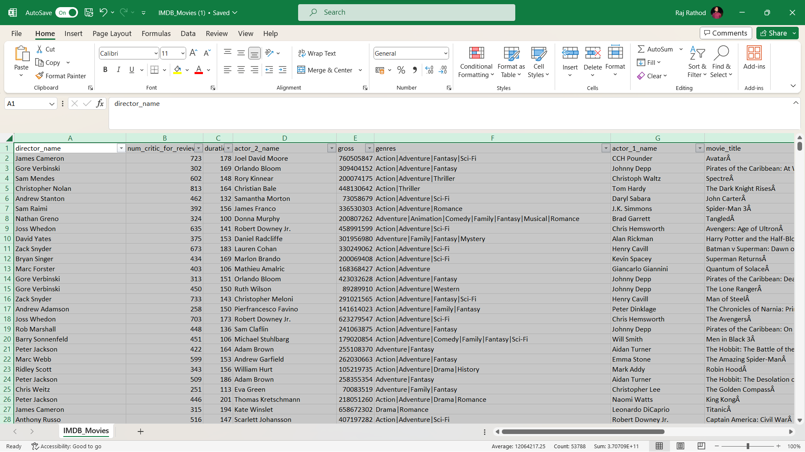
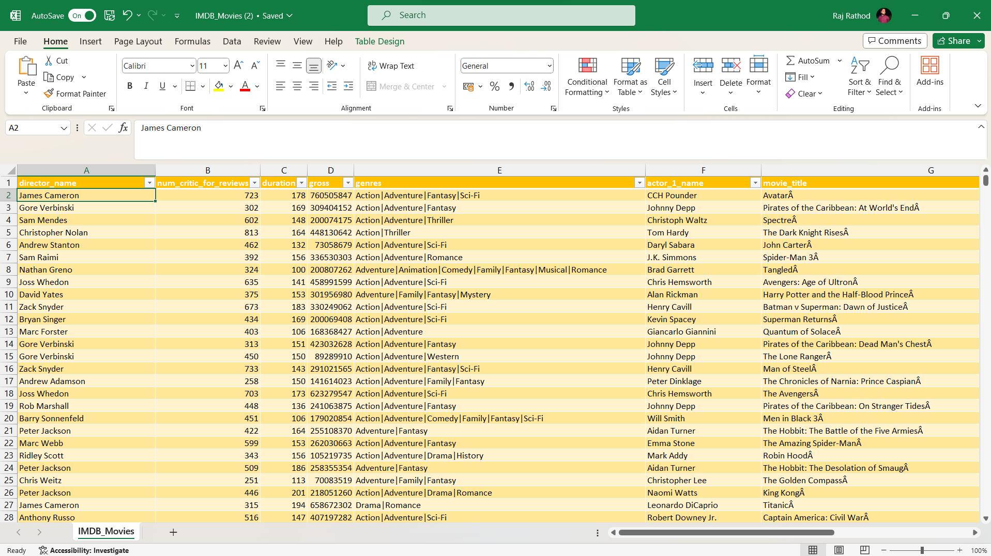
Insights
Task 1 – Data Cleaning

Slide 6
Data Analytics Tasks:
A. Movie Genre Analysis: Analyze the distribution of movie genres and their impact on the IMDB score.
Task: Determine the most common genres of movies in the dataset. Then, for each genre, calculate descriptive statistics (mean, median, mode, range, variance, standard deviation) of the IMDB scores.
Answer - The Most Common Genres of Movies in the IMDb is ‘Drama’ followed by ‘Comedy’ and then ‘Thriller’.
Also, The Descriptive Analysis Of Various Genres are as below
 | Descriptive Analysis fo Various Genres
Mean_IMDb | Mode_IMDb | Median_IMDb | Max_IMDb | Min_IMDb | StdDev_IMDb | Var_IMDb
590.67 | 129.00 | 473.50 | 1941.00 | 58.00 | 531.79 | 282805.65

Slide 7
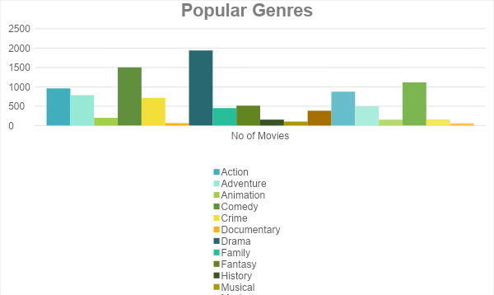
Movie Genre Analysis
Genre | No of Movies
Drama | 1941
Comedy | 1503
Thriller | 1117
Action | 962
Romance | 877
Adventure | 787
Crime | 714
Fantasy | 514
Sci-Fi | 497
Family | 450
Mystery | 383
Animation | 199
War | 160
History | 153
Sport | 151
Musical | 103
Documentary | 63
Western | 58

Slide 8
B. Movie Duration Analysis:
Task: Analyze the distribution of movie durations and identify the relationship between movie duration and IMDB score.
Answer – The Average Movie in the Dataset is of 110 Minutes.
Average |  |  | Median |  |  | Standard Deviation
110 |  |  | 106 |  |  | 22.76

Slide 9
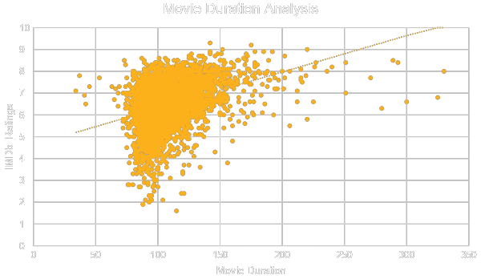
B. Movie Duration Analysis:

Slide 10
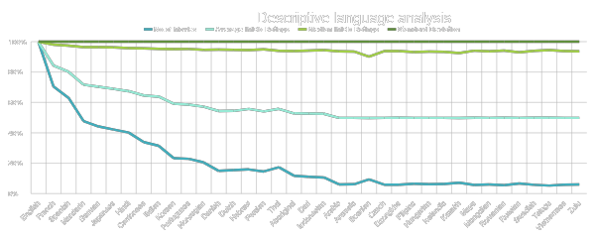
C. Language Analysis:
Task: Determine the most common languages used in movies and analyze their impact on the IMDB score using descriptive statistics.
Solution – The Most Common Language used in Movies is English Language followed by French, Spanish, Mandarin

Slide 11
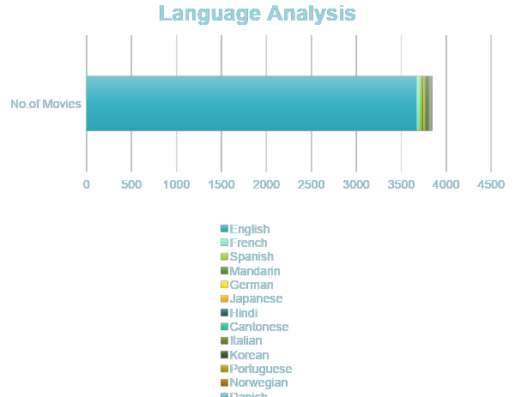
C. Language Analysis:
Language | No.of Movies | Average IMDb Ratings | Median IMDb Ratings | Standard Deviation
English | 3668 | 6.42 | 6.50 | 1.05
French | 37 | 7.29 | 7.20 | 1.05
Spanish | 26 | 7.05 | 7.15 | 1.05
Mandarin | 14 | 7.02 | 7.25 | 1.05
German | 13 | 7.69 | 7.70 | 1.05
Japanese | 12 | 7.63 | 7.80 | 1.05
Hindi | 10 | 6.76 | 7.05 | 1.05
Cantonese | 8 | 7.24 | 7.30 | 1.05
Italian | 7 | 7.19 | 7.00 | 1.05
Korean | 5 | 7.70 | 7.70 | 1.05
Portuguese | 5 | 7.76 | 8.00 | 1.05
Norwegian | 4 | 7.15 | 7.30 | 1.05
Danish | 3 | 7.90 | 8.10 | 1.05
Dutch | 3 | 7.57 | 7.80 | 1.05
Hebrew | 3 | 7.50 | 7.30 | 1.05
Persian | 3 | 8.13 | 8.40 | 1.05
Thai | 3 | 6.63 | 6.60 | 1.05
Aboriginal | 2 | 6.95 | 6.95 | 1.05
Dari | 2 | 7.50 | 7.50 | 1.05
Indonesian | 2 | 7.90 | 7.90 | 1.05
Arabic | 1 | 7.20 | 7.20 | 1.05
Aramaic | 1 | 7.10 | 7.10 | 1.05
Bosnian | 1 | 4.30 | 4.30 | 1.05
Czech | 1 | 7.40 | 7.40 | 1.05
Dzongkha | 1 | 7.50 | 7.50 | 1.05
Filipino | 1 | 6.70 | 6.70 | 1.05
Hungarian | 1 | 7.10 | 7.10 | 1.05
Icelandic | 1 | 6.90 | 6.90 | 1.05
Kazakh | 1 | 6.00 | 6.00 | 1.05
Maya | 1 | 7.80 | 7.80 | 1.05
Mongolian | 1 | 7.30 | 7.30 | 1.05
Romanian | 1 | 7.90 | 7.90 | 1.05
Russian | 1 | 6.50 | 6.50 | 1.05
Swedish | 1 | 7.60 | 7.60 | 1.05
Telugu | 1 | 8.40 | 8.40 | 1.05
Vietnamese | 1 | 7.40 | 7.40 | 1.05
Zulu | 1 | 7.30 | 7.30 | 1.05

Slide 12
D. Director Analysis:
Task: Identify the top directors based on their average IMDB score and analyze their contribution to the success of movies using percentile calculations.
Solution – Top Directors based on IMDb Score is Tony Kayne with Mean Average Rating of 8.6 and Percentile of 8.6 amongst all Top Directors and Percentile Rank is 1.
No of Movies | Top 10 Directors Name | Average IMDb Ratings | Percentile | Percentile Rank
1 | Tony Kaye | 8.6 | 8.6 | 1
1 | Charles Chaplin | 8.6 | 8.51
1 | Alfred Hitchcock | 8.5 | 8.5
1 | Damien Chazelle | 8.5 | 8.5
1 | Majid Majidi | 8.5 | 8.44
8 | Christopher Nolan | 8.4 | 8.4
1 | S.S. Rajamouli | 8.4 | 8.4
1 | Richard Marquand | 8.4 | 8.4
3 | Sergio Leone | 8.4 | 8.4
1 | Asghar Farhadi | 8.4 | 8.4
1 | Marius A. Markevicius | 8.4 | 8.4

Slide 13
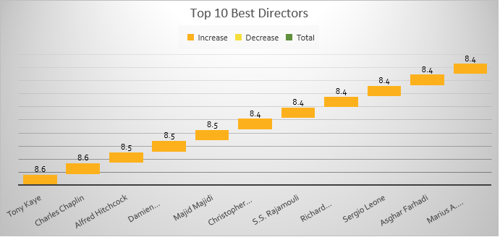
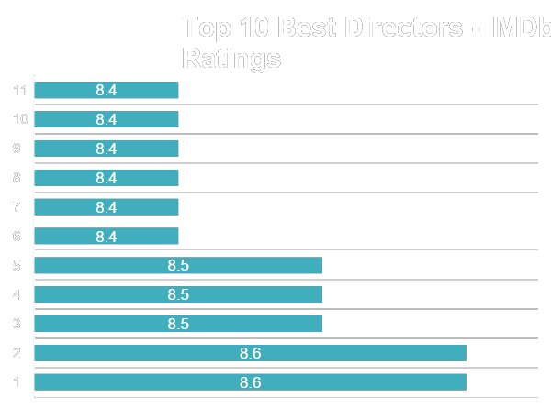
D. Director Analysis:

Slide 14
E. Budget Analysis:
Task: Analyze the correlation between movie budgets and gross earnings, and identify the movies with the highest profit margin.
Solution- The Correlation Coefficient is 0.100 which is Positive but If it could have near to 1,it could have been strong Possibility of High Budget Movies earns the Most.
The Top Highest Grossing Movies of IMDb is Avatar and Jurassic World both has Earned Profit over 500Million USD+

Slide 15
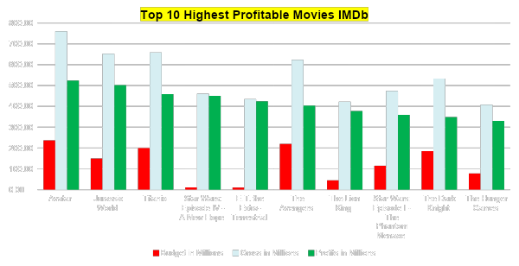
E. Budget Analysis:
Movie Title | Budget in Millions | Gross in Millions | Profits in Millions
Avatar | $237.00 | $760.51 | $523.51
Jurassic World | $150.00 | $652.18 | $502.18
Titanic | $200.00 | $658.67 | $458.67
Star Wars: Episode IV - A New Hope | $11.00 | $460.94 | $449.94
E.T. the Extra-Terrestrial | $10.50 | $434.95 | $424.45
The Avengers | $220.00 | $623.28 | $403.28
The Lion King | $45.00 | $422.78 | $377.78
Star Wars: Episode I - The Phantom Menace | $115.00 | $474.54 | $359.54
The Dark Knight | $185.00 | $533.32 | $348.32
The Hunger Games | $78.00 | $408.00 | $330.00
Correlation Coefficient
0.100823531
Maximum Gross Profitable Movie
$523.51
Million USD

Slide 16
Results
Through this project, I have gained a better understanding of data analysis and visualization techniques using Excel. It has helped me develop skills in cleaning and organizing data, identifying profitable movies, recognizing top directors, and exploring popular genres. By working on this project, I have gained practical experience in analyzing real-world data, extracting valuable insights, and presenting information effectively through charts and tables. It has improved my overall knowledge and proficiency in data analysis.

Slide 17
Thank You
Linkedin ID
Video Presenation
IMDb Data Analysis Raj Worksheet

