Slide 2
Topic |  |  | #
 | Project Goals for Beer Suggestion Engine |  | 3
 | Initial Structure of Engine |  | 4
 | Challenges |  | 5
 | Project Results & Demo |  | 7
 | Conclusions |  | 9

Slide 3
Project Goals
Wished to construct a webpage the provides untappd users with beer suggestions based on their profile characteristics
Sought to apply the following techniques:
Webscraping and information extraction
Database creation and manipulation
Collaborative filtering
Website development
Modules selected:
Selenium for automated web-browsing and BeautifulSoup for webscraping
Pandas for data organization and SQLite for database manipulation
Numpy for array manipulations and SciKit Learn for vector similarity calculations
Django for website development

Slide 4







Structure of project
Back-End
Front-End

Slide 5
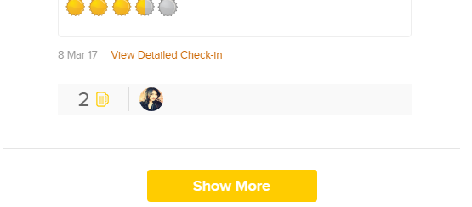
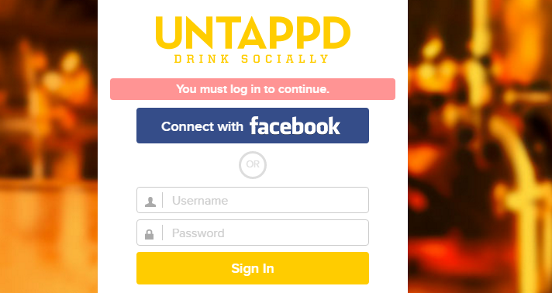
Implementation of selenium proved difficult
Purpose
Open full profiles
Automate signing in to untappd
Challenges
Implementation of waits
Increased bandwidth usage
IP blocking
Result
Tested Selenium
Decided against keeping it in the implementation
Implemented compassionate web-scraping

Slide 6
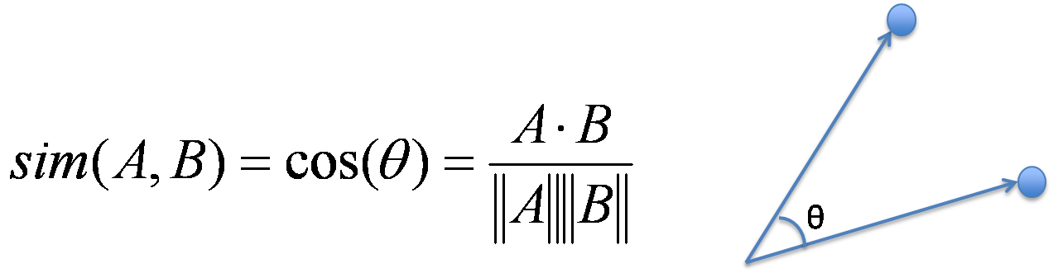
Profile vectorization was preprocessed to improve run-time
Purpose
Transform user profiles into comparable quantitative elements - vectors
Create suitable inputs for cosine-similarity function to find top-k profiles
Challenges
Creating user vectors every time was time consuming
Result
Preprocessed user vectors for users in our database and saved the resulting dataframe to csv
Read and updated the dataframe for each input user

Slide 7
Final Structure of Project
Back-End
Front-End

Slide 8
Project Demo - On-screen

Slide 9

Conclusions
Clarity in communication matters
Complex projects require flexibility and quick decision-making

