Slide 1
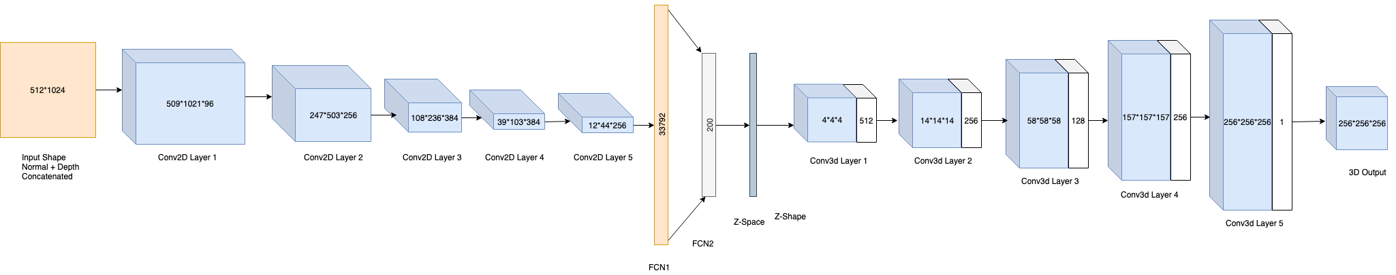
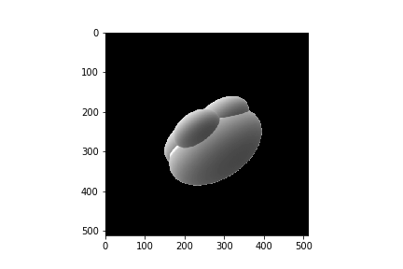
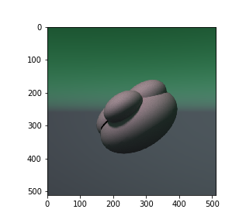
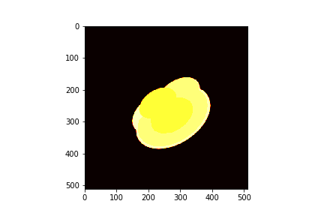
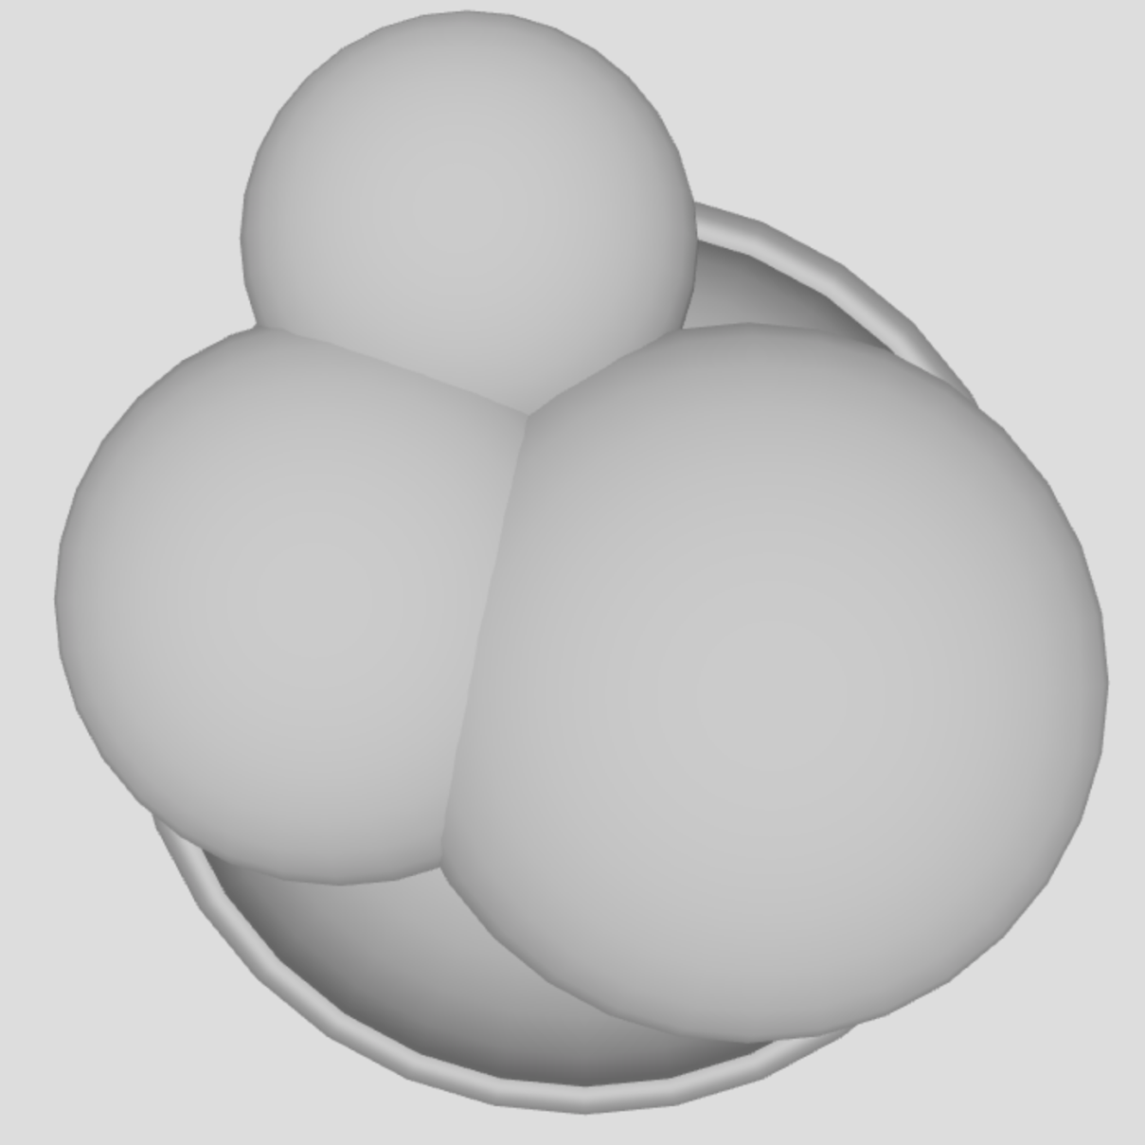
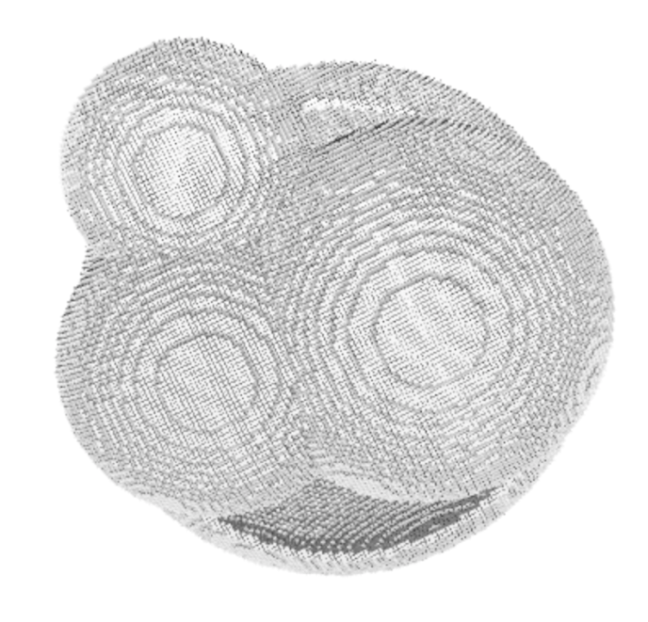
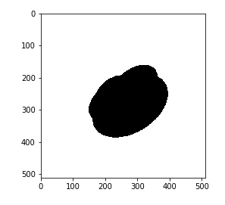
3D sketch generation of foraminifera from 2.5D sketches
Authors: Vishal Shitole, Shraddha Dhyade, Anusha Manur
Course Number: ECE 542-001
Team ID: 542-19
Advisor: Turner Richmond
Instructor: Prof. Edgar Lobaton
Motivation and Goals
In order to generate a 3D model from a 2.5D sketch of microscopic fossils called foraminifera containing a large amount of occluded data, we learn some prior information about the specimen from a synthetic dataset, utilizing an encoder-decoder network. Current rendering software is used to generated large amounts of highly varied data from different viewpoints, under different conditions, and with different textures. Thus, such a process can be incorporated into a data augmentation pipeline for generating large datasets with accurate ground truth labels for little cost.
In order to generate a 3D model from a 2.5D sketch of microscopic fossils called foraminifera containing a large amount of occluded data, we learn some prior information about the specimen from a synthetic dataset, utilizing an encoder-decoder network. Current rendering software is used to generated large amounts of highly varied data from different viewpoints, under different conditions, and with different textures. Thus, such a process can be incorporated into a data augmentation pipeline for generating large datasets with accurate ground truth labels for little cost.
Methodology and Results
Data Preprocessing:
Input is a synthetically generated colored image
Output is a voxelized 3D model.
We extract the normal image, depth image and silhouette from the input 2d image of the foraminifera.
The normal image is masked with the silhouette. Normal image(512x512) and depth image(512x512) are concatenated and passed to the network.
Output (256x256x256) is a voxelized model and this will be our ground truth for the network.
Network Structure::
Our network structure follows the Marrnet model which consists of encoder decoder model for 3D model generation.
The enoder network with 5 convolutional 2D layers and two fully connected layers. It generates a 200 dimensional latent space vector which acts as a input to the decoder network.
The decoder network consists of 5 convolutional layers that generate a 3d voxel output of size 256x256x256.
Normal
Input Image
Depth
Output Image
Voxelised Image
Silhouette
Conclusion and Extensions
Reference
Thus, we can infer that Marrnet can be effectively used to generate the 3D models for foraminifera fossil from the extracted normal, depth and silhouette
i.e. the 2.5D images extracted from a synthetically generated model.The future scope of the project is to work on the real images of the foraminifera. The network can be improved for 3d model generation from real image data of the foraminifera fossil. The real images however, will need to be pre processed as there will be some occlusion in these images due to dust, and this part also needs to be generated correctly.
[1] MarrNet: 3D Shape Reconstruction via 2.5D Sketches: NIPS 2017, Wu, Jiajun and Wang, Yifan and Xue, Tianfan and Sun, Xingyuan and Freeman, William T and Tenenbaum, Joshua B
[2] Jiajun Wu, Chengkai Zhang, Tianfan Xue, William T Freeman, and Joshua B Tenenbaum. Learning a Proba-bilistic Latent Space of Object Shapes via 3D Generative-Adversarial Modeling.
Notes:
‹#›

