Slide 1
10
Packages
Modules & Packages in Python
Modules
Functions

Slide 2

Module
What is Module?
A Python module is a .py file with function(s) and/or class(es) that you can reuse in your code. You can also create your own.
A module is a file consisting of Python code. It can define functions, classes, and variables, and can also include runnable code. Any Python file can be referenced as a module. A file containing Python code, for example: test.py, is called a module, and the modulename would be test. Modules are of two types:
Built-in modules
User defined modules
()
**
*
/

Slide 3
Module
Module Overview
Python, there are three possible ways to define a module:
A module can be written entirely in Python.
The itertools module is an example of a built-in module that is intrinsically present in the interpreter.
A module can be written in C and loaded dynamically at run-time.
In all three cases, the import statement is used to access the code of a module.
()
**
*
/

Slide 4

Package
What is Package?
A Python package is a directory of several modules. A package often holds several modules together, along with an __init__.py file.
Python treats directories containing the __init__ .py file as modules.
The __init__ .py file indicates a folder's contents as being part of a Python package. You can't import files from another directory into a Python project without a __init__ .py file.

Slide 5

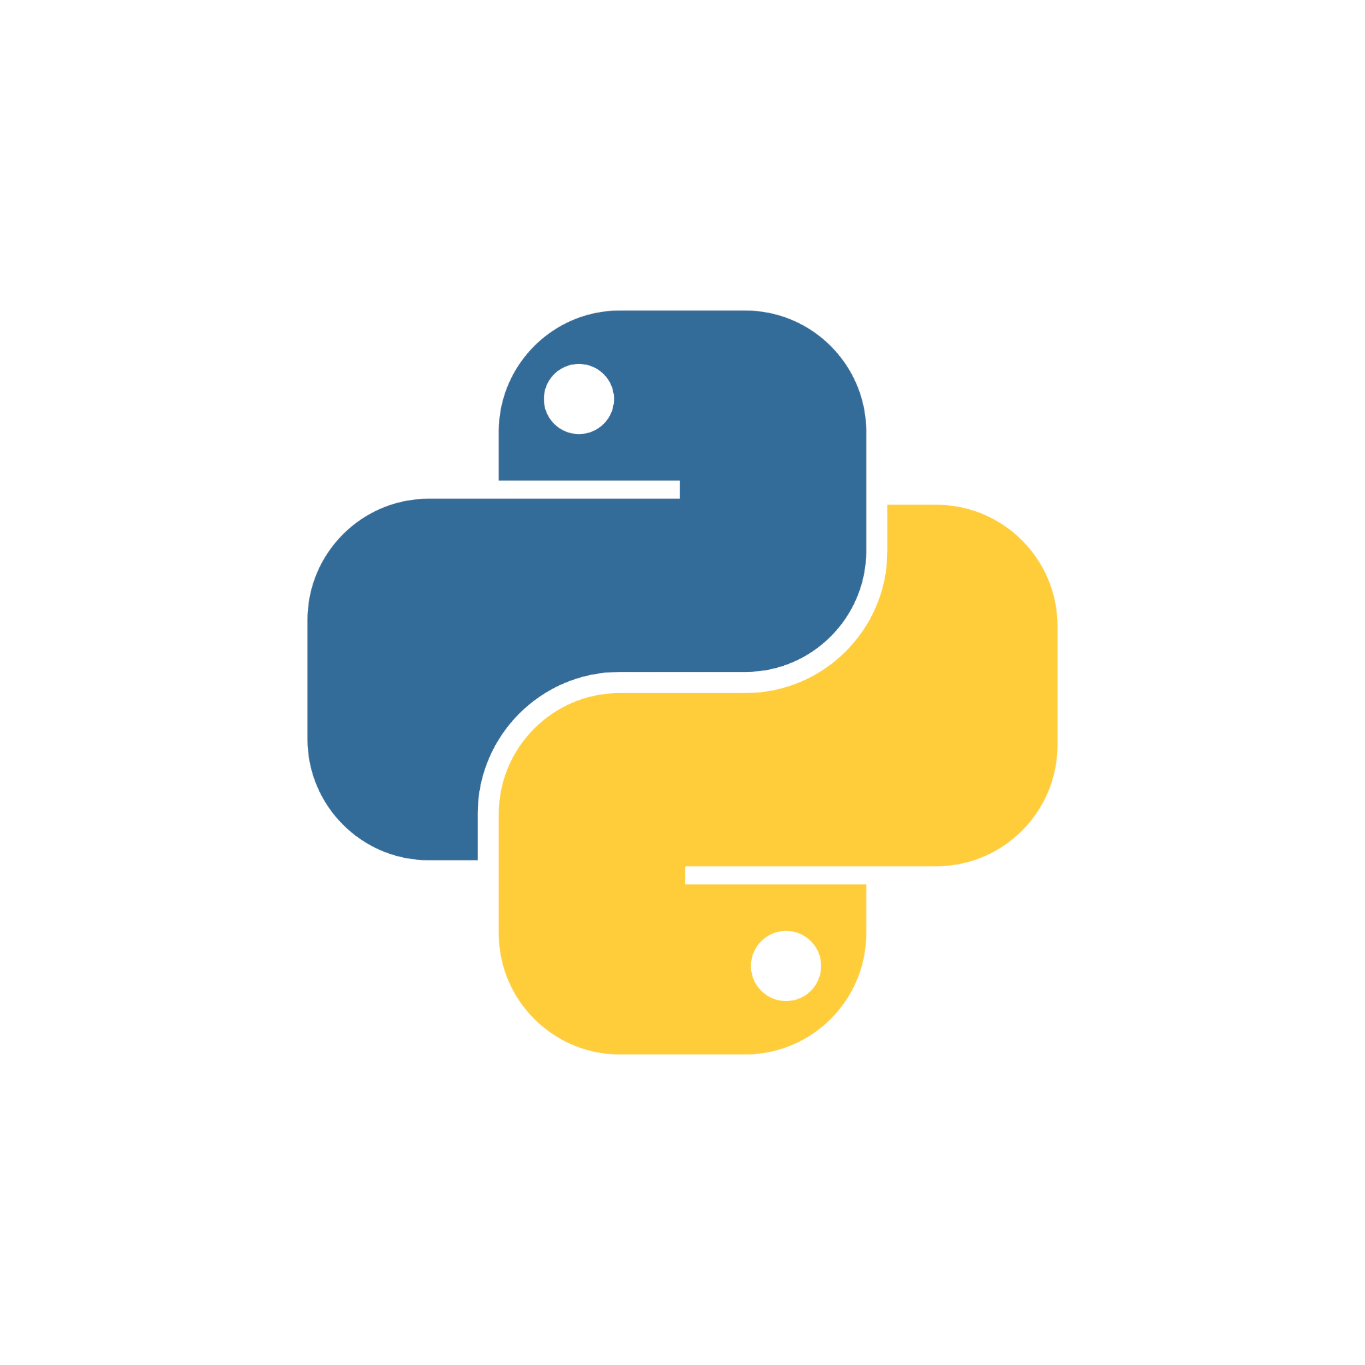
Structure of Package
pkg
A Python package can have several sub packages in it.
Each package can have several modules.
Each module should start with the __init__ .py file.
Each of the modules should be named with the .py file extension.
__init__.py
module1.py
module2.py

Slide 6

Naming Rules - Package & Modules
The following rules should be followed when naming Python modules and packages:
All lowercase letters
Underscore-separated words
No word separators (no hyphens)
Rules

Slide 7
Example for Package & Modules structure
pythonoperations
__init__.py
Sub-package
Sub-package
Sub-package
Arithmetic
Relational
Bitwise
__init__.py
__init__.py
__init__.py
addition.py
essthan.py
bitand.py
subtraction.py
graterthan.py
bitor.py
multiply.py
equals.py
bitnot.py
division.py
notequal.py
bitxor.py

Slide 8
Example Program Using Module
Example
Module Call
#Create a module using demomodule.py
def addition(a, b):
c = a+b
return(c)
import demomodule #Import the user defined module
a=int(input("Enter number 1"))
b=int(input("Enter number 2"))
print("The sum is", demomodule.addition(a,b)) #invoke or call the module
Output
Enter number 1 10
Enter number 2 20
The sum is 30

Slide 9
Example Program Using Module
Example
Module Call - The alias name is dm
#Create a module using demo.py
def addition(a, b):
c = a+b
return(c)
import demomodule as dm #Import the use defined module using alias name
a=int(input("Enter number 1"))
b=int(input("Enter number 2"))
print("The sum is", dm.addition(a,b)) #invoke or call the module
Output
Enter number 1 34
Enter number 2 45
The sum is 79

Slide 10
Naming Rules - Module & Package
Example
The simplest form is the one already shown in the previous example.
import <module_name>
The import statement makes the contents of the module available to the caller.
The import statement can have a different methods, as seen below.
Several comma-separated modules may be specified in a single import statement:
import <module_name>[ <module_name> ...]
Individual objects from the module can be imported directly into the caller's symbol table using an alternate form of the import statement:
from <module_name> import <name(s)>

Slide 11
Naming Rules - Module & Package
Example
You can also import an entire module under an alternate name:
import <module_name> as <alt_name>
It is also possible to import individual objects but enter them into the local symbol table with alternate names:
from <module_name> import <name> as <alt_name>[ <name> as <alt_name> …]

Slide 12
Example Program Using Packages
#Create a folder MyPackage consisting of the following files
Call for Packages and Module
__init__.py #Create an empty file
hello.py
arithmetic.py
from MyPackage import arithmetic
#Importing the package and the arithmetic.py file
from MyPackage import hello
#Importing the package and the hello.py file
print(hello.SayHello("Python Package"))
#Invocation or call for SayHello function
print("The Sum is:", arithmetic.sum(10,20))
#Invocation or call for sum function
print("The Average is:", arithmetic.average(10,20)) #Invocation or call for average function
print("The power is:", arithmetic.power(10,2))
#Invocation or call for arithmetic function
Code in arithmetic.py
def sum(x,y):
return x+y
def average(x,y):
return (x+y)/2
def power(x,y):
return x**y
Code in hello.py
def SayHello(name):
print("Hello ", name)
return()
Output
Hello Python Package
None
The Sum is: 30
The Average is: 15.0
The power is: 100

Slide 13
Example Program Using Packages
#Create a folder MyPackage consisting of the following files
Call for Packages and Module
ar & he are the alias name
__init__.py #Create an empty file
hello.py
arithmetic.py
#With Alias Name
from MyPackage import arithmetic as ar
#Importing the package and the arithmetic.py file
from MyPackage import hello as he
#Importing the package and the hello.py file
print(he.SayHello("Python Package"))
#Invocation or call for SayHello function
print("The Sum is:", ar.sum(10,20))
#Invocation or call for sum function
print("The Average is:", ar.average(10,20))
#Invocation or call for average function
print("The power is:", ar.power(10,2))
#Invocation or call for arithmetic function
Code in arithmetic.py
def sum(x,y):
return x+y
def average(x,y):
return (x+y)/2
def power(x,y):
return x**y
Code in hello.py
def SayHello(name):
print("Hello ", name)
return()
Output
Hello Python Package
()
The Sum is: 30
The Average is: 15.0
The power is: 100

Slide 14
LMS Activity

Slide 15
Itertools - An inbuilt Module
What is itertools?
This module implements a number of iterator building blocks.
This module is a memory-efficient, fast tool that can be used alone or in combination to develop iterator algebra operations.
Itertools supports many operations like map(), count(), repeat(), zip_longest(), groupby(), cycle() etc.
It consists of three types such as infinite iterators (3 functions), combinatorics iterators (4 functions ) using shortest input sequence (12 functions ).
In total itertools supports 19 different functionalities.
It is useful for larger data set operations with faster computation.
**
Infinite iterators
Iterators
Terminating on the shortest Input Sequence
()
*
/
Combinatoric iterators

Slide 16
map() illustration to understand how fast it works
Looping Method
Output
Result: 50 120 210
Time taken by for loop: 0.00315
# Starting time before looping method
# Defining lists
import time
L1 = [10, 20, 30]
L2 = [5, 6, 7]
t1 = time.time()
# List multiplication using for loop
print("Result:", end = " ")
for i in range(3):
print(L1[i] * L2[i], end = " ")
# Ending time after looping
# method
t2 = time.time()
print("\nTime taken by for loop: %.5f" %(t2 - t1))

Slide 17
map() illustration to understand how fast it works
Mapping Method
Output
Result: 50 120 210
Time taken by map function: 0.00008
# Python program to demonstrate # iterator module
import operator
import time
# Defining lists
L1 = [10, 20, 30]
L2 = [5, 6, 7]
# Starting time before map
# function
t1 = time.time()
# Calculating result
a, b, c = map(operator.mul, L1, L2)
# Ending time after map
# function
t2 = time.time()
# Time taken by map function
print("Result:", a, b, c)
print("Time taken by map function: %.5f" %(t2 - t1)
You may notice that the time taken to execute the list multiplication using map() function is less than the looping method.

Slide 18
Itertools
count()
# Python program to demonstrate
# infinite iterators
import itertools
# for in loop
for i in itertools.count(5, 5): #Starts with five and increments with 5
if i == 50: #If it meets the value 50
break #Breaks the infinite iterator count()
else:
print(i, end =" ")
Output
5 10 15 20 25 30 35 40 45

Slide 19
Itertools
cycle()
# Python program to demonstrate
# infinite iterators
import itertools
count = 0
# for in loop
for i in itertools.cycle('HI'): #Repeats the string 'HI' infinitely
if count > 5: # Checks for the time times count
break #breaks the infinite iterator cycle()
else:
print(i, end = " ")
count += 1
Output
H I H I H I

Slide 20
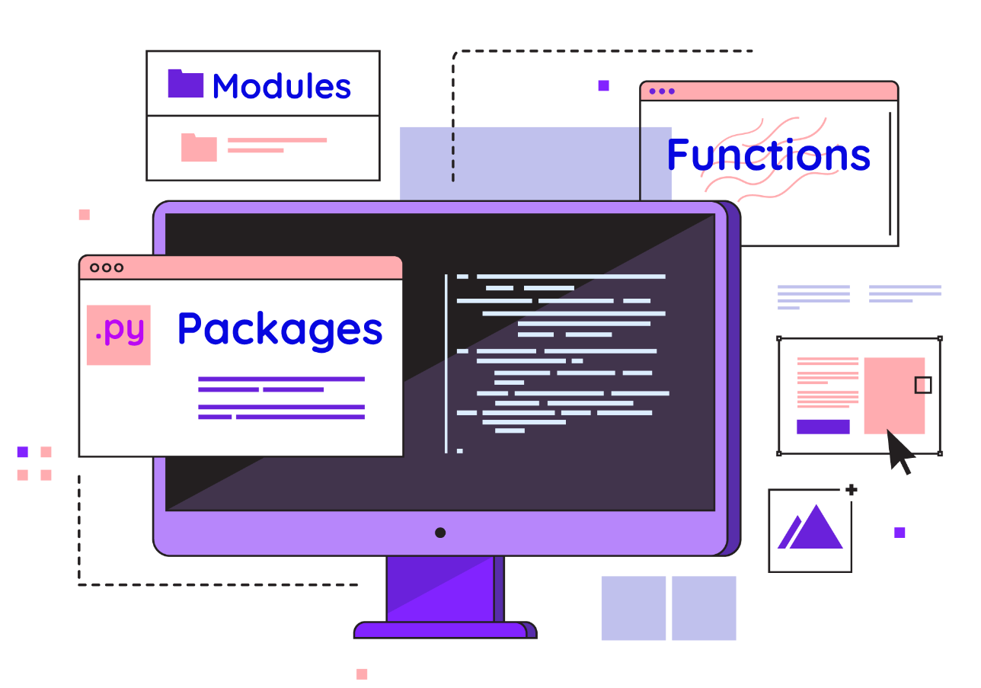
Advantages of Packages
Python modules and Python packages are two tools for modular programming in Python.
Modularizing Python code in a large application has various advantages:
Simplicity: Rather of focusing on the entire problem, a module usually focuses on one small segment of it.
Maintainability: Modules are usually built to establish logical boundaries between different problem domains.
()
**
*
/

Slide 21
Advantages of Packages
This makes it easier for a large group of programmers to collaborate on a large application.
Reusability: A single module functionality can be easily used by other parts of the application.
Scoping: Modules usually have their own namespace, which helps to avoid identifier collisions in different parts of a program.
()
**
*
/

Slide 22
LMS Activity

