Slide 1
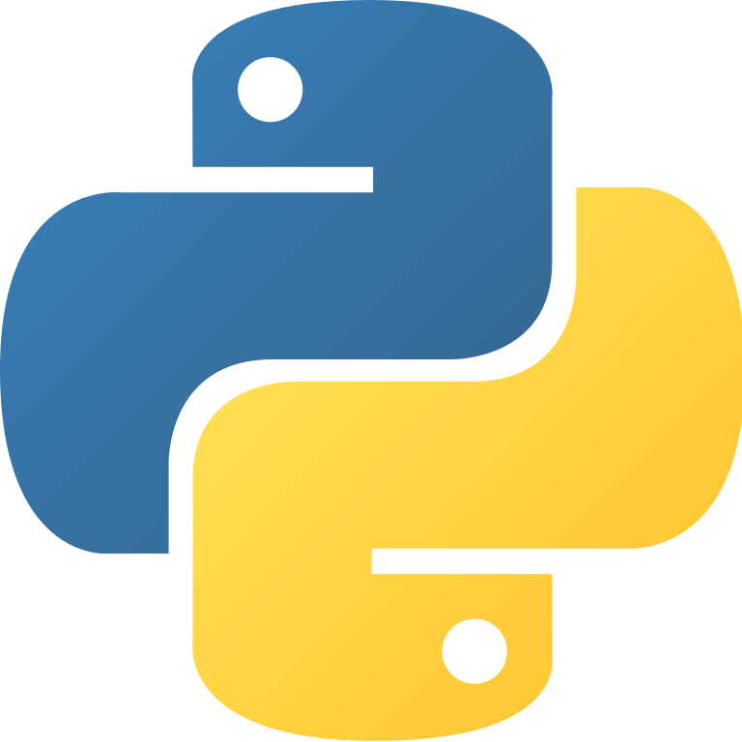
Fundamentals of Python
Python
#
“”
()

Slide 2
Agenda
( )
#
First Program
Comments

Slide 3
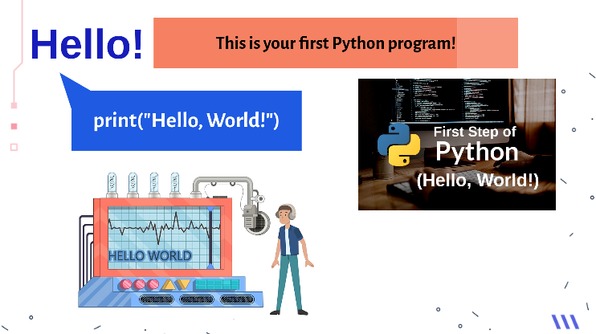
First Program

Slide 4
Python - Fundamental Concepts
Comments
Statements
Indentation
Single-line
Multi-line
Docstring
Python uses
indentation to indicate a block of code.
Empty
Simple
Compound

Slide 5
COMMENT
wHY DO WE USE COMMENTS#
Python
Computer ignores any text written after the hash.
Comments are not computed.
#
“‘’”
cOMMENT

Slide 6
COMMENT
wHat DOes a COMMENTS do?
Makes the source code more readable and understandable by the users.
To Explain the logic of the code.
Comments are generally ignored by compilers and interpreters.

Slide 7
Python COMMENT Line
Types of comment
#
#
‘‘‘’’’
Single-line
COMMENT
Multi-line
COMMENT
Doc string

Slide 8
COMMENT
Single-line comment
#
#
Starts with a hash symbol (#)
The hash sign must appear at the start of each line comment.

Slide 9
COMMENT
multi-line comment
#
#
Can write comments of multiple lines using hash at the beginning of each line.
Example
# THIS IS A MULTILINE
# COMMENT IN PYTHON
# USING THE SINGLE LINE
# COMMENT CONSECUTIVELY
Notes:
corrected

Slide 10
COMMENT
Doc string
‘‘‘’’’
“““”””
Comment spans within multiple lines.
Ignores everything in quotation marks.
Written using 3 signal or 3 double quotes.
This is called Doc strings.
Example
“““You can write docstring like this”””
‘‘‘You can also write docstring like this’’’

Slide 11
COMMENT
When to use comment?
Programming is often done by teams of people
Projects you work on will be inherited by other people
Comments make it easier for you to read your code!
Make sure the comment is short and relevant to the code
‘‘‘’’’

Slide 12
LMS Assignment

Slide 13

Indentation
Importance of INDENTATIOn
INDENTATION
ERROR
Notes:
Take care of this slide

Slide 14
Indentation
wHAT IS INDENTATION?
INDENTATION
ERROR
Indentation refers to the spaces at the beginning of a code line.
Whitespace is used for indentation in Python.
Python uses indentation to highlight the blocks of code.
All statements with the same distance to the right belong to the same block of code.

Slide 15
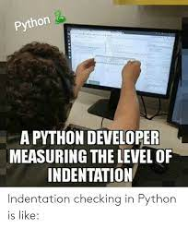
Indentation
Look at the meme
All statements with the same distance to the right belong to the same block of code.
If a block has to be more deeply nested, it is simply indented further to the right.

Slide 16
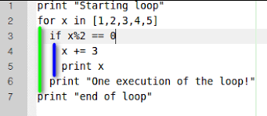
Indentation
Example Program
Notes:
Correct

Slide 17
Indentation
Example
For statement
If statement

Slide 18
LMS Assignment

Slide 19
Primary Data Type
.py
.txt
Numbers
Strings
Data Type
True/False
Boolean

Slide 20
Numbers
What are Numbers
Python has three built-in numeric data types: integers, floats and complex numbers.
Notes:
Need to be changed

Slide 21
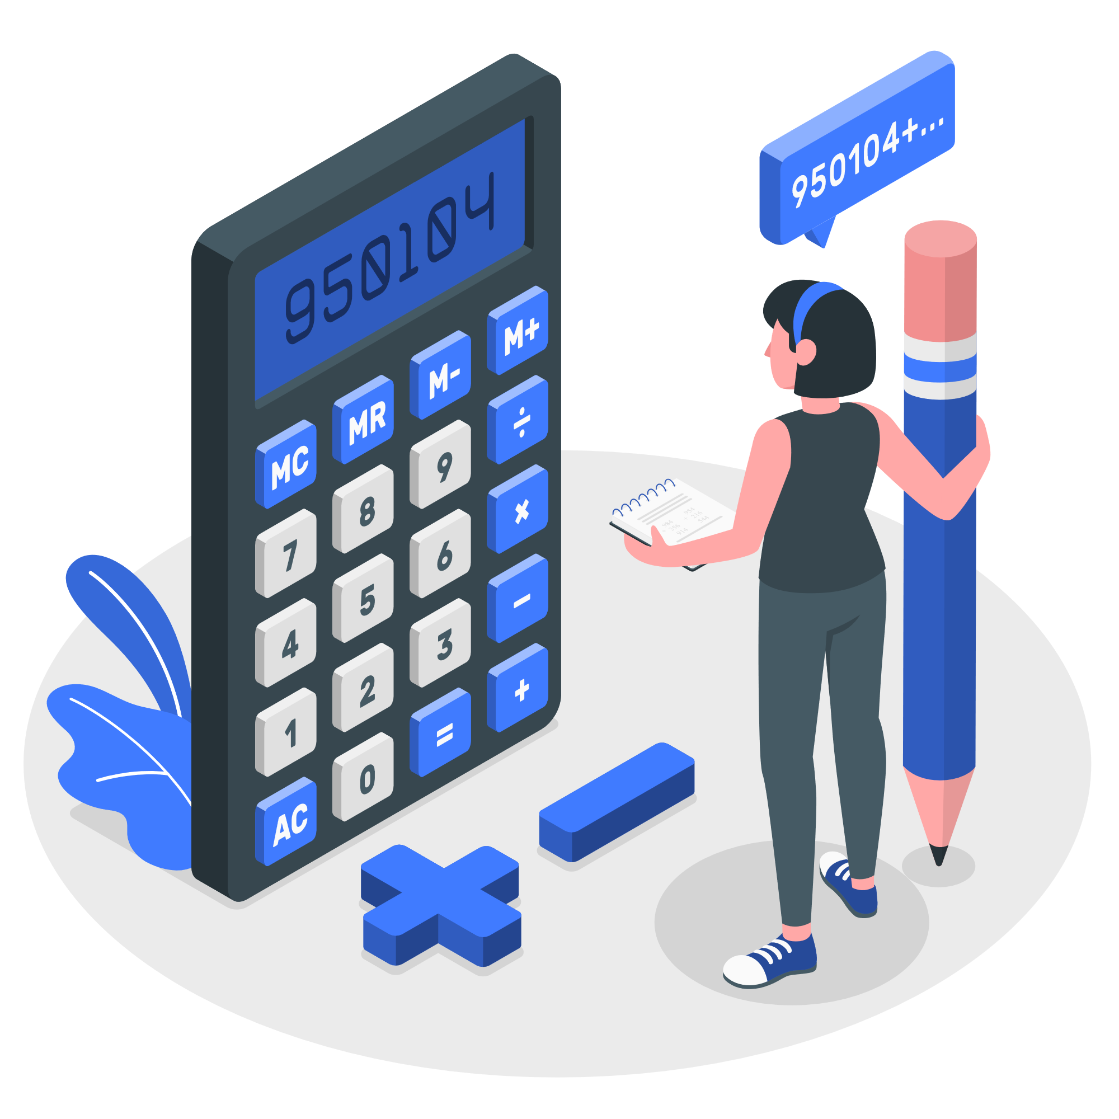
Numbers - Integers
What are Integers?
Integers are whole numbers,
They have no fractional parts
They can be positive, negative, or zero.
For example, 50, 0, -2 are treated as integers.
We can perform simple calculations with integers such as addition in these examples.
>>> 6 + 4
10
>>> 1 + 2 + 4 + 10 - 3
14
>>> print(1 + 2 + 3 + 4 + 5 + 10)
25
Notes:
Need to be changed

Slide 22

Numbers - Float
What are Float?
Float data types are similar to integers but will have a decimal point.
The decimal point can move or “float” to various positions within the number.
For example, -3.2, 0.0, 4.5652 are treated as floats.
We can perform simple calculations with floats such as addition in these examples.
>>> 1.5+2.3
3.8
>>> 1.1+2.2+3.3+4.4+5.5
16.5
Notes:
Need to be changed

Slide 23
Numbers - Complex
What are Complex numbers?
Complex numbers are constituted by 2 numbers. They are represented as “ x + yj ”.
They consist of real and imaginary parts, where x is a real number and y is an imaginary number.
The real imaginary part can be an integer or floating point.
In engineering and research, complex numbers are extremely essential. For examples.
>>> 3 +6j
(3+6j)
Notes:
Need to be changed

Slide 24
LMS Assignment

Slide 25

stRing
What is a string?
A string is a sequence of characters.
Strings most often contain non-numeric characters.
It can be letters, numbers, any special symbols such as exclamation signs or percentages.
Python recognizes both single quotes (') and double quotes (") as valid ways to use ‘strings’.
Example
>>> “I Love Python Coding”
‘I Love Python Coding’

Slide 26
strings
For string
The plus operator (+) works differently for strings;
Consider the numerical number. It simply does the addition of the given two numbers.
>>> 5 + 10
15
Whereas, with the string it does the string concatenation:
>>> '51' + ‘20'
'5120'
>>> ‘Python' + ‘Programming'
' PythonProgramming '
‘’ “”

Slide 27
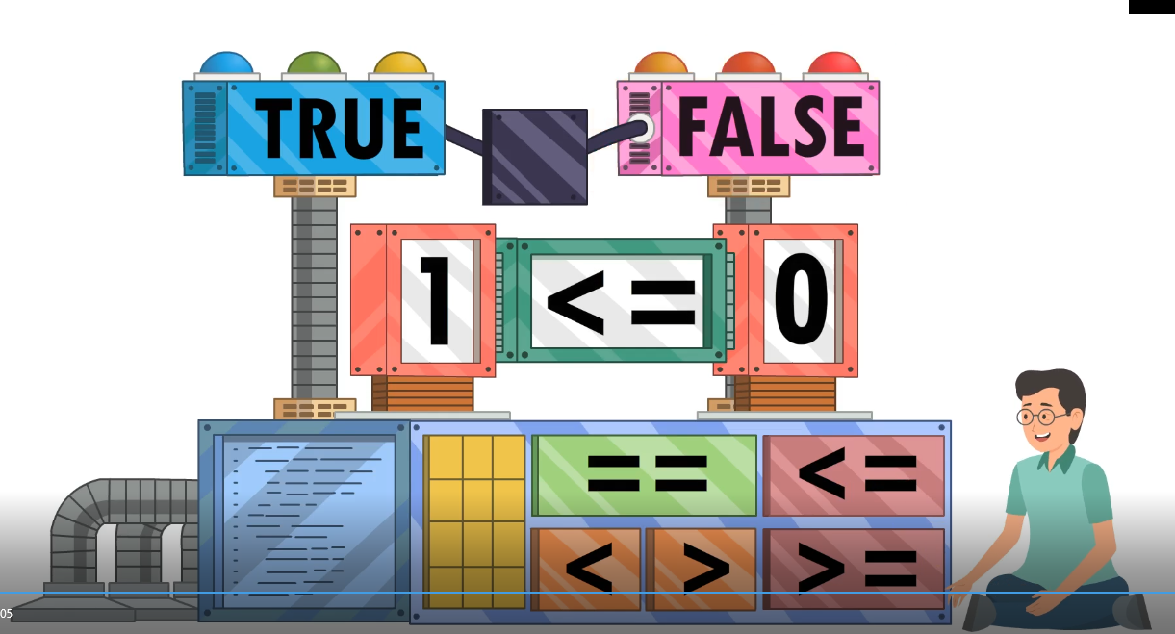
Boolean
What is boolean?
Booleans represent one of the values: True or False.
In programming, you often need to know if an expression is True or False.
You can evaluate any expression in Python, and get one of two answers, True or False.
Example
print(10 > 9)
Answer: True
print(10 < 9)
Answer: False

Slide 28
LMS Assignment

Slide 29
statement
What are statements?
Statements are simple codes written for execution

Slide 30
statement
Types of statements
Simple Statement
Complex Statement
Comprised in a single line.
Never affect the flow of program.
Example:
a=10, break, return, break, pass
A collection of statements working together.
May affect the flow of program.
Example:
if, elif, else, for, while, try, etc.
Empty Statement

Slide 31
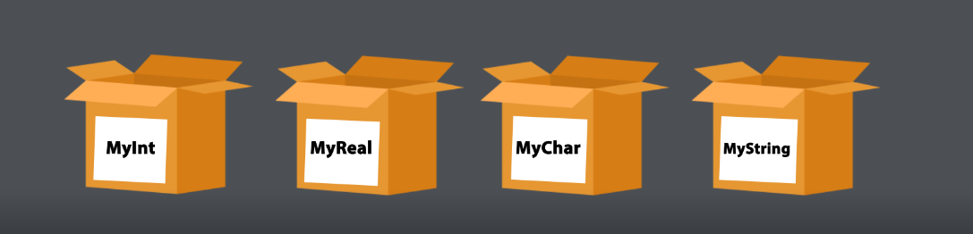
Values and variable
What is a variable?
Variables are containers or Memory Placeholders for storing data values.
It's like a box holding a character, an alphanumeric value, or another variable that you can change later.
For example a = 5. Here a is the variable and 5 is the value.
Variables can have values such as integers, characters, and strings.
Such as a = 5.2, name = “Sam”, greeting = “Hello World!”

Slide 32

Values and variable
Restriction for Variable name
Must start with a letter or the underscore character
Cannot start with a number
Can only contain alphanumeric characters and underscores (A-z, 0-9, and _ )
Variable names are case-sensitive (age, Age and AGE are three different variables)

Slide 33
Values and variable
Restriction for Variable name - Examples
Valid Variable(s) | Invalid Variable(s)
Num | Number 1
NUM | Num 1
Num1 | 1Num
_Num | Num.1
Num_1 | Program to do addition
IF | if
ELSE | else

Slide 34
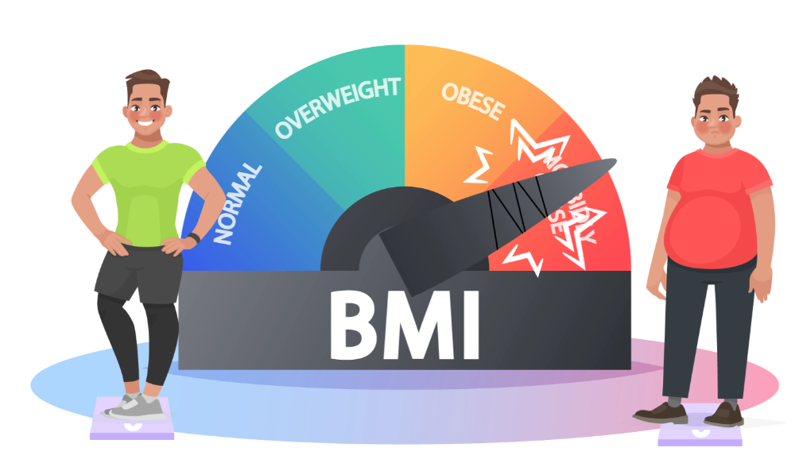
Values and variable
Application
Calculate BMI using Python Code
# height, weight and bmi are variables
# in this program
height =1.79
weight = 68.7
bmi = weight / height * height
print(bmi)

Slide 35
LMS Assignment

Slide 36
Identifiers
What are identifiers?
A Python identifier is a name used to identify a variable, function, class, module or other object.
An identifier starts with:
A letter A to Z or a to z
An underscore (_) followed by zero or more letters underscores and digits (0 to 9).
NOTE: A variable name is one example of an identifier.
Example : first_name, phone_91

Slide 37
Assignments
What are Assignments?
Variable Name = Value
(or)
Variable Name = Expression
Example : a = 10
Assignment operators are used to assigning value to a variable.
The name of the variable is on the left, and the value assigned to it is on the right.

Slide 38
Types of Assignments
Simple Assignment
Assign multiple values to multiple variables
Example
a=100
print(a)
100
Example
a, b = 100, 200
print(a)
100
print(b)
200

Slide 39
Types of Assignments
Assign different types of value to multiple variables
Assign same value to multiple variables
Example
a, b, c = 0.1, 100, ‘Python’
print(a)
0.1
print(b)
100
print(c)
‘Python’
Example
a, b , c = 2021
# all the variables a, b and c will be assigned with the same value 2021

Slide 40
Types of Assignments
Assign different types of value to multiple variables
Assign same value to multiple variables
Example
a, b, c = 0.1, 100, ‘Python’
print(a)
0.1
print(b)
100
print(c)
‘Python’
Example
a, b , c = 2021
# all the variables a, b and c will be assigned with the same value 2021

Slide 41
LMS Assignment

Slide 42

Keywords or reserved words
What are keywords?
Python has a set of keywords that are reserved words that cannot be used as variable names, function names, or any other identifiers.
Example
and = 10
Will give error

Slide 43
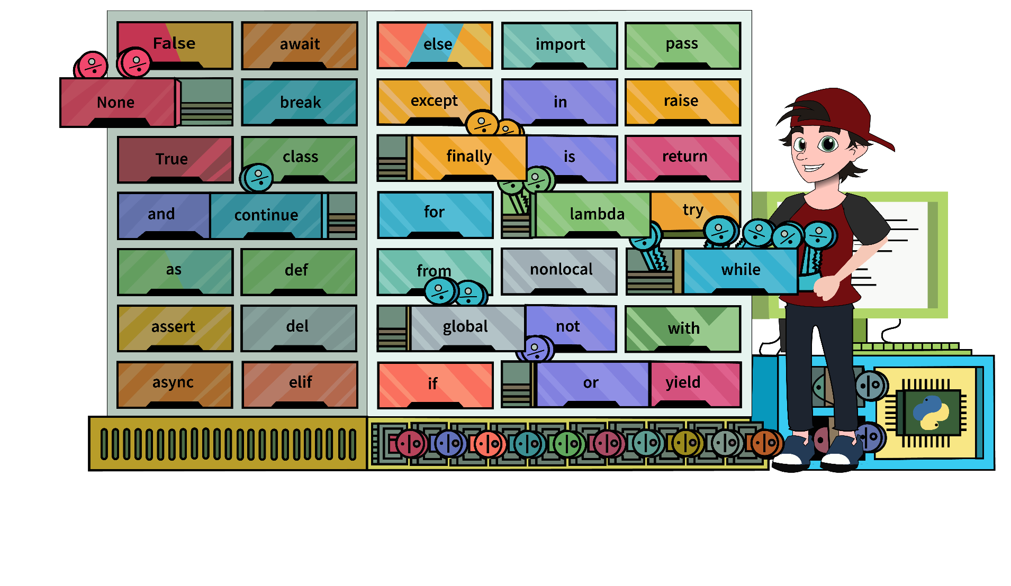
Keywords or reserved words
Categories of keywords
Value Keywords: True, False, None.
Operator Keywords: and, or, not, in, is.
Control Flow Keywords: if, elif, else.
Iteration Keywords: for, while, break, continue, else.
Structure Keywords: def, class, with, as, pass, lambda.
Returning Keywords: return, yield.
Import Keywords: import, from, as.

Slide 44

Built-in Function
What are keywords?
As of now, there are 68 built-in functions that Python can interpret.
Many built-in functions support mathematical operations.
Many useful functions can be used to speed up the coding process for a variety of tasks.

Slide 45
Built-in Function
Examples
Built-in Function | Description | Code | Output
abs() | Returns absolute value of a number | abs(-11) | Answer: 11
divmod() | Returns quotient and remainder of integer division | divmod(15, 2) | Answer: (7, 1)
max() | Returns the largest of the given arguments or items in an iterable | max(100, 20, 400) | Answer: 400

Slide 46
Built-in Function
Built-in Function | Description | Code | Output
min() | Returns the smallest of the given arguments or items in an iterable | min(100, 20, 400) | Answer: 20
pow() | Raises a number to a power | pow(10, 2) | Answer: 100
round() | Rounds a floating-point value round(100.56) | round(100.56) | Answer: 101 round(100.46) 100
sum() | Sums the items of an iterable | sum(10, 20, 30) | Answer: 60

Slide 47
LMS Assignment

