Slide 1

07.
Core Data Structures in Python

Slide 2
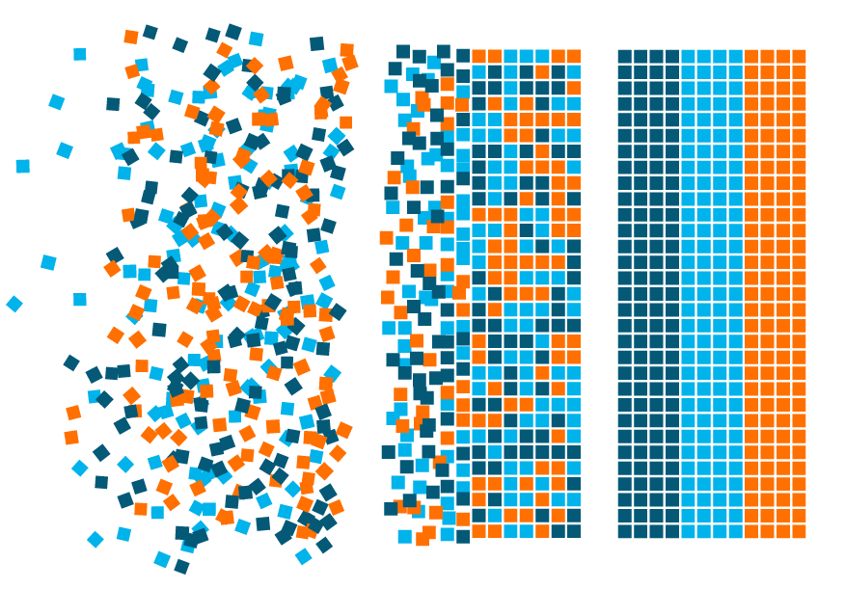
What is Data Structure - Agenda
What are data structures?
Why are data structures needed?
Types of data structures in Python
Built-In Data Structures
Lists
Tuple
Sets
Dictionary
Frozen Set

Slide 3
data Structure
What is Data structure?
Data is an important aspect when it comes to programming.
Data Structure is a primary memory allocation to store, organize and manage data for efficient access and modifications.
The essential constructs that support the development of your programmes are data structures.
Depending on your use case, each data structure provides a unique manner of arranging data so that it may be accessible quickly.

Slide 4

data Structure
Need for Data structure?
Let us understand through an analogy.
Just imagine the workspace, if it is arranged according to your work needs, that helps you work faster with ease of access to all the items.
The same goes to data as well, data needs to be stored efficiently for the better access and modifications. Data in the primary memory storage, to organize and manage is called as data structure.

Slide 5
Data structures in Python
Data Structures
Built-in Data
Structures
User Defined
Data Structures
Tuple
Dictionary
Stack
Tree
Hash Map
List
Set
Frozen Set
Linked
List
Graph
Queue
Collection Data Type

Slide 6

terminologies
List, Tuple, Set, Dictionary, Frozen sets are represented technically using the following terminologies:
Sequence
Containers
Collection
Integers, strings, complex numbers.
Like variable.
Can hold
Various data
types.
Collection data type.
Can hold many data types.

Slide 7
9
Array
8
7
What is an Array?
6
A Python Array is a collection of common types of data structures having elements with the same data type. It is used to store collections of data.
Array Length is 10
5
4
First Index
3
Element at Index 8
2
1
0

Slide 8

Creating Array using array Module
example
from array import *
array1 = array('i', [10,20,30,40,50])
for x in array1:
print(x)
Output
10
20
30
40
50

Slide 9

List
What is List?
Lists are similar to dynamic arrays in Python.
A dynamic array is able to resize and add elements after declaration. In Python, a list is a dynamic array.
The list can contain data of different types.
The items stored in the list are separated with a comma (,) and enclosed within square brackets [].
A constructor is used to create a list[].

Slide 10
Creating a List
Example
How to create a list?
#creating a list using list() #constructor
text = "Python"
print(list(text))
A constructor is a special kind of method that Python calls when it instantiates an object using the definitions found in your class.
In Python programming, a list is created by placing all the items (elements) inside square brackets [], separated by commas.
Output
['P', 'y', 't', 'h', 'o', 'n']
Notes:
A constructor is a special kind of method that Python calls when it instantiates an object using the definitions found in your class.

Slide 11
Creating a List
Example
# empty list creation
my_list = []
# list of integers
my_list = [10, 20, 30]
print(my_list)
# list with mixed data types
my_list1 = [2021, "Python", 88.9]
print(my_list1)
Output
[10, 20, 30]
[2021, 'Python', 88.9]
Notes:
A constructor is a special kind of method that Python calls when it instantiates an object using the definitions found in your class.

Slide 12
Slicing operator
20
40
50
20
100
10
510
Lst[ Initial : End : Increment or Update ]
-n
0
1
2
3
4
5
6
-1
With this operator, one can specify where to start the slicing, where to end, and specify the step.
Index -1 represents the last element and -n represents the first element of the list
# Initialize list
Lst = [20, 40, 50, 20, 100, 10, 510]
# Display list
print(Lst[1:5])
Output
[40, 50, 20, 100]
Notes:
https://www.geeksforgeeks.org/python-list-slicing/
You may create a PPT using this reference

Slide 13
Slicing operator
20
40
50
20
100
10
510
-7
-6
-5
-4
-3
-2
-1
Lst[ Initial : End : Increment or Update ]
# Code for accessing the elements from the last using negative indexing
Lst = [20, 40, 50, 20, 100, 10, 510]
# Display list
print(Lst[-1:-5:-1])
Output
[510, 10, 100, 20]
Notes:
https://www.geeksforgeeks.org/python-list-slicing/
You may create a PPT using this reference

Slide 14
2
3
python
Slicing operator
2
Slicing Operator
Start:Stop
hi
First Index
list1 = [1, "hi", "python", 2] #list index starts with 0
print ((list1[3:])) #Slicing Operator start:stop
print ((list1[0:2])) #slicing operator will get executed stop-1 (0 to 1)
print ((list1)) #prints the entire list
print (list1 + list1) #Concatenation
print (list(list1 * 3)) #Repetition & type conversion
1
Output
[2]
[1, 'hi']
[1, 'hi', 'python', 2]
[1, 'hi', 'python', 2, 1, 'hi', 'python', 2]
[1, 'hi', 'python', 2, 1, 'hi', 'python', 2, 1, 'hi', 'python', 2]
1
0

Slide 15
Difference Between Methods and Functions
Method
Function
Python is object oriented programming language. It supports, classes, objects and methods.
Methods are associated with the objects of the class they belong to. Functions are not associated with any object.
Methods is associated with an object.
We call a method on an object using the dot operator.
It is a group of statements capable of performing some tasks.
A function in a program can take arguments (that is, the data to operate on) and can optionally return some data after performing the intended task.

Slide 16
List Methods and Functions
Method | Meaning
append() | Adds an element at the end of the list
clear() | Removes all the elements from the list
copy() | Returns a copy of the list
extend() | Add the elements of a list (or any iterable), to the end of the current list
count() | Returns the number of elements with the specified value

Slide 17
List Methods and Functions
Method | Meaning
index() | Returns the index of the first element with the specified value
insert() | Adds an element at the specified position
pop() | Removes the element at the specified position
remove() | Removes the first item with the specified value
sort() | Sorts the list
reverse() | Reverses the order of the list

Slide 18
List Methods and Functions
Method | Meaning
max() | return maximum element of given list
min() | return minimum element of given list
len() | Returns length of the list or size of the list
concatenate(+) | Merges two lists and returns a single list.
repetition/ iteration(*) | Allows multiplying the list n times. The resultant list is the original list iterate n times.

Slide 19
Lms activity

Slide 20

Tuple
What is tuple?
Tuples are used to store multiple items in a single variable. A tuple is a collection which is ordered and unchangeable or immutable.
Tuples are written with parentheses.
Since tuples are indexed, they can have items with the same value
Tuples are ordered, it means that the items have a defined order, and that order will not change.
A tuple can contain different data types
It is also possible to use the tuple() constructor to make a tuple.

Slide 21
Tuple
example
To create a tuple with only one item, you have to add a comma after the item, otherwise Python will not recognize it as a tuple.
thistuple = ("apple",)
print(type(thistuple))
Using the tuple() method to make a tuple:
thistuple = tuple(("apple", "banana", "cherry")) #note the double round-brackets
print(thistuple)
Output
<class 'tuple'>
Output
('apple', 'banana', 'cherry')

Slide 22
Tuple Operations
Operations | Description | Examples
Creating a tuple | Creating the tuple with elements of different data types. | a =(20,40,60,"apple","ball")
Indexing | Accessing the item in the | print(a[0])
 | position 0 | 20
 | Accessing the item in the | print(a [2])
 | position 2 | 60
Slicing | Displaying items from 1st till 2nd. | print(a[1:3]) (40,60)
Concatenation | Adding tuple elements at the end of another tuple elements | b=(2,4) print(a+b) (20,40,60,"apple","ball",2,4)
Repetition | Repeating the tuple n no. of times | print(b*2) (2,4,2,4)

Slide 23
Tuple Operations
Operations | Description | Examples
Membership | Returns True if element is present in the tuple. Otherwise returns false. | a=(2,3,4,5,6,7,8,9,10) 5 in a True 100 in a False 2 not in a False
Comparison |  | a=(2,3,4,5,6,7,8,9,10) b=(2,3,4) a==b False a!=b True
 | Returns True if all elements in both elements are same.

Slide 24
Tuple Methods & Functions
Methods/Functions | Description | Example
a.index(tuple) | Returns the index of the first matched item. | a=(l,2,3,4,5)
 |  | a.index(5)
 |  | 4
a.count(tuple) | Returns the count of the given element. | a=(l,2,3,4,5)
 |  | a.count(3)
 |  | 1
len(tuple) | Returns the length of the tuple | len(a) 5

Slide 25
Tuple Methods & Functions
Methods/Functions | Description | Example
min(tuple) | returns the minimum element in a tuple | min (a) 1
max(tuple) | returns the maximum element in a tuple | max(a) 5
del(tuple) | Deletes the entire tuple. | del(a)

Slide 26
Tuple
example
Example for Tuple method
#Counting the number of elements in a tuple
a=(3,2,1,3,4,5)
a.count(3)
Output: 2

Slide 27
Lms activity

Slide 28
Set
What IS set?
Sets are used to store multiple items in a single variable.
A set is a collection which is both unordered and unindexed.
Set items are unordered, changeable, and do not allow duplicate values.
Sets are written with curly brackets.

Slide 29

set
Advantages of set
The main advantage of using a set over a list is that it has a highly optimised way for detecting whether a certain member is in the set. This is based on a hash table, which is a type of data structure. We can't use indexes to access items in sets because they're not arranged like lists.

Slide 30
Set Methods
Method | Meaning
add() | Adds an element to the set
clear() | Removes all the elements from the set
copy() | Returns a copy of the set
difference() | Returns a set containing the difference between two or more sets
difference_update() | Removes the items in this set that are also included in another, specified set

Slide 31
Set Methods
Method | Meaning
intersection() | Returns a set, that is the intersection of two or more sets
intersection_update() | Removes the items in this set that are not present in other, specified set(s)
isdisjoint() | Returns whether two sets have a intersection or not
issubset() | Returns whether another set contains this set or not
issuperset() | Returns whether this set contains another set or not

Slide 32
Set Methods
Method | Meaning
symmetric_difference() | Returns a set with the symmetric differences of two sets
symmetric_difference_update() | inserts the symmetric differences from this set and another

Slide 33
Set
example
A = {1, 2, 3, 4, 5}
print(A)
#Set Eliminates the duplication
A = {4, 5 , 1, 2, 3, 4, 5}
print(A)
Output
{1, 2, 3, 4, 5}
Output
{1, 2, 3, 4, 5}

Slide 34
Lms activity

Slide 35

Dictionary
What is Dictionary?
Dictionaries are written with curly brackets, and have keys and values.
Dictionaries are used to store data values in key:value pairs.
A dictionary is a collection which is ordered, changeable and does not allow duplicates.
As of Python version 3.7, dictionaries are ordered. In Python 3.6 and earlier, dictionaries are unordered.

Slide 36
Dictionary
What is Dictionary?
Values in a dictionary can be of any datatype and can be duplicated, whereas keys can’t be repeated and must be immutable.
JavaScript Object Notation: JSON is mostly used model for data exchange over the internet. Dictionary data structure is useful to handle JSON data.
Mutable, Dynamic. They can grow and shrink as needed.
Nested. A list can contain another list. A dictionary can contain another dictionary. A dictionary can also contain a list, and vice versa.

Slide 37
Dictionary Operations
List elements are accessed by their position in
the list, via indexing.
Dictionary elements are accessed via keys.
example
#Program for personal details
P_D = {“Name”:”Karan”, “Age”:24, “City”:”Delhi”, “Height”: 5.8}
print(P_D)
Output
{'Name': 'Karan', 'Age': 24, 'City': 'Delhi', 'Height': 5.8}

Slide 38
Dictionary Methods
Method | Meaning
clear() | Removes all the elements from the dictionary
copy() | Returns a copy of the dictionary
fromkeys() | Returns a dictionary with the specified keys and value
values() | Returns a list of all the values in the dictionary
get() | Returns the value of the specified key

Slide 39
Dictionary Methods
Method | Meaning
items() | Returns a list containing a tuple for each key value pair
keys() | Returns a list containing the dictionary's keys
pop() | Removes the element with the specified key
popitem() | Removes the last inserted key-value pair
update() | Updates the dictionary with the specified key-value pairs

Slide 40
Dictionary Methods
example
dict = {'Name': 'Jenifer', 'Age': 7, 'Class': 'Second'}
print(dict)
dict['Age'] = 8; # update existing entry
print(dict)
dict['School'] = "DPS School"; # Add new entry
print(dict)
del dict['Name'] # remove entry with key 'Name'
print(dict)
dict.clear() # remove all entries in dict
print(dict)
del dict # delete entire dictionary'
print(dict)
Output
{'Name': 'Jenifer', 'Age': 7, 'Class': 'Second'}
{'Name': 'Jenifer', 'Age': 8, 'Class': 'Second'}
{'Name': 'Jenifer', 'Age': 8, 'Class': 'Second', 'School': 'DPS School'}
{'Age': 8, 'Class': 'Second', 'School': 'DPS School'}
{}
<class 'dict'>

Slide 41
Dictionary Functions
Function | Meaning
cmp(dict1, dict2) | Compares elements of both dict.
len(dict) | Gives the total length of the dictionary. This would be equal to the number of items in the dictionary.
str(dict) | Produces a printable string representation of a dictionary
type(variable) | Returns the type of the passed variable. If the passed variable is a dictionary, then it would return a dictionary type.

Slide 42
Lms activity

Slide 43

Frozen set
What is Frozen Set?
Freeze the list, and make it unchangeable.
The frozenset() function returns an unchangeable frozenset object (which is like a set object, only unchangeable).
Example
mylist = ['Python', 'Java', 'Julia']
x = frozenset(mylist)
Output
frozenset({'Julia', 'Java', 'Python'})

Slide 44
Frozen Set
If you try to add an element to a frozen set, you will get an error.
example
# tuple of vowels
vowels = ('a', 'e', 'i', 'o', 'u')
fSet = frozenset(vowels)
print('The frozen set is:', fSet)
print('The empty frozen set is:', frozenset())
# frozensets are immutable
fSet.add('v')
Output
The frozen set is: frozenset({'e', 'i', 'a', 'o', 'u'})
The empty frozen set is: frozenset()

Slide 45
Frozen Set Operations
Like normal sets, frozenset can also perform different operations like copy, difference, intersection, symmetric_difference, and union
Similarly, other set methods like isdisjoint, issubset, and issuperset are also available.

Slide 46
Frozen Set Operations
example
# Frozensets
# initialize A and B
A = frozenset([1, 2, 3, 4])
B = frozenset([3, 4, 5, 6])
# copying a frozenset
C = A.copy() # Output: frozenset({1, 2, 3, 4})
print(C)
# union
print(A.union(B))
Output
frozenset({1, 2, 3, 4})
Output
frozenset({1, 2, 3, 4, 5, 6})

Slide 47
Frozen Set Operations
example
# intersection
print(A.intersection(B))
# difference
print(A.difference(B))
# symmetric_difference
print(A.symmetric_difference(B))
Output
frozenset({3, 4})
Output
frozenset({1, 2,})
Output
frozenset({1, 2, 5, 6})

Slide 48
Frozen Set Operations
example
# Frozensets
# initialize A, B and C
A = frozenset([1, 2, 3, 4])
B = frozenset([3, 4, 5, 6])
C = frozenset([5, 6])
# isdisjoint() method
print(A.isdisjoint(C))
# issubset() method
print(C.issubset(B))
Output
True
# issuperset() method
print(B.issuperset(C))
Output
True
Output
True

