Slide 1

08.
Control Flow statements in Python

Slide 2

COntrol flow statements
wHat are control flow statements?
A control statement is a statement that determines whether other statements or a block of statements will be executed or not.
An if statement decides whether to execute another statement, or decides which of two statements to execute.
A loop decides how many times to execute another statement.

Slide 3
Control Flow statements
Flow Control
Conditional Statements
Transfer Statements
Iterative Statements
if
if-else
if-elif-else
Nested if-else
break
continue
pass
for
while

Slide 4

Decision Making
wHat is Decision Making?
Decision making is the most important aspect of almost all the programming languages.
As the name implies, decision making allows us to run a particular block of code for a particular decision.

Slide 5
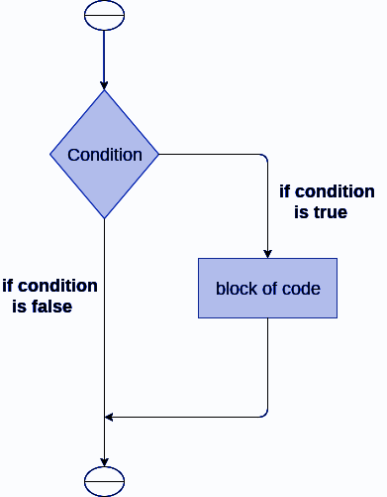
The If statement
What is If statement?
The if statement is used to test a particular condition and if the condition is true, it executes a block of code known as if-block.
The condition of if statement can be any valid logical expression which can be either evaluated to true or false.

Slide 6

The if statement
example
num = int(input("Enter the number?"))
if num%2 == 0:
print("Number is even")
Output
Enter the number?
22
Number is even

Slide 7
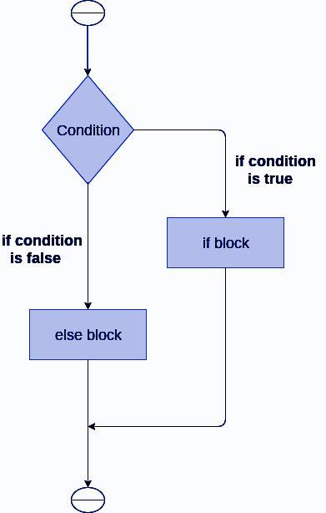
The if-else statement
What is if-else statement?
The if-else statement provides an else block combined with the if statement which is executed in the false case of the condition.
If the condition is true, then the if-block is executed. Otherwise, the else-block is executed.

Slide 8
The if-else statement
example
age = int (input("Enter your age? "))
if age>=18:
print("You are eligible to vote !!")
else:
print("Sorry! you have to wait !!")
Output
Enter your age?
25
You are eligible to vote !!

Slide 9
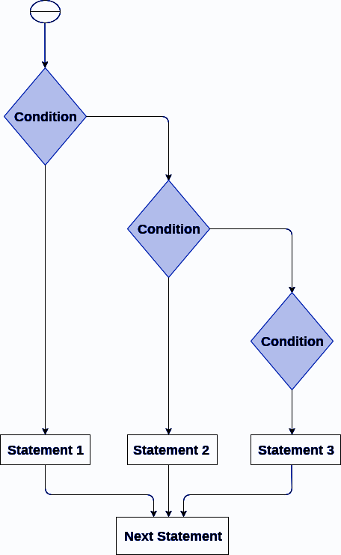
The elif statement
What is elif statement?
The elif statement enables us to check multiple conditions and execute the specific block of statements depending upon the true condition among them.

Slide 10
The if-else statement
example
mark = int(input("Enter the number?"))
if mark >= 80:
print("Excellent")
elif (mark < 80) and (mark >= 60):
print("Good")
elif (mark < 60) and (mark >= 50):
print("Average")
else:
print("Fail")
Output
Enter the number?
62
Good

Slide 11
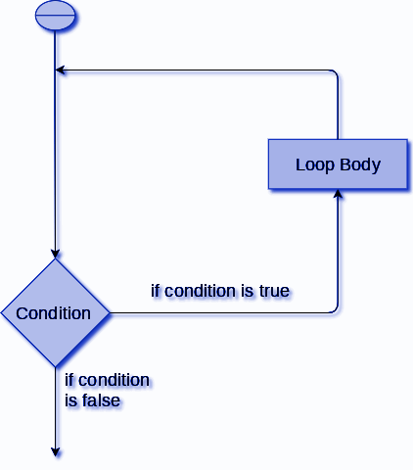
Loops
What are loops?
The flow of the programs written in any programming language is sequential by default.
Sometimes we may need to alter the flow of the program.
The execution of a specific code may need to be repeated several numbers of times.

Slide 12

Advantages of Loops
What are THE advantages loops?
There are the following advantages of loops in Python.
It provides code reusability.
Using loops, we do not need to write the same code again and again.
Using loops, we can traverse over the elements of data structures (array or linked lists).

Slide 13
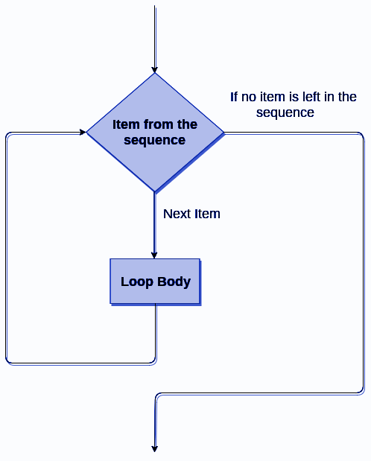
FOR Loop
What IS FOR loop?
The for loop in Python is used to iterate the statements or a part of the program several times. It is frequently used to traverse the data structures like list, tuple, or dictionary.
The range() function is used to generate a sequence of numbers.

Slide 14

Range function
What IS range function?
The range() function is used to generate a sequence of numbers.
The range() function returns a sequence of numbers, starting from 0 by default, and increments by 1 (by default), and stops before a specified number.
Syntax
range (Start, Stop, Step)

Slide 15
iF Else statement - Range Function
example
n=int(input("Enter the number up to which you want to print the natural numbers"))
for i in range(0,n):
print(i)
Output
range (Start, Stop, Step)
Enter the number up to which you want to print the natural numbers
Input - 6
0
1
2
3
4
5

Slide 16
iF Else statement - Range Function
example
n=int(input("Enter the number up to which you want to print"))
for i in range(1,n,3 ):
print(i)
n=int(input("Enter the number up to which you want to print"))
for i in range(1.0,n,0.1):
print(i)
Enter the number up to which you want to print
12
Output: 1, 4, 7, 10
Enter the number up to which you want to print
1.5
Output: 1.0, 1.1, 1.2, 1.3, 1.4

Slide 17

Nested FOR Loop
What IS nested FOR loop?
Python allows us to nest any number of for loops inside a for loop. The inner loop is executed n number of times for every iteration of the outer loop.

Slide 18
The if-else statement
example
n = int(input("Enter the number of rows you want to print?"))
for i in range(0,n):
print()
for j in range(0,i+1):
print("*",end="")
n = int(input("Enter the number of rows you want to print?"))
for i in range(0,n):
print()
for j in range(0,i+1):
print(i,end="")
Output
Enter the number of rows you want to print?
5
*
**
***
****
*****
Output
Enter the number of rows you want to print?
5
1
2 2
3 3 3
4 4 4 4
5 5 5 5 5

Slide 19
using else statement with for loop
example
Else statement with FOR loop?
for i in range(0,5):
print(i)
else:
print("for loop completely exhausted, since there is no break.")
Unlike other languages like C, C++, or Java, python allows us to use the else statement with the for loop which can be executed only when all the iterations are exhausted.
Output
0
1
2
3
4
for loop completely exhausted, since there is no break.

Slide 20
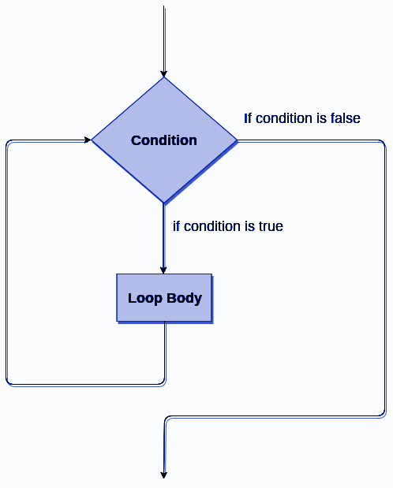
While Loop
What is while loop?
The while loop is also known as a pre-tested loop. In general, a while loop allows a part of the code to be executed as long as the given condition is true.
Example
i=1
while i<=5:
print(i)
i=i+1
Output
1
2
3
4
5

Slide 21
While loop
example
#Program for odd number generation
i=1
while i<=10:
print(i)
i=i+2 # odd
#Program for even number generation
i=0
while i<=10:
print (i)
i=i+2 # even
Output
1
3
5
7
9
Output
0
2
4
6
8
10

Slide 22
using else statement with while loop
example
Else statement with while loop
i=1
while i<=5:
print(i)
i=i+1
else:
print("The while loop is exhausted")
Python enables us to use the else statement with the while loop also.
The else block is executed when the condition given in the while statement becomes false. Like for loop, if the while loop is broken using break statement, then the else block will not be executed and the statement present after else block will be executed.
Output
1
2
3
4
5
The while loop is exhausted

Slide 23
break statement
example
What is break statement?
list =[10,20,30,40,50,60,70]
count = 1
for i in list:
if i == 50:
print("item matched")
break
else:
count = count + 1
print("found at",count,"location")
The break is a keyword in python which is used to bring the program control out of the loop.
The break statement breaks the loops one by one, i.e., in the case of nested loops, it breaks the inner loop first and then proceeds to outer loops.
Output
item matched
found at 5 location

Slide 24
continue statement
example
What is continue statement?
for i in range(1,8):
if i<6:
print("Skip")
continue
print (i)
The continue statement in python is used to bring the program control to the beginning of the loop.
The continue statement skips the remaining lines of code inside the loop and starts with the next iteration.
It is mainly used for a particular condition inside the loop so that we can skip some specific code for a particular condition.
Output
Skip
Skip
Skip
Skip
Skip
6
7

Slide 25
Pass statement
example
What is pass statement?
li =['a', 'e', 'i', 'o', 'u']
for i in li:
if(i =='a'):
pass
else:
print(i)
The pass statement is a null operation since nothing happens when it is executed.
It is used in the cases where a statement is syntactically needed but we don't want to use any executable statement in its place.
Output
e
i
o
u

Slide 26
Iterating a List
example
What is iterating a list?
List = ["John", "David", "Ram", "Abdullah"]
for i in List:
#It will iterate over the elements #of the List and it prints each
#element in each iteration.
print(i)
A list can be iterated by using a ‘for’ loop. A simple list containing four strings can be iterated as follows.
Output
John
David
Ram
Abdullah

Slide 27

Adding element to a List
What is adding element to a list?
Python provides append() method by using which we can add an element to the list.
However, the append() method can only add the value to the end of the list.

Slide 28
Assigning elements to a list
example
list =[ ]
n = int(input("Enter the number of elements in the list"))
#Number of elements will be entered by the user
for i in range(0,n):
# for loop to take the input
list.append(int(input("Enter the item?"))) #Append Method
# The input is taken from the user and added to the list as #the item
print("printing the list items....")
for i in list: # traversal loop to print the list items
print(i, end = " ")
Output
Enter the number of elements in the list
6
Enter the item?44
Enter the item?55
Enter the item?11
Enter the item?22
Enter the item?33
Enter the item?88
printing the list items....
44 55 11 22 33 88

Slide 29
Removing elements from the list
example
List = [0,1,2,3,4]
print("printing original list: ")
for i in List:
print(i,end=" ")
List.remove(0) #Remove Method
print("\nprinting the list after the removal of first element...")
for i in List:
print(i,end=" ")
Output
printing original list:
0 1 2 3 4
printing the list after the removal of first element...
1 2 3 4

Slide 30
Lms activity

