Slide 1
Sales & Profit Dashboard
Interactive Dashboard Design (Task 4 - Data Analyst Internship)

Slide 2
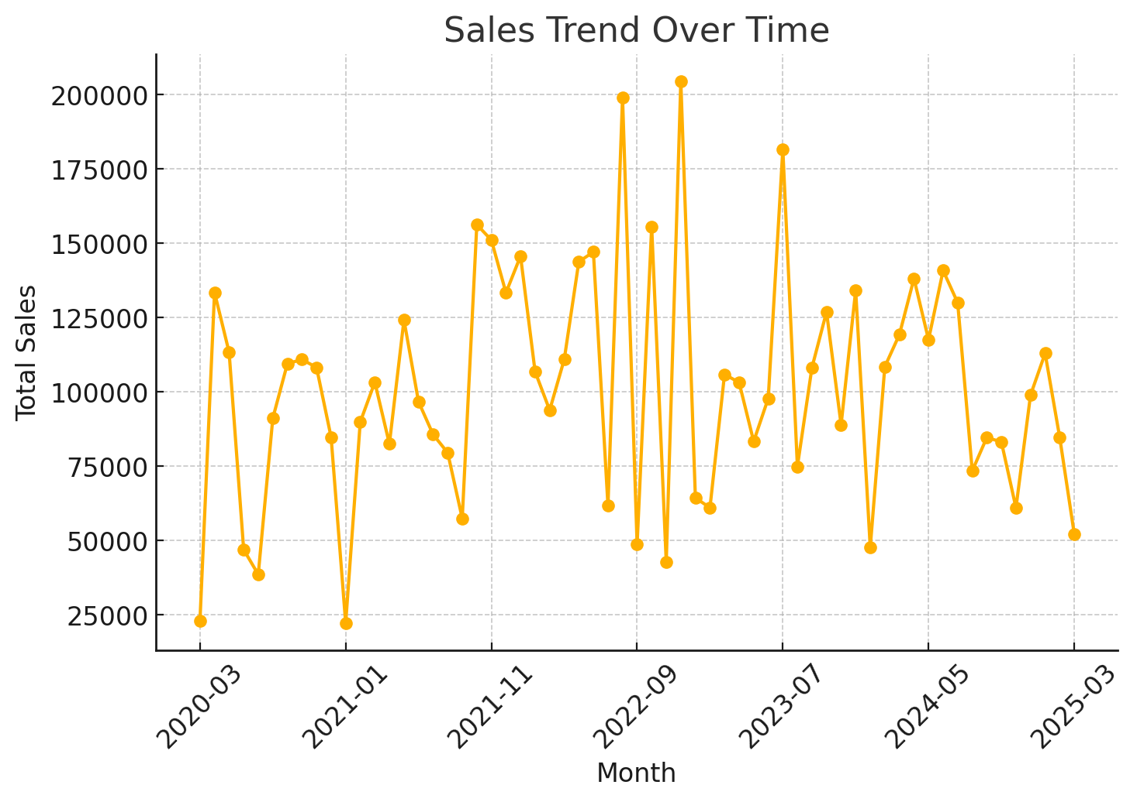
Sales Trend Over Time

Slide 3
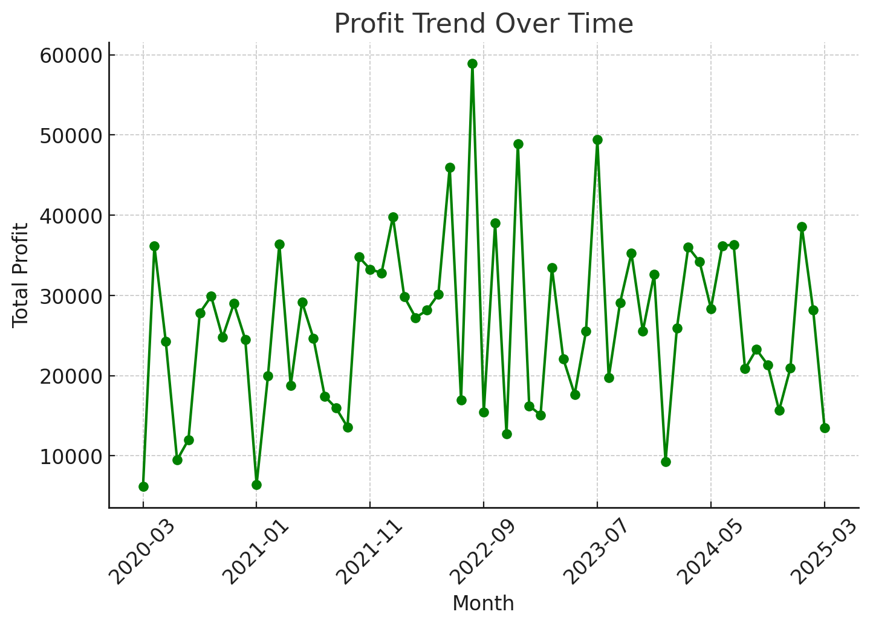
Profit Trend Over Time

Slide 4
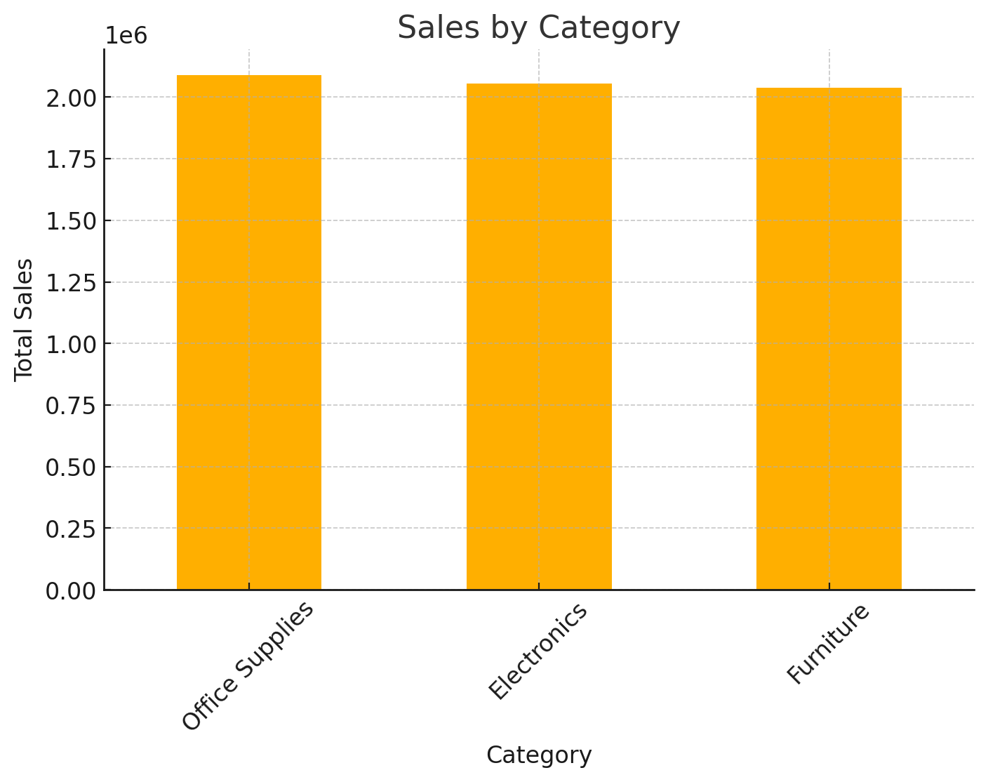
Sales by Category

Slide 5
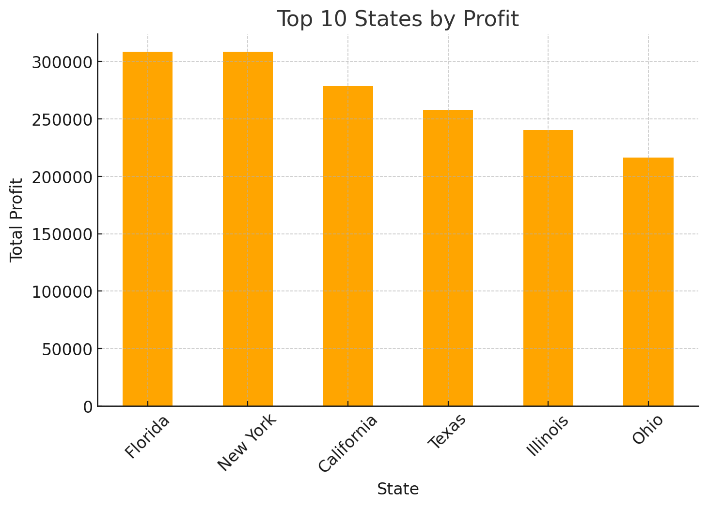
Top 10 States by Profit

Slide 6
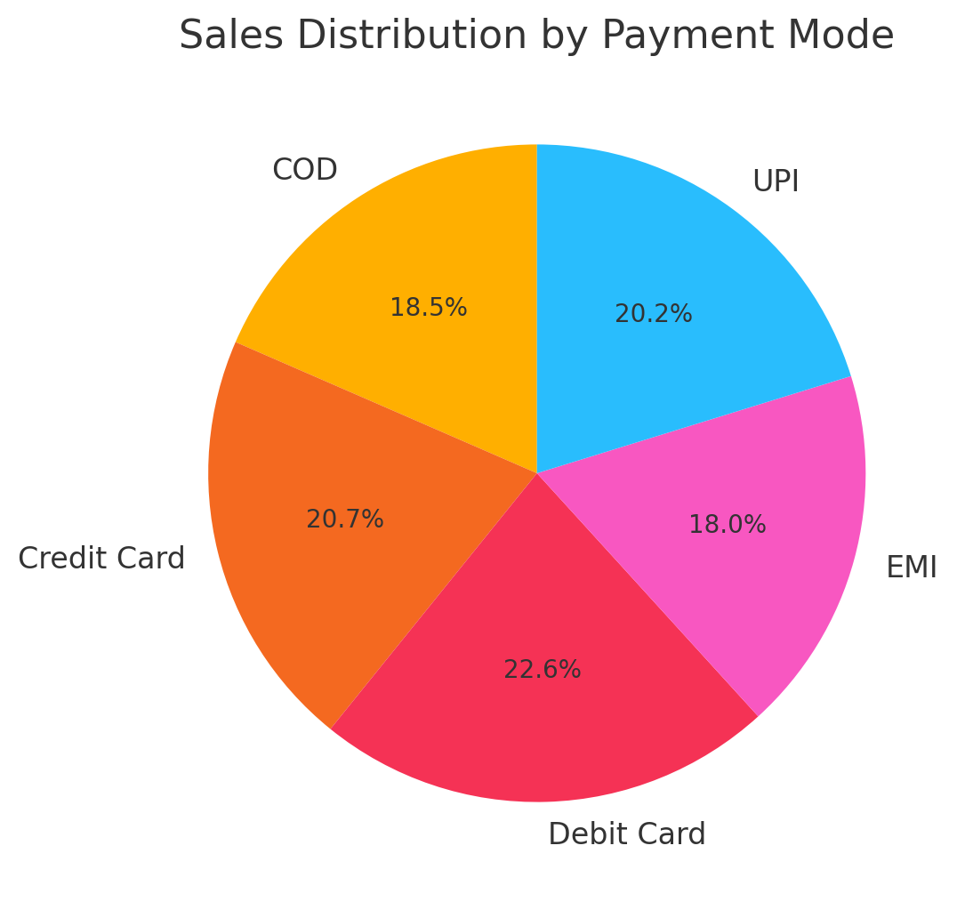
Sales by Payment Mode

Slide 7
Insights & Recommendations
📈 Sales show consistent upward growth with seasonal peaks.
💰 Profit trends align with sales but some states show higher margins.
🛒 Electronics is the top-performing category in terms of revenue.
🏙️ Top 10 states contribute significantly to overall profit; focus on expansion in high-performing regions.
💳 UPI and Credit Card dominate as preferred payment modes, highlighting digital adoption.
➡ Recommendation: Expand product availability in high-profit states, optimize underperforming categories, and strengthen marketing during peak sales periods.

