Slide 1
An
Introduction to
Agile Methodology

Slide 2
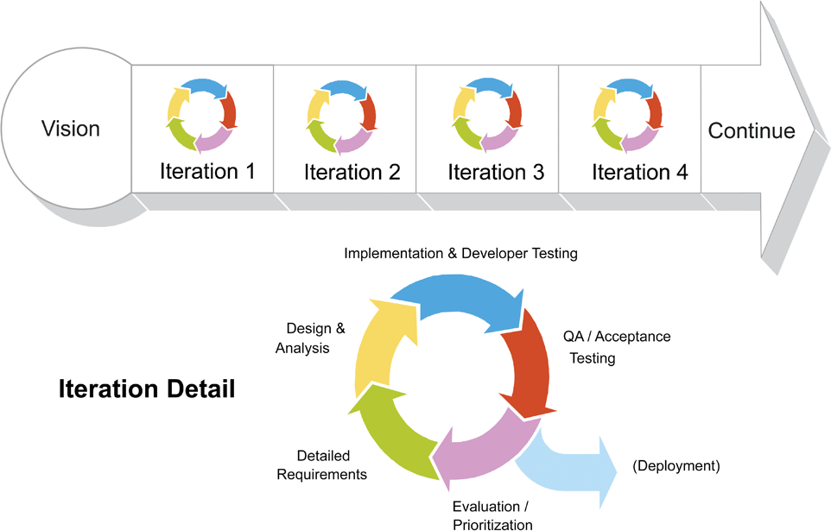
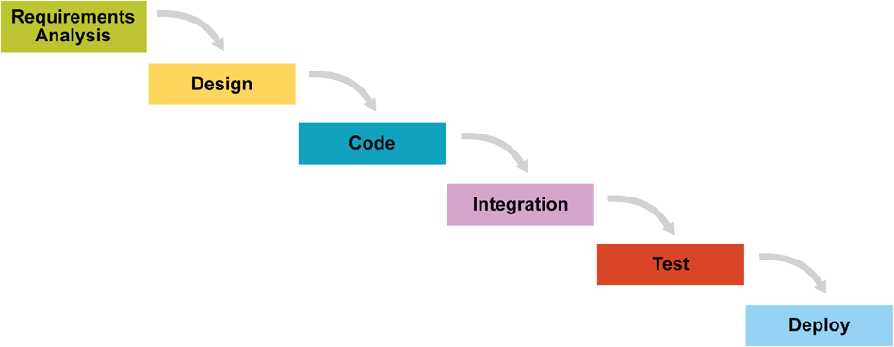
WATERFALL vs AGILE

Slide 3
Introduction
Classical methods of software development have many disadvantages:
huge effort during the planning phase
poor requirements conversion in a rapid changing environment
Heavy documentation
New methods:
Agile Software Development Methodology

Slide 4
What is Agile ?
Customer involvement | The customer should be closely involved throughout the development process. Their role is provide and prioritise new system requirements and to evaluate the iterations of the system.
Incremental delivery | The software is developed in increments with the customer specifying the requirements to be included in each increment.
People not process | The skills of the development team should be recognised and exploited. The team should be left to develop their own ways of working without prescriptive processes.
Embrace change | Expect the system requirements to change and design the system so that it can accommodate these changes.
Maintain simplicity | Focus on simplicity in both the software being developed and in the development process used. Wherever possible, actively work to eliminate complexity from the system.

Slide 5
Contd…
Agile methods are considered
Lightweight
People-based rather than Plan-based
Several agile methods
No single definition
Agile Manifesto closest to a definition
Set of principles
Developed by Agile Alliance

Slide 6
Agile Manifesto
A Statement of Values
Individuals and interactions over processes and tools
Working software over comprehensive documentation
Customer collaboration over contract negotiation
Responding to change over following a plan
http://www.agilemanifesto.org

Slide 7
Agile Methods
Scrum: Widely used
Extreme Programming (XP)
Dynamic Systems Development Method (DSDM)
Feature-Driven Development (FDD)
Lean and Kanban Software Development
Crystal

Slide 8
History of Scrum
1995:
analysis of common software development processes 🡪 not suitable for empirical, unpredictable and non-repeatable processes
Design of a new method: Scrum by Jeff Sutherland & Ken Schwaber
Enhancement of Scrum by Mike Beedle & combination of Scrum with Extreme Programming
1996:
introduction of Scrum at OOPSLA conference
2001:
publication “Agile Software Development with Scrum” by
Ken Schwaber & Mike Beedle
Successful appliance of Scrum in over 50 companies
Founders are members in the Agile Alliance

Slide 9
Characteristics
Self-organizing teams
Product progresses in a series of month-long “sprints”
Requirements are captured as items in a list of “product backlog.
Uses generative rules to create an agile environment for delivering projects
One of the “agile processes”

Slide 10
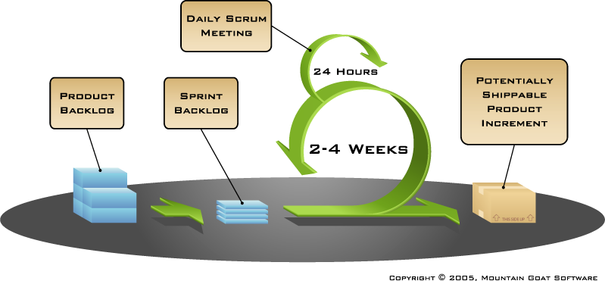
How Scrum Works?

Slide 11
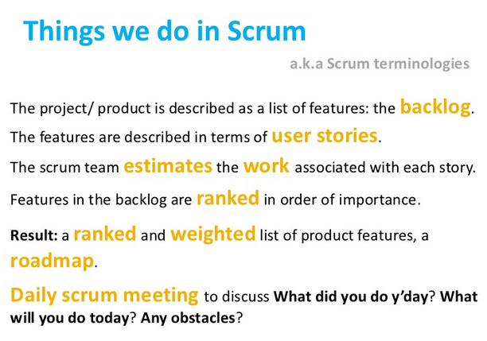

Slide 12
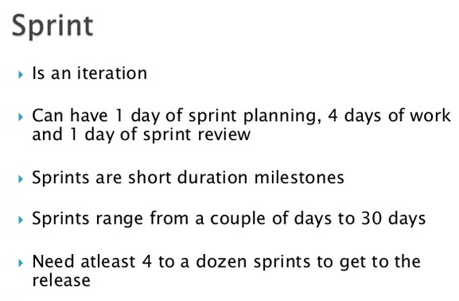

Slide 13
Sprints
Scrum projects make progress in a series of “sprints”
Analogous to XP iterations
Target duration is one month
+/- a week or two
But, a constant duration leads to a better rhythm
Product is designed, coded, and tested during the sprint

Slide 14
Scrum Framework
Roles : Product Owner, ScrumMaster, Team
Ceremonies : Sprint Planning, Sprint Review, Sprint Retrospective, & Daily Scrum Meeting
Artifacts : Product Backlog, Sprint Backlog, and Burndown Chart

Slide 15
Product Owner
Define the features of the product
Decide on release date and content
Be responsible for the profitability of the product
DOR,DOD
Adjust features and priority every iteration, as needed
Accept or reject work results.

Slide 16
The Scrum Master
Represents management to the project
Responsible for enacting Scrum values and practices
Ensure that the team is fully functional and productive
Enable close cooperation across all roles and functions

Slide 17
Scrum Team
Typically 5-10 people
Cross-functional
QA, Programmers, UI Designers, etc.
Members should be full-time
Teams are self-organizing
Membership can change only between sprints

Slide 18
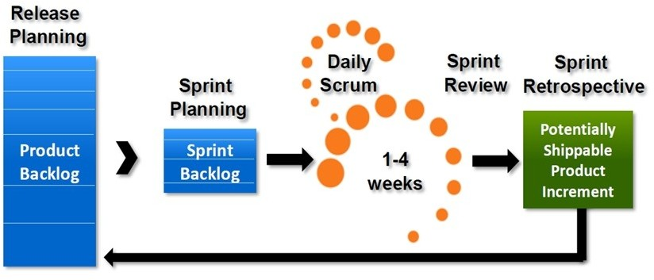

Slide 19
Ceremonies
Sprint Planning Meeting
Sprint
Daily Scrum
Sprint Review Meeting

Slide 20
Spring Planning Meeting
Product Owner
Scrum Team
Customers
Management
Product Backlog
Sprint Planning
Meeting
Team Capabilities
Sprint Goal
Business Conditions
Technology
Sprint Backlog
Current Product

Slide 21
Parts of Sprint Planning Meeting
1st Part:
Creating Product Backlog
Determining the Sprint Goal.
Participants: Product Owner, Scrum Master, Scrum Team
2nd Part:
Participants: Scrum Master, Scrum Team
Creating Sprint Backlog

Slide 22
Pre-Project/Kickoff Meeting
A special form of Sprint Planning Meeting
Meeting before the begin of the Project

Slide 23
Sprint
A month-long iteration, during which is incremented a product functionality
NO outside influence can interfere with the Scrum team during the Sprint
Each Sprint begins with the Daily Scrum Meeting

Slide 24
Daily Scrum
Parameters
Daily
15-minutes
Stand-up
Not for problem solving
Three questions:
What did you do yesterday
What will you do today?
What obstacles are in your way?

Slide 25
Daily Scrum
Is a meeting in which team members make commitments to each other and to the Scrum Master
Is a good way for a Scrum Master to track the progress of the Team

Slide 26
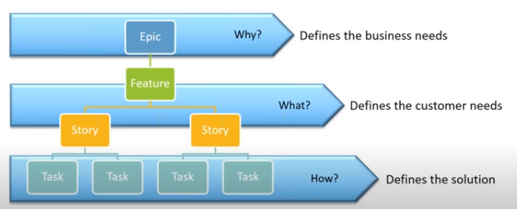

Slide 27
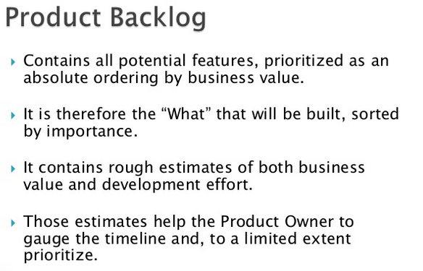

Slide 28
Product Backlog
Requirements for a system, expressed as a prioritized list of Backlog Items
Is managed and owned by a Product Owner
Spreadsheet (typically)
Usually is created during the Sprint Planning Meeting
Can be changed and re-prioritized before each PM

Slide 29
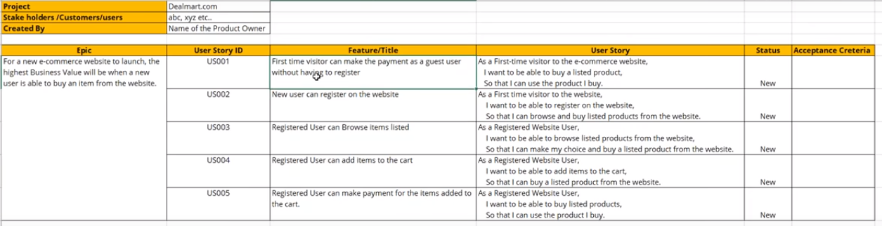
Sample Product Backlog

Slide 30
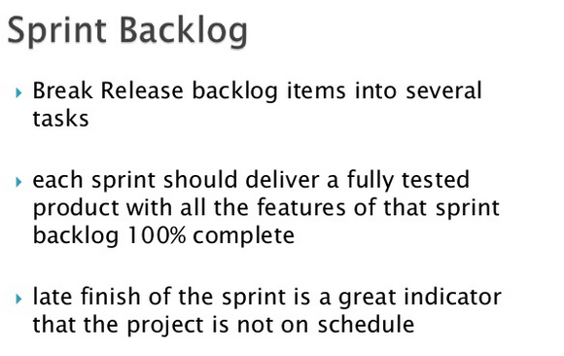

Slide 31
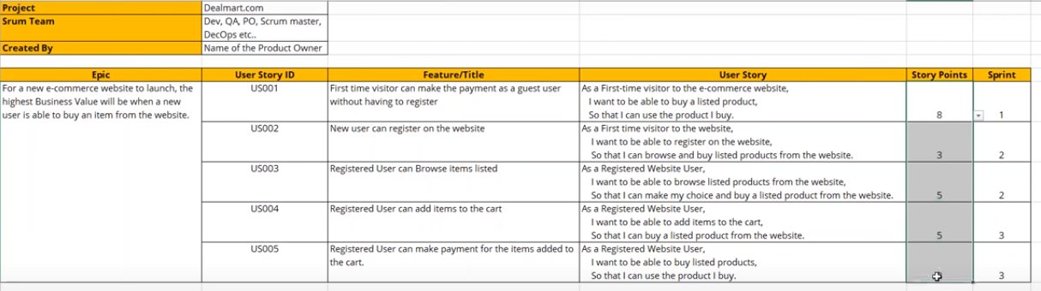

Slide 32
Sprint Burn down Chart
Depicts the total Sprint Backlog hours remaining per day
Shows the estimated amount of time to release
Ideally should burn down to zero to the end of the Sprint
Actually is not a straight line
Can bump UP

Slide 33
Release Burndown Chart
Will the release be done on right time?
X-axis: sprints
Y-axis: amount of hours remaining
The estimated work remaining can also burn up

Slide 34
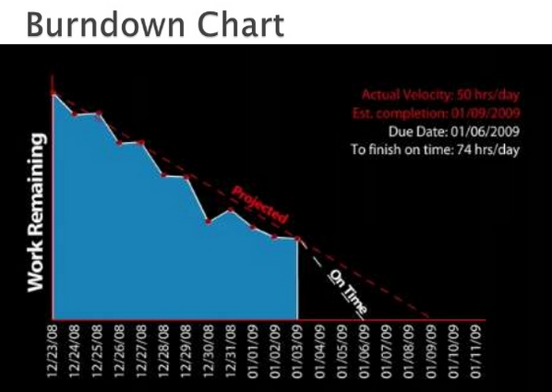

Slide 35
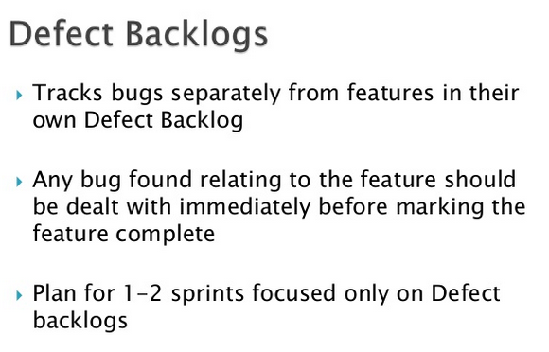

Slide 36
Scalability of Scrum
A typical Scrum team is 6-10 people
Jeff Sutherland - up to over 800 people
"Scrum of Scrums" or what called "Meta-Scrum“
Frequency of meetings is based on the degree of coupling between packets

Slide 37
Pros/Cons
Advantages
Completely developed and tested features in short iterations
Simplicity of the process
Clearly defined rules
Increasing productivity
Self-organizing
each team member carries a lot of responsibility
Drawbacks
“Undisciplined hacking” (no written documentation)
Violation of responsibility
Current mainly carried by the inventors

Slide 38
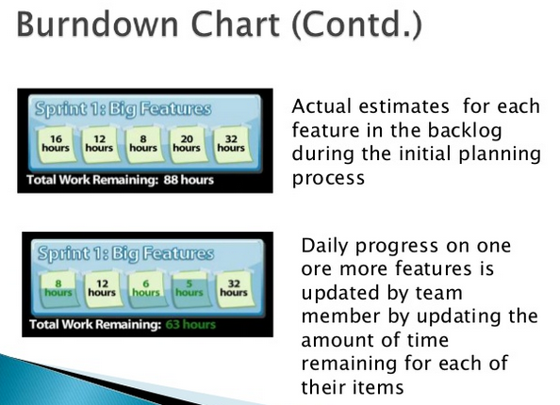

Slide 39
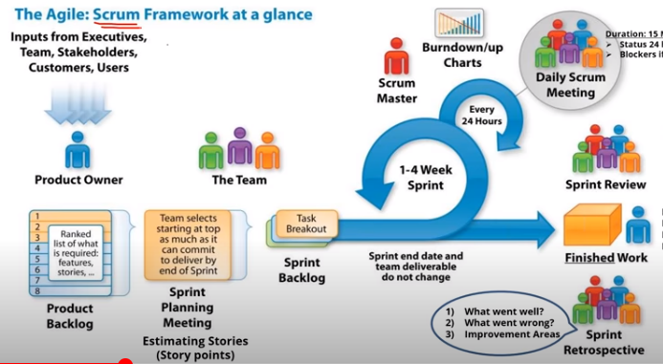

Slide 40
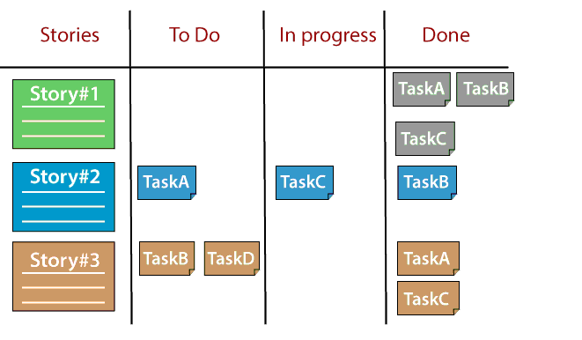
SCRUM

Slide 41
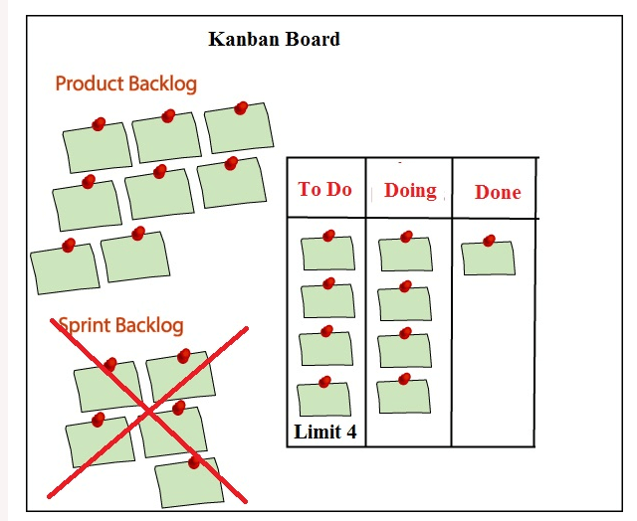

Slide 42
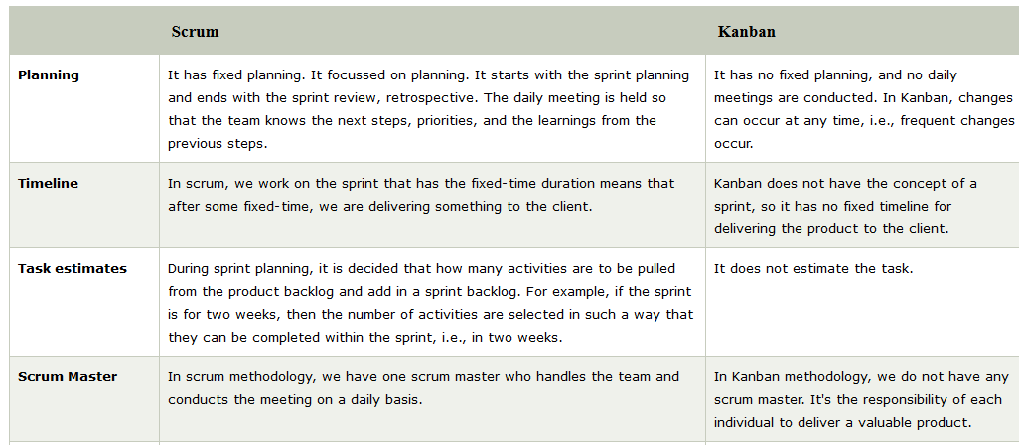

Slide 43
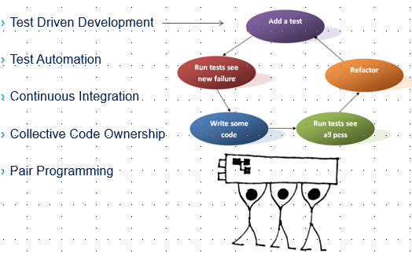
Extreme Programming

Slide 44
XP is short for eXtreme Programming, a framework which focuses heavily on ensuring the quality of delivered software and which prescribes engineering solutions towards that end.
An XP team (comprised of all who contribute to the project) engage in Release Planning and Iteration Planning. They work in very short development cycles so that changes requested by the customer (who works on-site with the team) can be incorporated frequently.

Slide 45
The value that XP practices can add though is undisputable and many organisations which use Scrum adopt Pair Programming, Test Driven Development and Refactoring as practices which improve quality, speed up the release process and/or reduce the need to revisit work due to technical debt.

Slide 46
Atlassian Jira
Jira is a bug tracking tool developed by an Australian company Atlassian in 2002. It is used for project management, issue tracking, and bug tracking. Jira is not an open-source tool, i.e., Jira software is not available at free of cost; it's a paid service.
It is used to prioritize the tasks.
One can easily get to know about the next release of the build as Jira tool provides better visibility.
It provides a better flexibility workflow so that the team can adjust accordingly.

Slide 47
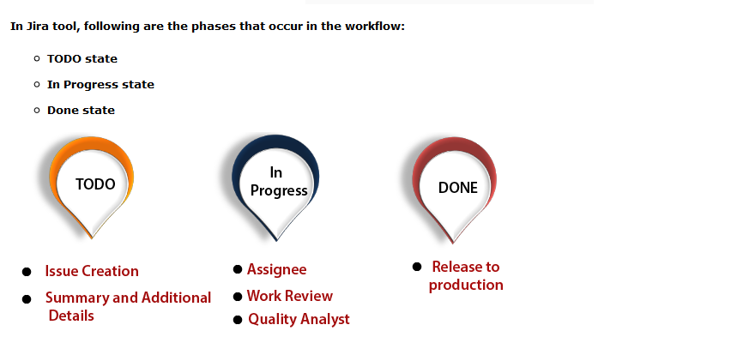

Slide 48
An issue in Jira can be a bug, feature, task, or any project work. Each Jira project comes with default issue types, and these issue types depend on the type of project that you are using.
There are three types of Jira projects:
Jira Core (business projects)
Jira Software (software projects)
Jira Service Desk (service desk projects)

Slide 49
Two types of issue exist in Jira Core:
Task:The task is a work that needs to be completed.
Subtask:Subtask is a piece of work which needs to be done to complete a task.
Five types of issue exist in Jira Software:
Bug:A bug is a problem that exists in the functionality of a product.
Epic:Epic is a big user story which needs to be broken into smaller stories.
Subtask:Subtask is a piece of work which needs to be done to complete a task.
Task:Task is a work that needs to be completed.
Story:The story is the smallest unit of work which needs to be completed.

Slide 50
Eight types of issue exist in Jira Service Desk:
Change It requests a change in a current IT profile.
IT help It requests for help related to an IT-related problem.
Incident It is used for reporting an incident.
New feature It requests for adding a new feature or capability in software.
Problem It is used for investigating and reporting the root cause of multiple incidents.
Service request It is requesting for help from an internal or customer service desk.
Service request with approval It is used for requesting help that requires the approval of a manager or a board.
Support It is used for requesting help for customer support related issues.

Slide 51
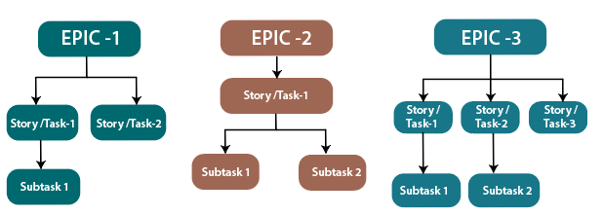
JIRA application can be used to break the pieces of work into issues. Issues can be represented as tasks, subtasks, bug, epic, feature requests, or other pieces of work.
Bug A bug is the problem or defect that occurs in the functions of a product.
Epic

Slide 52
Epic is a large user story which is to be broken into smaller stories
It cannot be achieved in a single sprint.
The whole epic is completed in months.
Epic refers to a set of activities which are not converted into user stories yet.
First, Epics are converted into user stories, and then user stories are converted into several tasks on which agile team work.
Subtask Subtask is a piece of work which is to be done to complete the whole work.
Task The task is the work which is to be completed or done to achieve the team's goal.
Story The story is a list of tasks that need to be completed within a project.
It defines the high-level design of project requirements.
It defines the short and simple descriptions of the whole project.
It is owned by the product owner of a company, but anyone can write the user story.

Slide 53
The Jira workflow is known as defect lifecycle or bug lifecycle. The bug lifecycle consists of the following phases:
Open issue When the issue is created by the tester, then the issue is assigned to the software developer, and they start working on it.
In Progress This is the phase where the software developers start working on the issue.
Resolved issue When the issue is resolved by the software developer and waiting for the verification by the software tester. If the verification is successful, then the issue is closed; otherwise, the issue gets reopened.
Reopened issue If the verification is unsuccessful, then the issue is reopened and assigned to the software developer.
Close issue If the verification of the fixed bug is successful, then the issue is closed by the tester.

Slide 54
