Slide 1

Project Title -Seasonal Agriculture Performance Analysis
Student Name –Shraddha Kishor Thorat
College Name-TSSM’s Bhivarabai Sawant Collage Of Engineering & Research ,Pune
AICTE STU ID : STU684ad9f9904d61749735929

Slide 2

PROBLEM STATEMENT
Agricultural activities are influenced by seasonal variations in environmental conditions, farming practices, resource availability and market conditions. As a result, agricultural performance may differ from one season to another.
However, raw agricultural data does not clearly explain how agricultural performance changes across seasons or what patterns can be observed in different seasonal conditions.
The problem is to analyze the given agricultural dataset and investigate seasonal differences in agricultural performance by identifying meaningful patterns, trends, relationships and variations within the available data.

Slide 3
Project Description
Agricultural Performance Analysis Using Data Analytics and Visualization
This project analyzes agricultural data to evaluate and compare crop performance across Kharif, Rabi, and Zaid seasons. It focuses on important factors such as crop yield, water usage, production cost, revenue, profit, and disease and pest risk.
Python and Jupyter Notebook are used for data cleaning, analysis, and visualization. The project helps identify seasonal patterns and provides useful insights for better crop planning and resource management.

Slide 4

WHO ARE THE END USERS?
Farmers – To make better decisions about crops and resources.
Agricultural Planners – To analyze seasonal agricultural performance.
Researchers & Students – For studying agricultural trends and data.
Government & Agricultural Departments – For planning and decision-making.

Slide 5

Technology Used
Programming Language: Python
Platform: Jupyter Notebook
Libraries: Pandas, NumPy, Matplotlib, Seaborn
Techniques: Data Cleaning, Data Analysis, Statistical Analysis, and Data Visualization

Slide 6
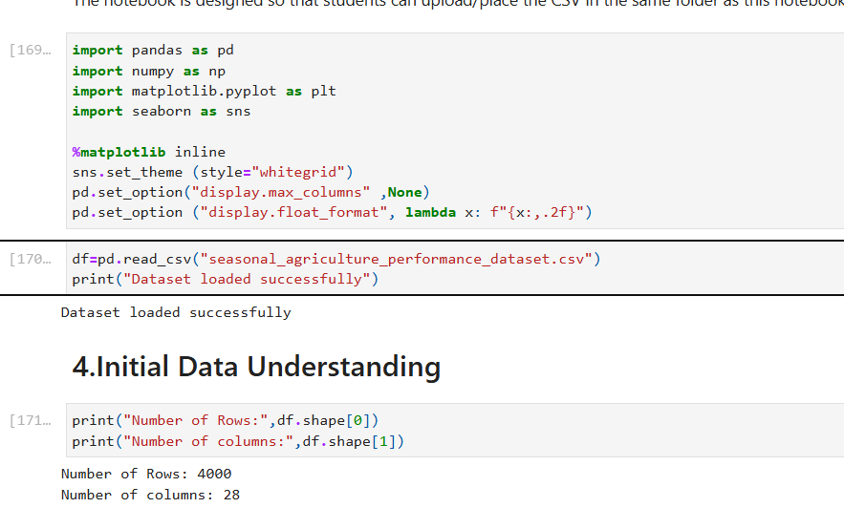
RESULTS

Slide 7
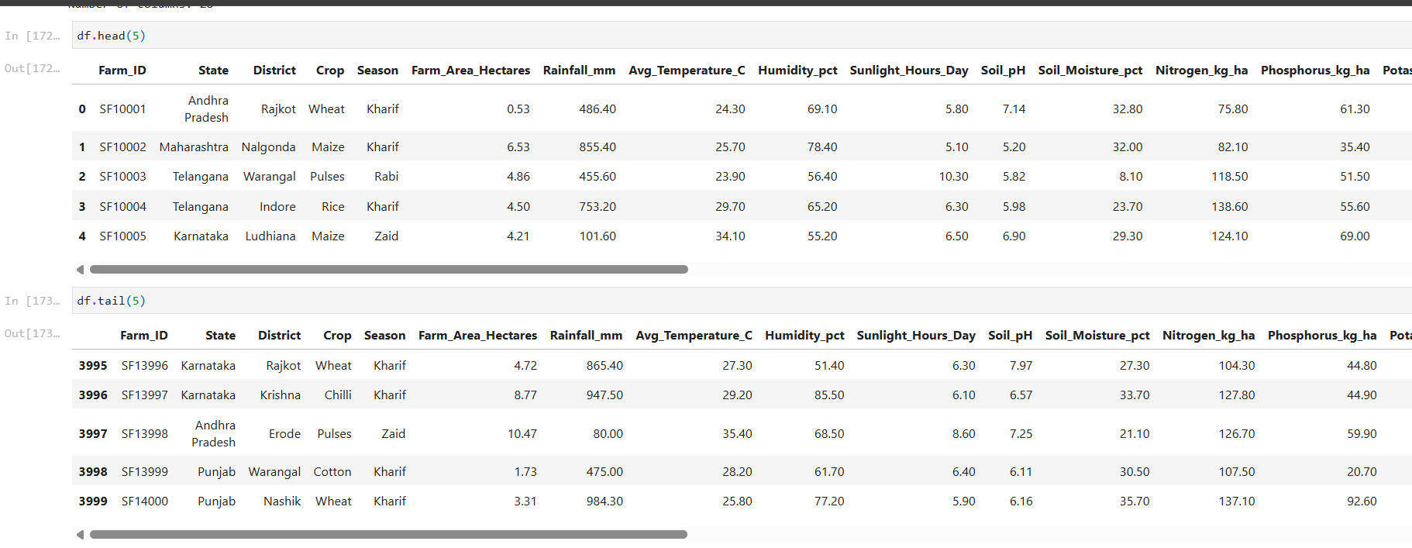
RESULTS

Slide 8
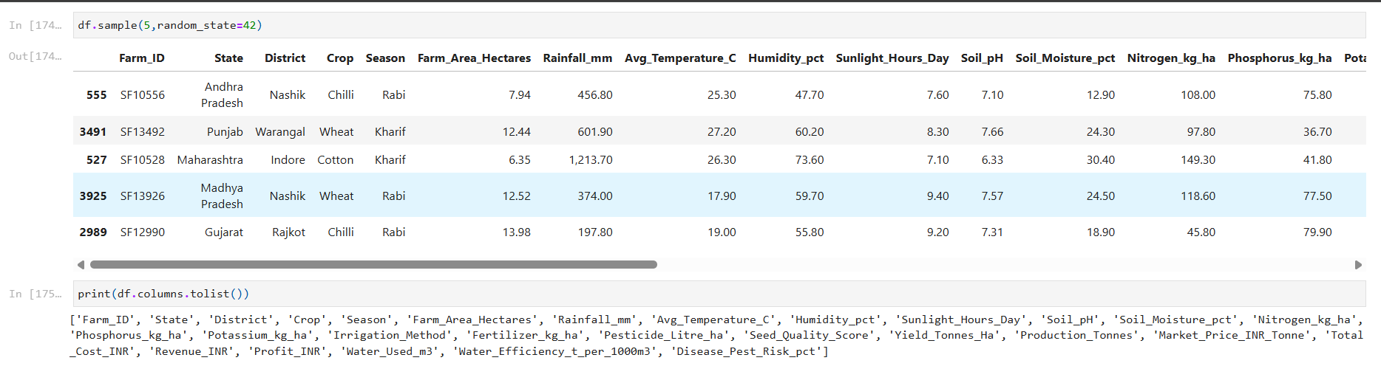
RESULTS

Slide 9
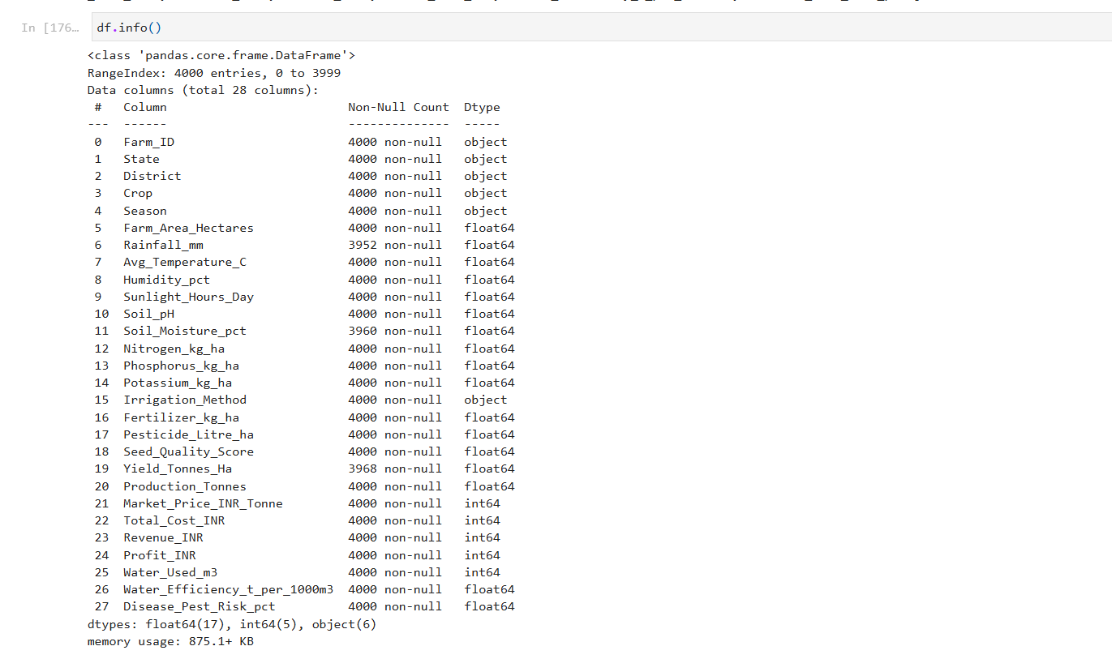
RESULTS
[Add screen shots of your code ]

Slide 10
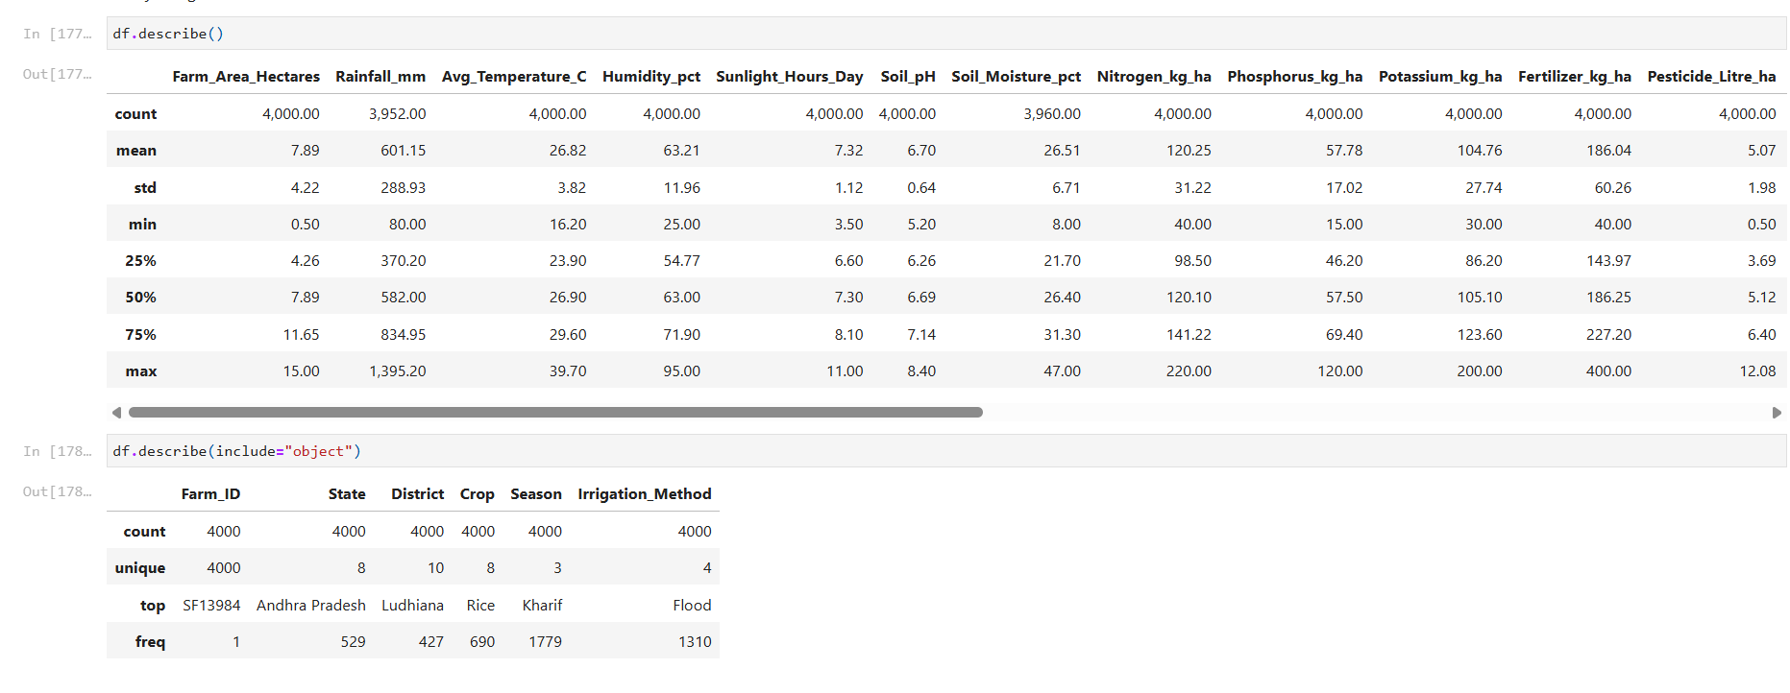
RESULTS

Slide 11
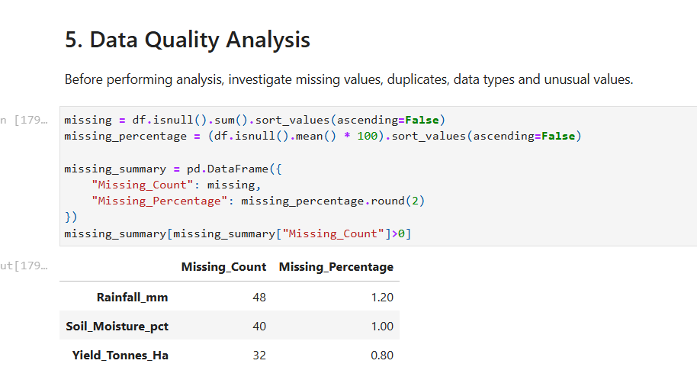
RESULTS

Slide 12
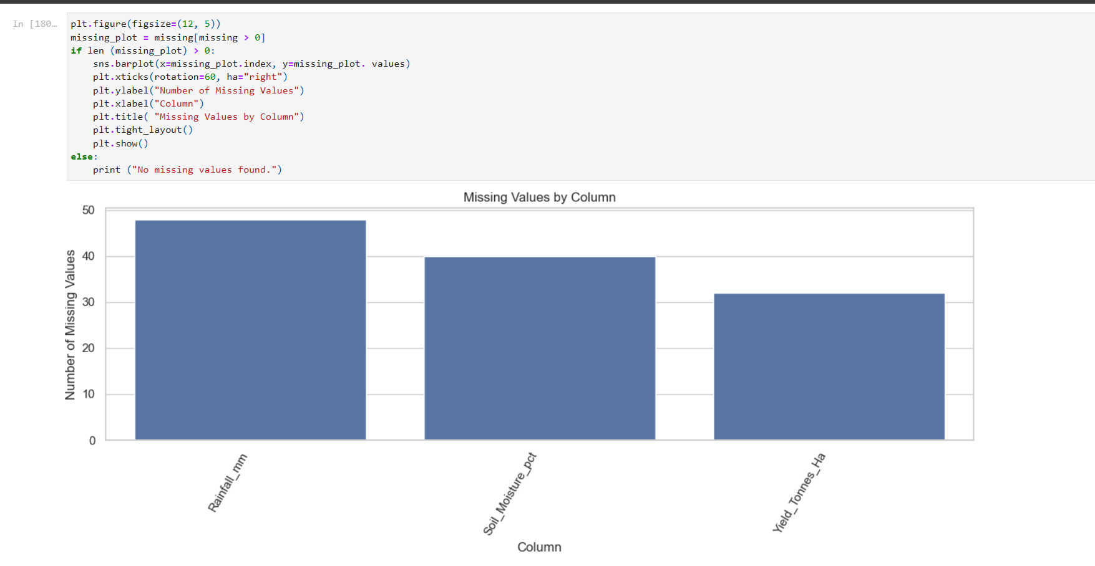
RESULTS

Slide 13
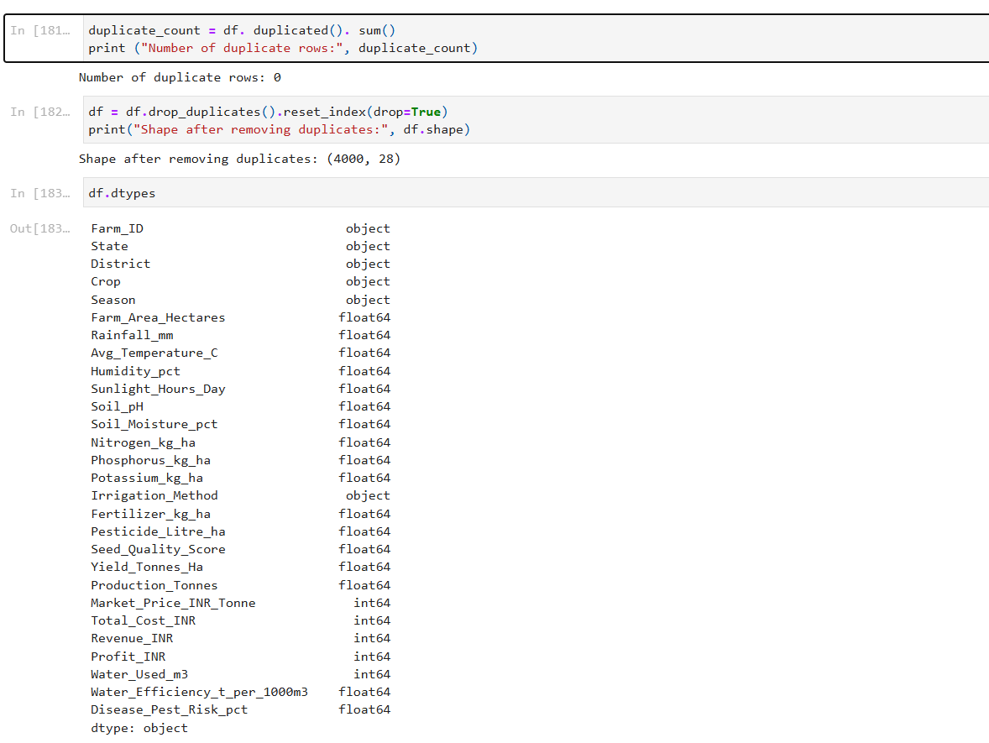
RESULTS

Slide 14
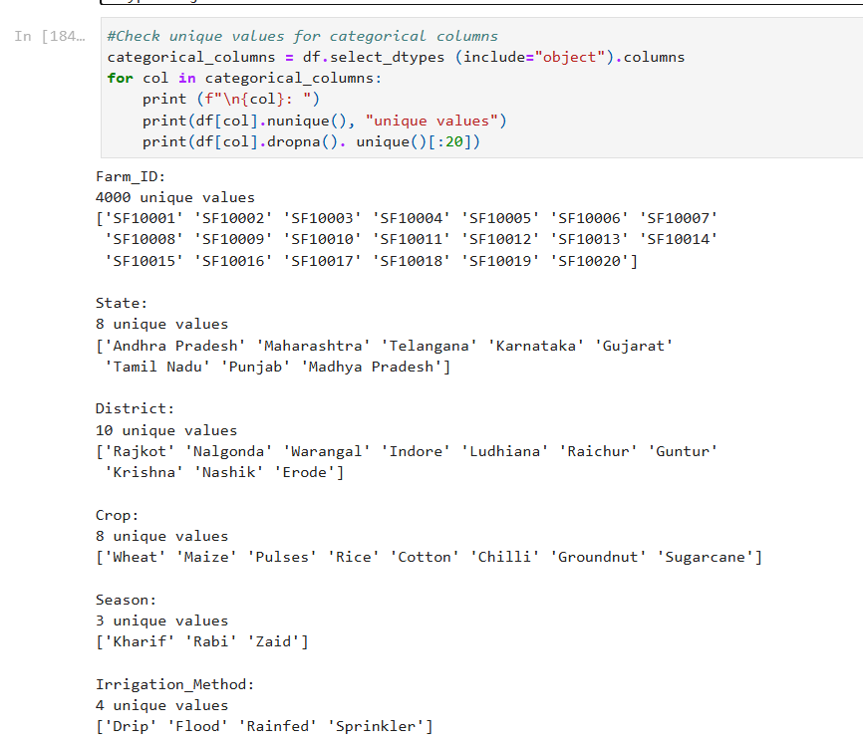
RESULTS

Slide 15
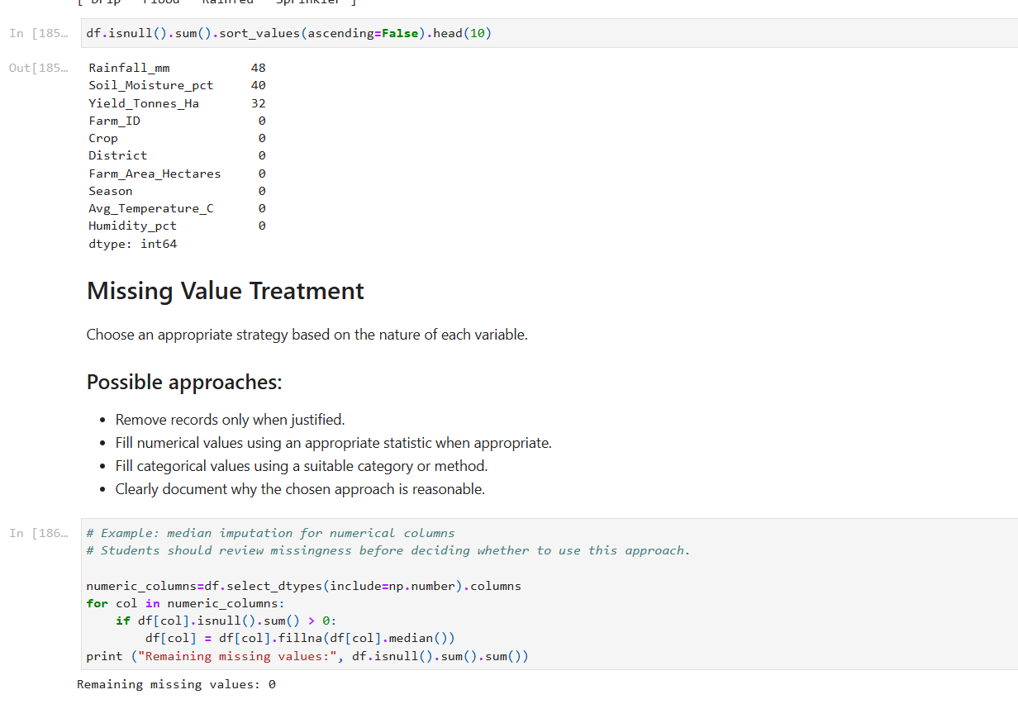
RESULTS

Slide 16
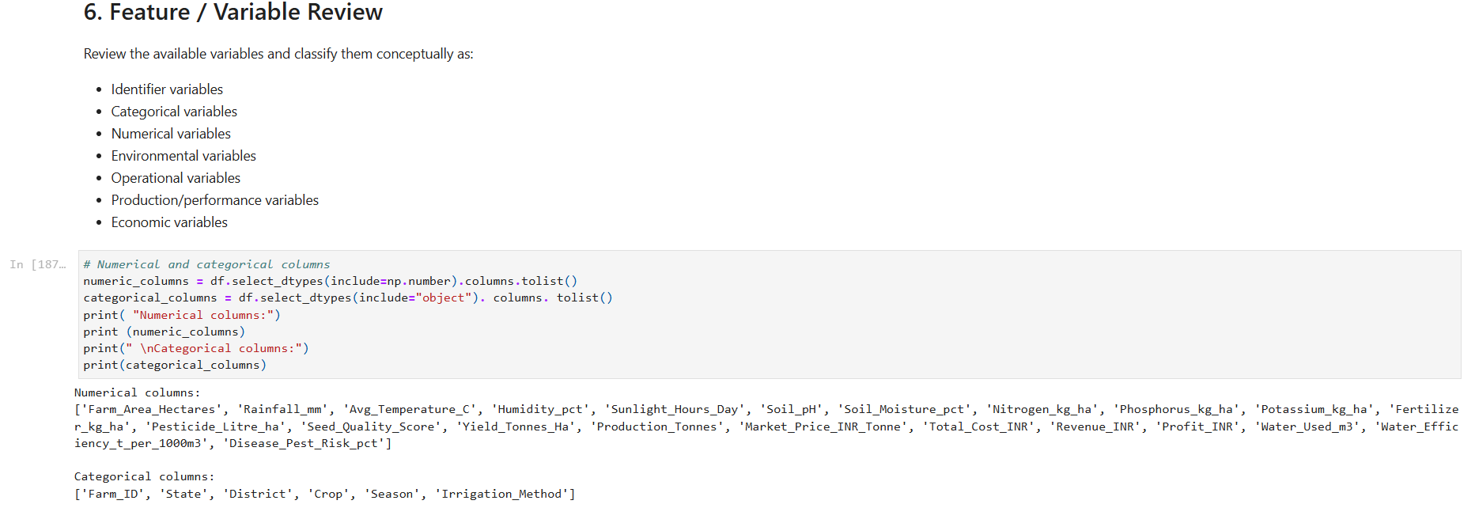
RESULTS

Slide 17
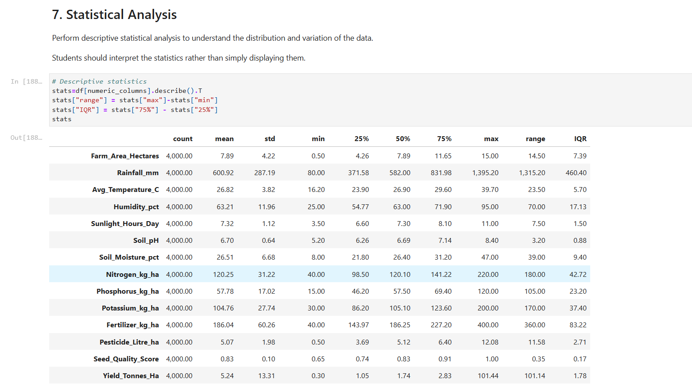
RESULTS

Slide 18
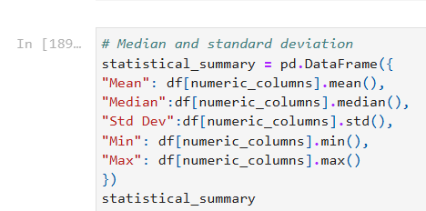
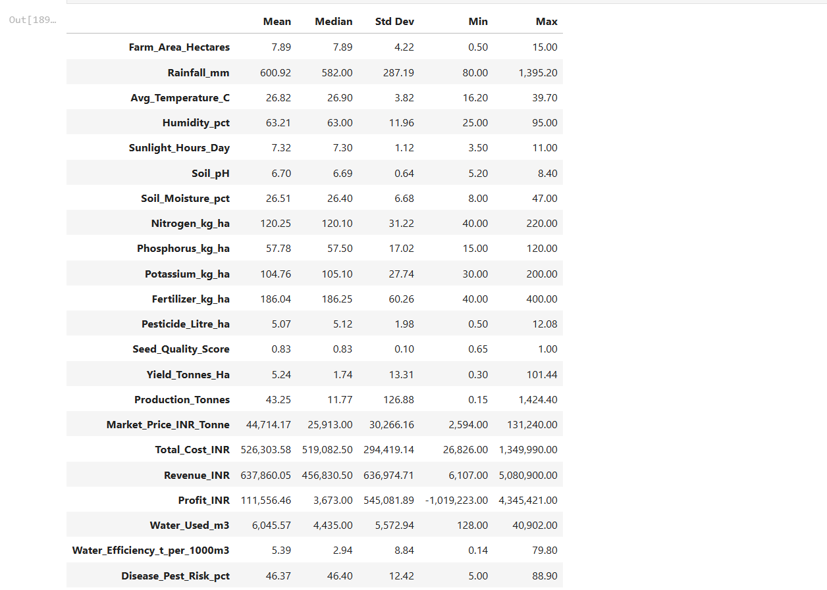
RESULTS

Slide 19
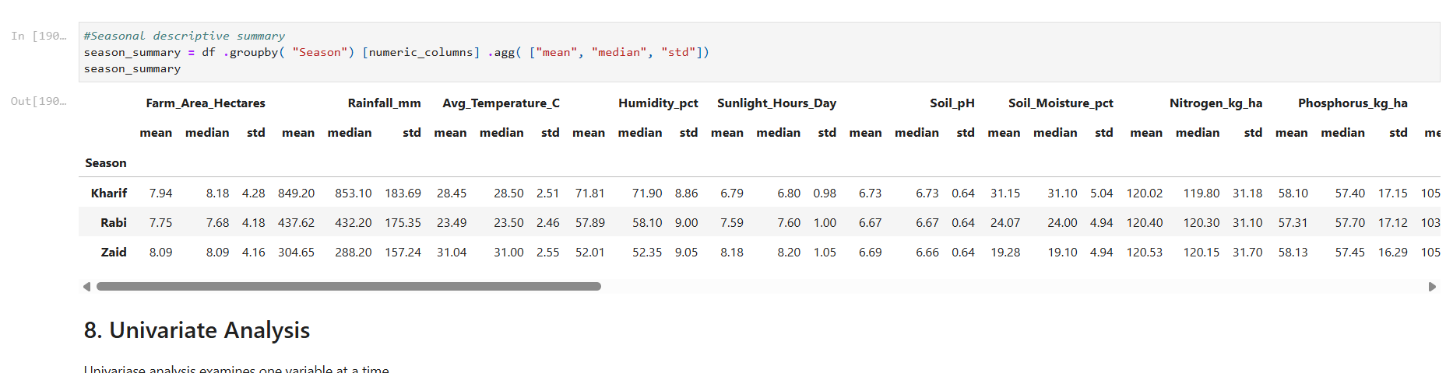
RESULTS

Slide 20
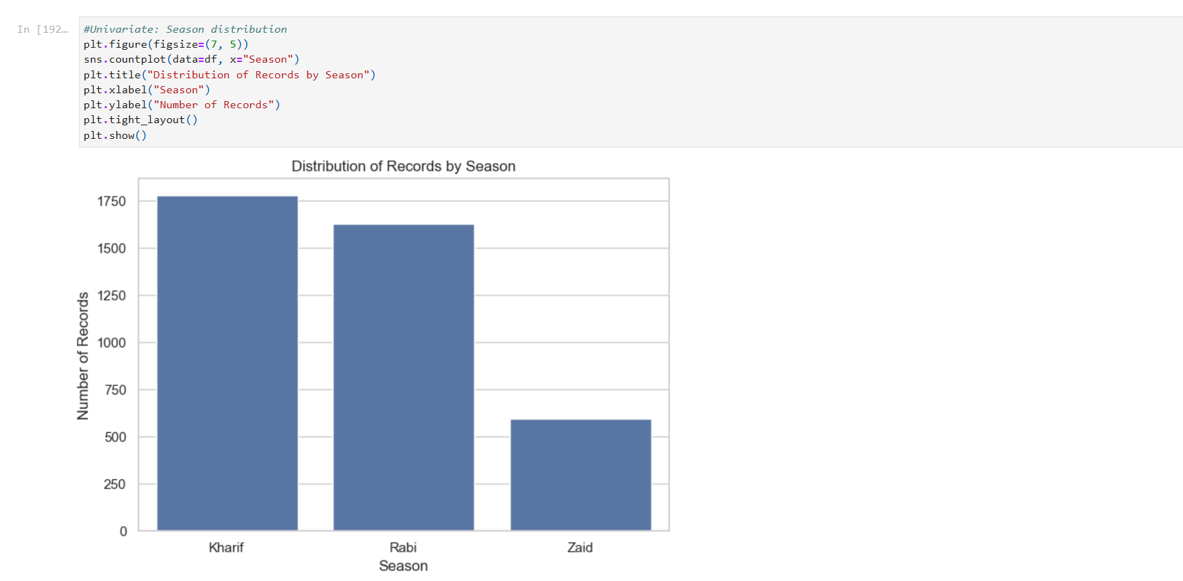
RESULTS

Slide 21
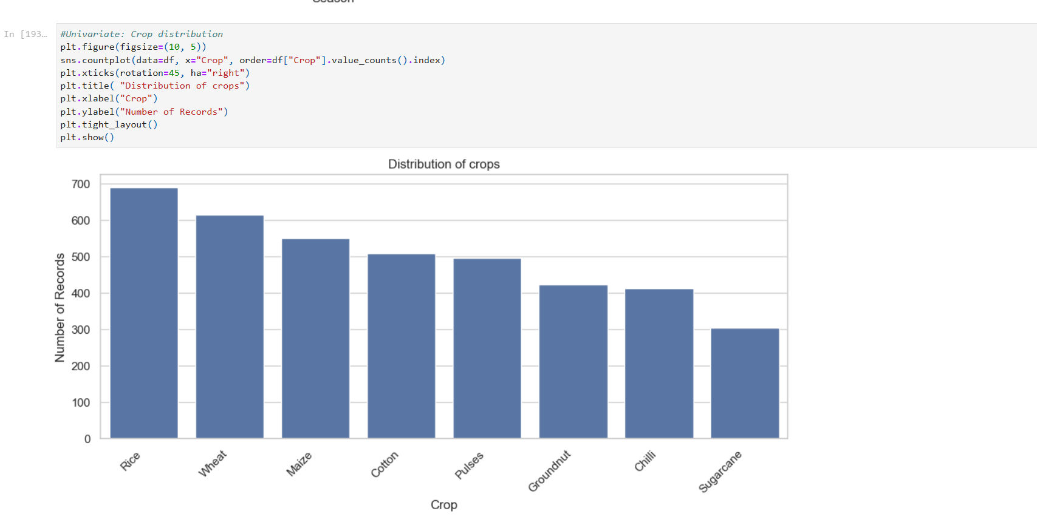
RESULTS

Slide 22
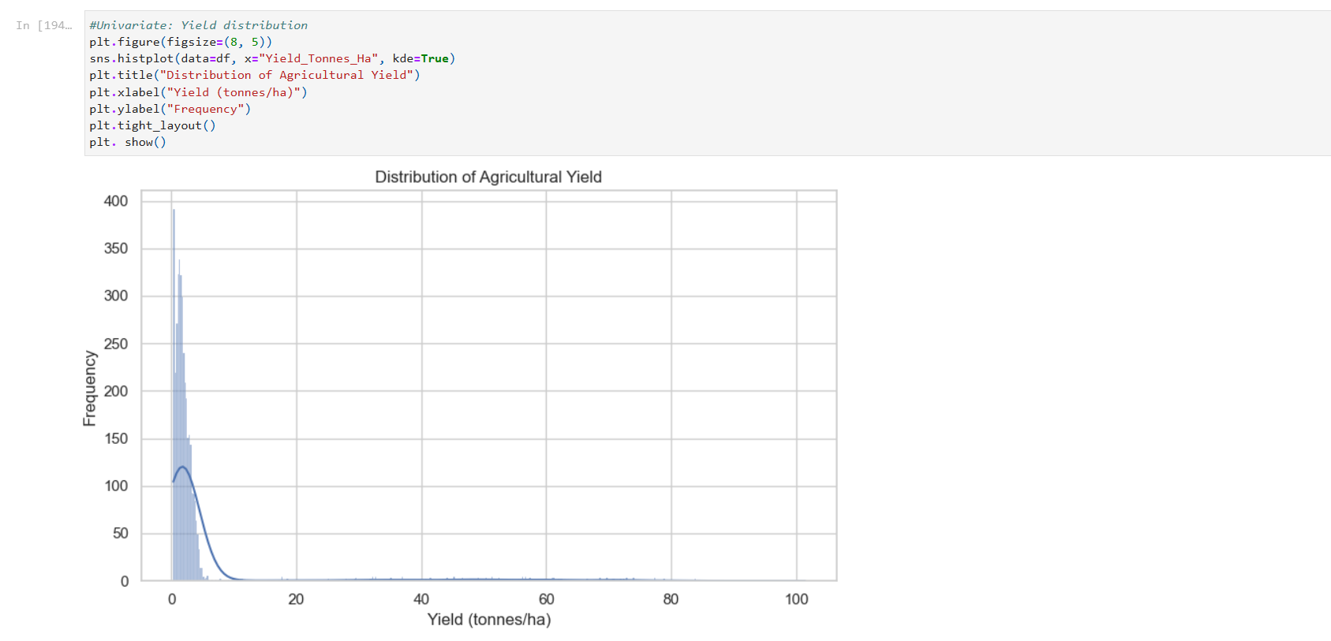
RESULTS

Slide 23
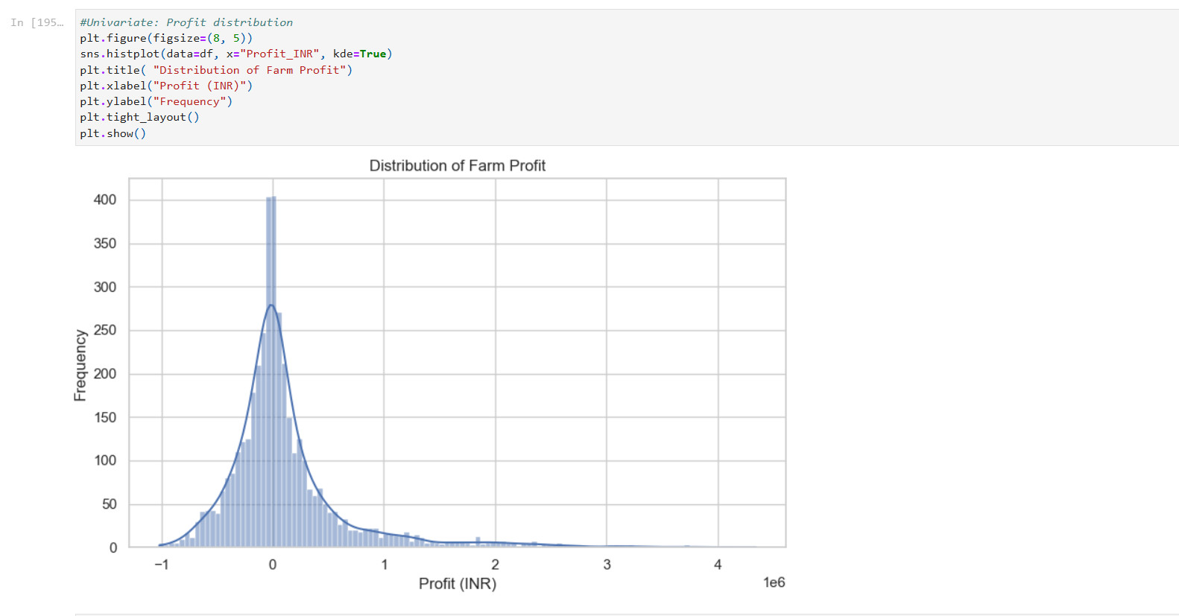
RESULTS

Slide 24
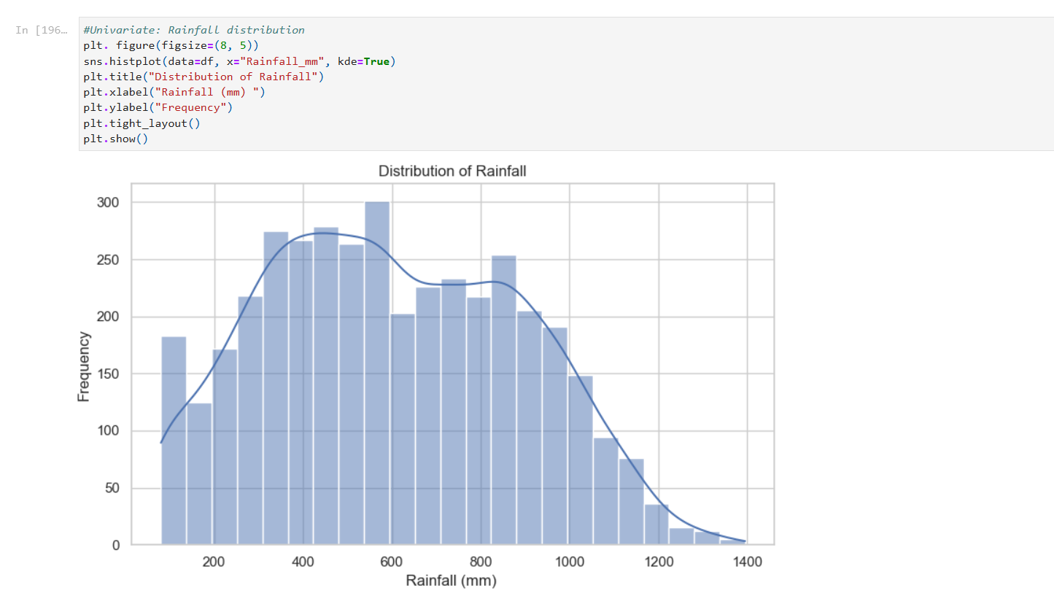
RESULTS

Slide 25
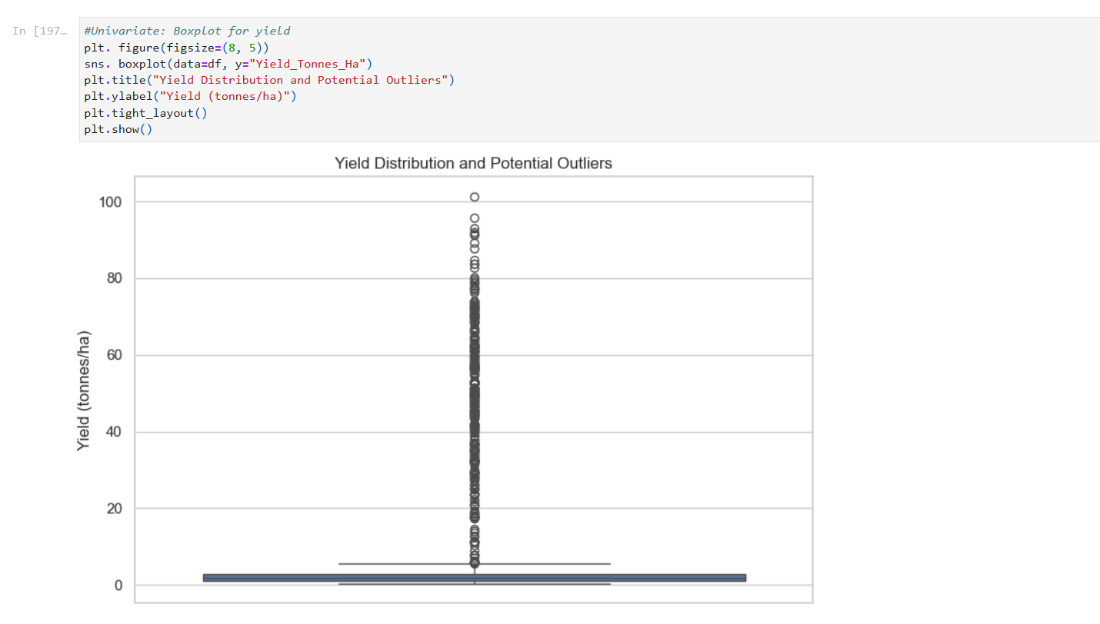
RESULTS

Slide 26
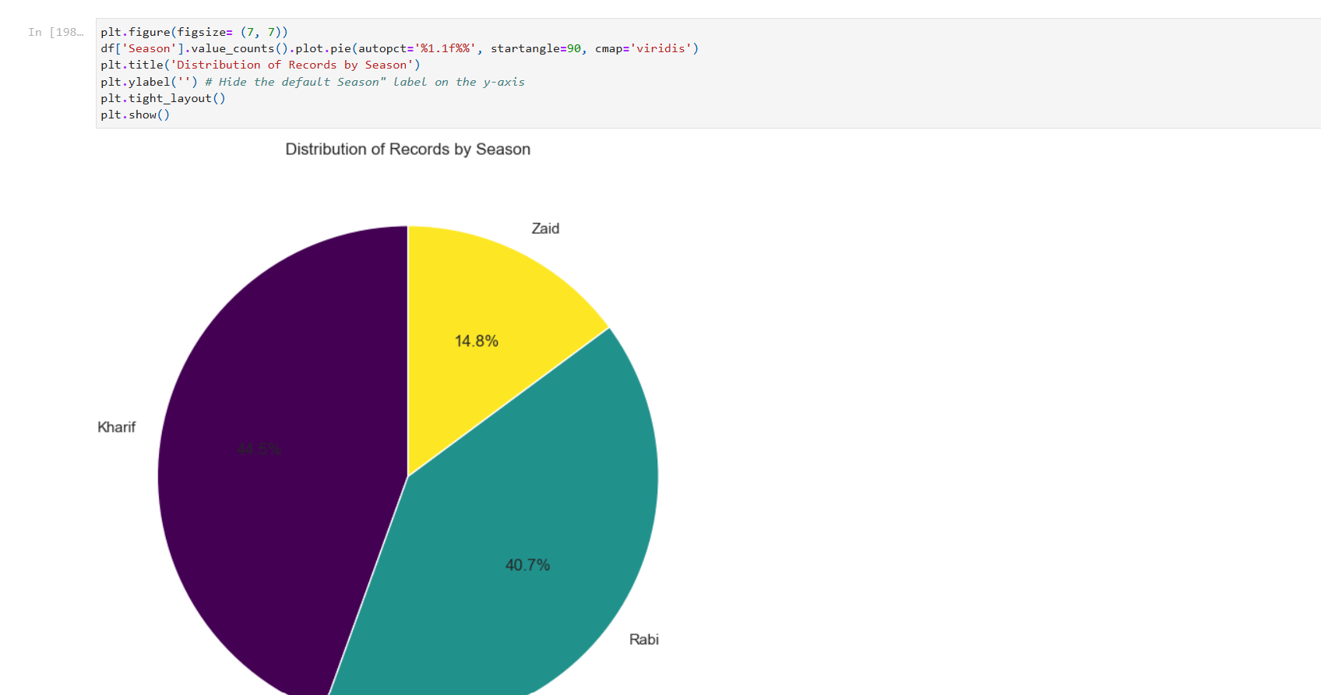
RESULTS

Slide 27
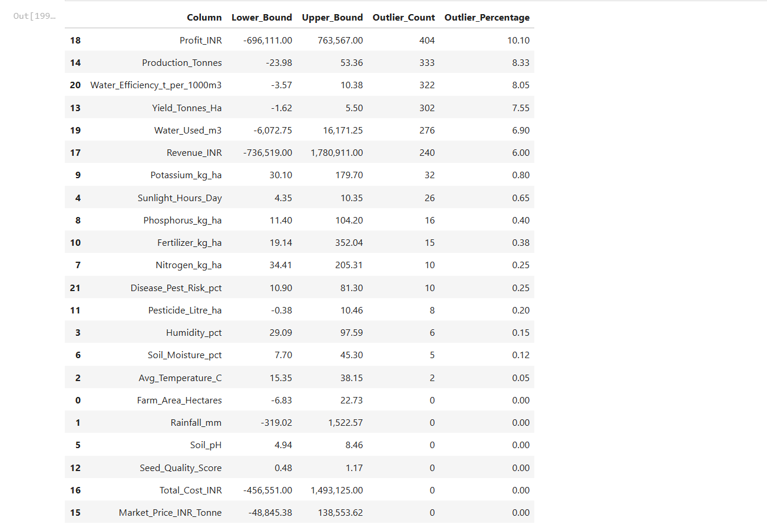
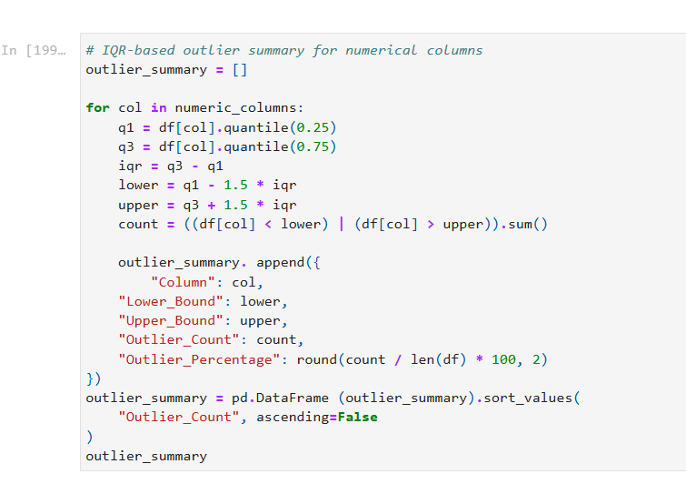
RESULTS

Slide 28
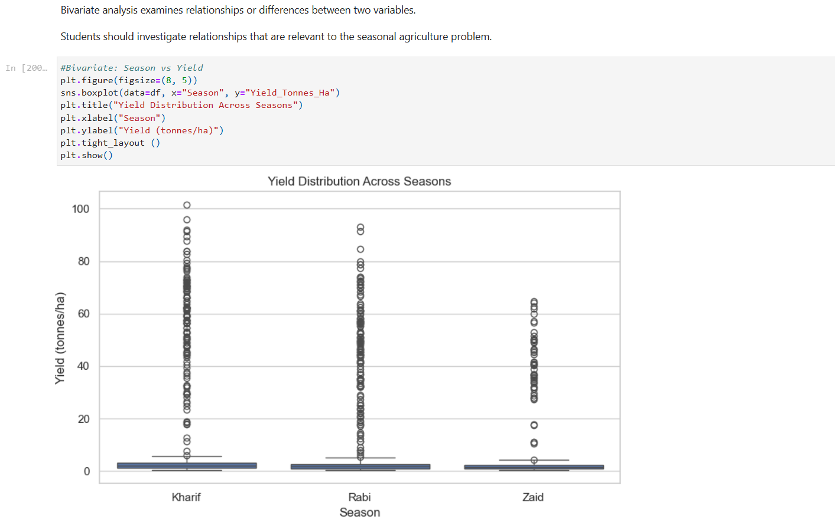
RESULTS

Slide 29
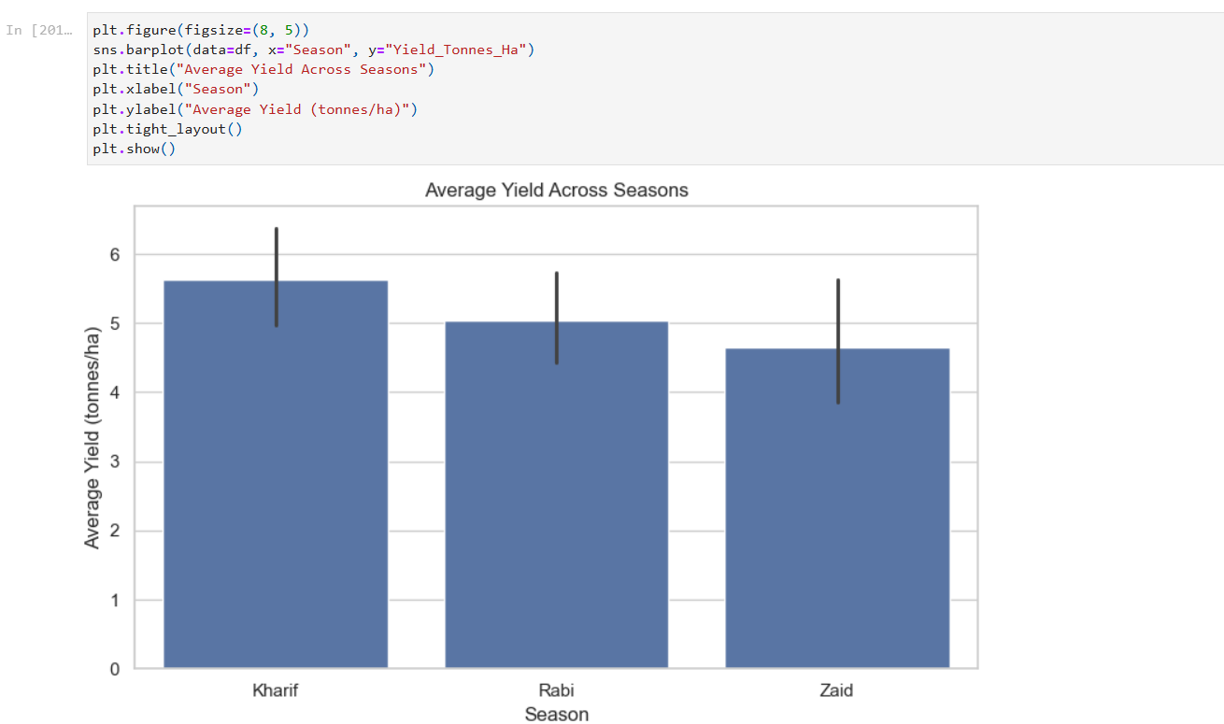
RESULTS

Slide 30
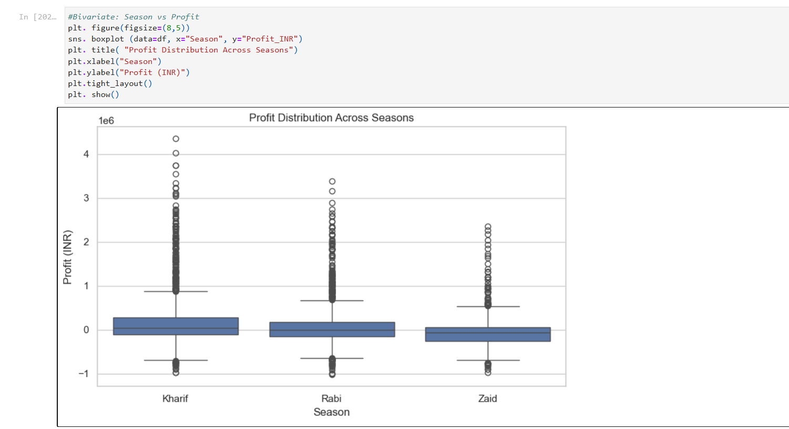
RESULTS

Slide 31
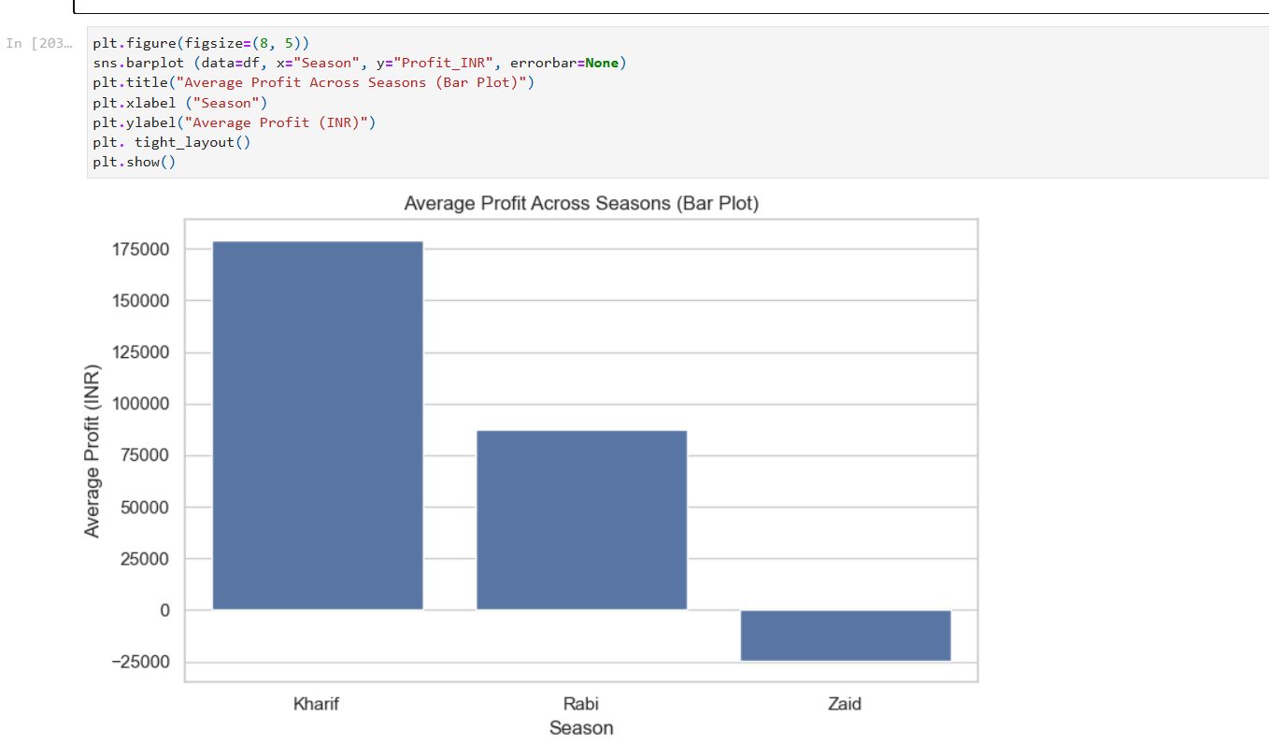
RESULTS

Slide 32
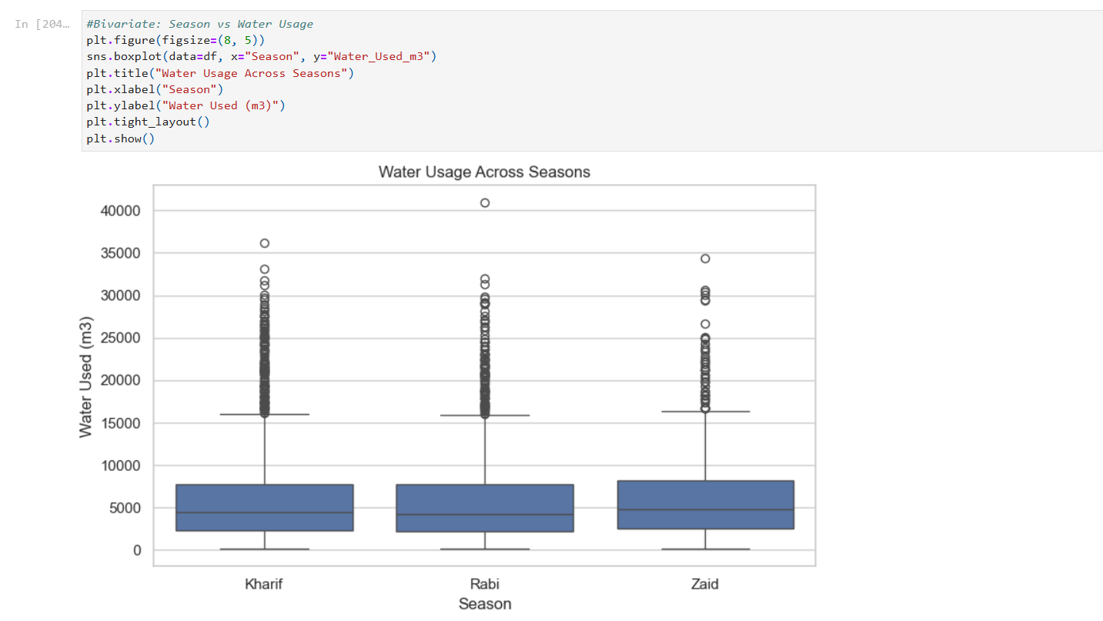
RESULTS

Slide 33
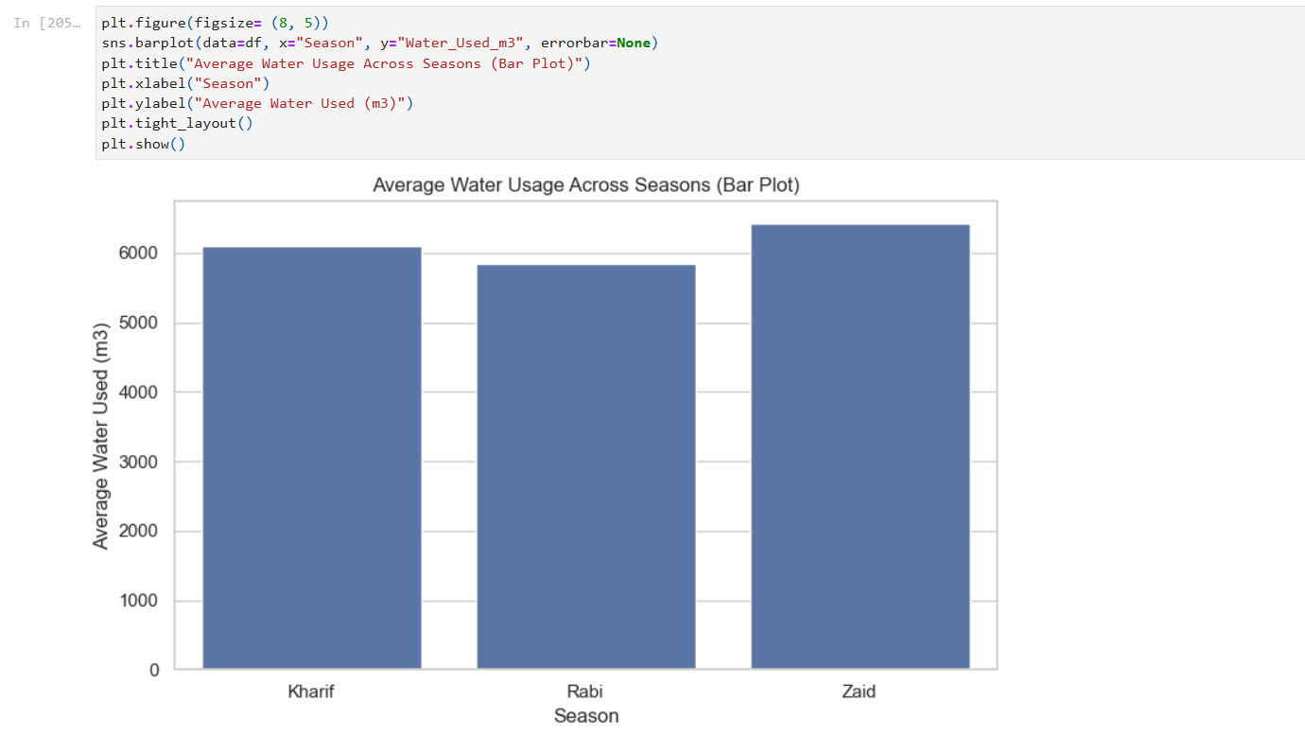
RESULTS

Slide 34
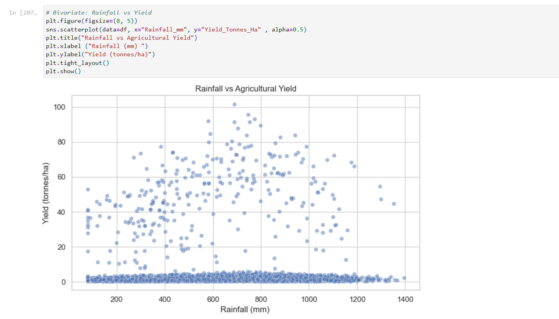
RESULTS

Slide 35
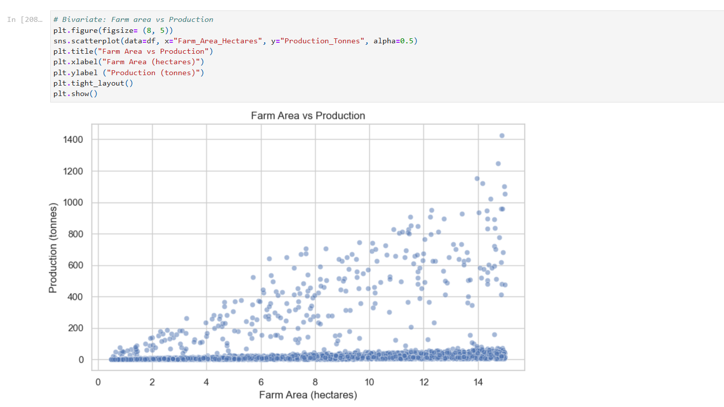
RESULTS

Slide 36
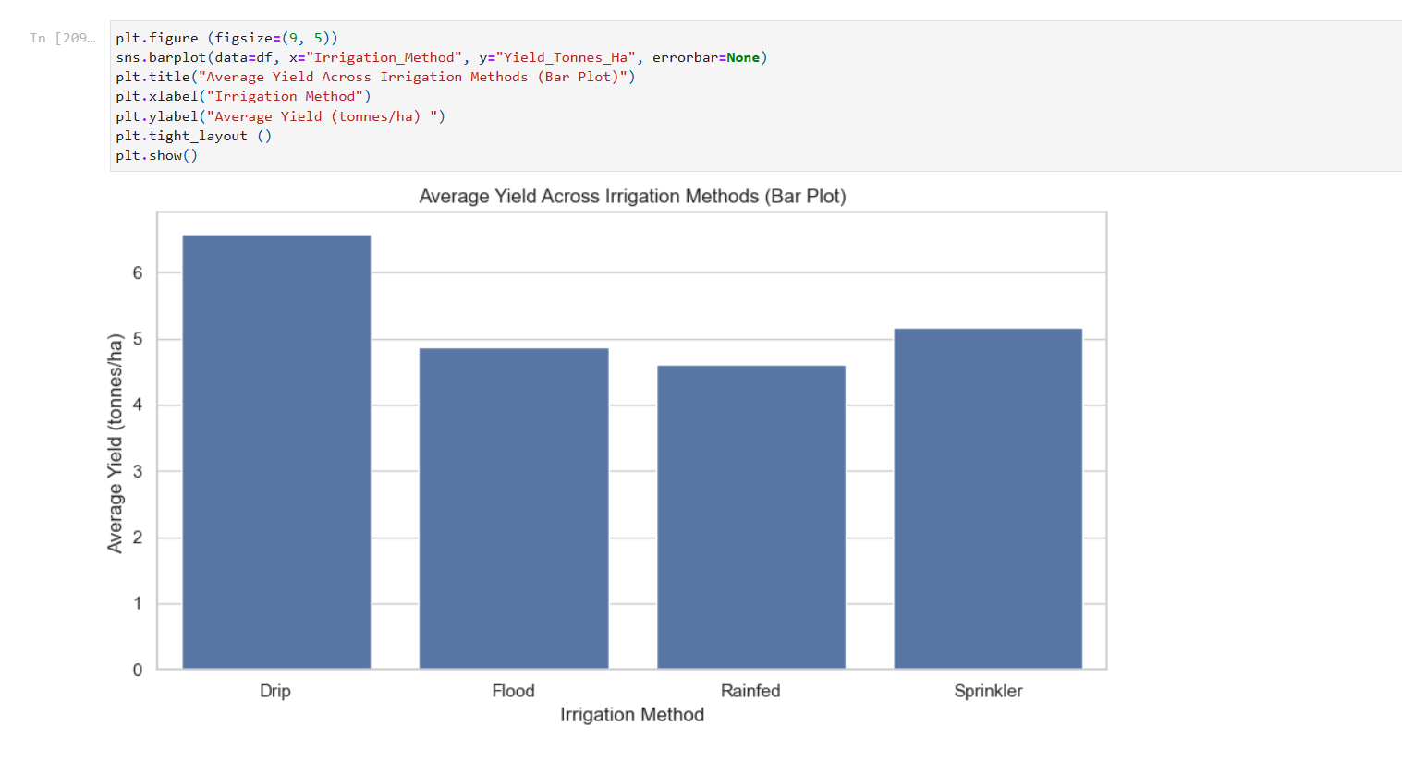
RESULTS

Slide 37
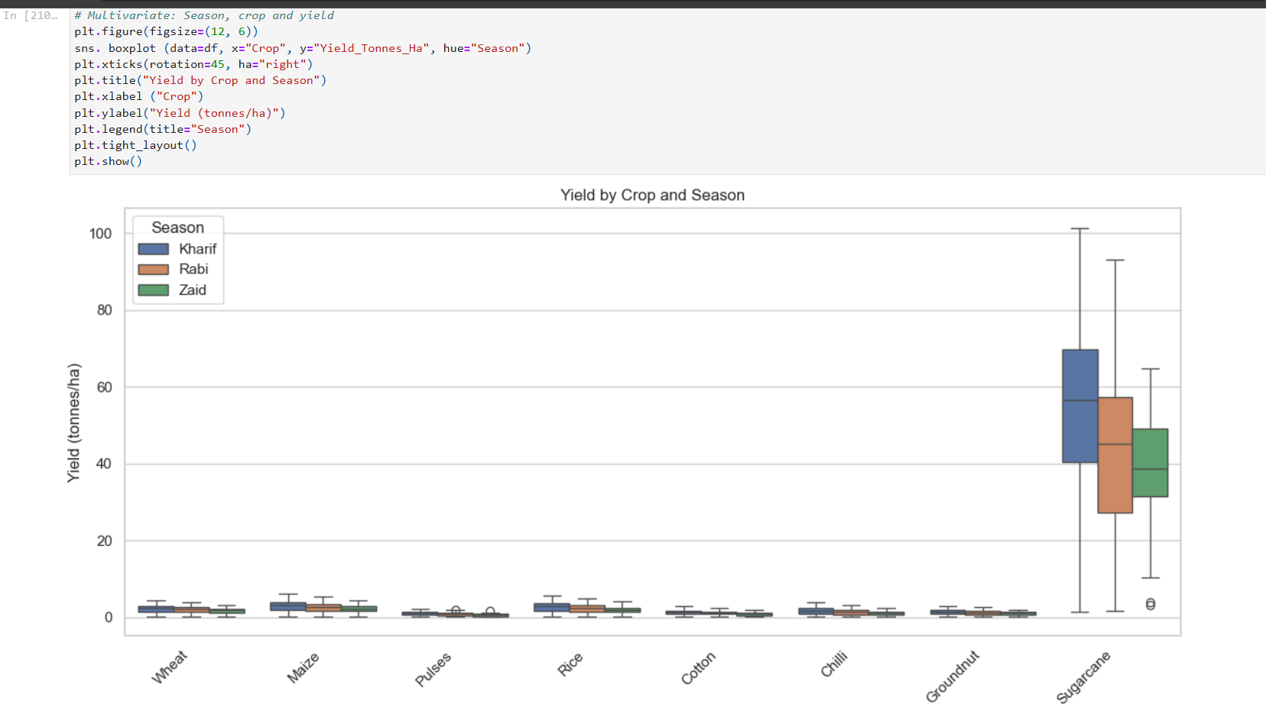
RESULTS

Slide 38
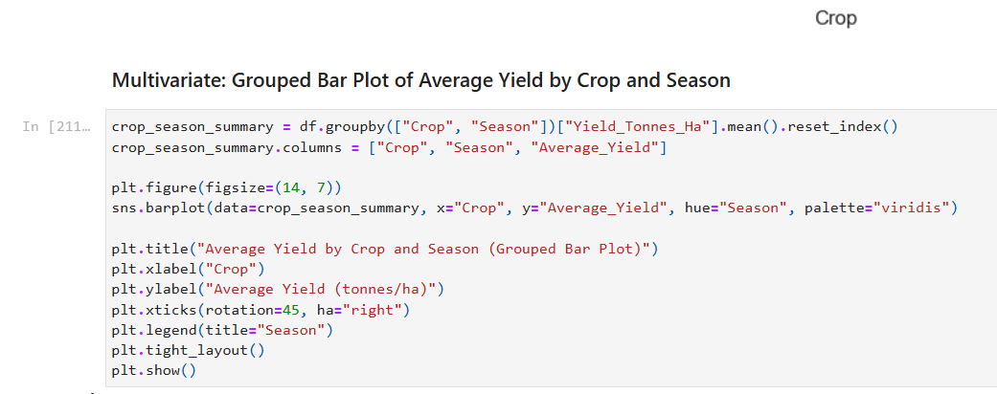
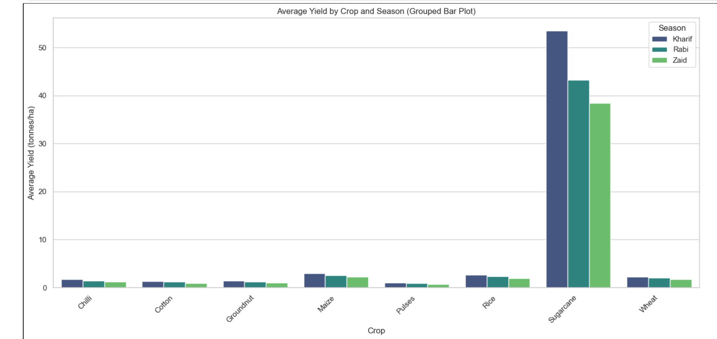
RESULTS

Slide 39
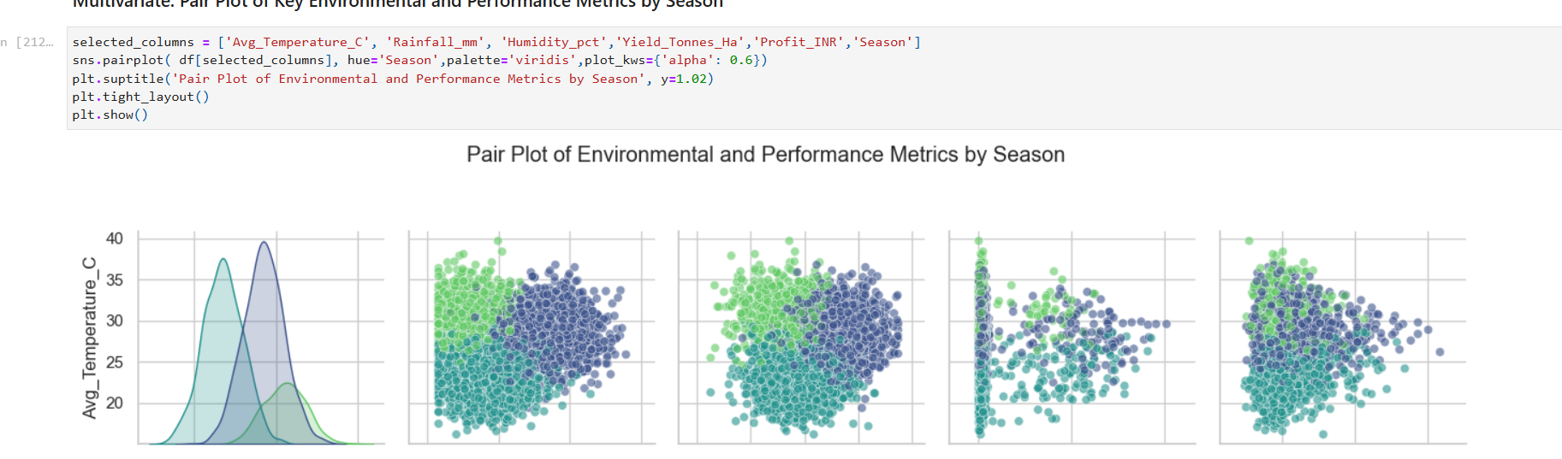
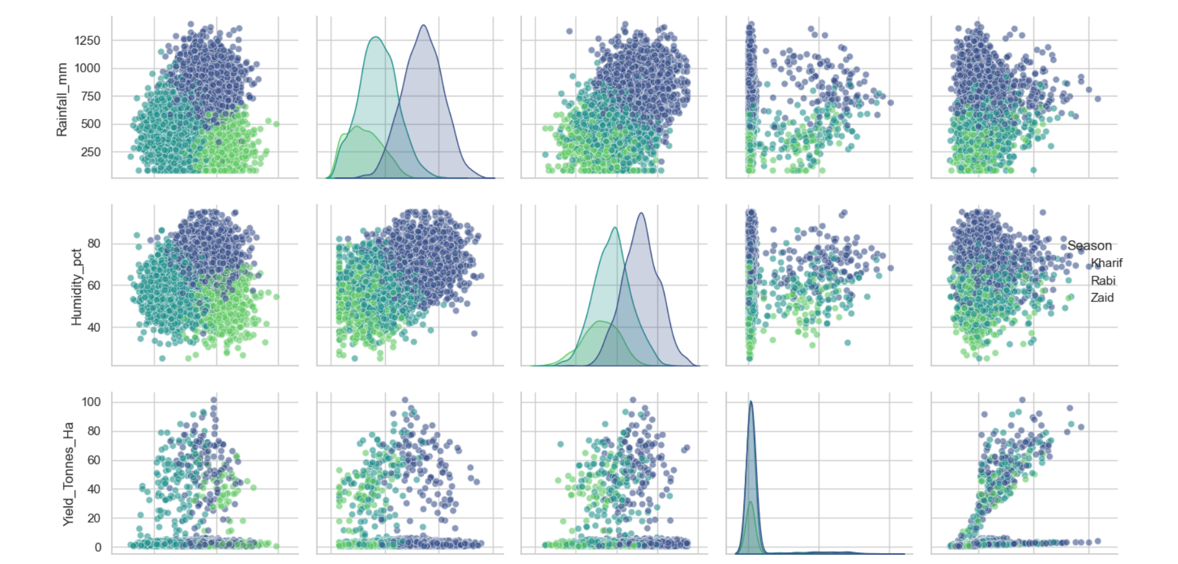
RESULTS

Slide 40
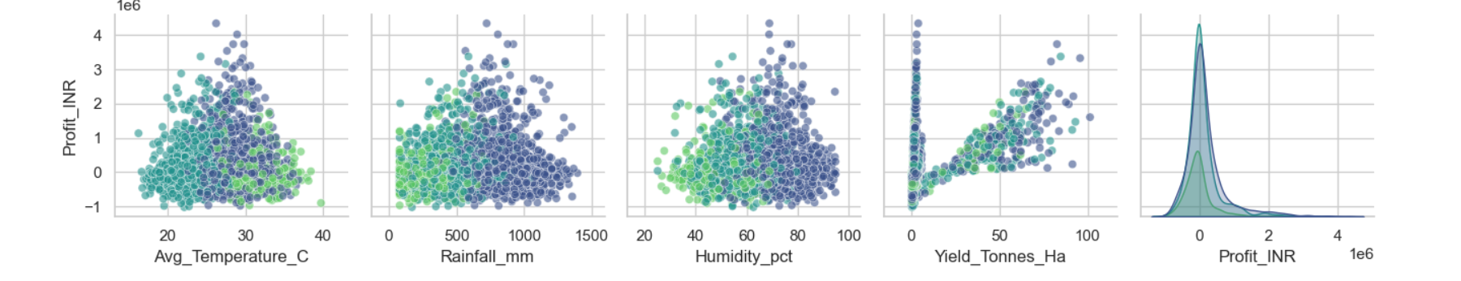
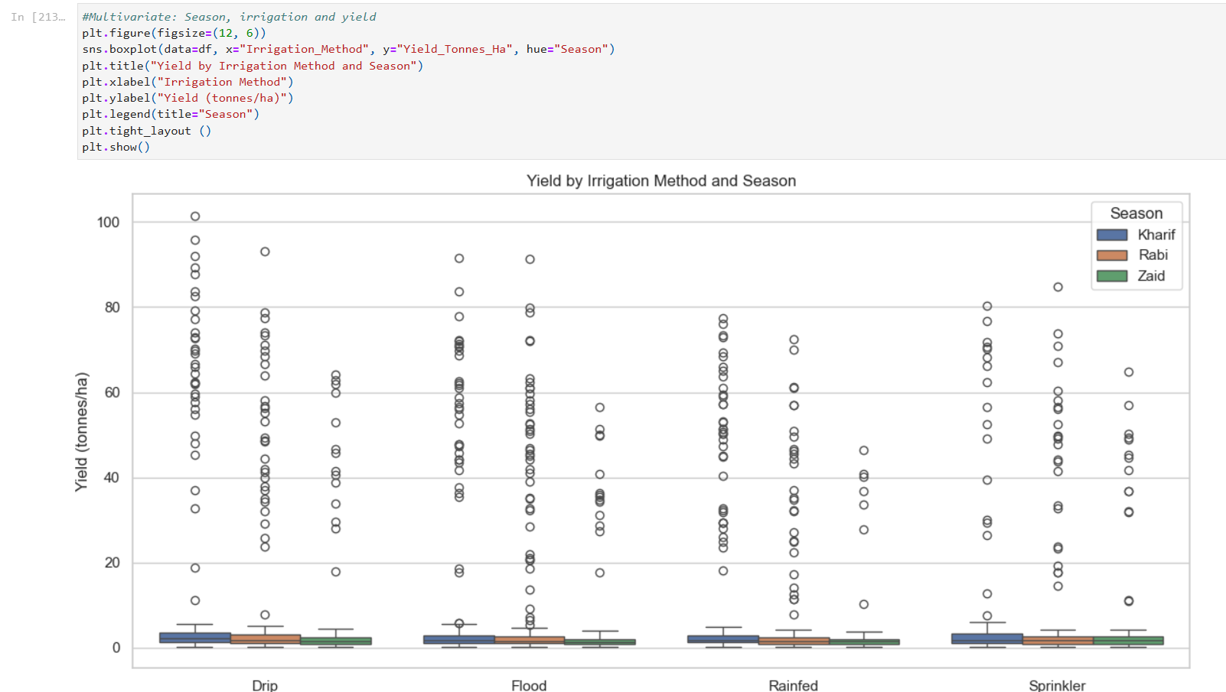
RESULTS

Slide 41
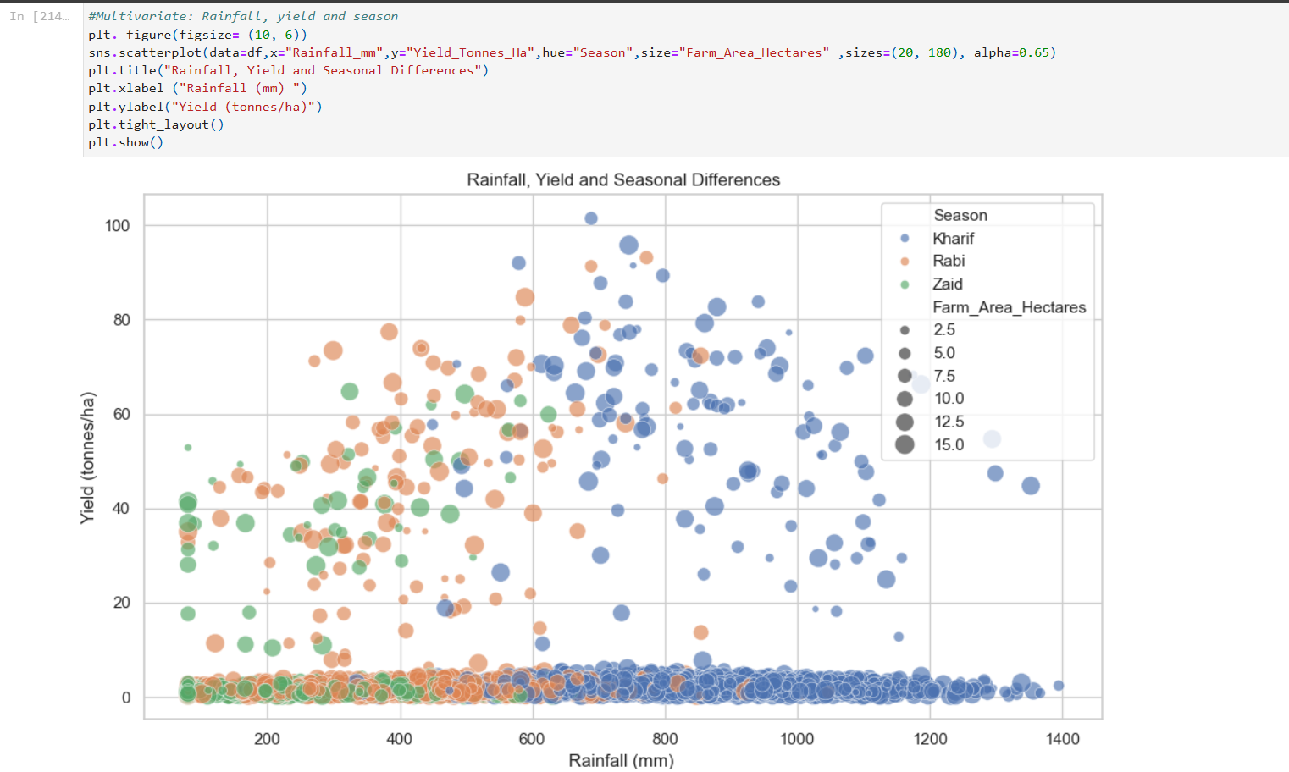
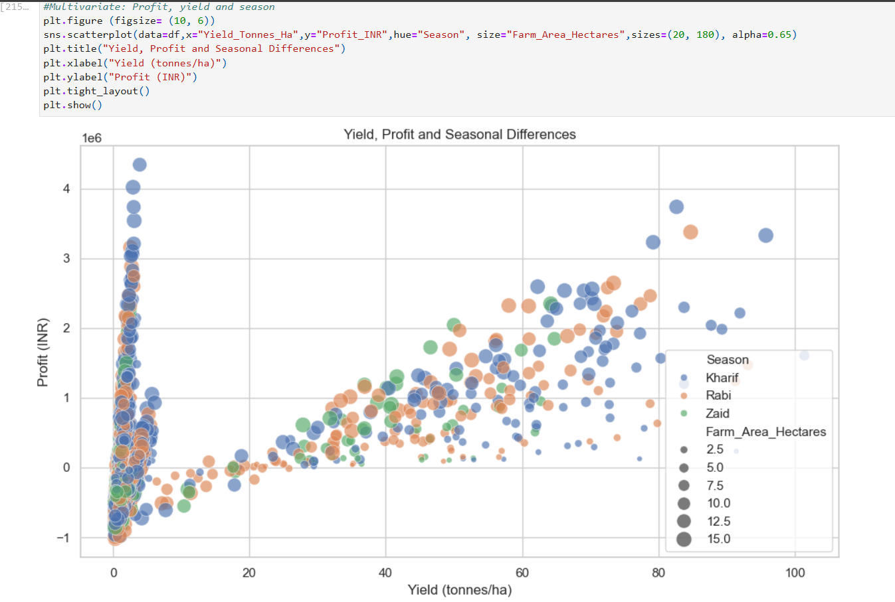
RESULTS

Slide 42
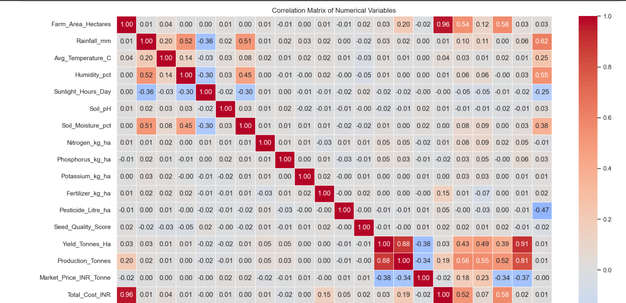
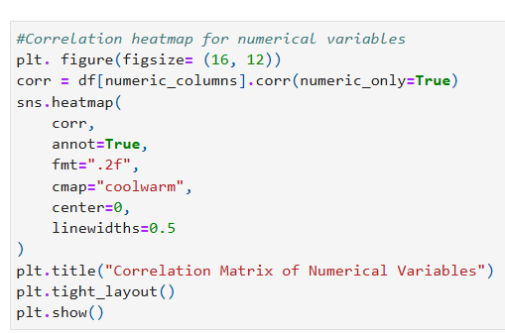
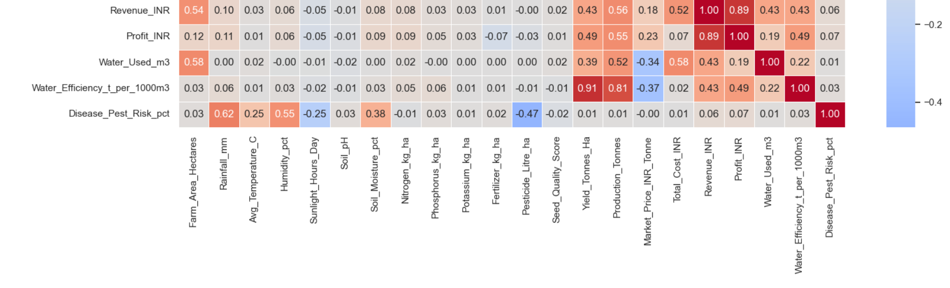
RESULTS

Slide 43
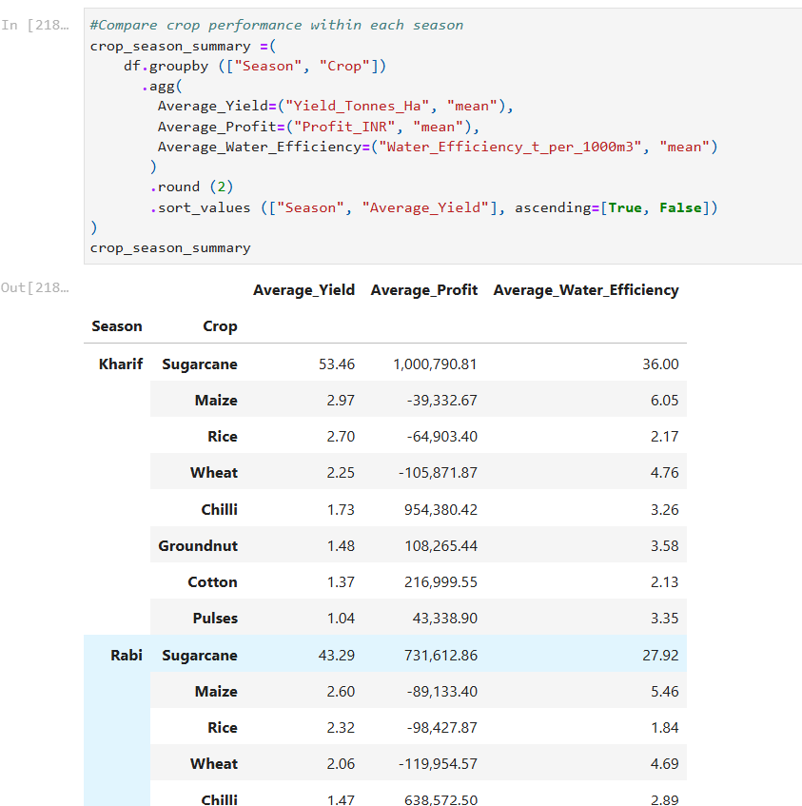
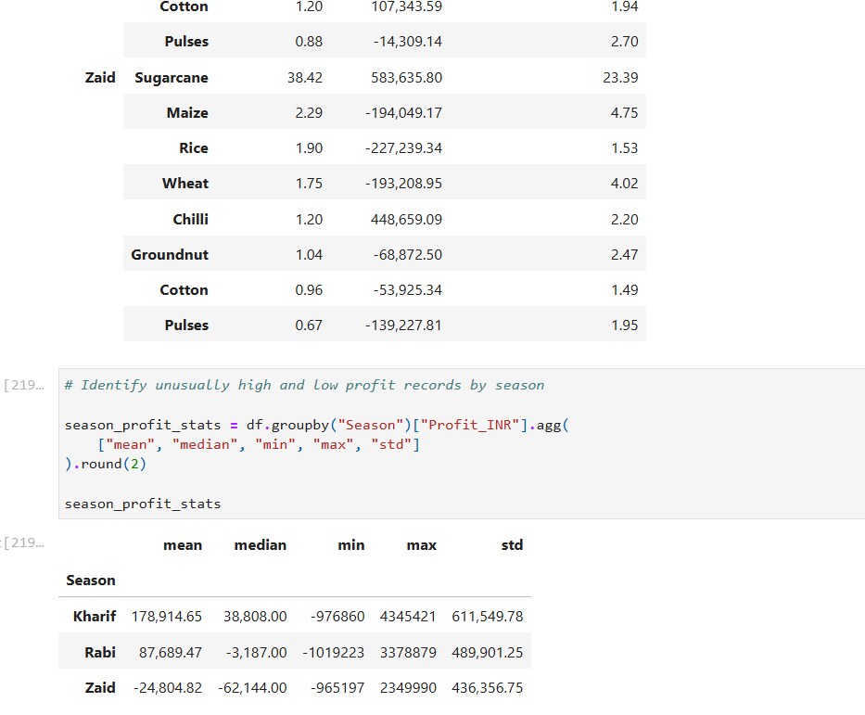
RESULTS

Slide 44
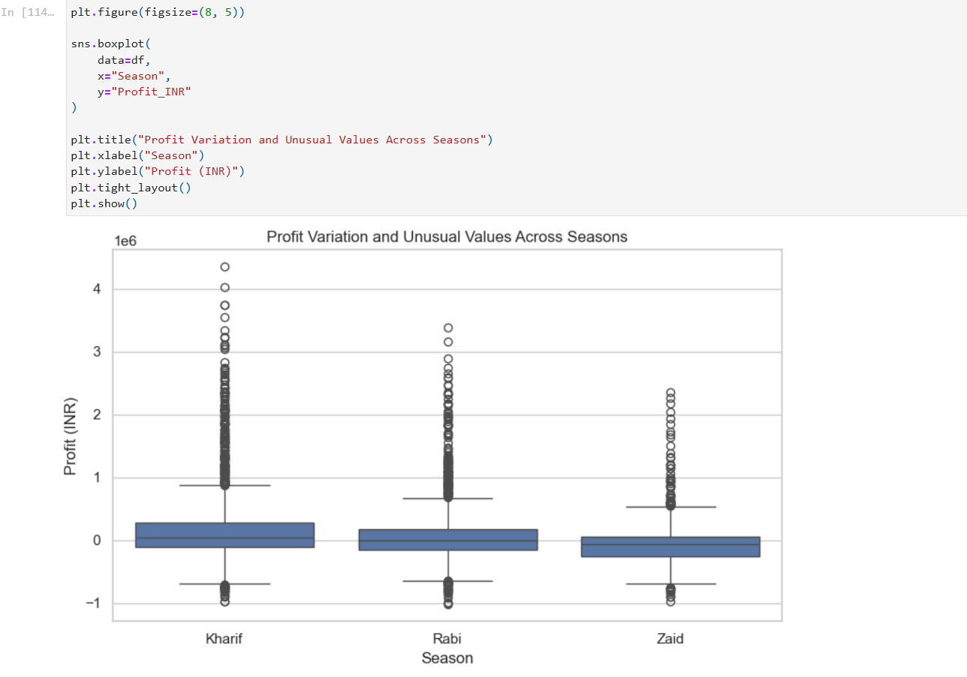
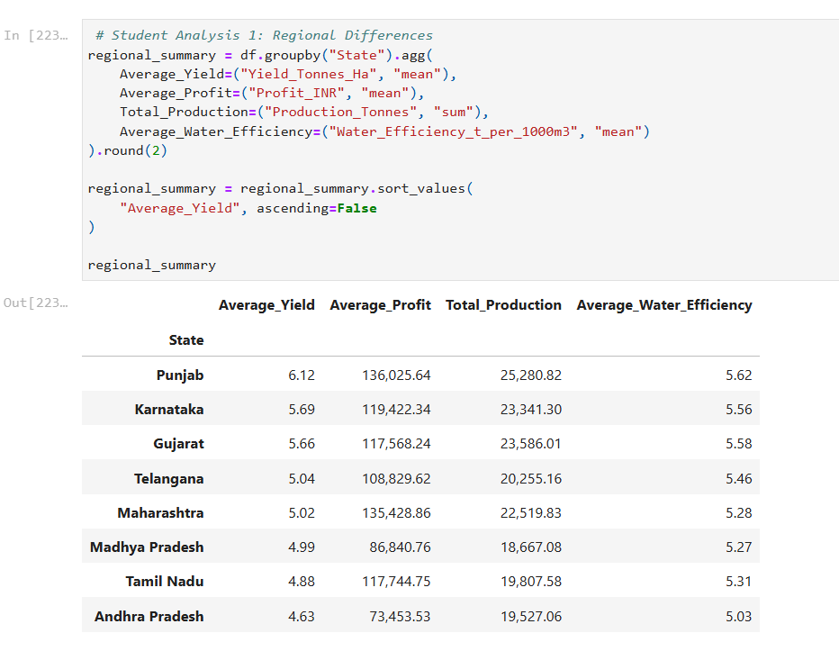
RESULTS

Slide 45
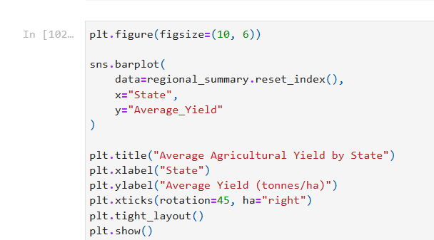

RESULTS

Slide 46


RESULTS

Slide 47

RESULTS

Slide 48


RESULTS

Slide 49
Future scope
Develop a predictive model to forecast crop yield and profit.
Add real-time weather and soil data for better analysis.
Use Machine Learning to predict disease and pest risks.
Develop a web or mobile application for farmers.
Provide crop recommendations based on soil, weather, and seasonal conditions.

Slide 50
GitHub Link
https://github.com/shraddha5060/Seasonal-Agriculture-Performance-Analysis

Slide 51

VOIS Course completion certificate - Course name- Data Visualization

Slide 52
Thank you
.
.

