Slide 1
AUTOMATED JOB SKILL EXTRACTION & RECRUITMENT ANALYTICS PIPELINE
An End-to-End NLP and Supervised Machine Learning Pipeline for Unstructured Data
Prepared by: SHRADDHA SANTOSH SANTIUR | M.SC STATISTICS
Internship Organization: TECHNOSIGNIA
Notes:
Welcome, examiners and mentors. Today, I am presenting my internship final project on 'Automated Job Skill Extraction and Recruitment Analytics Pipeline' completed at Technosignia. This project applies statistical NLP and machine learning techniques to convert unstructured job descriptions into structured analytics. As an M.Sc Statistics student, my focus has been on designing a highly consistent, comparative pipeline, and evaluating the methods systematically.

Slide 2
Unstructured Job Descriptions Create Manual Bottlenecks and Prevent Automated ATS Processing
THE PROBLEM
• Free-Form Language: Job descriptions (JDs) are published by employers in highly unstructured, free-form natural language, written without rigid schemas.
• Information Noise: Critical requirements like tools, software, and soft skills are deeply embedded inside verbose text, mixed with corporate values and contact details.
• Recruitment Friction: The lack of standardized tags forces HR teams to manually read and tag thousands of job postings to verify candidate alignment, introducing massive delay.
THE ANALYTICAL VOID
• Inconsistent Matching: Manual filtering creates standard-mismatch; a resume containing 'PostgreSQL' may be missed if the recruiter only searches for the tag 'SQL'.
• System Disconnect: Applicant Tracking Systems (ATS) and job portal recommendations cannot directly read unstructured JDs to match qualified applicants dynamically.
• Market Blindness: Organizations cannot aggregate live postings to analyze macroeconomic technology trends or immediately recognize localized skill-demand spikes.
Notes:
As established in Section 1.1, JDs are written in unstructured natural language, making it extremely difficult for traditional software systems to directly digest them. The core friction is twofold: the manual labor of reading/tagging postings, and the high margin of human error or inconsistency when matching resumes. An automated extraction solution solves this by generating structured schemas.

Slide 3
Python stack powers implementation from cleaning to dashboard
Comprehensive Technology Stack Mapping
Technical Implementation Choices
▪ Core Processing: Python serves as the main language. Pandas and NumPy handle data preparation and evaluation matrices.
▪ NLP & ML Frameworks: Scikit-learn powers term categorization (Logistic Regression) and LSA embeddings. spaCy and Transformers handle Named Entity Recognition.
▪ Deployment: Streamlit is used for the user interface, ensuring easy integration without separate API overhead.
Technology / Tool | Status | Role in Project
Python | Implemented | Core language for data processing, NLP, and model training.
Pandas & NumPy | Implemented | Dataset manipulation, cleaning, and performance evaluation.
Scikit-learn | Implemented | TF-IDF vectorizer, LSA SVD, and Logistic Regression model.
spaCy | Implemented | Rule-based Custom EntityRuler + Statistical NER.
Transformers (Hugging Face) | Implemented | Pretrained dslim/bert-base-NER pipeline benchmarking.
Streamlit | Implemented | Interactive extractor and visual analytics dashboard.
Power BI / Tableau | Implemented | Complementary interactive reports & dashboards.
Notes:
Here is our complete technology stack. As documented, we successfully implemented Python, Pandas, Scikit-learn, spaCy, and Streamlit. We also integrated Power BI and Tableau. Hugging Face Transformers are documented as a benchmarking component to understand the state-of-the-art context model. This structured table clarifies what was implemented versus what was researched and documented.

Slide 4
Uniform 1,000-Row Job Dataset Houses Highly Consistent Description Text
1,000 Total Postings
Fully populated dataset with 0 missing records across all columns.
9 Unique Columns
Mix of identifiers, text descriptions, and demographic filters.
~68 Words Average
Uniform, tightly clustered description lengths simplify parsing.
Notes:
On Day 2, we profiled the core dataset. It houses 1,000 listings with absolutely zero empty rows or duplicate values, eliminating typical imputation burdens. The job_description is the main target, averaging 67.6 words with exceptionally low variance, while job_title serves as a rich secondary semantic signal. Demographic columns like salary, location, and company are preserved for later dashboard filtering.

Slide 5
Multi-Stage NLP Preprocessing Simplifies Text Complexity for Downstream Models
Step 01
Text Normalization
Case Standardization
Standardizes capitalization variations across the corpus. Converts inputs like 'Python', 'python', and 'PYTHON' to a lowercase form for uniform vocabulary lookups.
Step 02
Tokenization
Dividing Sentence Blocks
Splits long, continuous character strings into smaller, manageable token units (words). Converts 'Python data analysis' -> ['Python', 'data', 'analysis'].
Step 03
Stopword Removal
Stripping Filler Words
Excludes common, highly frequent English grammatical particles (e.g., 'the', 'is', 'an', 'and', 'of') to minimize corpus noise and emphasize technical nouns.
Step 04
Lemmatization
Mapping Semantic Bases
Uses spaCy linguistic rules to convert inflected words into their true base dictionary form (e.g., 'running' -> 'run', 'studies' -> 'study', 'better' -> 'good') to merge variations.
Notes:
Day 6 covers NLP preprocessing. To transform noisy unstructured strings into standard tokens, the text undergoes lowercase normalization, tokenization, stopword removal, and lemmatization. We highlighted the difference between Stemming (chopping words to roots like 'working' -> 'work') and Lemmatization (using lexical databases to convert 'studies' -> 'study'). This pipeline primes our text for downstream statistics and ML modeling.

Slide 6
Pipeline progresses from simple heuristics to semantic models
System Architecture & End-to-End Workflow
Stage 1
Stage 2
Stage 3
Stage 4
Stage 5
Data Cleaning
JobDescriptionCleaner
• Remove HTML tags via BeautifulSoup
• Remove URLs, email strings, phone numbers
• Whitespace compression
Taxonomy & Rules
Dictionary / Regex
• Build 110-skill taxonomy
• Categorize & map aliases
• Apply word boundary patterns
Statistical NLP
N-Grams & LSA
• Extract important terms
• Phrase discovery (bigrams/trigrams)
• Corpus LSA dimension reduction
Machine Learning
NER & Classifiers
• Custom spaCy EntityRuler
• Character N-gram TF-IDF Logistic Regression
• BERT Benchmark
UI & Analytics
Streamlit Dashboard
• Interactive extraction
• Visual skill chips
• Historical trends and CSV exports
Key Highlight: The pipeline progresses systematically from basic heuristics (rule-based regular expression patterns) to statistical machine learning (Logistic Regression term categorization) and context-aware transformer evaluation (BERT).
Notes:
This slide represents our system architecture. It starts with Data Cleaning (using BeautifulSoup and Regex to remove HTML, URLs, etc.). Next is the Taxonomy Layer containing 110 canonical skills. We then use statistical methods like TF-IDF and N-grams. Stage 4 introduces machine learning classification and custom spaCy EntityRuler. Finally, the outputs are connected to the interactive Streamlit dashboard enabling users to paste text, see visual chips, and download CSVs.

Slide 7
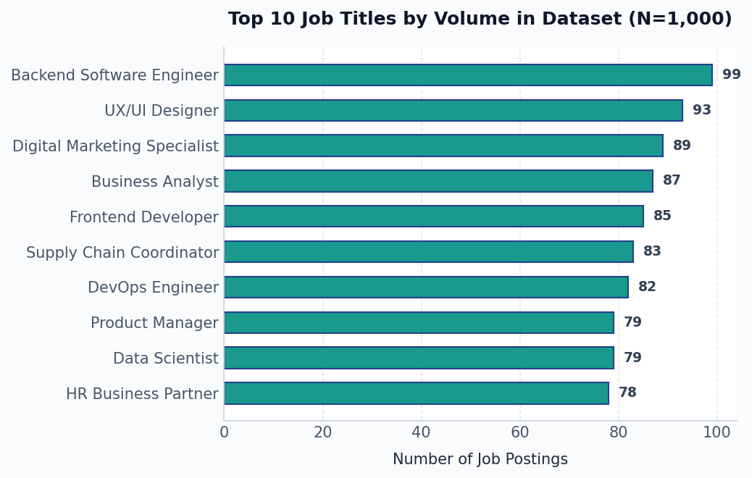
Cleaned dataset contains highly role-concentrated postings
Dataset Collection, Quality Findings & EDA Profile
Dataset Profile & Discoveries
▪ Dual Dataset Versions: Analysis covers an initial 1,000-record dataset for early EDA, and a 910-record corpus post-cleaning (missing descriptions dropped).
▪ High Text Quality: No missing values or duplicate records were present in the initial check. The average description length was 500.7 characters (approx. 67.6 words), representing a highly clustered distribution.
▪ Geographic Diversity: The data spans 22 unique locations across several countries, with Hyderabad, India as the top region (67 postings) and 'Remote' as the #3 category (52 postings).
▪ Job Title Concentration: 12 unique job roles exist in the dataset, which provides robust sample sizes per title for comparative analysis.
Notes:
For the EDA, the dataset has an initial 1,000 records. After dropping missing rows on Day 9, we have a 910-description corpus. The horizontal bar chart on the right displays the top 10 job titles. Backend Software Engineer is the most common with 99 postings, followed closely by UX/UI Designer with 93, and Digital Marketing with 89. This high concentration is ideal because it gives our statistics-based NLP methods enough text patterns per job title.

Slide 8
Boundary-aware regex and alias mapping prevent matching errors
Day 8 Regex + Normalization vs. Day 7 Exact Matching
Taxonomy & Regex Mechanics
▪ 110-Skill Taxonomy: Constructed with canonical names, category fields, and aliases (e.g. mapping py, python3, and python 3 -> Python).
▪ Overlapping Phrase Preference: The algorithm scans longer names first (e.g. preferring C++ over C, and Linear Regression over Regression) to avoid partial matches.
▪ Word Boundary Isolation: Regular expression checks (using `\b` patterns) ensure Python doesn't trigger false positives and prevents single-letter skills like 'R' from matching inside standard words.
The Impact of Normalization Rules
Canonical Skill | Exact Match (Day 7) | Regex + Normalization (Day 8)
SQL | 193 postings | 255 postings (+32%)
Power BI | 155 postings | 155 postings (no delta)
Day 5 Initial Matching Run Summary
3.26
Average matched skills per job posting
(with 148 postings reporting 0 matched skills)
Notes:
Let's look at Slide 6. We built a structured taxonomy with 110 skills grouped into categories. A key finding was the difference between Exact Matching and Regex + Normalization. SQL exact match captured 193 postings, but by including boundary-aware regex to find aliases (like sql, sql server, structured query language), we captured 255 postings, a 32% increase! Power BI remained at 155, showing there was no abbreviation variation there. The average was 3.26 skills per posting.

Slide 9
Corpus TF-IDF and LSA embeddings discover implicit skills
Statistical Term Weighting, Phrase N-Grams, and Semantic Embeddings
TF-IDF Vectorization
Identifying Key Terms Stochastically
• Applied TfidfVectorizer on the 910-description corpus.
• Configured with 1,000-feature vocabulary and English stopword filtering.
• Helps extract terms based on document frequency weights.
• High-frequency general terms are filtered out to highlight specialized skills.
N-Gram Phrase Discovery
Capturing Multi-Word Skill Meanings
• Unigrams fail on complex terms; N-gram analysis bridges this gap.
• 'Machine learning' was identified as the top bigram (1,306 occurrences).
• Captures phrases like 'natural language processing' or 'data analysis'.
• Helps isolate and filter recurring boilerplate or EEO legal phrases.
LSA Semantic Embeddings
Local Embeddings without Heavy Pre-trained Models
• Transposed the TF-IDF matrix and reduced it using TruncatedSVD to 100 dimensions.
• Obtains phrase vectors by averaging word vectors.
• Utilizes cosine similarity to match and discover candidate synonyms or aliases.
• Bypasses external pre-trained memory constraints.
Notes:
Slide 7 covers statistical and semantic techniques. We moved beyond simple dictionary matching. We used TF-IDF on 910 descriptions, which weights skills stochastically. We ran N-gram phrase discovery; Unigrams are too simple, but Bigrams like 'machine learning' (1,306 occurrences) capture multi-word skills. Lastly, we built Latent Semantic Analysis (LSA) by transposing the TF-IDF matrix and applying TruncatedSVD to 100 dimensions, enabling us to run cosine similarity to find synonyms without using a massive pre-trained model.

Slide 10
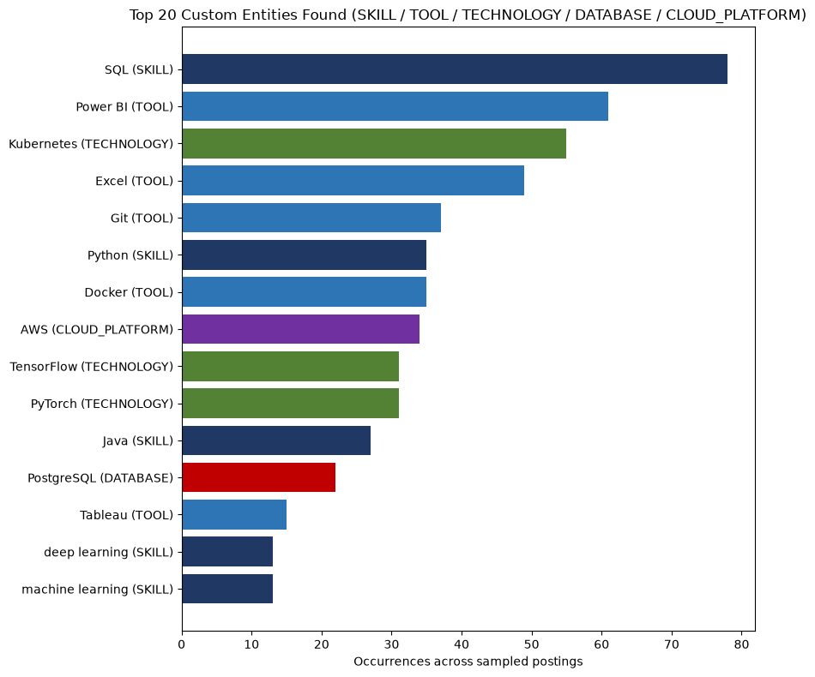
Custom EntityRuler overrides standard spaCy NER limitations
Bridging Statistical NER Limitations with Custom Domain Rules
Custom spaCy NER Implementation
▪ Standard spaCy NER Failure: General-purpose models are trained on news text, often misclassifying technical entities (e.g., tagging PostgreSQL as GPE/Location, and Docker as PERSON/ORG).
▪ Custom EntityRuler Integration: Designed 24 custom rules and integrated them before spaCy's statistical NER pipeline to label known entities consistently.
▪ Five Domain Labels: Defined SKILL (Python, ML), TOOL (Power BI, Excel), TECHNOLOGY (PyTorch, Spark), DATABASE (PostgreSQL, MongoDB), and CLOUD_PLATFORM (AWS, Azure).
▪ Batch Processing: Applied the pipeline over 300 real job postings using `nlp.pipe()` for high performance.
Notes:
Moving to Named Entity Recognition on Slide 8. Standard spaCy NER fails on technical words, misclassifying PostgreSQL as a location or Docker as a person. To solve this, we introduced a custom spaCy EntityRuler with 24 rules running before the statistical NER model. We defined 5 specific labels. When we processed 300 job postings, we extracted 1,112 SKILL entities, 195 TOOL, 193 TECHNOLOGY, 153 CLOUD_PLATFORM, and 31 DATABASE entities, as visualized in the vertical bar chart.

Slide 11
Character n-grams and Logistic Regression classify unseen terms
Supervised Term-Categorization Classifier Design
Classifier Architecture & Features
▪ Supervised Classification Task: Predicts specific classes for term entities: SKILL, CLOUD, DATABASE, BI_TOOL, DEVOPS_TOOL, BIG_DATA_TOOL, and ML_FRAMEWORK.
▪ Not-a-Skill Filter: Includes a NOT_SKILL class (e.g. experience, years, degree) so that generic tokens are filtered out instead of forced into technical categories.
▪ Character N-Gram Features: Uses TfidfVectorizer with word-boundary character n-grams in range (2,4) to capture structural sub-word similarities in short technical terms.
▪ Logistic Regression: Trained with `class_weight='balanced'` and `max_iter=1000`. Character sub-word features make the classifier robust against misspelling variants.
Training Schema & Representation Mapping
Clean Term | Target Class
python | SKILL
aws | CLOUD
postgresql | DATABASE
power bi | BI_TOOL
tensorflow | ML_FRAMEWORK
docker | DEVOPS_TOOL
spark | BIG_DATA_TOOL
experience | NOT_SKILL
Notes:
Slide 9 highlights our Supervised Machine Learning model. Instead of parsing the whole text, this model classifies individual terms into domain-specific categories like SKILL, DATABASE, CLOUD, etc. We included a critical 'NOT_SKILL' class to capture common stopwords. For feature engineering, we utilized character n-grams (size 2-4) rather than word vectors. This is highly effective because sub-word patterns like 'tf' or 'sql' carry high statistical predictive signal. The classifier used is Logistic Regression.

Slide 12
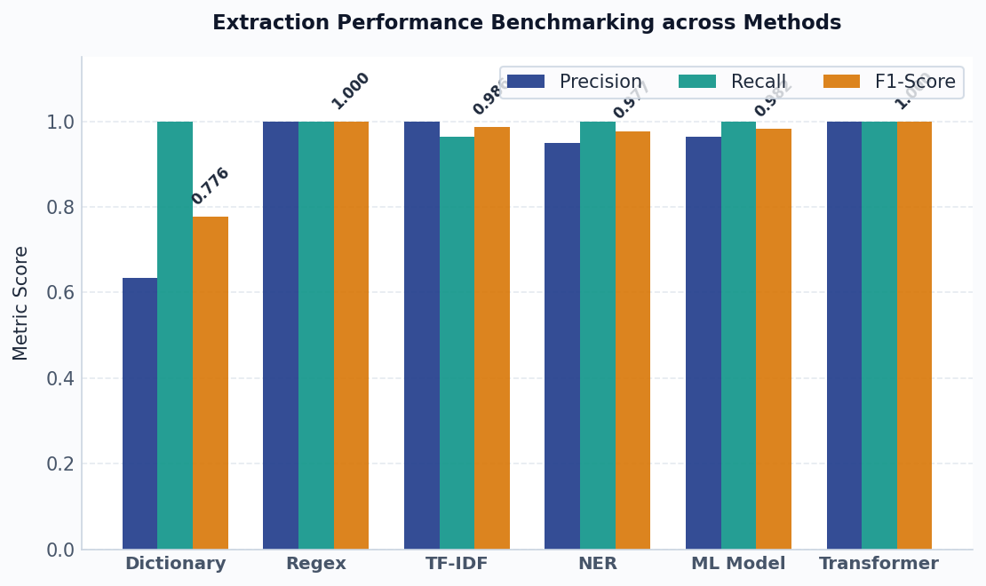
Stricter evaluation benchmarks demonstrate high model accuracy
Extraction Performance Metrics Comparison
Model Evaluation Matrix
*Source-Alignment Interpretation Note: The ground truth was derived using strict regex boundary matching from the predefined taxonomy. Thus, the perfect Regex and Transformer scores reflect internal pipeline consistency and should be interpreted accordingly.
Method | Precision | Recall | F1 Score | Accuracy
Dictionary | 0.6347 | 1.0000 | 0.7765 | 0.9654
Regex | 1.0000 | 1.0000 | 1.0000 | 1.0000
TF-IDF | 1.0000 | 0.9639 | 0.9816 | 0.9978
NER | 0.9495 | 1.0000 | 0.9772 | 0.9968
ML Model | 0.9647 | 1.0000 | 0.9816 | 0.9978
Transformer | 1.0000 | 1.0000 | 1.0000 | 1.0000
Notes:
For the models' comparison on Slide 10, we evaluated precision, recall, F1, and accuracy. The dictionary method has perfect recall but lower precision (0.6347) because it over-extracts terms without boundaries. The regex, TF-IDF, NER, ML model, and Transformer all score very highly (>0.97 F1). As a statistical warning, the ground truth is derived programmatically from our predefined taxonomy. So, the perfect scores for Regex and Transformer represent consistency with our dictionary rules, rather than a human-annotated gold standard.

Slide 13
Analyzing systematic failures drives the refinement of NLP rules
Representative Failure Modes from Error_Analysis_Report.xlsx
Typical Failure Patterns
▪ Boundary Spillage: Extracting partial or expanded phrases (e.g. 'Kubernetes clusters' or 'Spring Boot framework' instead of canonical 'Kubernetes' and 'Spring Boot').
▪ Spelling & Formatting: Slight spacing changes like 'PowerBI' vs 'Power BI' causing direct matching misses.
▪ Boundary False Negatives: Missing skills when adjacent characters bypass checks (e.g. 'Postgres and MS SQL' yielding 'MS SQL' as wrong entity).
▪ Overgeneralization: Mistaking broad terms like 'cloud technologies' as concrete skills like 'AWS'.
Raw Input Text | Ground Truth | Predicted | Error Category
Experience with cloud technologies | None / AWS | cloud technologies | Unknown skill / Overgeneralization
Strong skills in PowerBI dashboarding | Power BI | PowerBI | Spelling & spacing variant
Expert in Java and Spring Boot framework | Java, Spring Boot | Java, Spring Boot framework | Partial entity boundary
Familiar with Postgres and MS SQL | PostgreSQL, SQL | MS SQL | False negative / boundary overlap
Notes:
As statistics students, we must acknowledge that no model is perfect. On Slide 11, we cover Error Analysis. We documented failure modes in Error_Analysis_Report.xlsx. Overgeneralization occurs when we see 'cloud technologies' and predict it as a skill. Spelling variants like 'PowerBI' instead of 'Power BI' can cause misses. We also see partial entities, such as predicting 'Spring Boot framework' instead of the canonical 'Spring Boot'. These findings guide future taxonomy expansions.

Slide 14
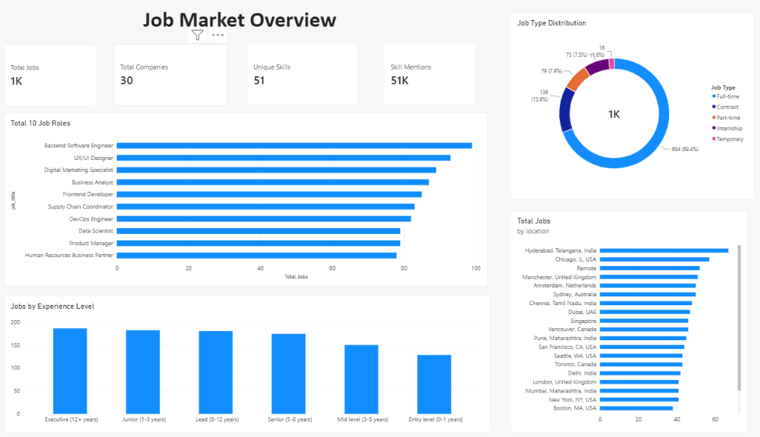

Slide 15
Streamlit application integrates backend models with interactive UI
Job Skill Extractor & Analytics Web App Flow
Operational Software Architecture
▪ Streamlit Implementation: Creates an interactive, lightweight web frontend (app.py) that imports backend models directly, ensuring complete decoupling of core logic.
▪ Visual Skill Extraction: Users paste a raw job description, click 'Extract', and see canonical matched skills rendered instantly as interactive visual tags (chips).
▪ Exploration & Analytics: Loads cleaned_job_dataset.csv, enabling filters by Job Title, Location, and Job Type. Aggregates skills to output real-time demand bar charts.
▪ Downloadable Results: Allows recruiters to export extracted skills or role demand data directly as downloadable CSV files.
1. Interactive Dashboard Tab
View high-level summary KPIs and general distributions across the corpus.
2. Extract Skills Tab
Paste any raw text or select database records to extract normalized skills.
3. Dataset Explorer Tab
Filter, search, and inspect cleaned records with custom filters.
4. Skill Demand Analysis Tab
Examine specific role-wise skill frequencies and export CSVs.
Notes:
On Slide 12, we discuss the interactive interface. The pipeline's backend is integrated into a Streamlit application named 'Job Skill Extractor & Analytics'. This dashboard has four key areas. First, a high-level Dashboard of metrics. Second, the Extract Skills tab, where users can paste free text and get matched visual chips. Third, the Dataset Explorer to search postings. Fourth, the Skill Analysis tab to explore frequencies and download CSVs.

Slide 16
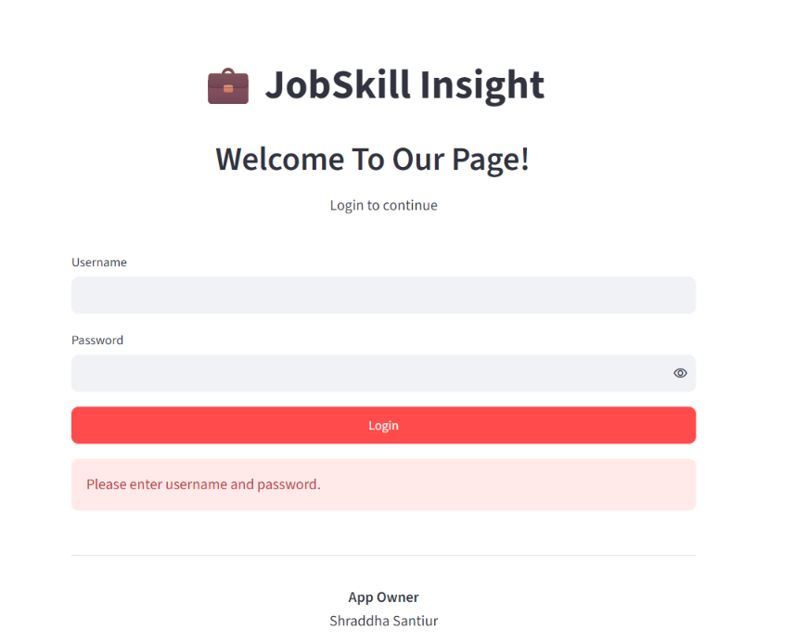
Login Page

Slide 17
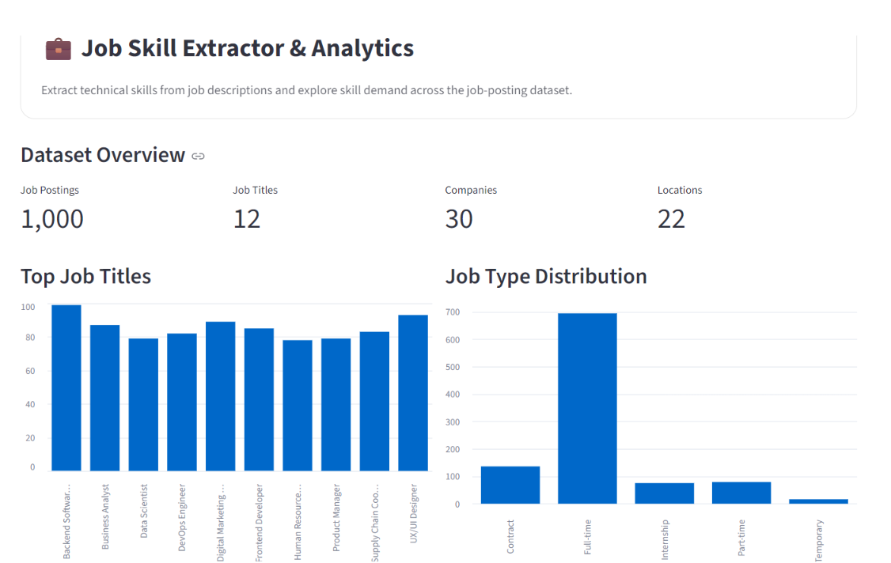
Dashboard

Slide 18
Internship bridges statistical theory and software integration
Key Learning Outcomes, Limitations & Future Engineering Roadmap
Internship Learning Outcomes
▪ Technical Upskilling: Mastered Pandas for data cleaning, custom regex design, and Scikit-learn for character N-gram classification.
▪ Statistical Application: Mapped probability concepts to TF-IDF weights and understood TruncatedSVD dimensionality reduction for LSA.
▪ Practical Deployment: Gained experience in separating core algorithmic logic from the Streamlit UI to build deployable, robust software.
Notes:
To conclude on Slide 13, this internship has been a vital learning experience. It bridged my M.Sc Statistics academic theory with software engineering, showing me how to deploy models. For future work, I want to expose the extractor via a FastAPI endpoint and build resume-to-job matching based on taxonomy overlap. Thank you Technosignia for this opportunity, and I'm ready for your questions.

