Slide 1

Predicting Fare prices of Uber Trip in New York.
Project Members:
Anuja Salunke : 07
Shraddha Bagal : 39
Snehal Patil : 46
Vidhi Borele : 55
Guided by:
Trupti ma’am
Tushar Kute Sir

Slide 2

Introduction
Objectives, Tools used
Data Pre-processing
Methodology
Machine Learning Algorithms
Data Visualization & Representation
Conclusion
Future Scope

Slide 3
Introduction
Uber is defined as a P2P platform. The platform links you to drivers who can take you to your destination safely.
The dataset includes primary data of 9 columns and 200000 rows.
Uber pickups and drop-offs with details including the date, time of the ride as well as longitude-latitude information, number of passengers etc.
Effective taxi dispatching will facilitate each driver and passenger to know the fare amount depending on the distance of the trip.

Slide 4
What does Uber do for Data Analysis?
Every ride booked on Uber gives their team a large amount of information, including the riders booking preferences, pickup, and drop-off trends, availability of drivers in the area, traffic patterns, duration, speed, weather factors, and more.
Some popular uses include calculating a competitive fare to maximize profits (using predictive modelling algorithms).
Estimating surge prices, tuning the requirements of drivers in a particular region, catching fake rides, and fake drivers, and estimating ride info like ETA.

Slide 5
Objectives
To predict the Fare Prices of the trip after choosing the pickup and drop-off location in New York City.
To find out the best Machine Learning Algorithm model for predicting the fare amount.
Tools Used
Python(Pandas)
Machine Learning
Geopy library
Tableau

Slide 6
Insight Generation
(Extracting knowledge from the data)
To perform a preliminary EDA, we will follow specific steps to extract and understand the data visually:
Identify a feature to explore and find the unique values in that column
Handle NaN or NULL values.
Find the negative values.
Identify outliers and peculiar trends and provide explanations for these trends by relating them to the real world.
After this process, we will better understand the story our limited data is trying to tell. This will make the decision-making process for solving a business problem well-informed and smooth.

Slide 7
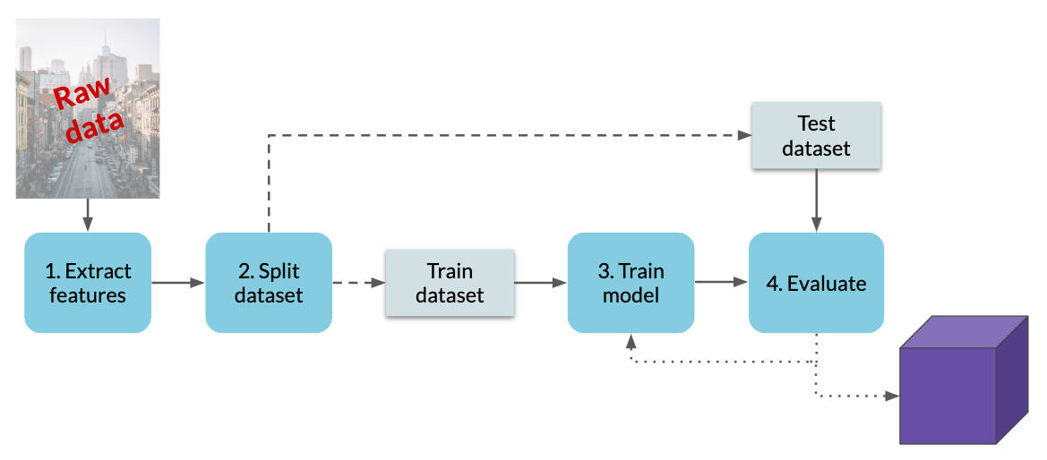

Slide 8
Different models used for Prediction
SIMPLE LINEAR REGRESSION :
It is used to estimate the relationship between two quantitative variables :
How strong the relationship is between two variable.
The value of the dependent variable at a certain value of the independent variable.
LASSO REGRESSION :
Lasso regression is a type of linear regression that uses shrinkage.
Shrinkage is where data values are shrunk towards a central point, like the mean.

Slide 9
DECISION TREE REGRESSION:
With a particular data point, it is run completely through the entirely tree by answering True/False questions till it reaches the leaf node.
The final prediction is the average of the value of the dependent variable in that particular leaf node.
Through multiple iterations, the Tree is able to predict a proper value for the data point.
RANDOM FOREST REGRESSOR:
The bootstrapping Random Forest algorithm combines ensemble learning methods.
It is done through the decision tree framework to create multiple randomly drawn decision trees from the data, averaging the results to output a new result that often leads to strong predictions/classifications.

Slide 10
GRADIENT BOOSTING :
It refers to a class of ensemble machine learning algorithms that can be used for classification or regression predictive modeling problems.
Ensembles are constructed from decision tree models. Trees are added one at a time to the ensemble and fit to correct the prediction errors made by prior models.
XGBOOST:
XGBoost is a powerful and popular implementation of the gradient boosting ensemble algorithm.
Extreme Gradient Boosting (xgboost) is similar to gradient boosting framework but more efficient.

Slide 11
Accuracy based on different Machine learning Algorithms
Machine Learning Model
Linear Regression | 0.75
Lasso Regression | 0.671
Elastic net | 0.712
Decision Tree Regressor | 0.6083
Random Forest Regressor | 0.807
Gradient Boost Regressor | 0.7969
XGBoost | 0.8228

Slide 12
Conclusion
People prefer to have a shared ride for their journeys.
People avoid riding when it rains.
When traveling long distances, the price also increases accordingly.
Uber could be the first choice for long distances.
This guide briefly outlines some of the tips and tricks to simplify analysis and undoubtedly highlighted the critical importance of a well-defined business problem, which directs all coding efforts to a particular purpose and reveals key details.

Slide 13
THANK YOU !

