Slide 1
Deciphering Airline Performance Data Data Mining B-565 Shraddha Ramprakash Gupta Radhika Ganesh Subhadra Mishra

Slide 2

Source: https://www.dreamstime.com/illustration/airport-angry.html

Slide 3
Overview
Comprehensive dataset crucial for understanding root causes.
Explore methods for analyzing airline delays and cancellations dataset.
Uncover insights to refine airline operations and enhance passenger satisfaction.
Identify primary reasons behind delays/cancellations for operational refinement.
Prediction of delays on future datasets.

Slide 4
Dataset
Dataset has been downloaded from the website of Bureau of Transportation Statistics (BTS) which is a part of the US Department of Transportation (DOT).
Reporting Carrier On-Time Performance data is available from 1987 onwards.
We have selected the data from January 2022 to August 2023.

Slide 5
Data Preprocessing and Analysis
Data for individual months from January 2022 to August 2023 were downloaded from BTS website and the csv files were merged to prepare the final dataset (70 lakh rows approx. and 34 columns).
ARR_DEL15 column: Delay = 1, No Delay=0
Cancelled column: Cancelled: 1, Not Cancelled=0

Slide 6
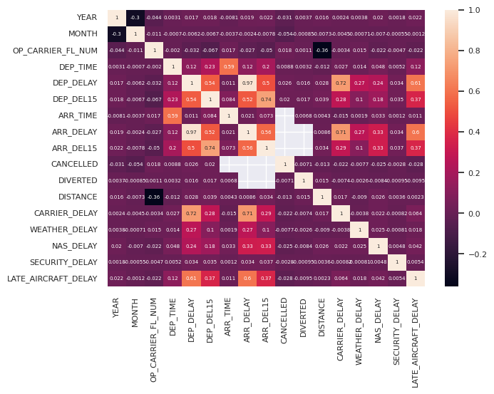
Correlation

Slide 7
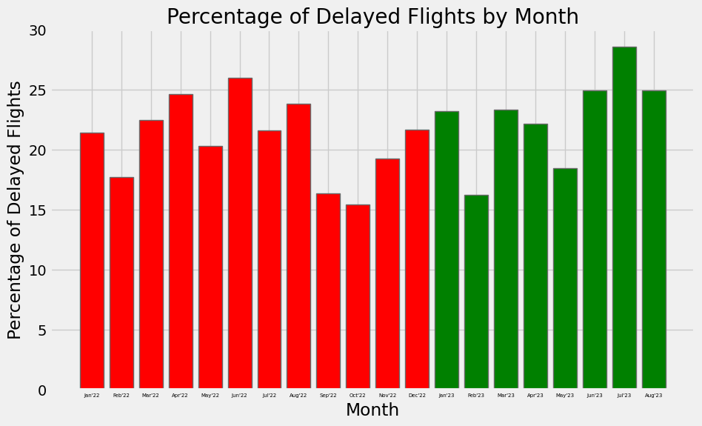
2022
2023

Slide 8
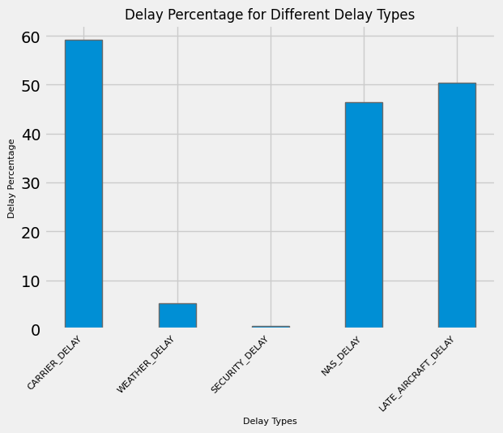
Plot of different causes of delay as a percentage of total delayed cases.

Slide 9
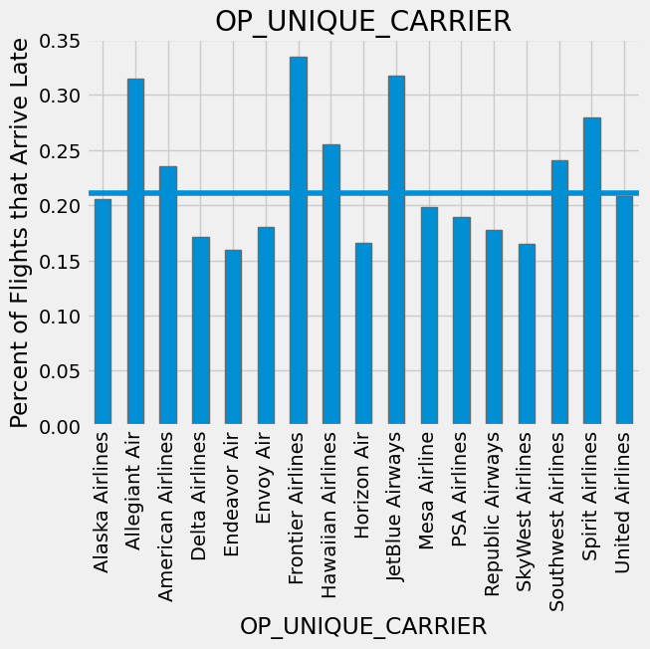
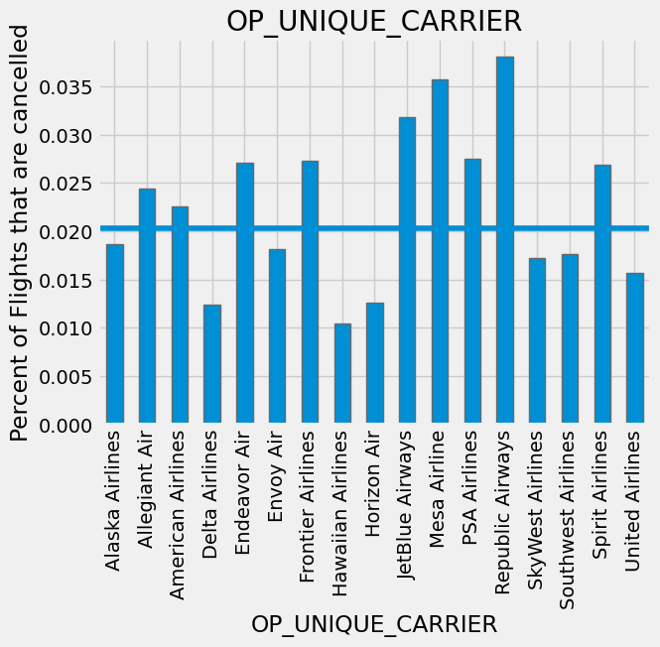
Carrier wise distribution of delayed and cancelled flights

Slide 10
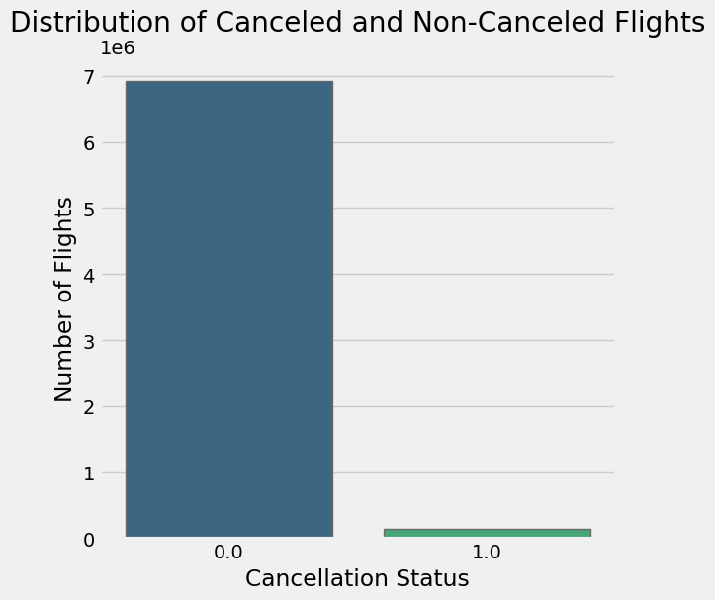
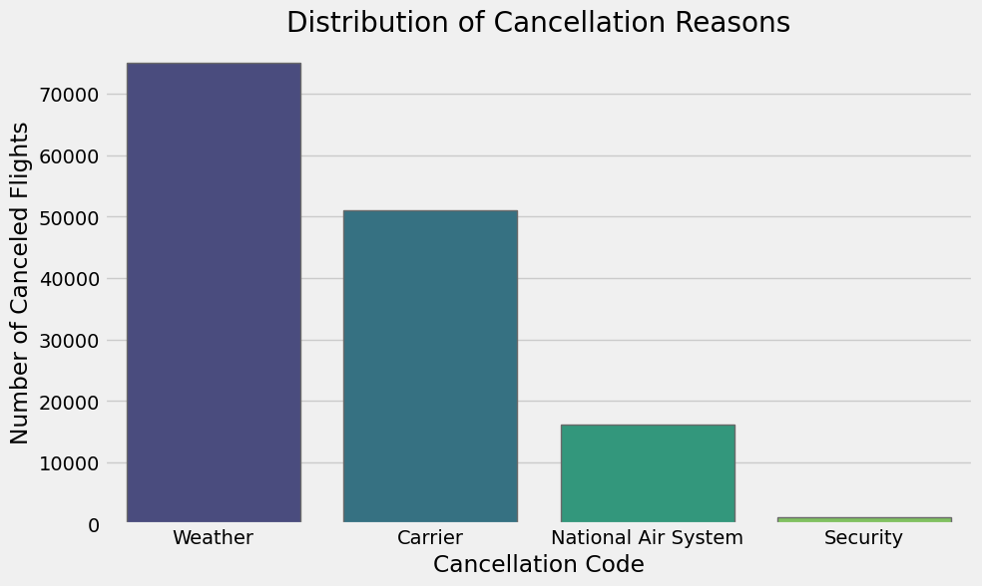
Percentage of cancelled flights and distribution of cancellation reasons

Slide 11
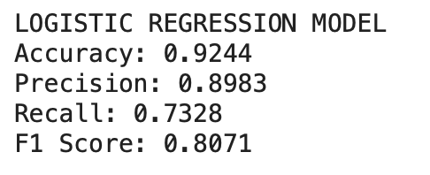
Decision Tree and Logistic Regression Models

Slide 12
Thank You!

