Slide 1

Project Title :
Car Market Trends Analysis with Car Dekho Data
Student AICTE ID : STU6832ab424991f1748151106
~ By Shraddha Dattatray Kharade

Slide 2

PROBLEM STATEMENT
The used-car market is influenced by several factors such as the manufacturing year, present price, kilometers driven, fuel type, transmission type, seller type, and number of previous owners.
Buyers and sellers often find it difficult to understand the true market value of a used vehicle and identify the factors that affect its resale price.
This project aims to analyze CarDekho data to discover market trends, measure vehicle depreciation, identify value-for-money cars, and provide smart recommendations based on customer preferences.

Slide 3
Project Description
This project performs an end-to-end analysis of used-car market data from CarDekho.
The analysis includes:
• Data cleaning and preprocessing
• Exploratory Data Analysis (EDA)
• Selling price trend analysis
• Fuel type and transmission analysis
• Car age and kilometers-driven analysis
• Vehicle depreciation analysis
• Market segmentation into Budget, Mid-Range and Premium categories
• Value-for-Money analysis
• Smart vehicle recommendation system
The goal is to transform raw data into meaningful business insights that can support better decisions for car buyers and sellers.

Slide 4

WHO ARE THE END USERS?
Car Buyers
To compare vehicles and identify value-for-money options.
Car Sellers
To understand factors affecting resale value and make better pricing decisions.
Automobile Dealerships
To analyze market demand and manage vehicle inventory.
Market Analysts
To identify trends in the used-car market.
Data Analysts
To use the project as a decision-support analytics model.

Slide 5

Technology Used
Python
Used as the primary programming language.
Pandas
Used for data loading, cleaning and analysis.
NumPy
Used for numerical operations.
Matplotlib
Used for creating data visualizations and charts.
Jupyter Notebook
Used to develop and document the complete analysis.
Dataset
CarDekho Used Car Dataset

Slide 6
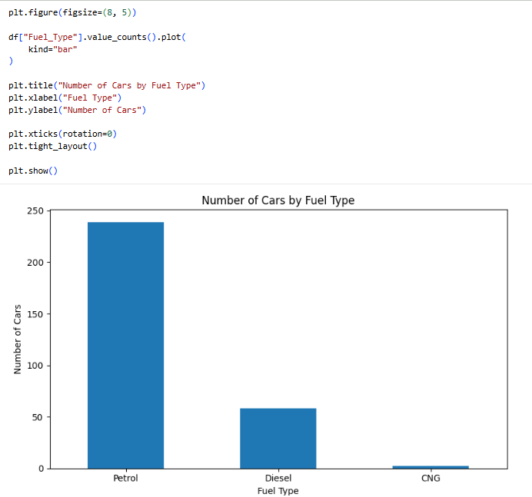
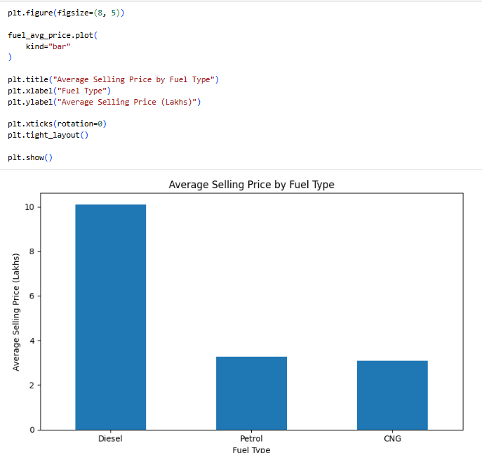
RESULTS
https://github.com/shraddhakharade126/Edunet_CARDEKHO_PR_DataAnalytics.git

Slide 7
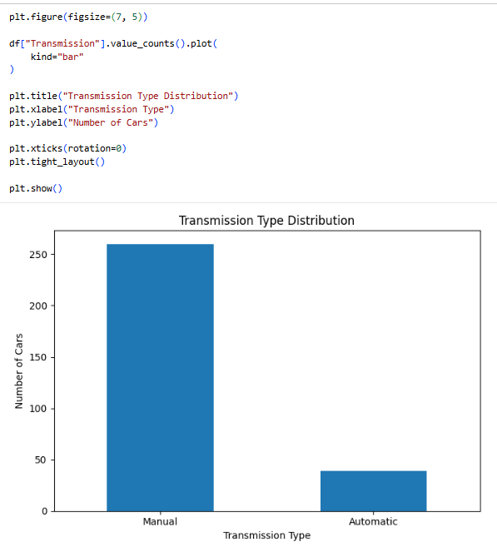
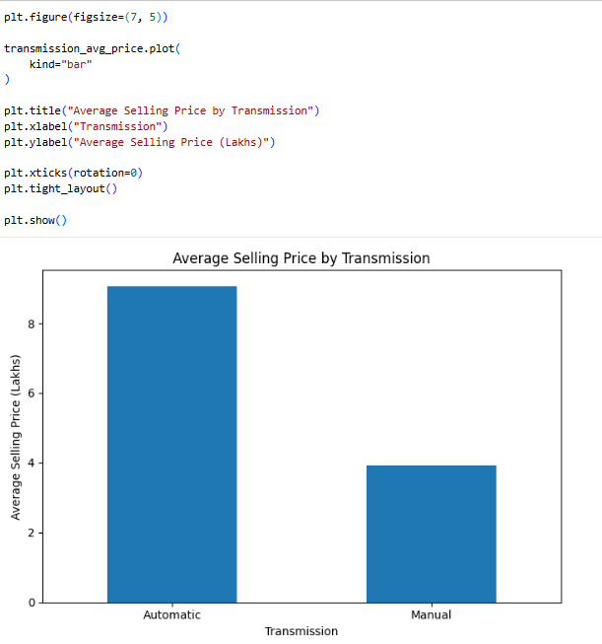
RESULTS
https://github.com/shraddhakharade126/Edunet_CARDEKHO_PR_DataAnalytics.git

Slide 8
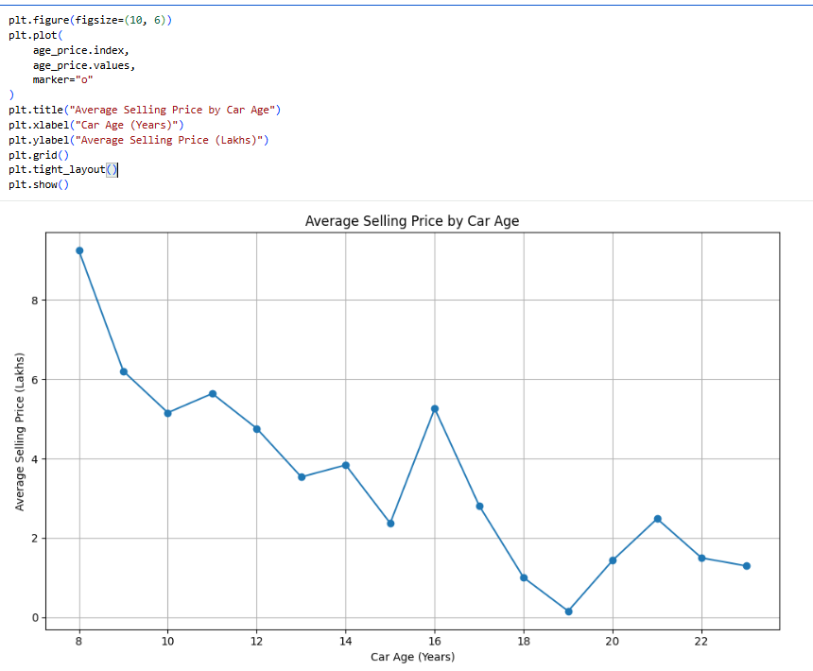
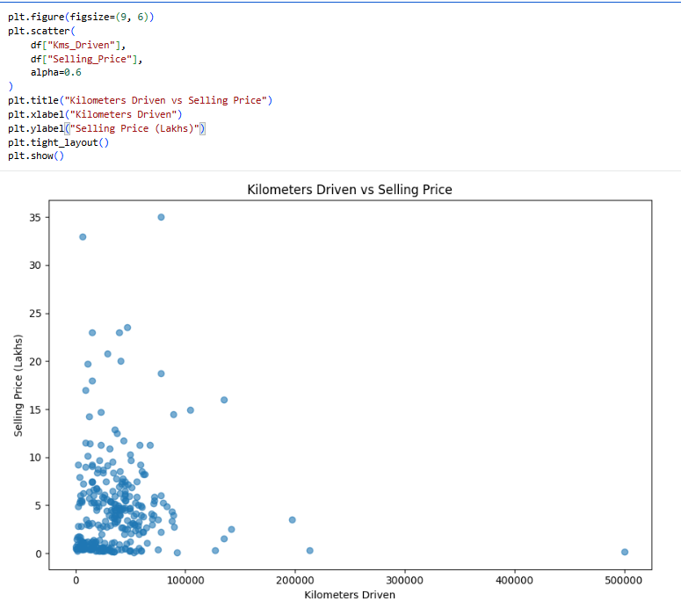
RESULTS
https://github.com/shraddhakharade126/Edunet_CARDEKHO_PR_DataAnalytics.git

Slide 9
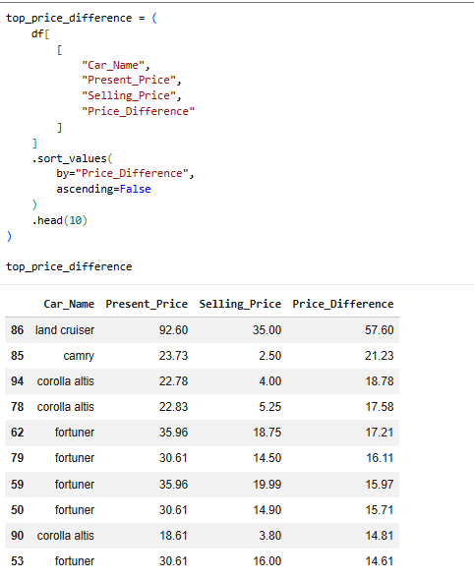
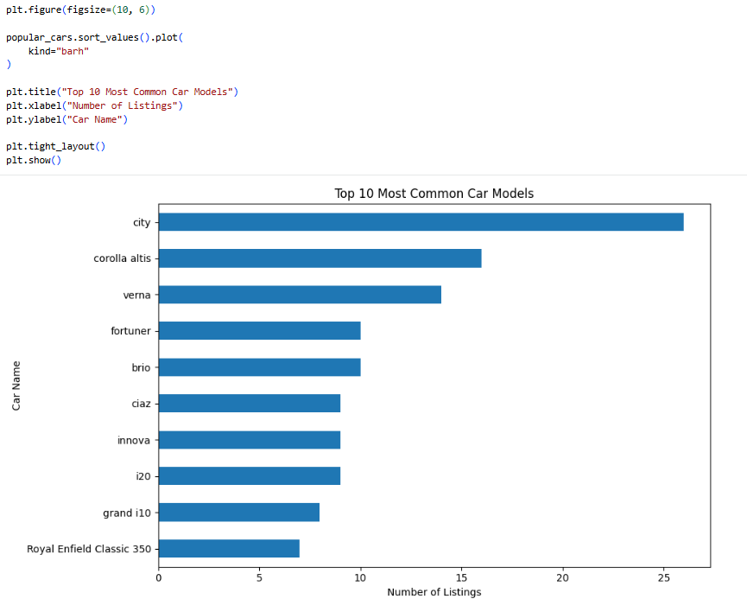
RESULTS
https://github.com/shraddhakharade126/Edunet_CARDEKHO_PR_DataAnalytics.git

Slide 10
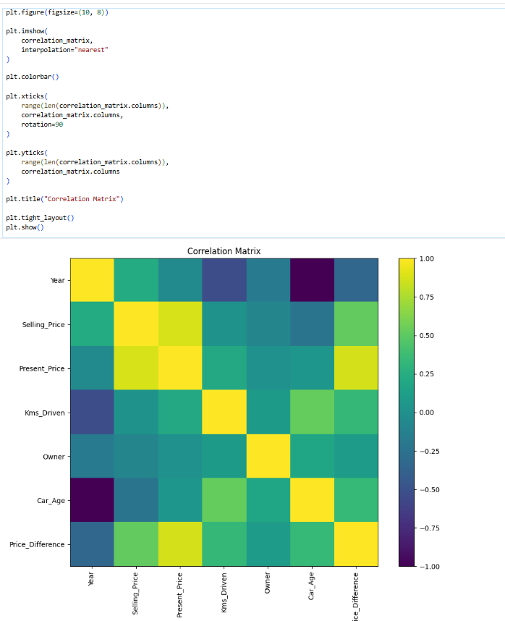
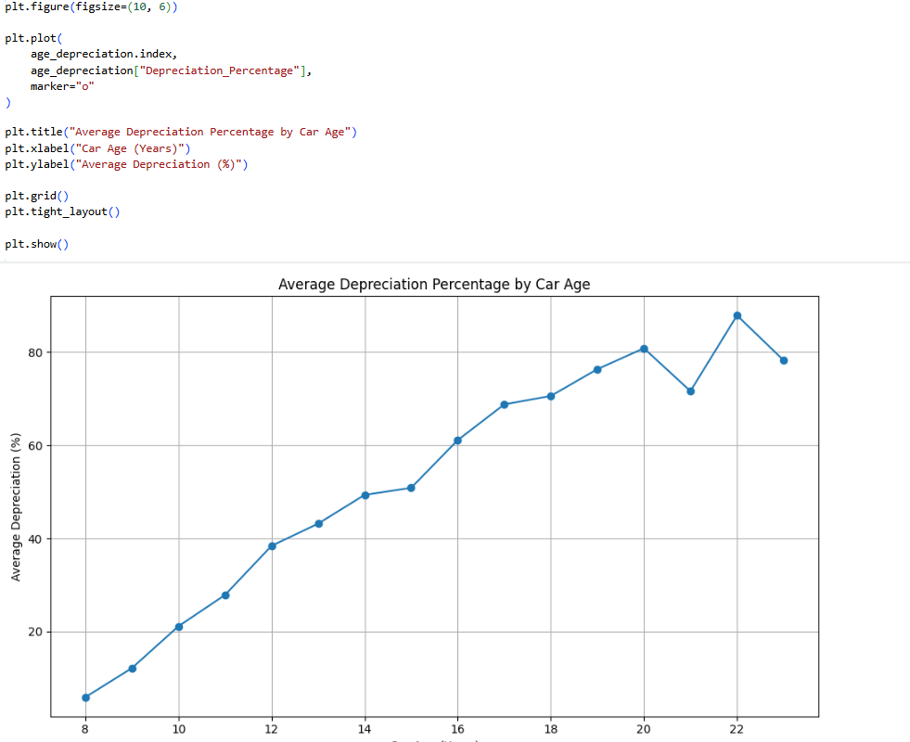
RESULTS
https://github.com/shraddhakharade126/Edunet_CARDEKHO_PR_DataAnalytics.git

Slide 11
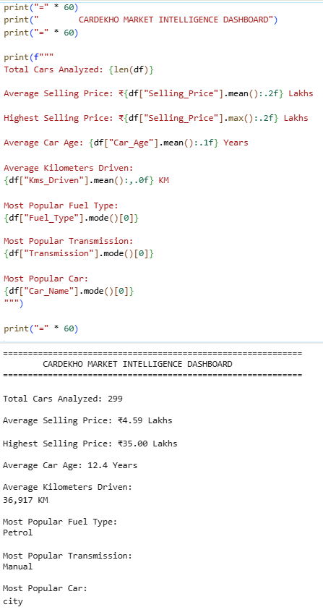
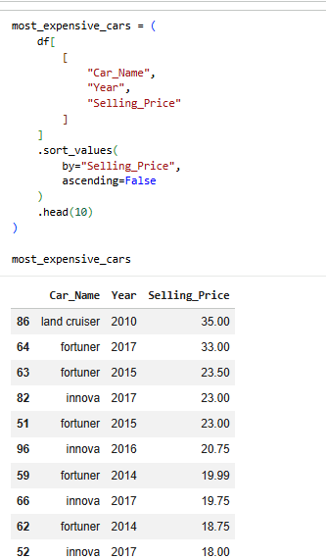
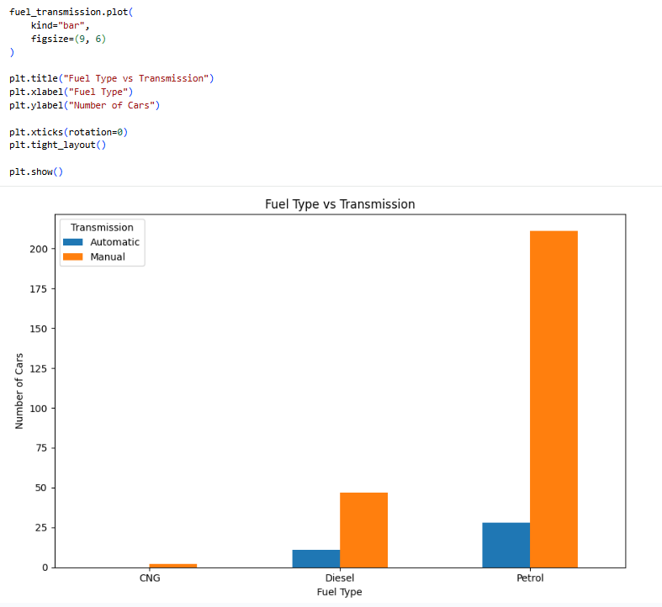
RESULTS
https://github.com/shraddhakharade126/Edunet_CARDEKHO_PR_DataAnalytics.git

Slide 12
RESULTS
DATA VISUALIZATION RESULTS
The following visualizations were generated during the analysis:
Average Selling Price by Fuel Type
Car Age vs Selling Price
Present Price vs Selling Price
Average Depreciation by Car Age
Top 10 Most Common Car Models
Transmission Type Distribution
Kilometers Driven vs Selling Price
ETC.,
These visualizations help identify patterns and relationships within the used-car market.
https://github.com/shraddhakharade126/Edunet_CARDEKHO_PR_DataAnalytics.git

Slide 13
CONCLUSION
The Car Market Intelligence project successfully analyzed used-car data to understand important market trends and factors affecting vehicle resale prices.
The project demonstrated that data analytics can be used to:
• Understand used-car market behavior
• Analyze vehicle depreciation
• Identify value-for-money vehicles
• Segment the market based on price
• Support buyers and sellers with data-driven insights
This project transforms raw CarDekho data into meaningful and actionable market intelligence.
.
.

Slide 14
Car Market Intelligence :
Price Trends, Depreciation & Smart Vehicle Recommendations
Thank you!
.
.

