Slide 1
NGS saturation studies.

Slide 2
%M at a CpG, as measured by WGBS, can be modelled as a binomial (coin flip) distribution
N => “Number of trials” => Number of reads at the CpG
p => “probability of ‘success’” => p(M)
=> (# M reads)/(# M reads + #U reads)
If distribution is binomial, the *technical* variation for a site with M=50% (point of maximum uncertainty) is defined as:
Total reads at CpG => CpG “coverage”
8 Sep 2014. Formula corrected. Previous one had N term on numerator.
p(M)

Slide 3
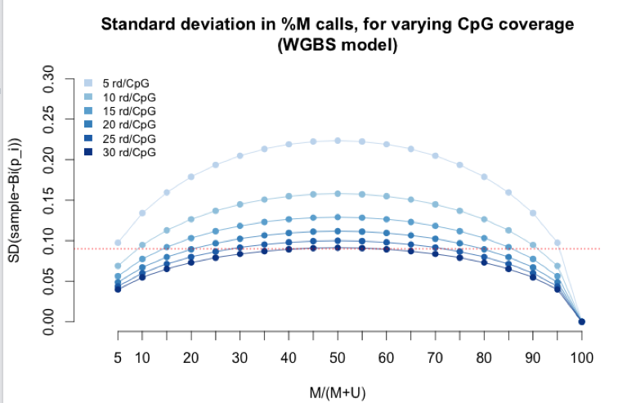
Armed with this formula, I computed uncertainty for all hypothetical %M (x-axis), with all feasible values for CpG coverage (each trendline)
At 30X coverage (darkest blue), technical variability for 50% methylation
is theoretically 9%.
My guess is the field decided this was the
Acceptable upper-bound of technical uncertainty.
Maximum unreliability between technical replicates
< 10%.
Hypothetical % Methylation
This simulation replicates this comment from Hansen..Irizarry (2012). “ This has led most WGBS studies to employ a high coverage design since even 30X coverage yields standard errors as large as 0.09.”

Slide 4
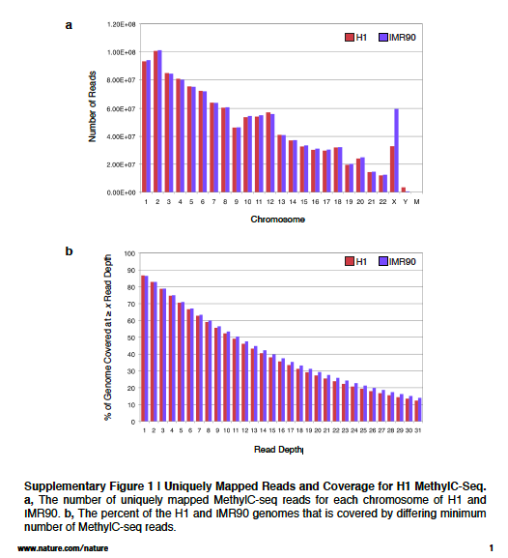
Lister et al. (2009). Nature. Seems to be the upper bound for future studies.
We interrogated the sequenced bases at each reference cytosine position one at a time, where read depth refers to the number of reads covering that position. For each position, the number of trials (n) in the binomial distribution was the read depth. For each possible value of n we calculated the number of cytosines sequenced (k) at which the probability of sequencing k cytosines out of n trials with an error rate of p was less than the value M, where M * (number of unmethylated cytosines) < 0.01 * (number of methylated cytosines). In this way, we established the minimum threshold number of cytosines sequenced at each reference cytosine position at which the position could be called as methylated, so that out of all methylcytosines identified no more than 1% would be due to the error rate

Slide 5
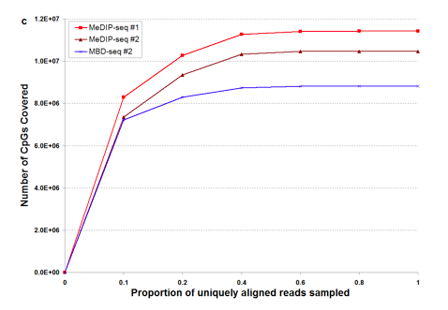
Harris et al. (2010). Nat Biotech. Comparison of sequencing-based methods to profile DNA methylation and identification of monoallelic epigenetic modifications
Figure S7c
“. For MeDIP-seq #1 (25,994,131 total reads), MeDIP-seq #2 (23,094,829 total reads) and MBD-seq #2 (29,518,370 total reads) enriched regions unthresholded (b) and at a false discovery rate of 1% (c) were calculated by FindPeaks v4.0.11⁸ and the number of CpGs contained within these regions were enumerated (sampling depth “1”).
Random sub-samplings at the fractions indicated were generated and the CpG coverage re-calculated. For unthresholded regions saturation was not observed for the MeDIP-seq replicates #1 and #2 (19.3M and 19.5M CpGs covered, respectively) as background signal continued to accumulate with deeper sequencing. Similarly, saturation was not observed for unthresholded regions in the MBD-seq library (16.2M CpGs covered). To account for potential background present in the immunoprecipitations we applied a false discovery rate threshold of 1% to the regions enriched in the MeDIP-seq and MBD-seq replicates and re-plotted CpGs covered relative to increasing sequencing depth (Supplementary Fig. 7c).
For MeDIP-seq replicate #1 and #2 saturation was observed at 15.6 million reads (11.4M CpGs covered) and 13.9 million reads (10.5M CpGs covered) respectively.
…
These plots provide a practical guide to determine how deeply to sequence in order to achieve the particular experimental goals. Approaching saturation, there are diminishing returns on additional sequencing. “

Slide 6
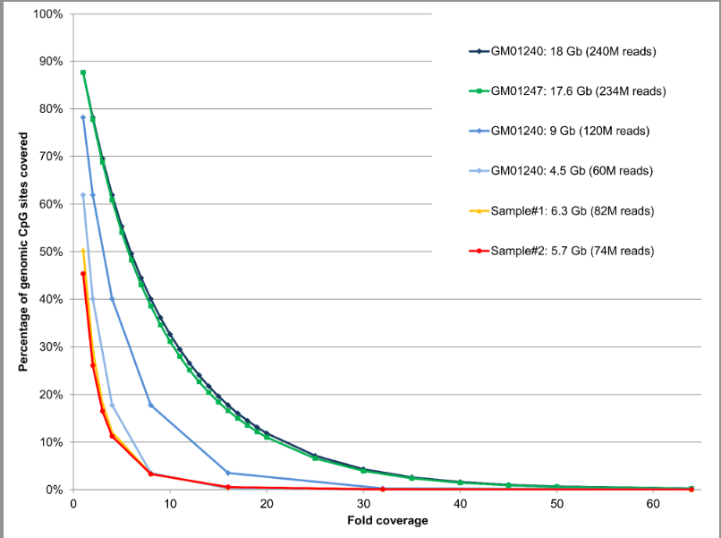
Clarke et al. (2013). PlosOne. A Comparison of the Whole Genome Approach of MeDIP-Seq to the Targeted Approach of the Infinium HumanMethylation450 BeadChip® for Methylome Profiling
Sequencing depth and CpG coverage. The percentage of genomic CpG sites covered at different depths of sequence (fold coverage) is shown for GM01240 (240 M reads, 18 Gb of sequence ) in dark blue; for GM01247 (234 M reads, 17.6 Gb ) in green; for GM01240 (120 M reads, 9 Gb ) in blue; for GM01240 ( 60 M reads, 4.5 Gb) in light blue; for Sample#1 (82 M reads, 6.3 Gb ) in yellow; for Sample#2 ( 74 M reads, 5.7 Gb ) in red. It is important to note that Sample#1 and Sample#2 (unrelated to this study but processed in the same way) were both sequenced on one lane of an Illumina GAII resulting in a lower sequencing yield compared to GM01240 and GM01247 which were both sequenced on one lane of an Illumina HiSeq 2000. The data for the 120 M and 60 M reads graphs for GM01240 were calculated from the 240 M dataset by taking a subset of the reads equivalent to half (1/2) and a quarter (1/4) of the original dataset. All experimental datasets were sequenced to saturation according to the MEDIPS saturation analysis (data for GM01240 and GM01247 are shown on Figure S2).
doi:10.1371/journal.pone.0050233.s003

