Slide 1


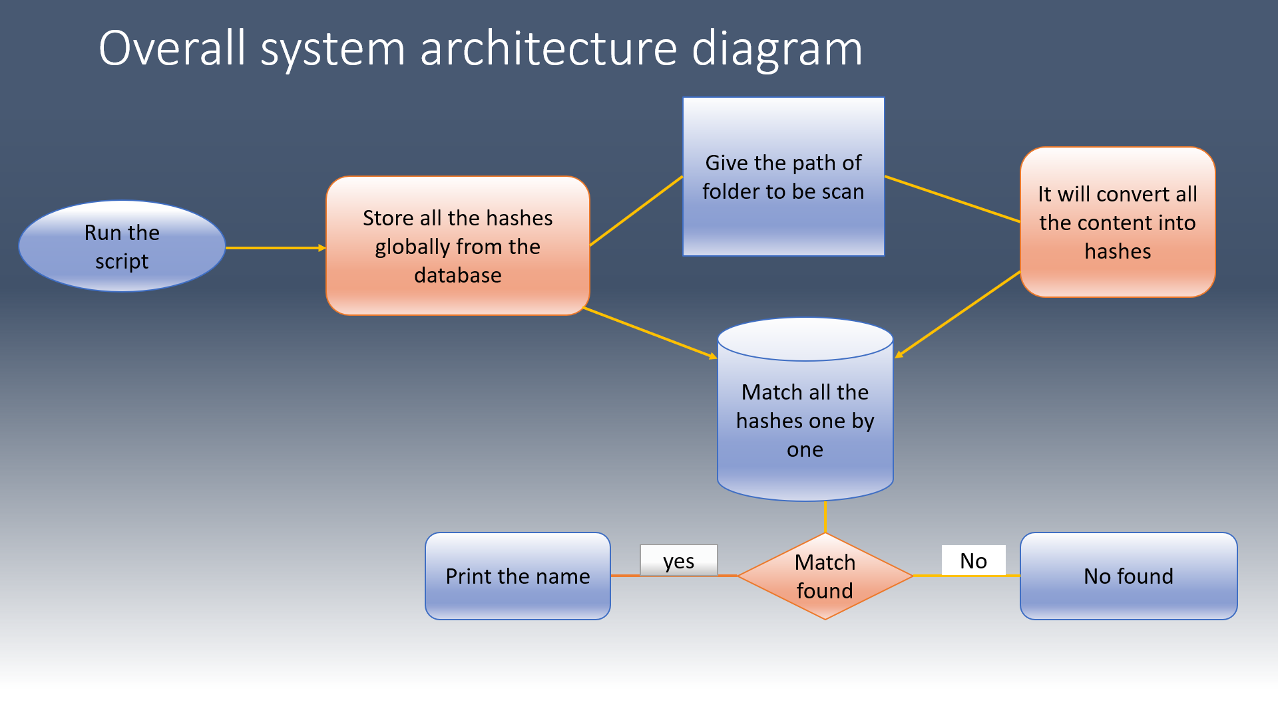


DENGUARD - ANTIVIRUS
STUDENTS: MANSI BAKHSHI,
SHRADDHA PANDEY, CHANCHAL SHARMA, D.S.J.NANDINI,
GUIDE: Dr. MD ASDAQUE HUSSAIN
Project Group ID:- 16
ABSTRACT
INTRODUCTION
RESULTS
DISCUSSION
Our denguard antivirus is a simple antivirus software which can scan any malicious file that is present within a directory or folder. There is a facility of choosing the specific operations such as removal of malicious files, removal of junk files that are present in the system. We have stored the hashes of 40,000+ viruses in our database.
Our denguard antivirus is a simple antivirus software which can scan any malicious file that is present within a directory or folder.
Our idea is to develop an antivirus software that consists the following features:
Detects Virus and malware .
Detects and Removes temp files(junk files )
Checks system memory and health
Checks health and performance of RAM.
This tool help the organization to scan the system and detect the malware and viruses and if it is found then remove that so that we will make ourself safe from these threats.
When we give the path of the folder it will scan each and every file that is present in the folder. If any malicious file is present in the particular folder then it will inform or notify us with the particular name of the virus.
There is a facility of choosing the specific operations such as removal of malicious files, removal of junk files that are present in the system.
When we give the path of any folder or directory, then it will scan each and every file to check for the malicious code. In order to do this it generates a hash of each file and checks whether the hash matches with the hash of any virus. We have stored the hashes of 40,000+ viruses in our database. The code of this anti virus software is written in the python programming language. So, it takes less time to scan the files.
We are also providing the facility of removing the junk file from the system which occupies more space in the RAM and causes degradation of performance.
MODULES AND METHODS
CONCLUSION
Antivirus Software is very useful to day-to-day users to protect their computers from malware. There are a lot of antivirus softwares in the market, each having their own pros and cons. Other than antivirus software there are many other methods available to protect devices from external hands such as network firewall special list tool etc.
REFERENCES
Figure 1. Logo.
https://docs.python.org/3/library/hashlib.html
https://docs.python.org/3/library/os.html#module-os
https://docs.python.org/3/library/sys.html#module-sys
https://www.verizon.com
Figure 2. Security.

