Slide 1



TEAM 11 · PYTHON HACKATHON · SEPTEMBER 2026 · ANALYSIS DEMO
PyInsights
What can admission day tell us? Finding heart-failure patients at risk of readmission, a long stay, or death
Zigong Heart Failure dataset (PhysioNet) · 2,008 hospitalized patients
PARTICIPANTS
Dhivya Gopinathan
Lakshmi Panchagnula
Shraddha Parakh
Swadhika Selvaraj

Slide 2

01
ABOUT THE DATASET
Seven linked tables, one story per patient
Hospitalized Patients with Heart Failure, Zigong Fourth People's Hospital, China (PhysioNet v1.3)
2,008
Table | Rows | Cols | What it holds
Demography | 2,009* | 7 | Age group, gender, height, weight, BMI, occupation
Hospitalization & discharge | 2,008 | 21 | Admission route, NYHA class, Killip grade, stay, outcomes
Cardiac complications | 2,008 | 14 | Heart-failure type, echo results
Labs | 2,008 | 107 | BNP, kidney function (GFR), sodium, ~100 tests
Patient history | 2,008 | 17 | Comorbidities (diabetes, CKD, COPD), Charlson score
Responsiveness | 2,008 | 6 | Glasgow coma scale, consciousness
Prescriptions | 15,362 | 2 | Drugs given (many rows per patient)
patients admitted for heart failure
168
clinical variables
2016–19
admissions, Dec 2016 to Jun 2019
*One invalid demography record removed in cleaning; all tables joined on inpatient_number.

Slide 3
02
OUR QUESTION AND APPROACH
One question, answered in five steps
Each stage answered a question that shaped the next
1
2
3
4
5
Clean
Describe
Relate
Predict
Dashboard
Can we trust the data?
What does the cohort look like?
Which markers go with readmission?
Can admission data flag risk?
How would a care team use it?
Yes, after fixing proven errors only
Readmission, not death, is the burden
Severity, kidney function, comorbidity, sodium
Death well (AUC 0.80); readmission only weakly
Interactive cohort views and admission-time model results.
Our question: After a heart-failure admission, which patients are at risk, and which admission-day signals help the care team act first?

Slide 4

03
CATEGORY 1 · DATA PREPROCESSING AND CLEANING
Fix only what the data proves is wrong
Every change checked against the raw files and the data dictionary first
Decimal-entry errors
Impossible values
RESULT
18 mitral-valve values in 17 patients read 409 instead of 4.09. Divided by 100, then confirmed against the recorded E/A ratio.
1 empty patient record removed. 3 weights, 4 heights, 2 LVEDD readings and vital-sign zeros set to missing; BMI recalculated.
patient_master
2,008 × 198
One row per patient: 6 tables joined, plus drug count and 25 drug flags. Same 2,008 IDs in every table, 0 duplicates.
No blanket imputation
Rebuilt a broken file
LVEF is 68% missing, blood gases missing as a block. A missing test may never have been ordered, so we did not fill it in.
Prescriptions had been cleaned on 4 demo rows. Rebuilt on all 15,362 real rows. Raw files never overwritten.

Slide 5
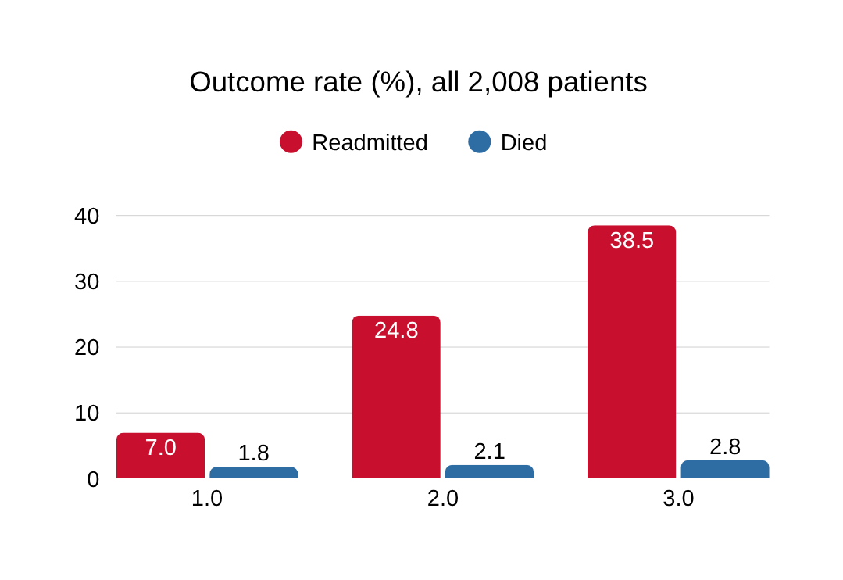
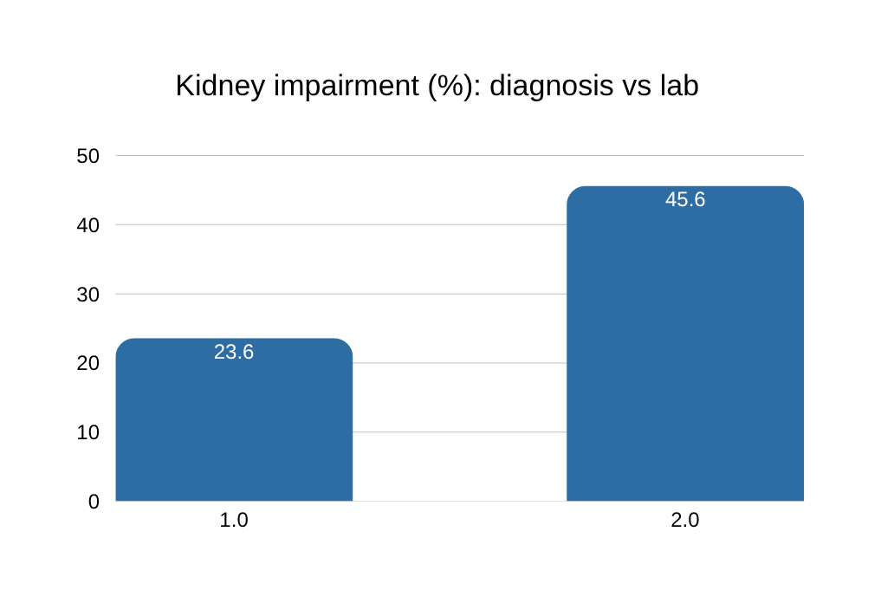
04
CATEGORY 2 · DESCRIPTIVE ANALYSIS
Readmission dominates, and kidney damage hides
Two baseline facts that set the direction for everything after
773 readmissions vs 57 deaths at 6 months. We focused on
readmission
479 patients have low GFR but no CKD flag. We used measured
GFR from here on.
Also: 82% arrive in NYHA class III/IV (none in class I); median stay 8 days; 7.65 drugs per patient on average. Source: Descriptive Q1, Q4, Q5, Q7; Prescriptive Q1

Slide 6

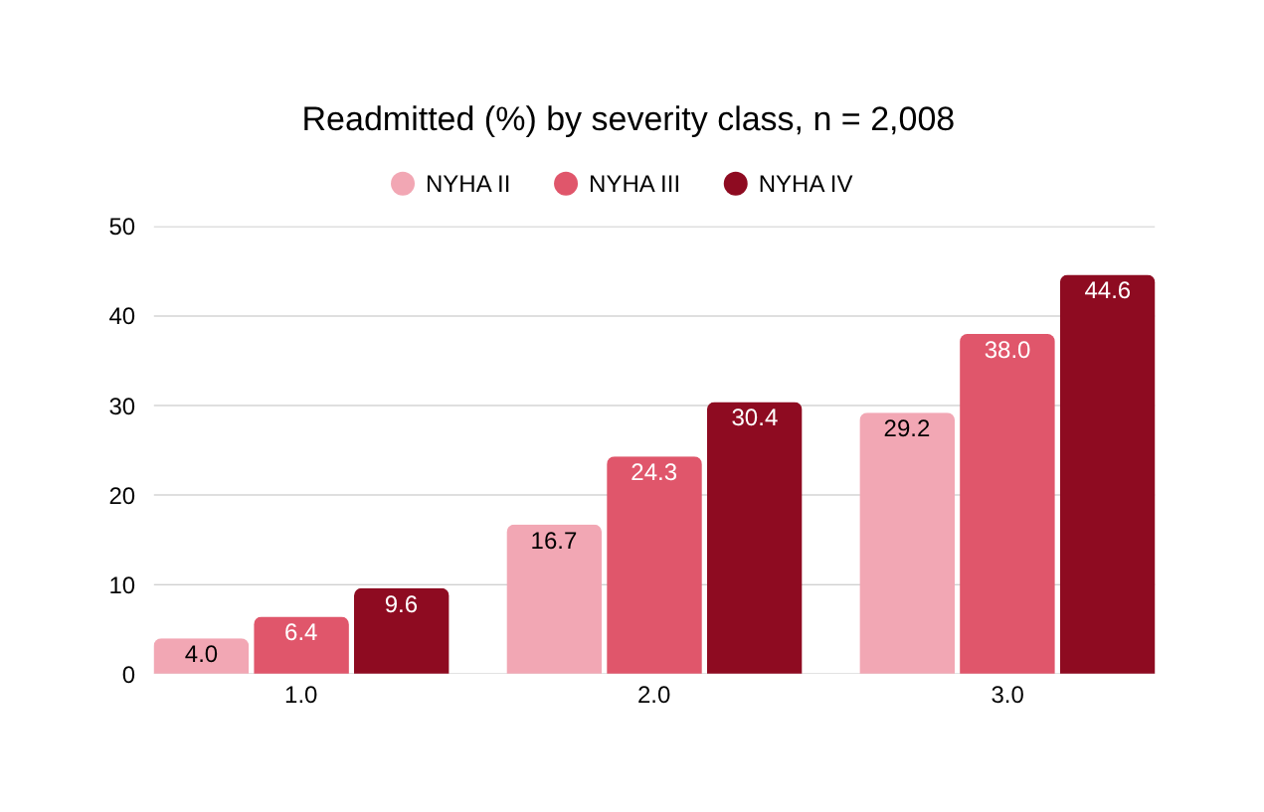


05
CATEGORY 3 · PRESCRIPTIVE ANALYSIS
Sicker at admission, more likely to come back
Readmission rate by NYHA class, at every follow-up window
1.71×
Class IV vs II/III, odds of readmission
28 days
3 months
1.52×
6 months
1.45×
All p < 0.005. The second severity grade, Killip, added nothing beyond NYHA (likelihood-ratio p = 0.48), so we kept one severity measure, not two.
Source: Prescriptive Q5, Q6, Q8

Slide 7

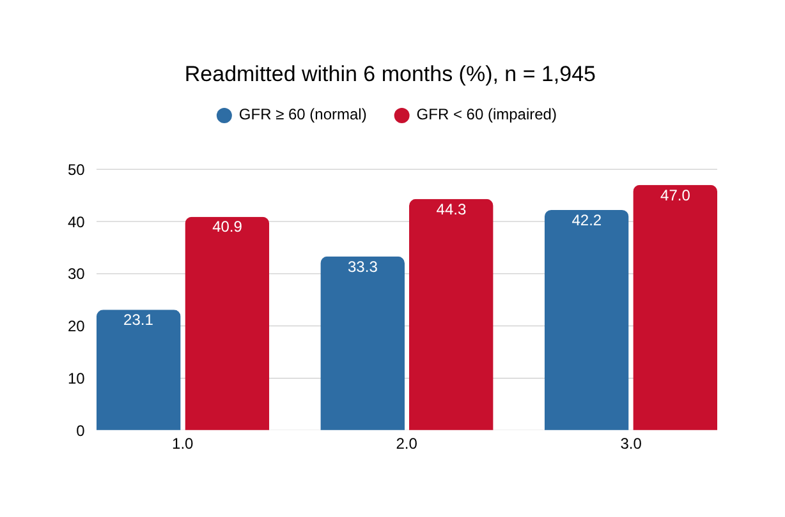
06
CATEGORY 3 · PRESCRIPTIVE ANALYSIS
Kidney function adds risk that severity misses
6-month readmission by NYHA class, split by measured kidney function (GFR)
A mild patient with weak kidneys looks like a severe patient
NYHA II + low GFR: 40.9%
NYHA IV + normal GFR: 42.2%
  Adding GFR to NYHA + Killip improves the model (LR p = 0.000005)
  The gap is widest in mild patients and narrows by class IV (interaction p = 0.086: suggestive, not proven)
Source: Prescriptive Q3, Q4, Q5, Q9

Slide 8
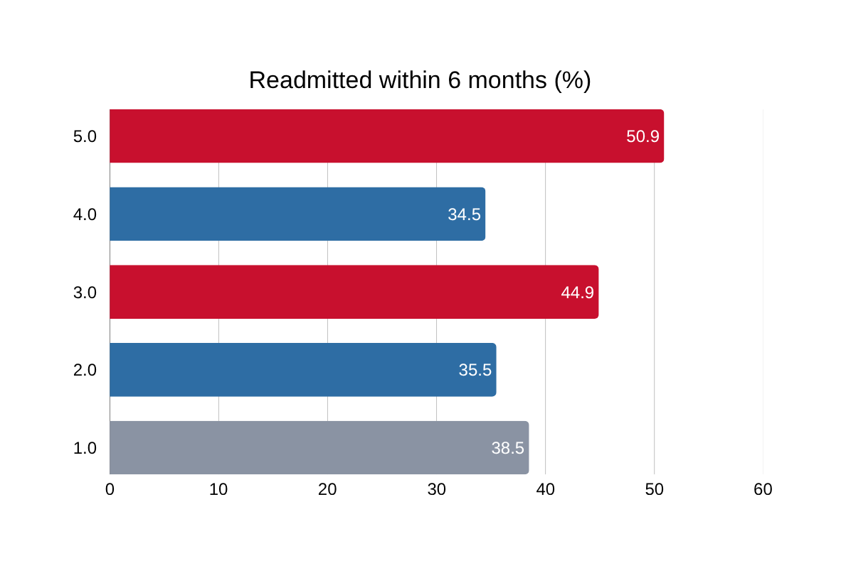
07
CATEGORY 3 · PRESCRIPTIVE ANALYSIS
Comorbidities and sodium add risk; BNP and Killip do not
Associations, not causes; each tested against a comparison group
Low sodium → early readmission
28-day readmission 11.3% in the lowest sodium quartile vs 2.9% in the highest; holds after adjusting for severity (OR 0.933 per mmol/L).
More drugs → longer stay
Prolonged stay 22.4% → 46.9% across medication quartiles; 1.2× odds per extra drug, after adjusting for severity.
Tested, did not help
BNP did not improve prediction beyond severity (AUC 0.558 → 0.548). Killip added nothing beyond NYHA.
Source: Prescriptive Q12, Q14, Q17, Q21, Q23, Q24

Slide 9
08
CATEGORY 4 · PREDICTIVE ANALYSIS
A fair test: four outcomes, admission-day data only
Why models: no single marker is strong enough alone, so we tested whether combining them predicts what happens next
6-month readmission
28-day readmission
Prolonged stay (>10 days)
6-month mortality
38.5% 773 patients
6.9% 137 of 1,986
24.8% 498 patients
2.8% 57 patients
Leakage rule
Fair evaluation
Only what is known at admission. Excluded: length of stay, discharge details, in-hospital drugs, outcome and event-time fields.
Held-out test sets or repeated cross-validation; compared with a no-information baseline and NYHA + Killip alone; judged on AUC, PR-AUC and recall, not accuracy.
H0 (each outcome): admission-day data predicts no better than a no-information baseline (AUC = 0.5).
H1: severity, kidney function, cardiac stress, vitals and comorbidity together separate patients better than chance.

Slide 10
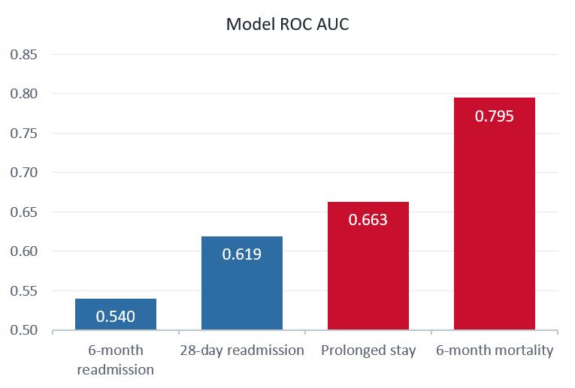
09
CATEGORY 4 · PREDICTIVE ANALYSIS
The more acute the outcome, the better we predict it
ROC AUC by outcome (0.5 = chance)
6-month mortality: AUC 0.795
Top 20% of risk scores hold 63% of deaths. Beats severity alone (+0.07 AUC). H0 rejected.
28-day readmission: AUC 0.619
Catches 26 of 34 readmissions (77%), but flags 64% of patients (precision 8%). H0 rejected; an exploratory early-readmission signal.
6-month readmission: AUC 0.540
Too weak to act on. Post-discharge information may improve readmission prediction.
Prolonged stay AUC 0.663 (severity alone 0.545). AUCs come from different validation designs, so read the pattern, not an exact ranking.Source: Predictive Q1–Q4

Slide 11
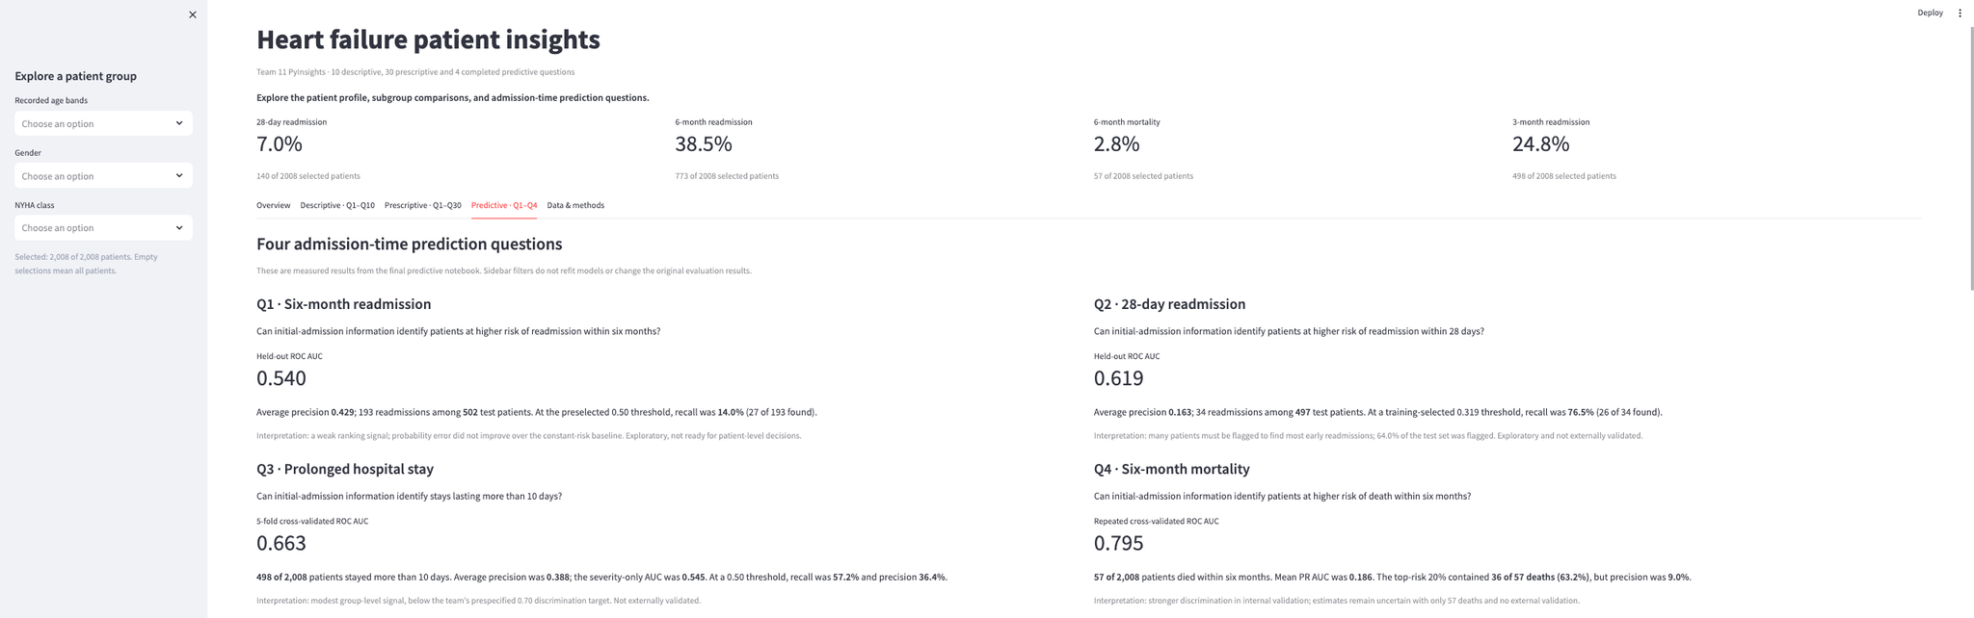
10
CATEGORY 5 · DASHBOARD (STREAMLIT)
One dashboard connects the full analysis
Start with the patient cohort
Explore a patient group
Follow the evidence
Understand the limits
Use the sidebar to select an age band, gender, or NYHA class. The cohort rates and charts update for that group.
The Descriptive and Prescriptive tabs show the patterns and group comparisons behind our questions. The Predictive tab shows the results for all four admission-time models.
The model results come from our completed analysis and do not change with the sidebar filters. The dashboard helps us explore findings; it does not calculate a risk score for an individual patient.
The Overview tab shows readmission and mortality rates for the 2,008 patients in our cleaned dataset.

Slide 12
What we learned, and what comes next
38.5%
41%
0.80 vs 0.54
come back within 6 months. Readmission, not death, is the everyday burden.
readmission for mild patients with weak kidneys, the same as severe patients. Check measured GFR, not the diagnosis flag.
Admission day predicts death well but readmission weakly. The missing signal comes after discharge.
Next steps: add sodium and post-discharge data to the readmission models, test on later patients (train 2016–18, test 2019), and model death and readmission together.
Thank you
Team 11 PyInsights: Dhivya Gopinathan · Lakshmi Panchagnula · Shraddha Parakh · Swadhika Selvaraj

