Slide 1
Turning Analytics into Executive Business Insights
Day 54/60 | ABTalks Data Science Challenge
Customer Risk • Sales • Customer Value • Retention

Slide 2
Executive Summary
A snapshot of the customer portfolio
Customers analysed: 793
Total sales in dataset: ₹2,261,536.78
Total estimated CLV: ₹2,556,306.97
Average estimated CLV per customer: ₹3,223.59
High-risk customers: 264 (33.29%)

Slide 3
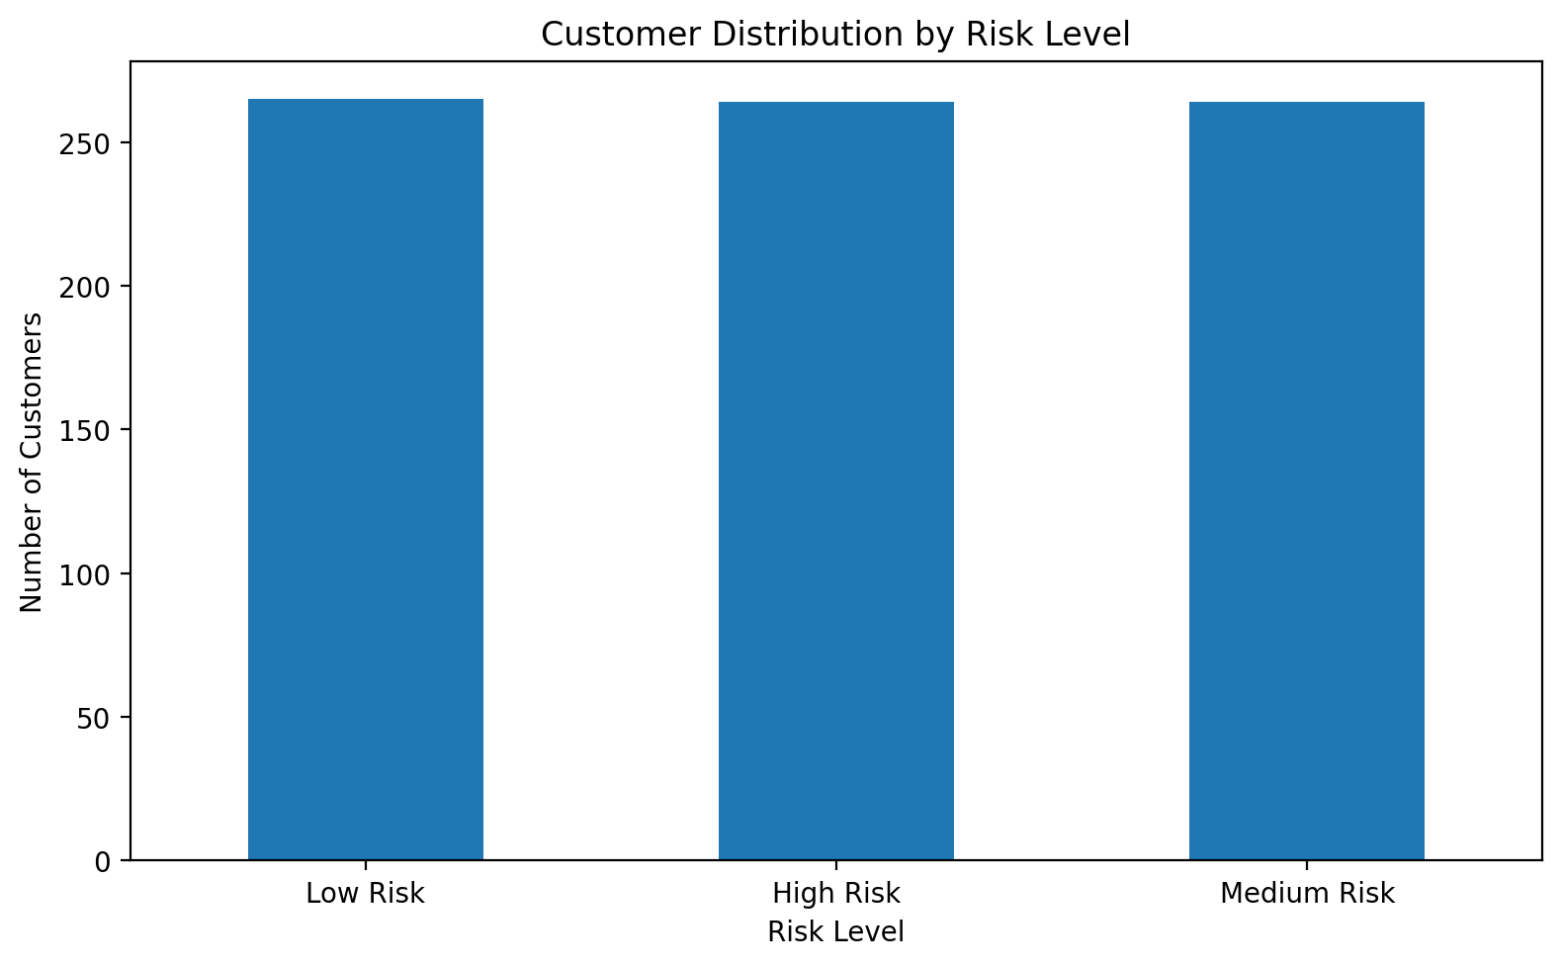
Customer Risk Distribution
BUSINESS TAKEAWAY
264 customers (33.29%) are classified as high risk. Review their behaviour and retention needs before selecting interventions.

Slide 4
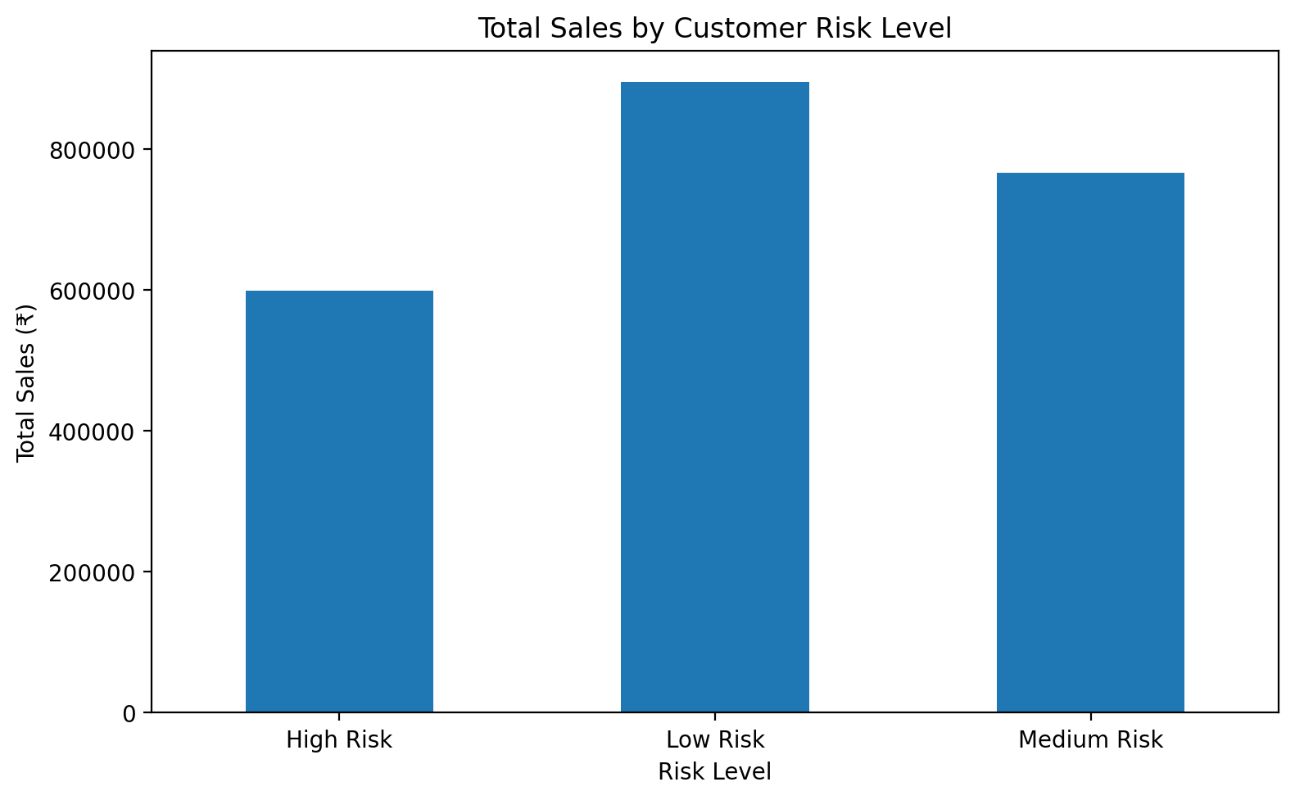
Sales Contribution by Risk Group
BUSINESS TAKEAWAY
High-risk customers contribute 26.48% of recorded sales. Assess this segment for possible re-engagement opportunities.

Slide 5
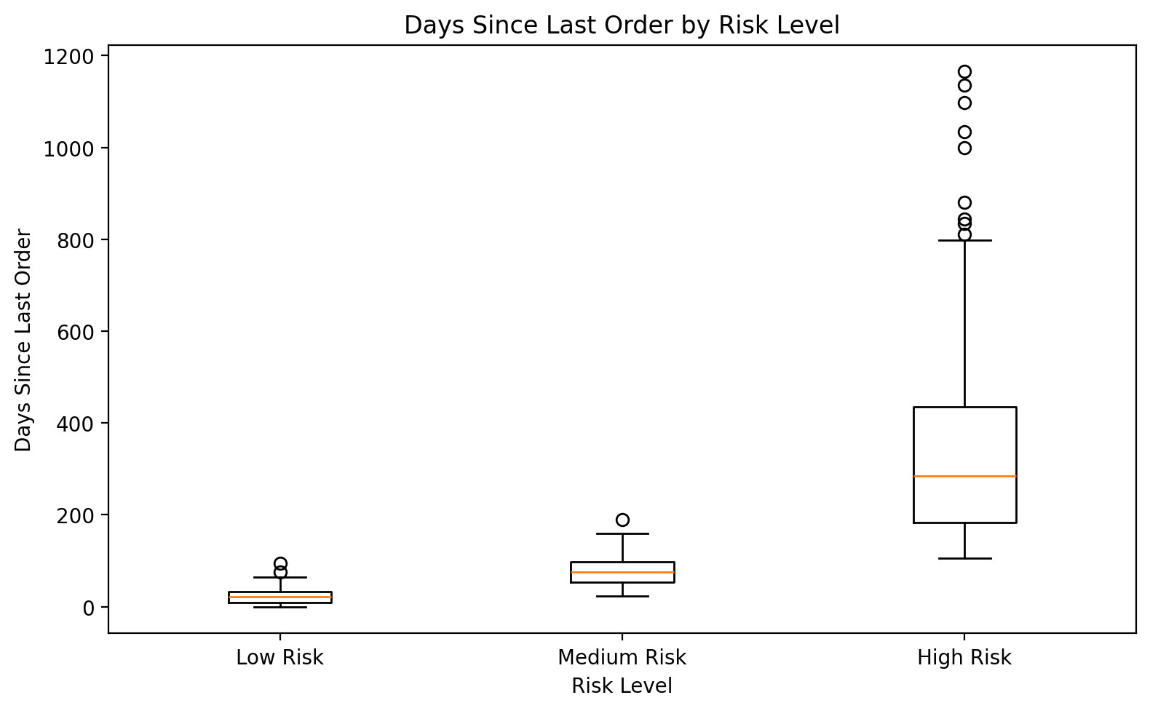
Customer Purchase Recency
BUSINESS TAKEAWAY
Average days since last order: High Risk 345.04; Medium Risk 77.56; Low Risk 22.74. Consider testing targeted engagement for inactive customers.

Slide 6
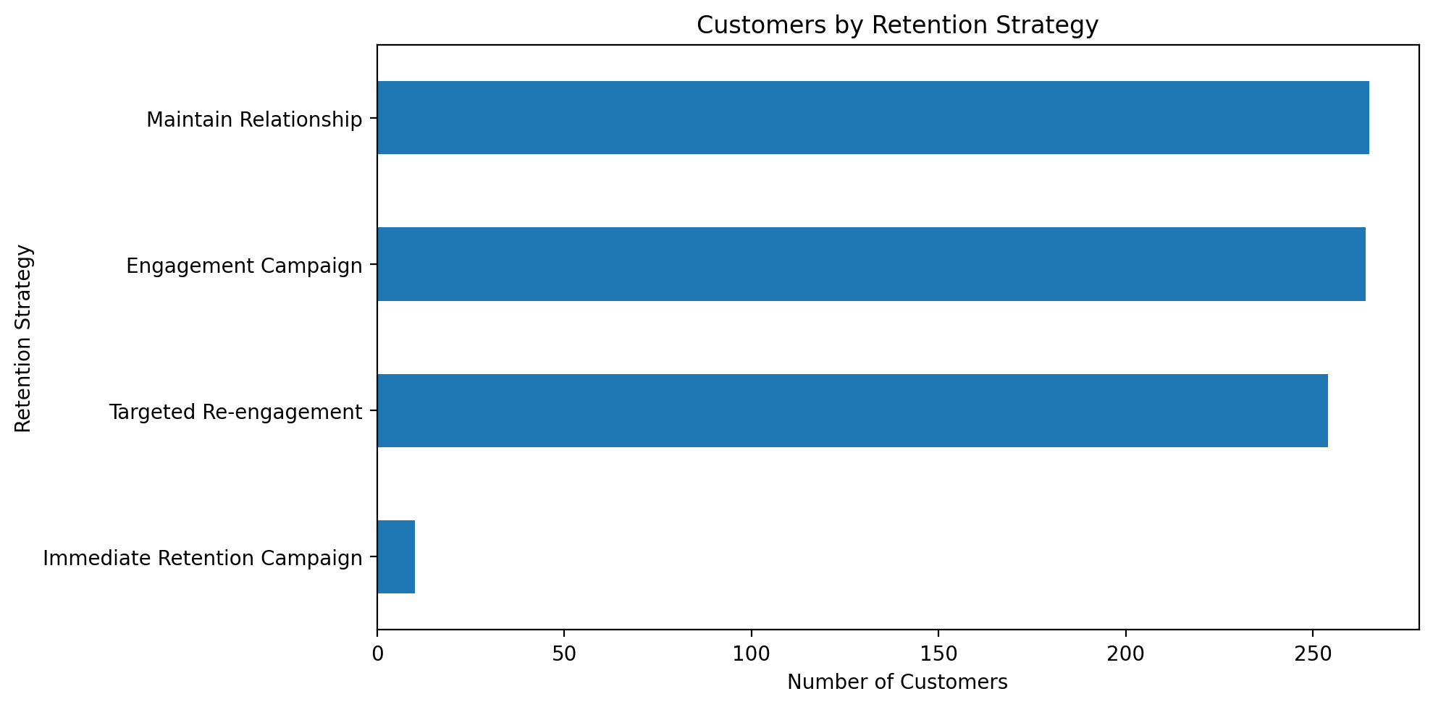
Retention Strategy Distribution
BUSINESS TAKEAWAY
Review how retention strategies are assigned. The current dataset assigns high-risk customers to Targeted Re-engagement or Immediate Retention Campaign.

Slide 7
Customer Value at Risk
High-risk estimated CLV: ₹800,909.84
Share of total estimated CLV: 31.33%
Average estimated CLV for high-risk customers: ₹3,033.75
Business implication: investigate whether targeted retention can protect valuable customer relationships.
Important: estimated CLV is a model-derived measure, not guaranteed future revenue.

Slide 8
Recommended Business Actions
1. Review high-risk customers with long purchase gaps.
2. Test targeted re-engagement on a defined customer segment.
3. Prioritise outreach using risk, estimated CLV, and business context.
4. Track repeat purchases, recovered sales, and campaign response.
5. Compare results against a baseline before scaling campaigns.

Slide 9
Limitations and Next Steps
Risk classifications describe model or dataset categories; they do not guarantee churn.
Historical associations do not prove that a retention campaign causes better outcomes.
Estimated CLV should not be interpreted as guaranteed future revenue.
Validate the recommendations with campaign experiments and subsequent customer data.
Monitor customer activity and review results regularly.

