Slide 1
Data Collection And Management
Shraddha Subhedar
RIN: 661673295
Date: OCTOBER 4 2016

Slide 2
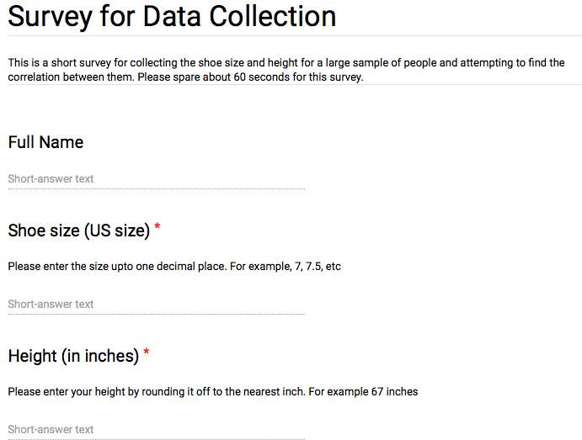
INTRODUCTION
Goal: Find the degree of correlation between shoe size and the height of different individuals.
Mode: Generation i.e. Survey
Link to Google form: https://goo.gl/forms/TFbrZoJbrjw2KlKM2

Slide 3
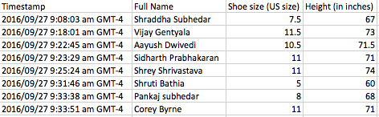
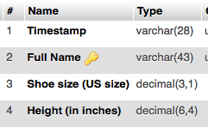
DATA ORGANISATION

Slide 4
METADATA AND PROVENANCE
Timestamp
Units of Measurement
Google Form
Responders (friends, family and classmates)
Database Structure

Slide 5
PROBLEMS FACED
Confusion about reference unit
Precision value
Time since last measurement
Variability for different manufacturers
Duplicates

Slide 6
LESSONS LEARNT
Need for additional variables (gender, age, etc. ) to interpret the results correctly.
Conversion table for measurement
Input field validation to accept values in the required format.
Inclusion of explicit region variable rather than time zone.

Slide 7
QUESTIONS?

