Slide 1
Project report on: PDF Protection Tool using Python (GUI Based)
Submitted by: Shradha Garg
Course: B.Tech (Computer Science)
Internship Organization: Inlighn Tech
Date: 21 June 2025

Slide 2
Objective
To develop a graphical tool using Python that allows users to select any PDF file and apply password protection, enhancing file-level document security.

Slide 3
Technologies Used
- Python 3.11
- Tkinter (GUI Library)
- PyPDF2 (PDF Processing)
- OS Module (File operations)

Slide 4
Key Features
- GUI Interface (No command-line required)
- Browse any PDF file from the system
- Enter custom password
- Generate password-protected PDF with a single click
- Auto-saves output in the same folder

Slide 5
Project Workflow
1. Launch the application
2. Click 'Browse' and select a PDF file
3. Enter password in input field
4. Click 'Protect PDF'
5. Output PDF is saved with _protected suffix

Slide 6
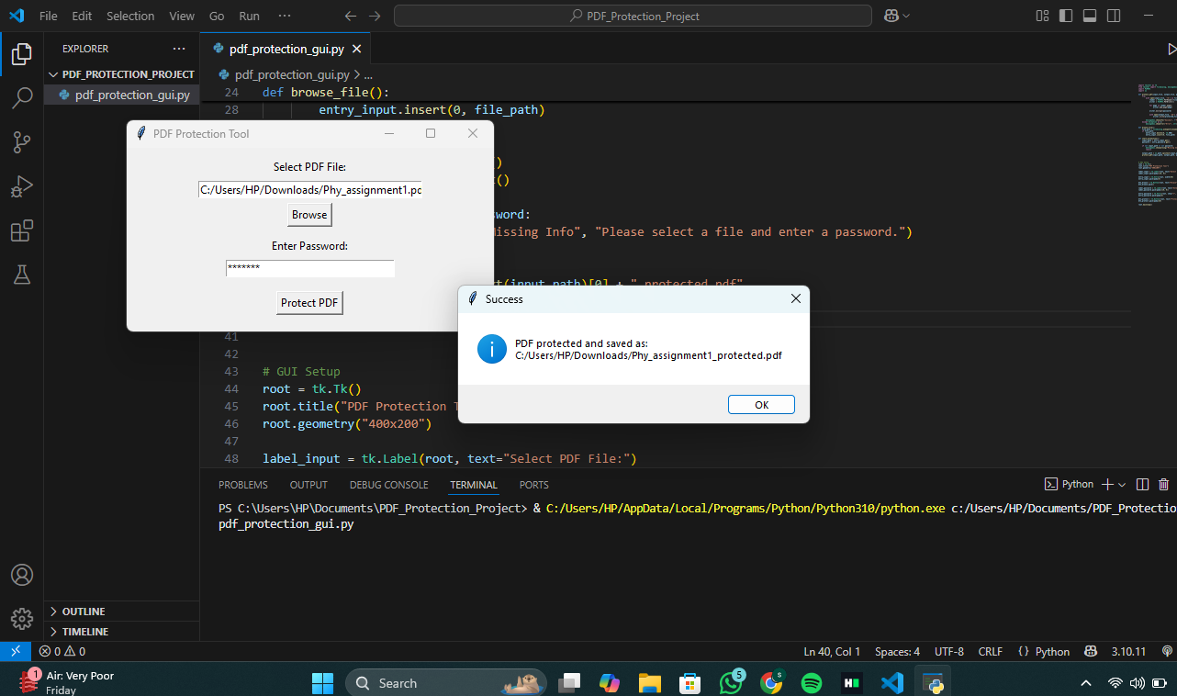
Screenshot – GUI Tool
Main GUI window showing PDF file selection and password input

Slide 7
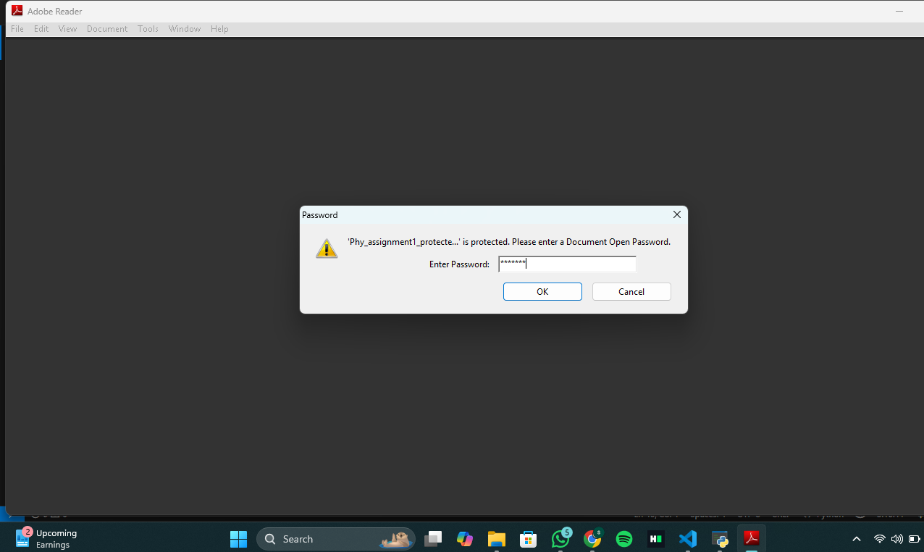
Screenshot – Output PDF
Output PDF prompting for password during open

Slide 8
Code Summary
- Used PyPDF2 to read & write PDFs
- Used writer.encrypt() to add password
- Tkinter used for file dialog and button interface
- Output file saved using original filename + _protected

Slide 9
Output Demonstration
- Successfully created a password-protected PDF
- File tested by reopening and verifying password prompt
- Screenshots taken for documentation and proof

Slide 10
Tools & Libraries
- Python 3.11
- Tkinter
- PyPDF2
- OS

Slide 11
Conclusion
The project helped reinforce concepts of file handling, user input via GUI, encryption logic, and PDF manipulation. This tool can be extended to batch processing or integrated with other PDF utilities like PDF Cracker or Merge tools.

Slide 12
THANK YOU

