Slide 1


Datathon 2025
FirstMav

Slide 2




FirstMav Introduction
Shradha Maharjan
MS in Computer Science, 2025
Klein Morrow
MS in Computer Science, 2026
Venkata Sai Kavuri
MS in Computer Science, 2026
Preeti Timalsina
MS in Cybersecurity, May 2026

Slide 3
Agenda
Business Problem and available data
Portfolio Overview
Overview of data
Who are FNBO's secured credit card customers?
What are their spending patterns and top categories?
Where are the customers?
Credit Utilization
Customer Distribution by Credit Score
Fico Trend
Customer Behavior Segments
High Risk Customers and their behavior
Data Driven Predictions – Credit improvement
Opportunities and Strategic Actions
Research studies on New Customers needs
Conclusion and Closing Thoughts

Slide 4

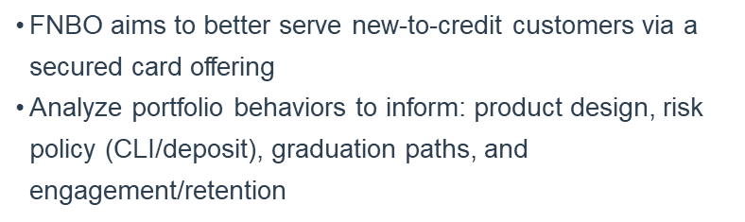


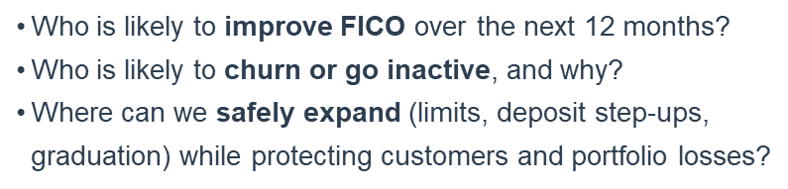
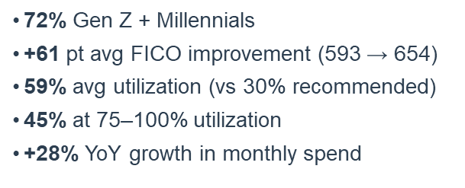

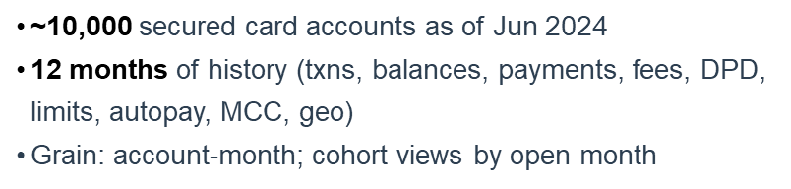

Slide 5

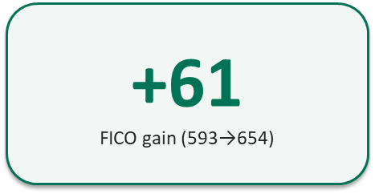
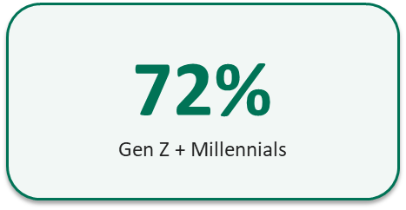
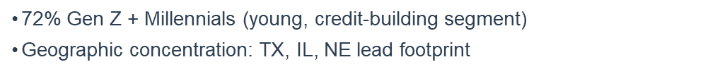

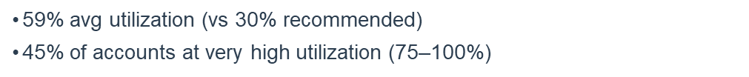
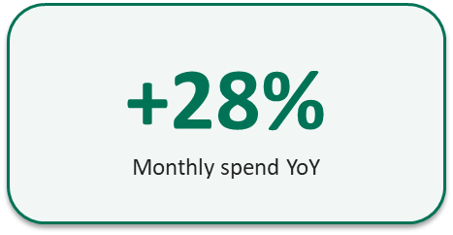
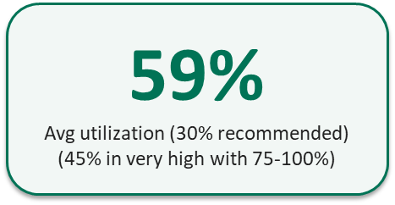
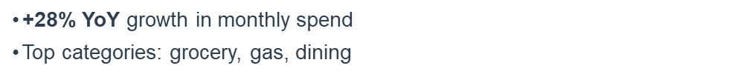

Slide 6
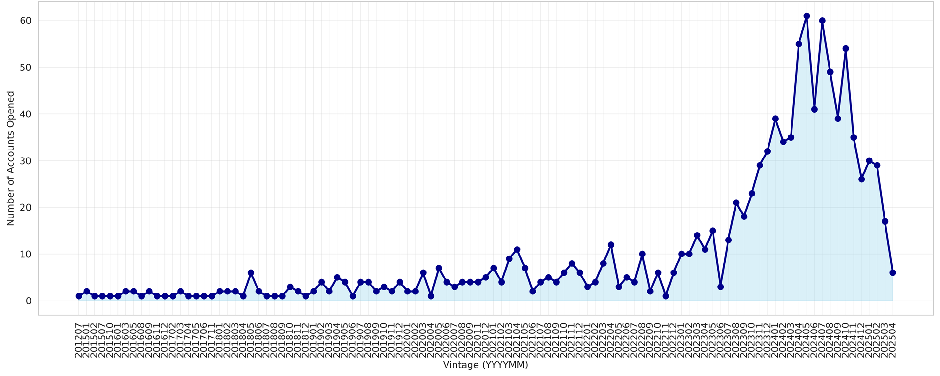
Overview of data
83.5% of accounts improved vs. open

Slide 7
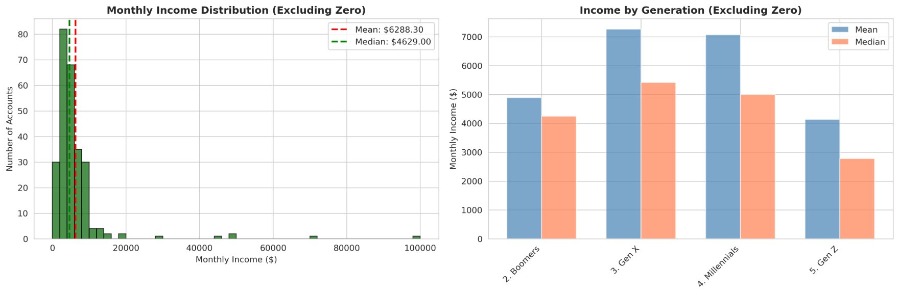
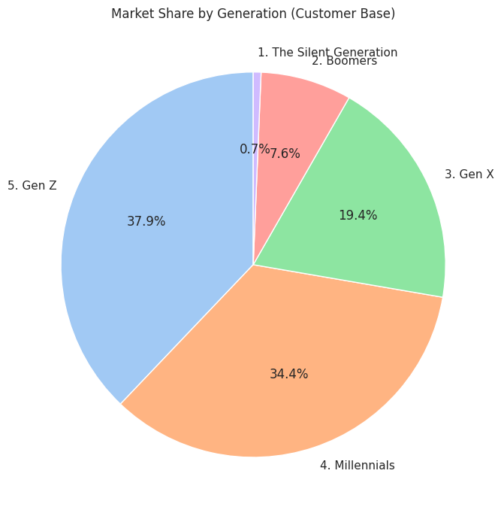
Secured Credit Card Customers. Who are they?
Market Share by income group and generation

Slide 8
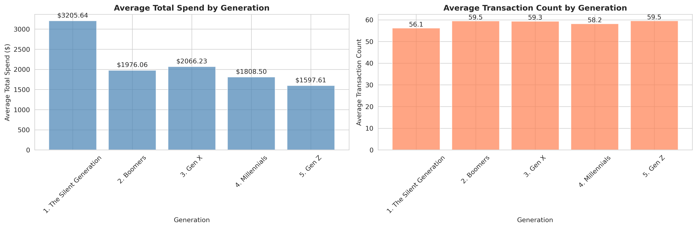
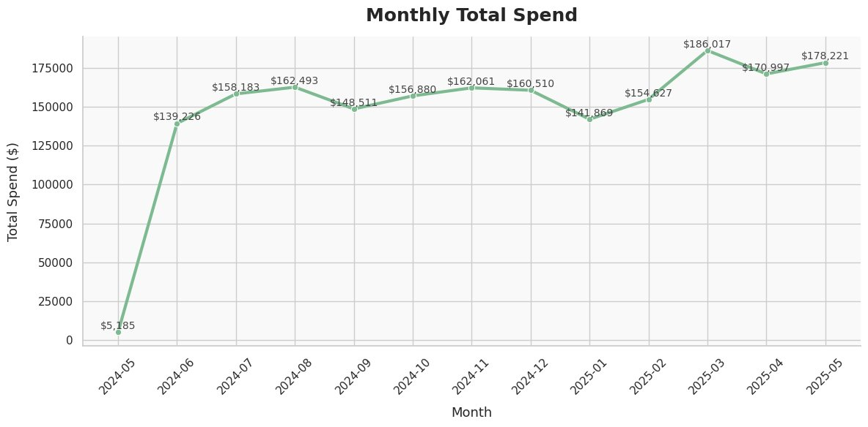
Total Spend and transaction count by Generation

Slide 9
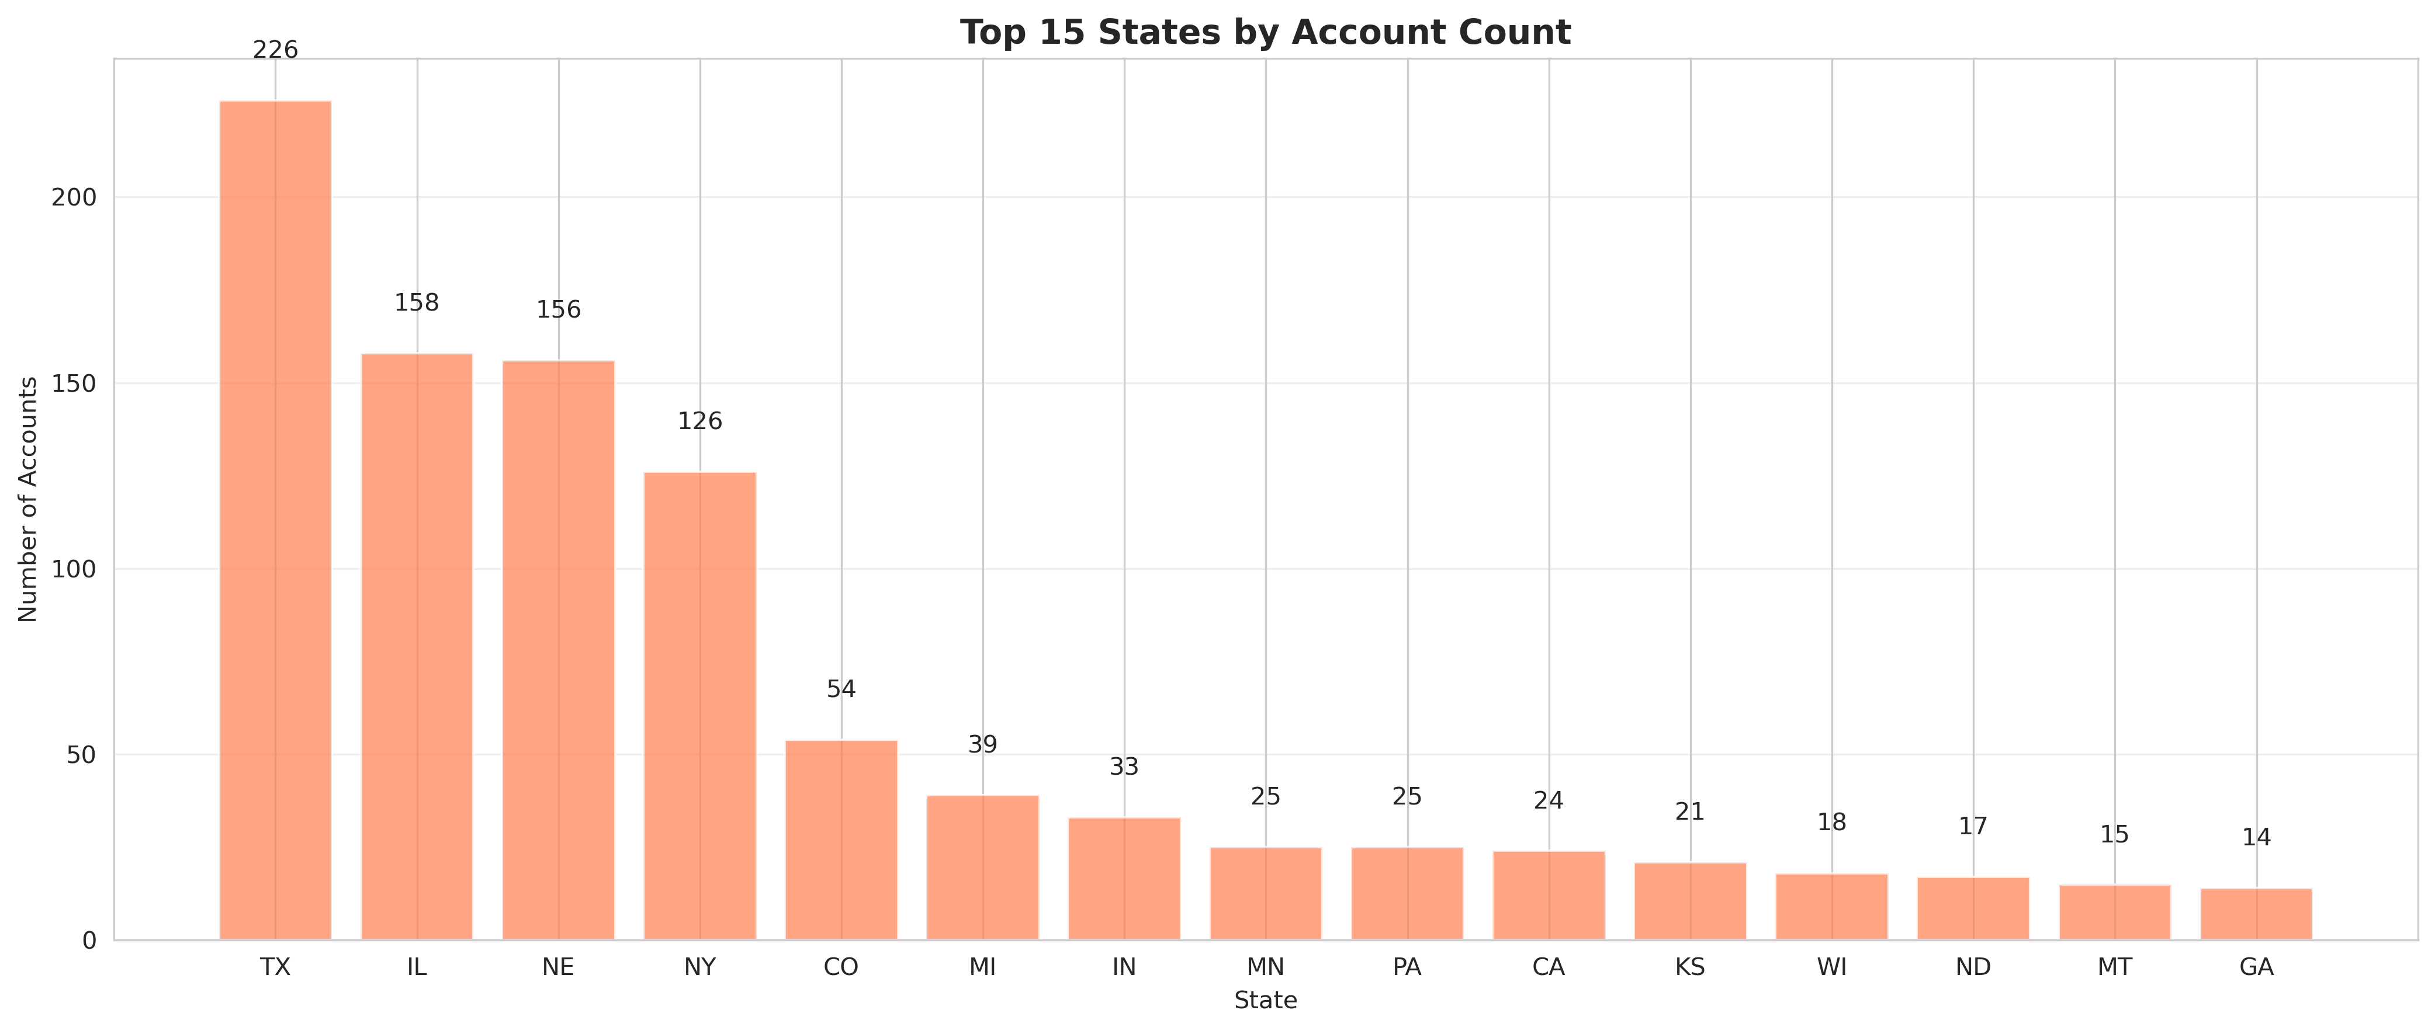
Where are the customers?

Slide 10
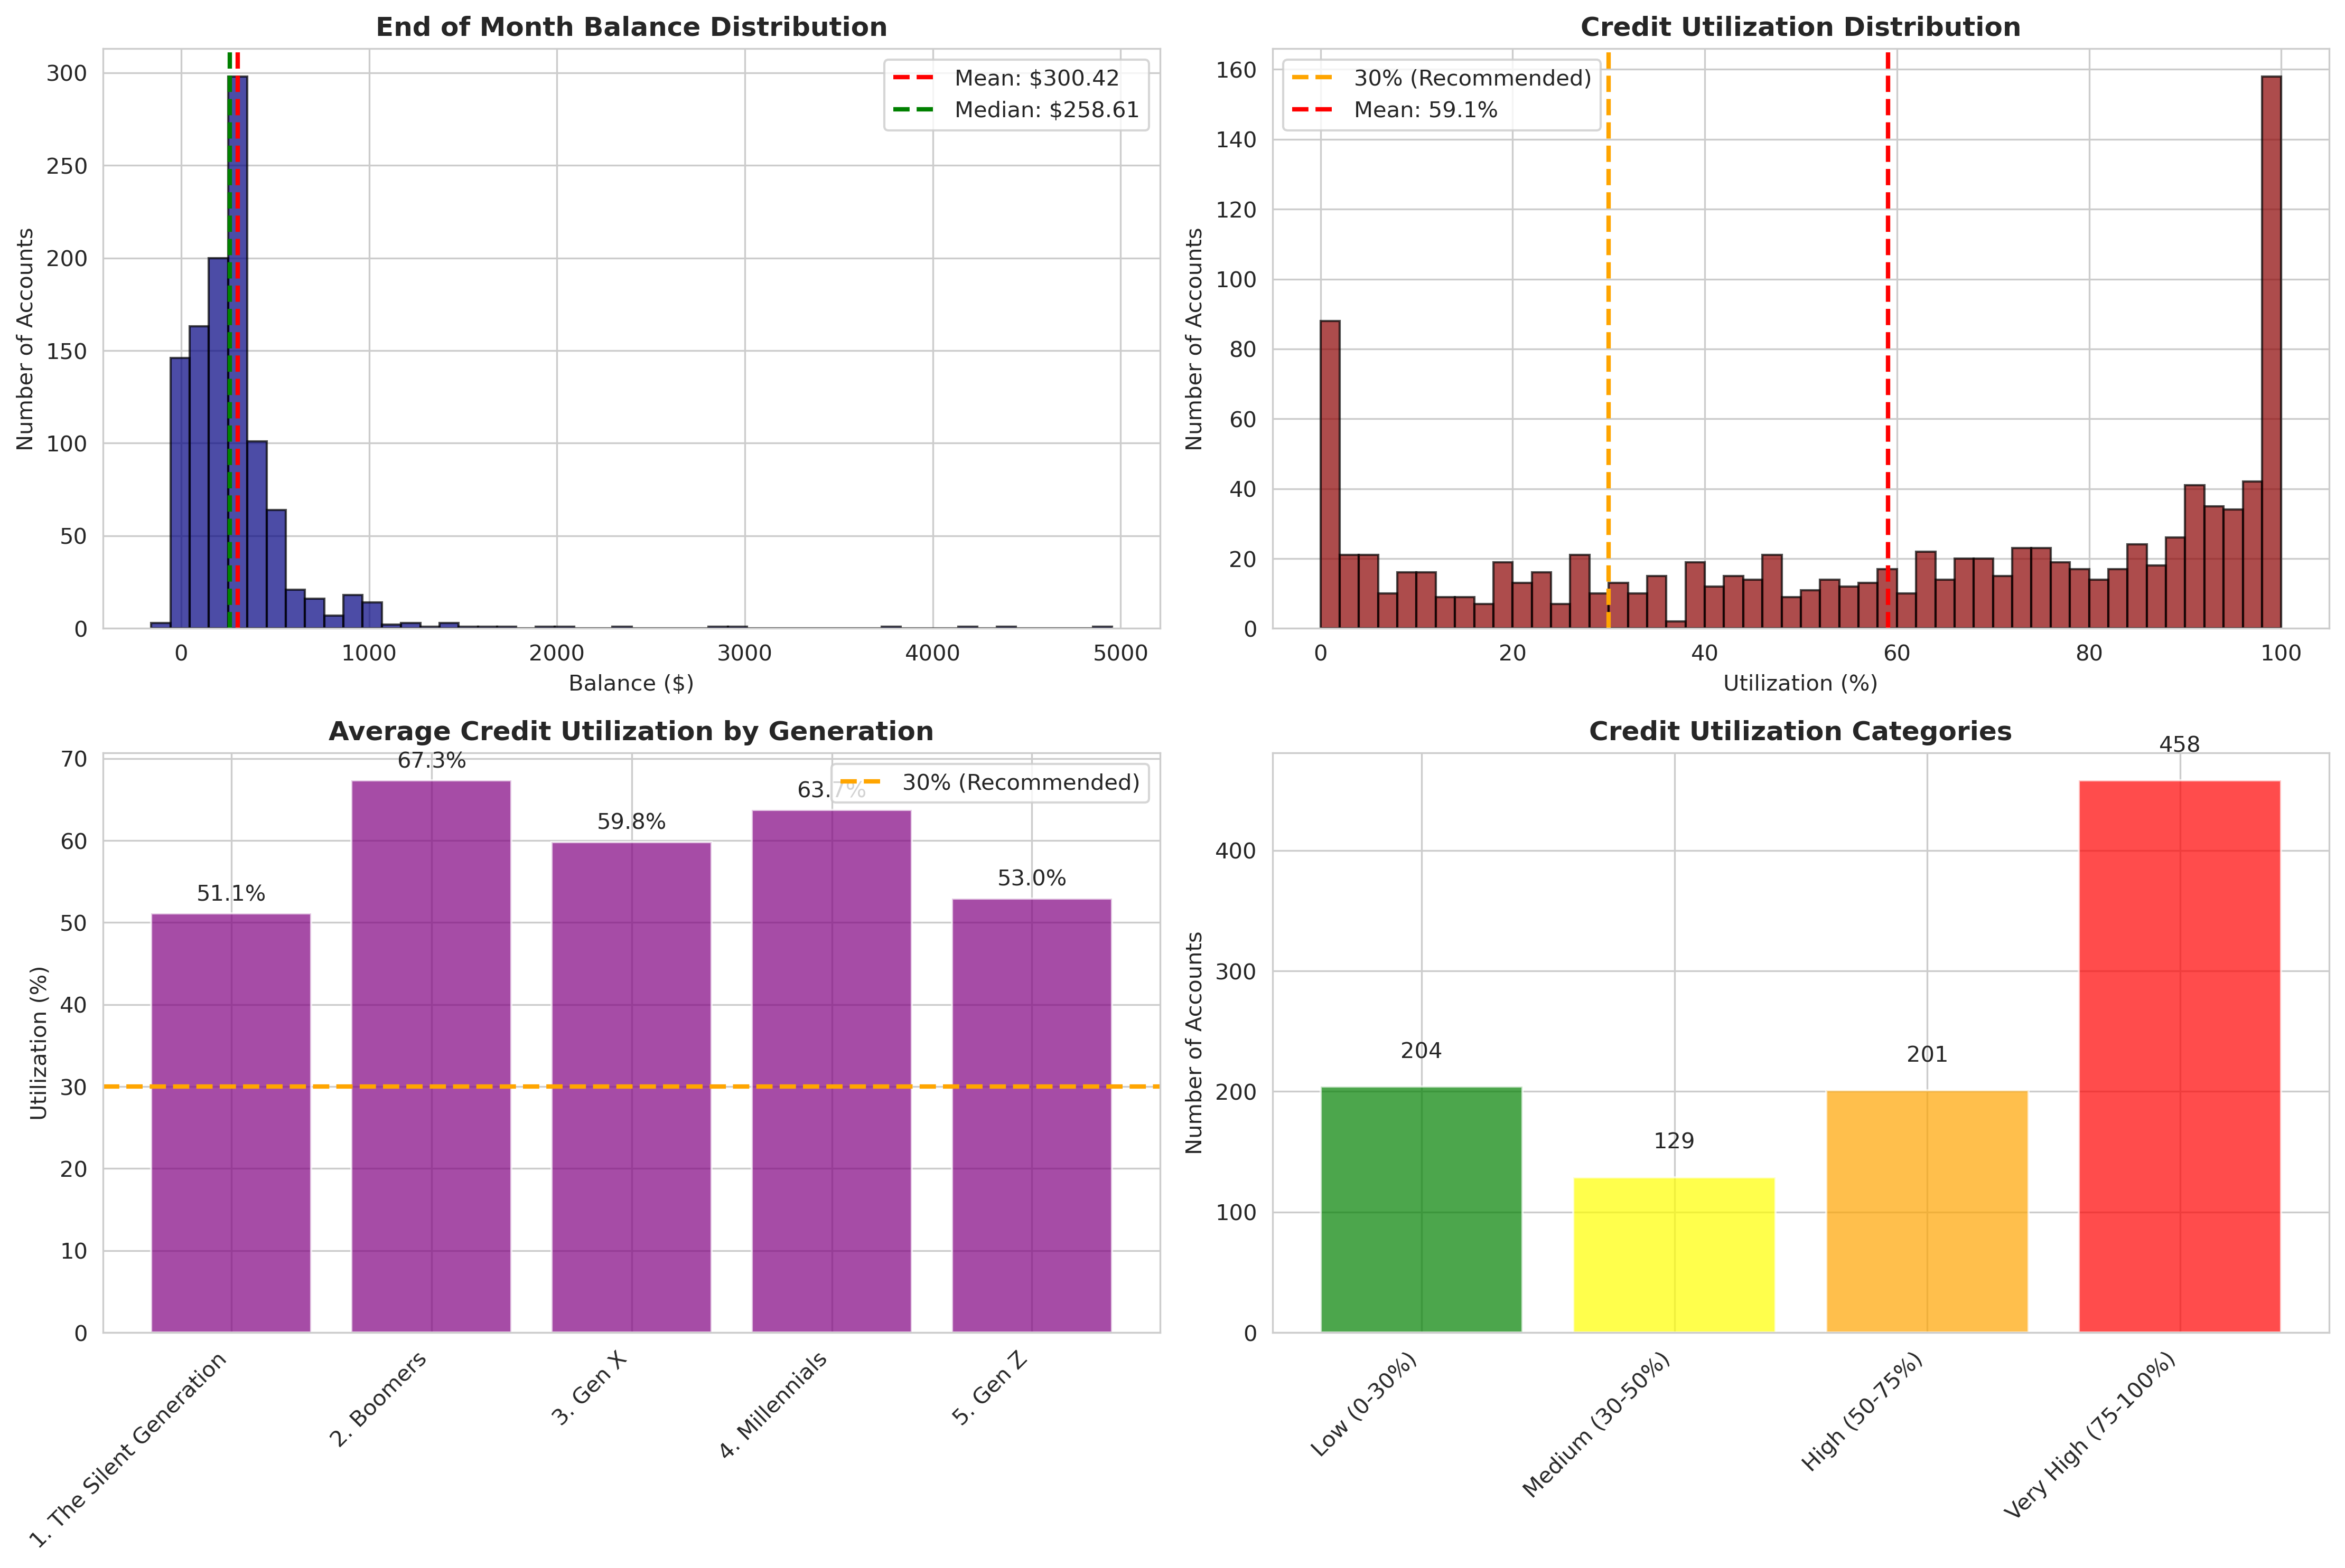
Credit Utilization

Slide 11
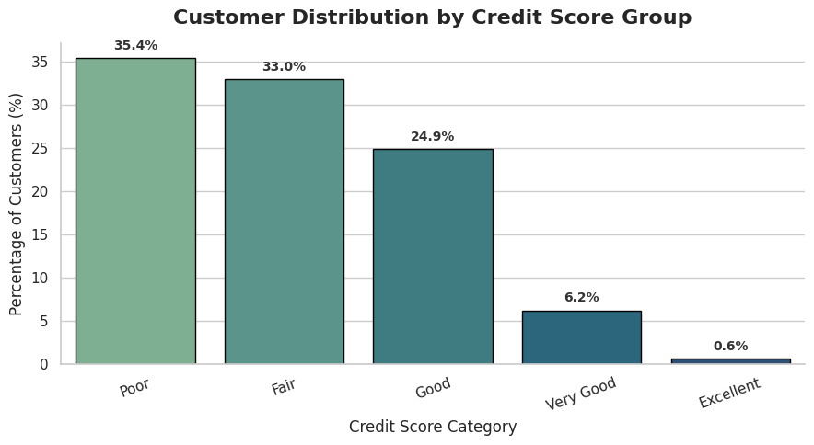
Customer Distribution by Credit Score Group
68.4% in poor to fair category
Score < 580 = Poor
Score 580 - 669 = Fair
Score 670 - 739 = Good
Score 740 - 799 = Very Good
Score >=800 then Excellent

Slide 12
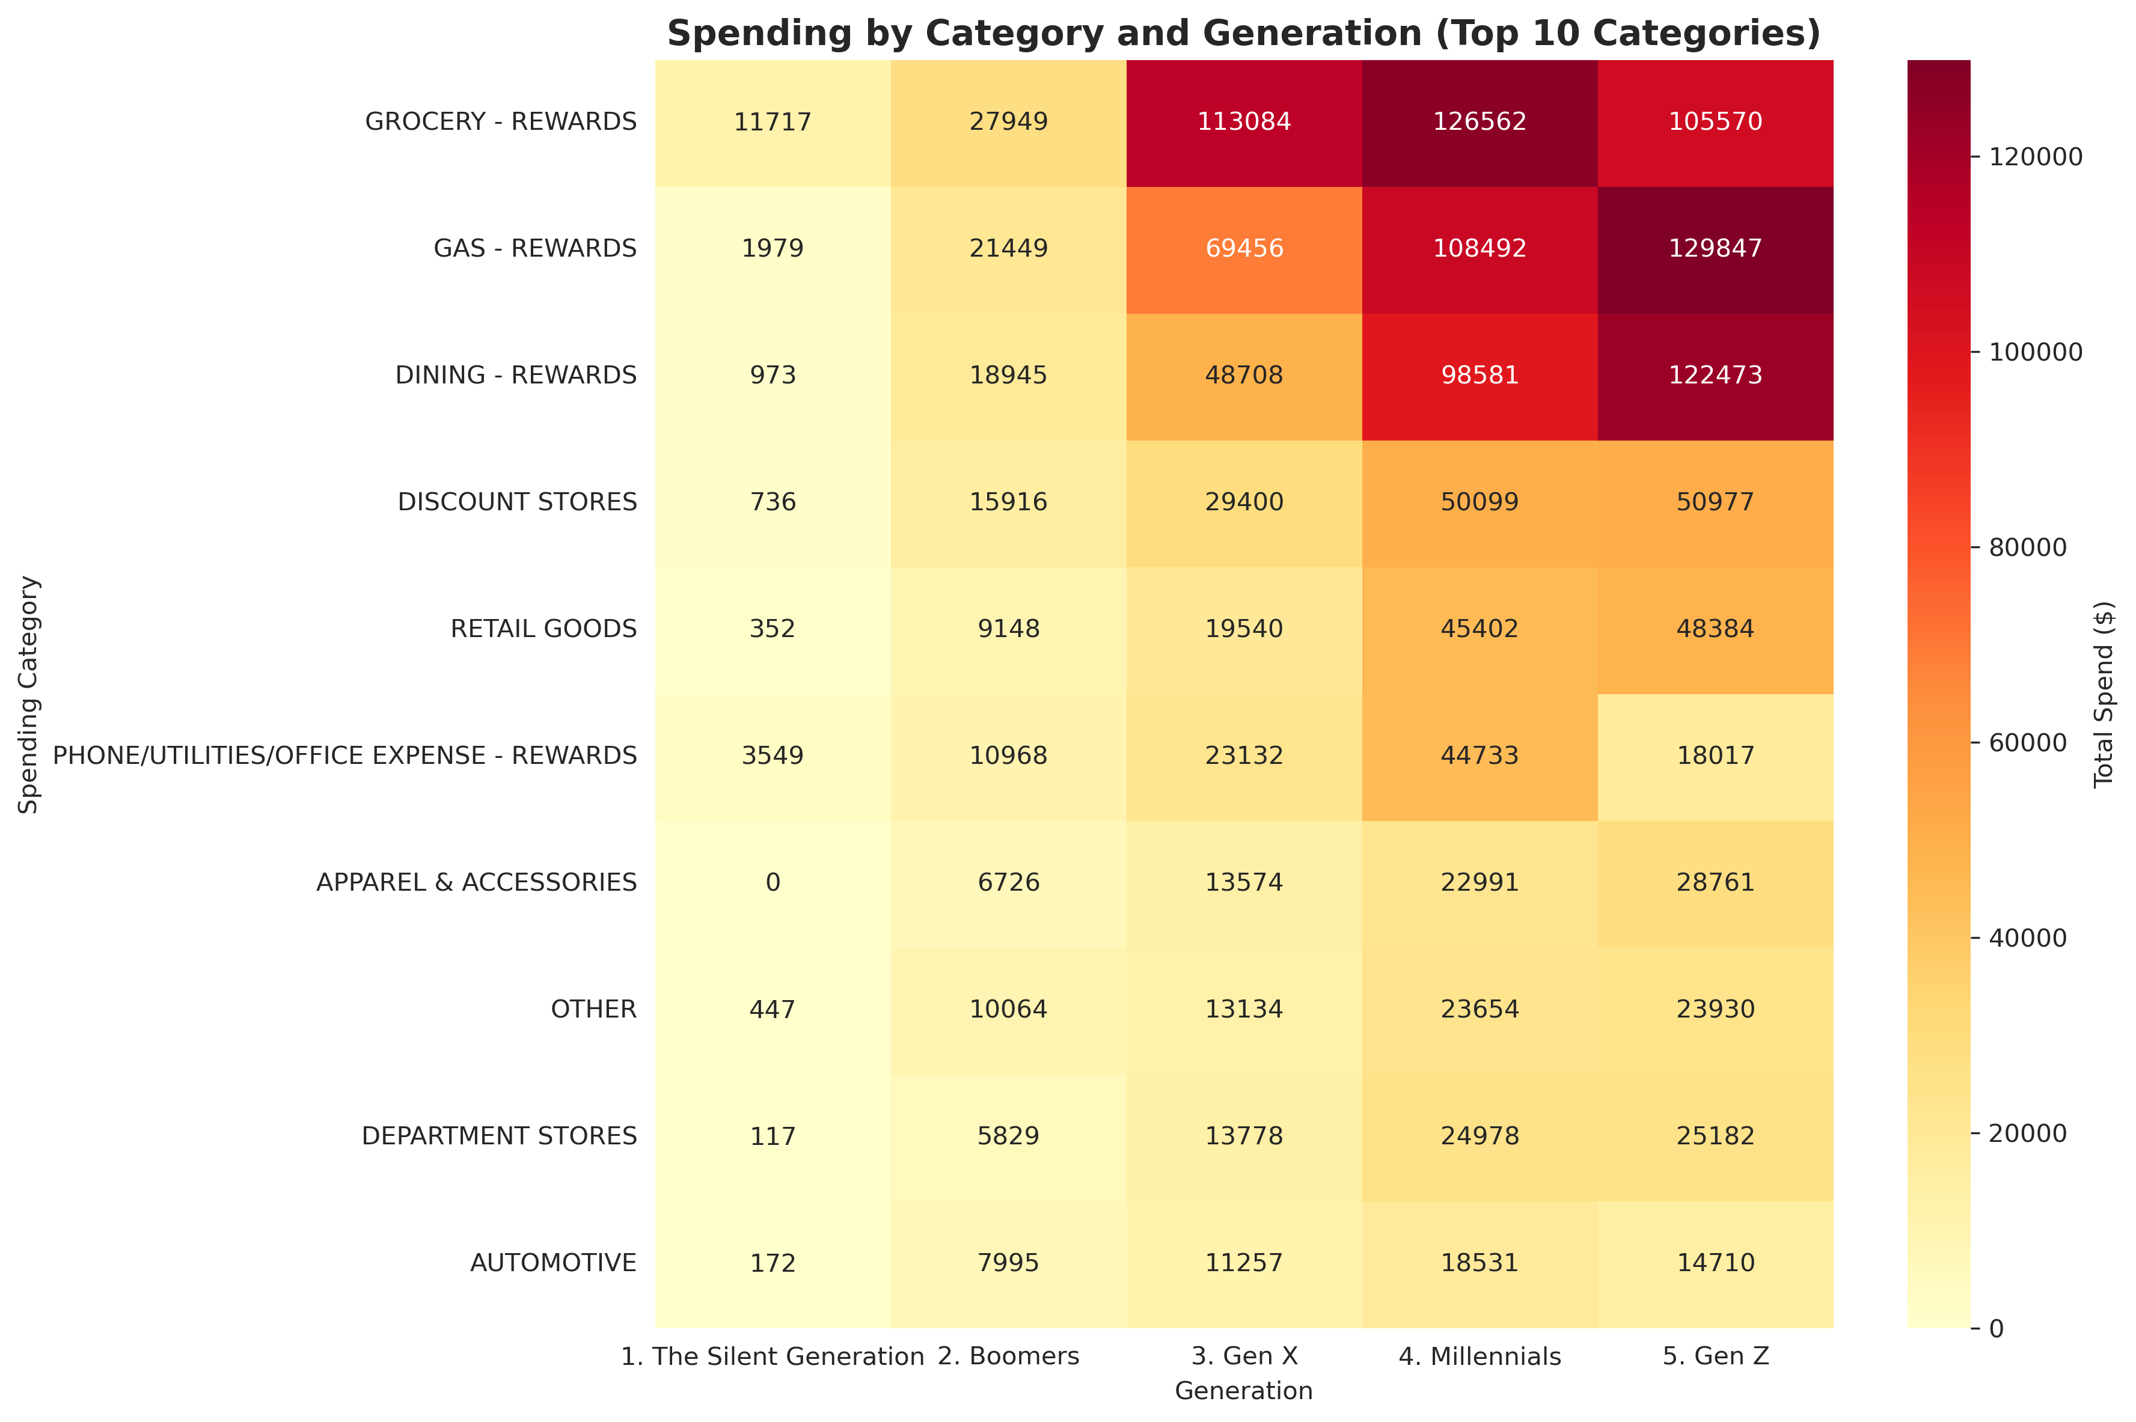
Top Spending Category by generation
Reflects similar top category patterns for all generations with few up and down on the GenZ spending.
Typical top 3:
Groceries, Gas, Dining
Gen Z top 3:
Gas, Dining, Groceries

Slide 13
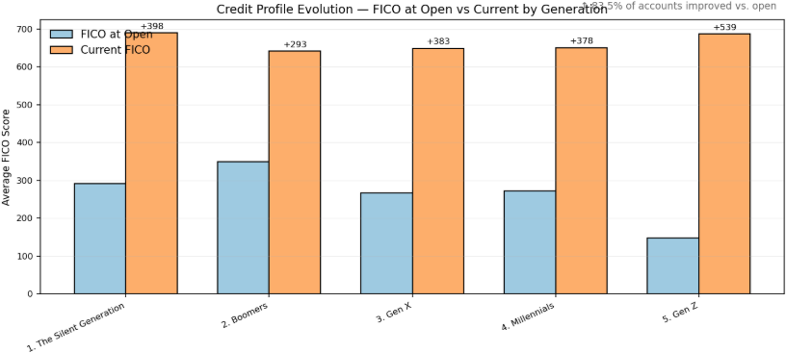
FICO at Account opening vs. Now
83.5% of accounts improved vs. open

Slide 14
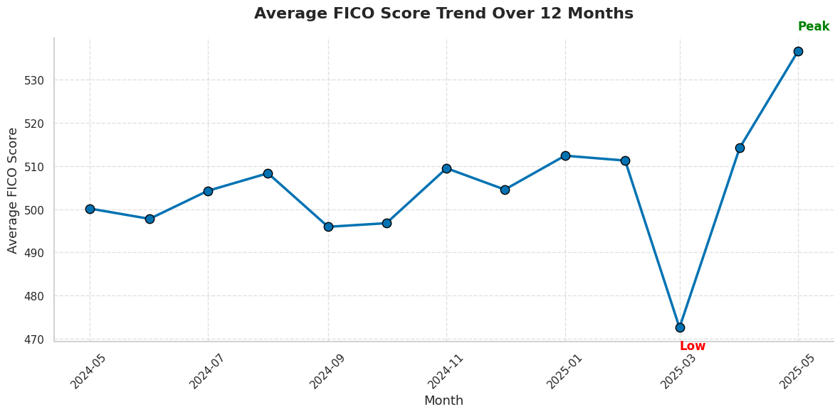
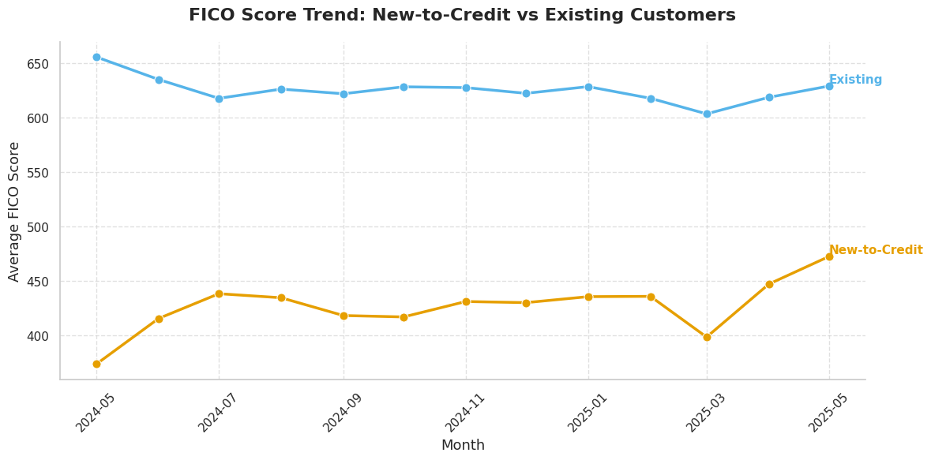
FICO Score Trend
2025-March Dip
Student loan delinquencies reappearing on credit files (equifax global credit report Q1 2025)

Slide 15
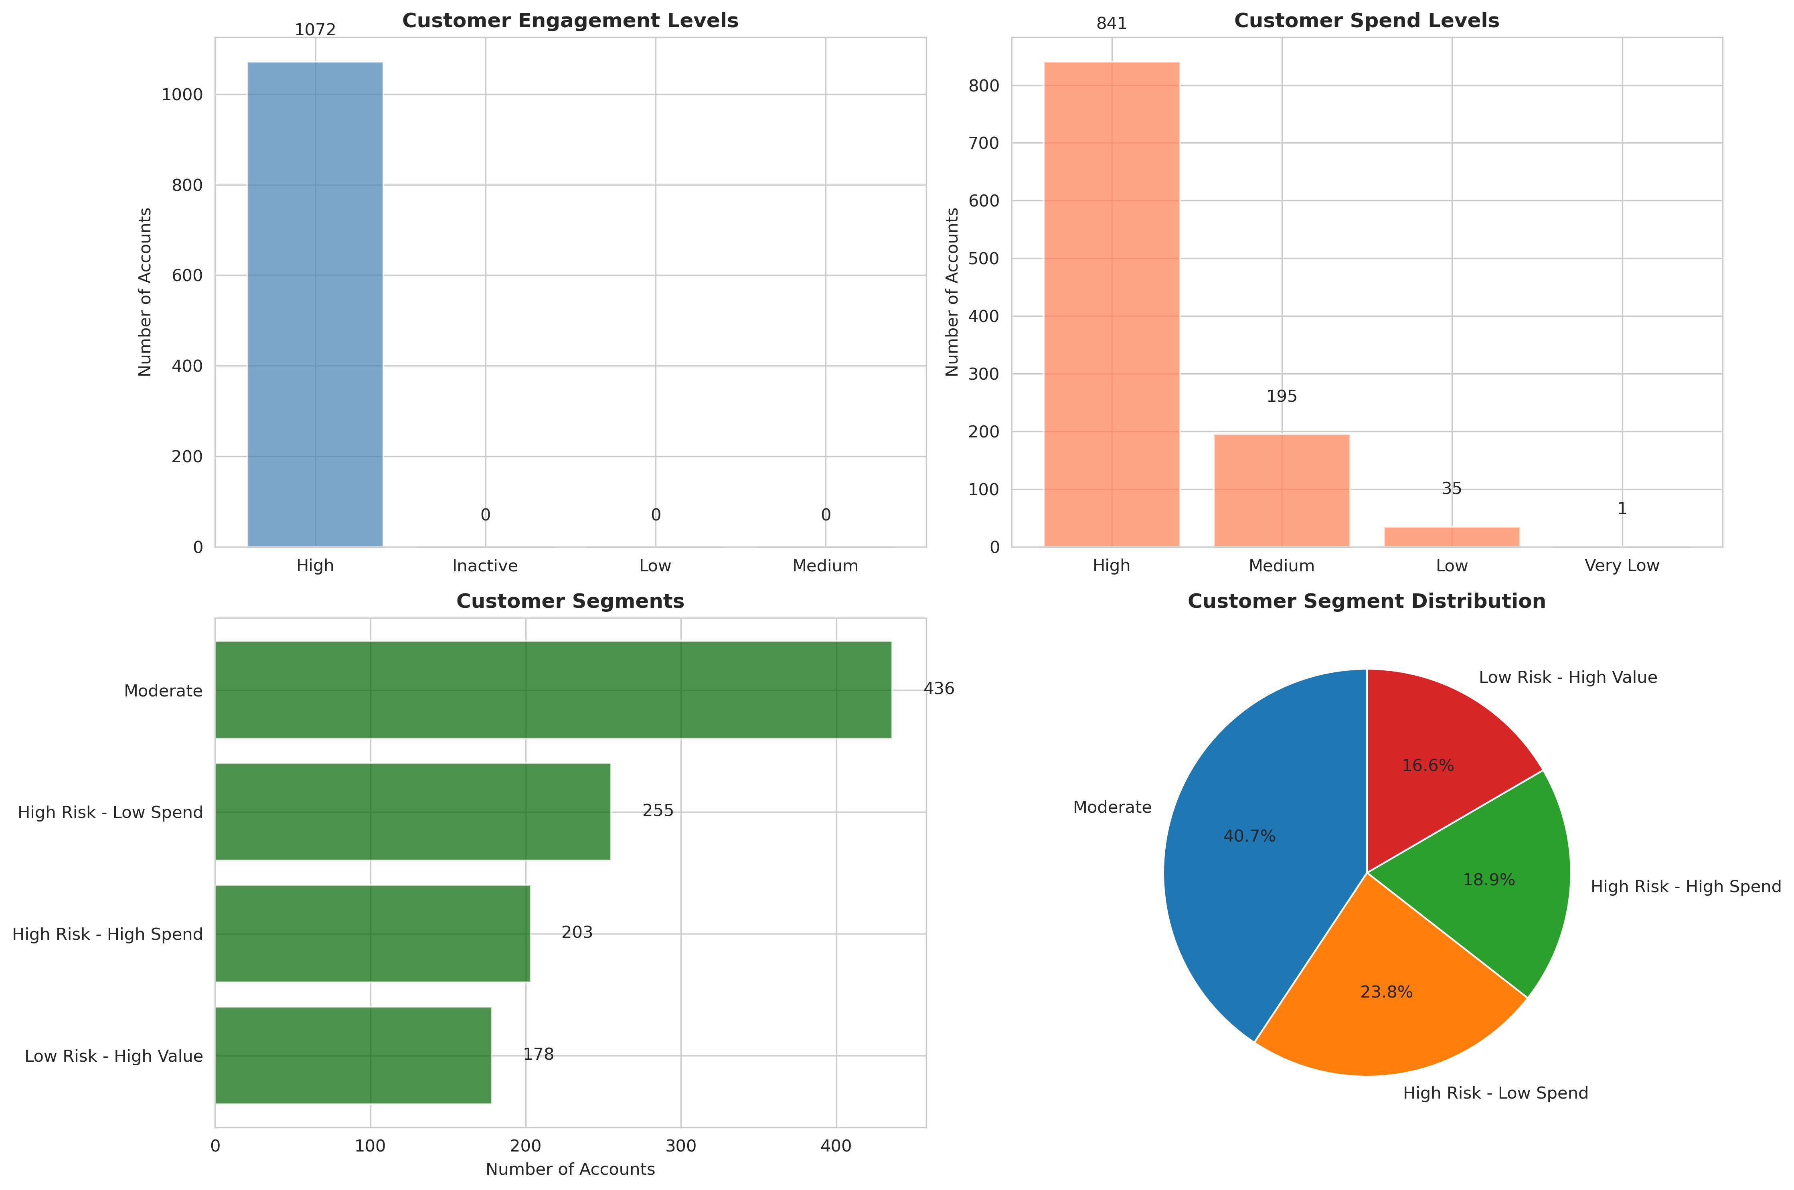
Customer Behavior Segments
Moderate (41%) — balanced spend and credit health.
High Risk - Low Spend (24%) — minimal use, potential drop-offs.
High Risk - High Spend (1G%) — active but over-leveraged.
Low Risk - High Value (16%) — prime candidates for graduation.
Allows to personalize engagement strategies.

Slide 16

Moderate customers dominate, but risk groups are significant:
About 46% of accounts fall into the moderate segment, while the rest are spread across high-risk low-spend (23.8%), high-risk high-spend (18.9%), and low-risk high-value (10.6%) groups. This reveals that over 40% of customers carry elevated risk traits.
Hidden risk among high spenders:
Even though spending and engagement appear healthy, the overlap between high-risk and high-spend segments suggests that some of the most active customers may also pose financial risk — a key area requiring deeper examination.
Engagement ≠ stability:
High engagement doesn’t necessarily translate to financial stability. Some of the most active users might also have high utilization or inconsistent repayment behavior.
High engagement and spending concentration:​​
The majority of accounts show high engagement and high spending levels, indicating strong overall activity within the portfolio.

Slide 17
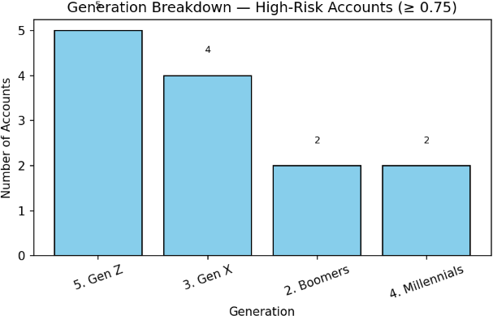
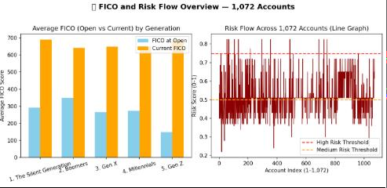
High Risk Customers
GenZ and GenX dominate high risk accounts
Risk Flow shows many accounts above the high-risk threshold, long tail persists.
Focus: Utilization Control, CLI Placing and security/education for younger segments

Slide 18
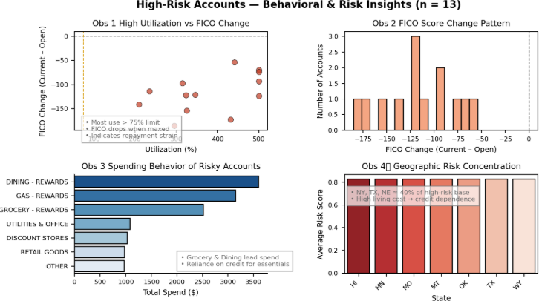
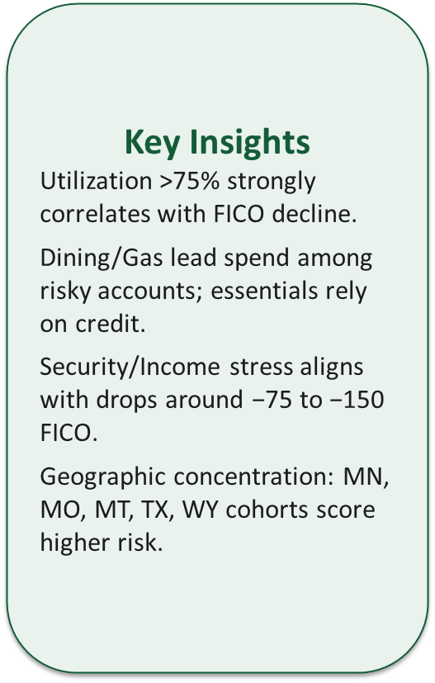
High Risk Behaviors

Slide 19
Data Driven Predictions
Goals
Which customers are likely to improve their FICO score, and
Which customers are likely to churn or become inactive.

Slide 20
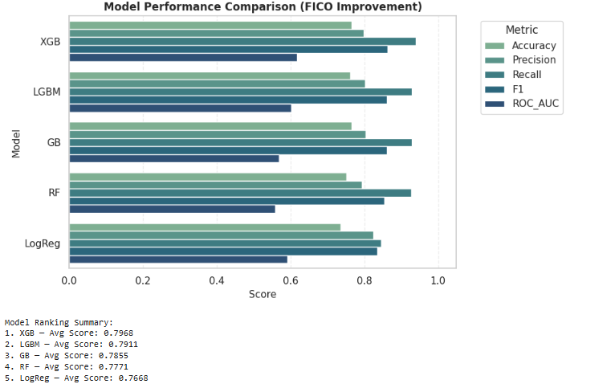
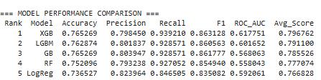
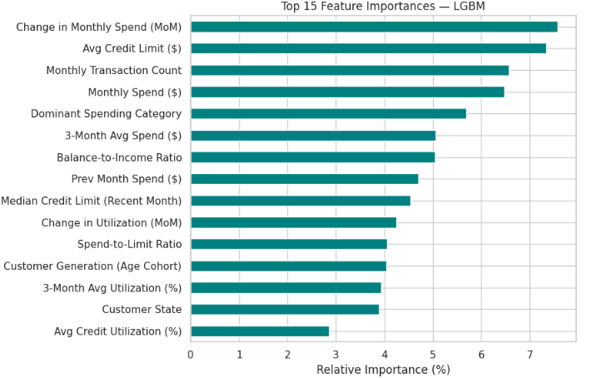
Model used to predict credit improvement

Slide 21
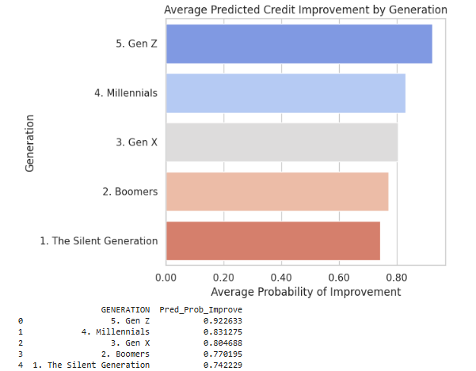
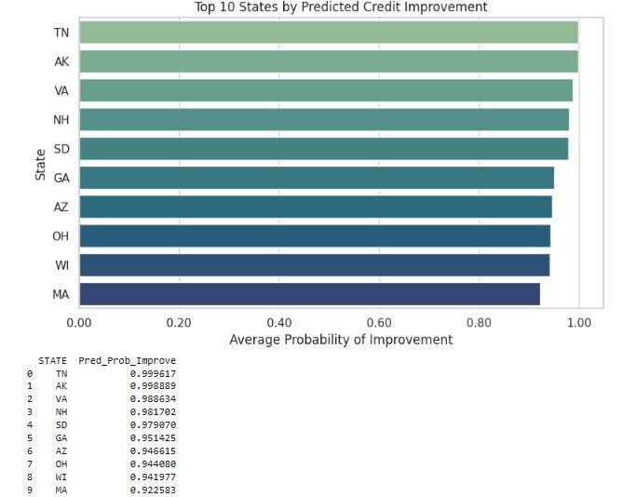
Predicted improvement by generation and state
TN and AK have the highest predicted credit improvement (~0.99), followed by VA and NH (~0.98), signaling a meaningful geographic lift

Slide 22
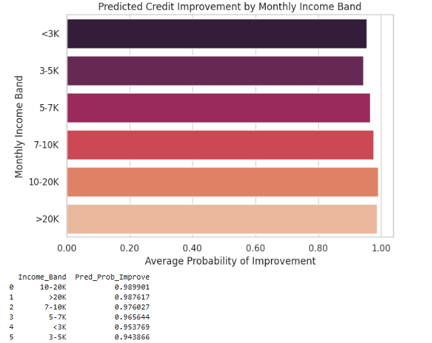
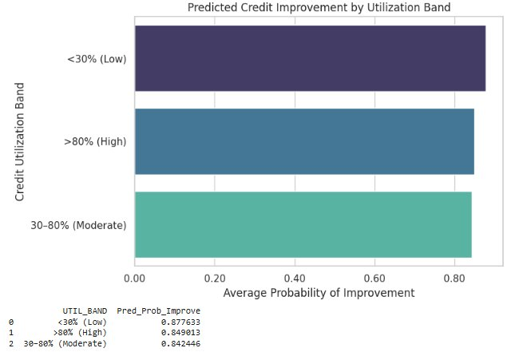
Predicted improvement, by monthly income and credit utilization
Utilization calculated as:
END_OF_MTH_BALANCE/CREDIT_LMT

Slide 23
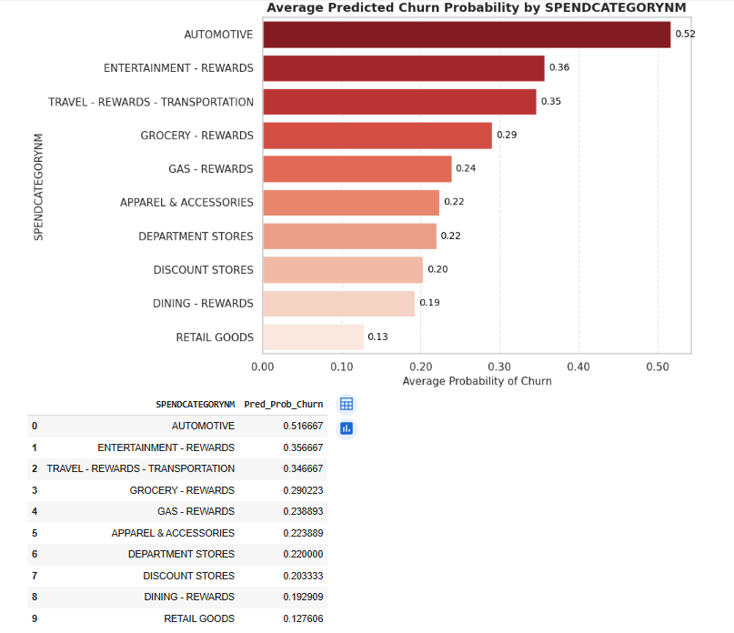
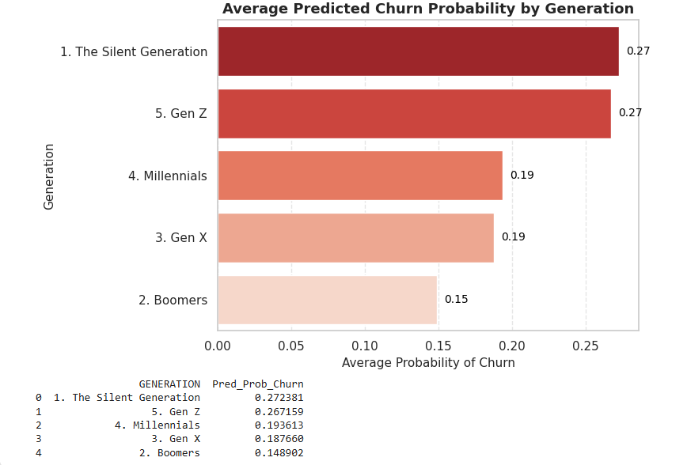
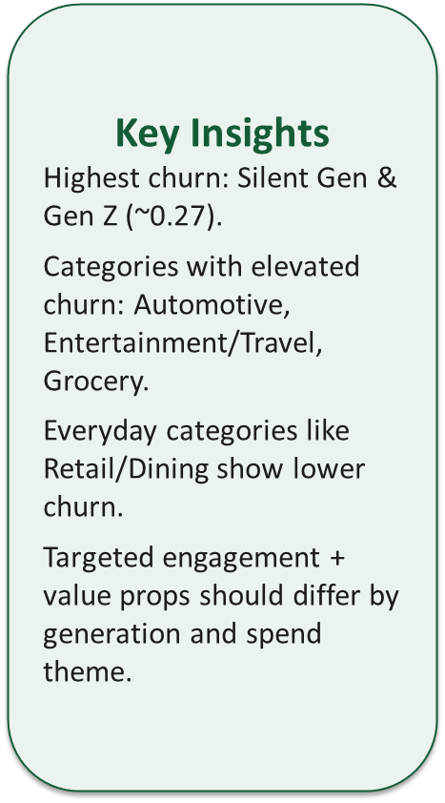
Who may become inactive?

Slide 24
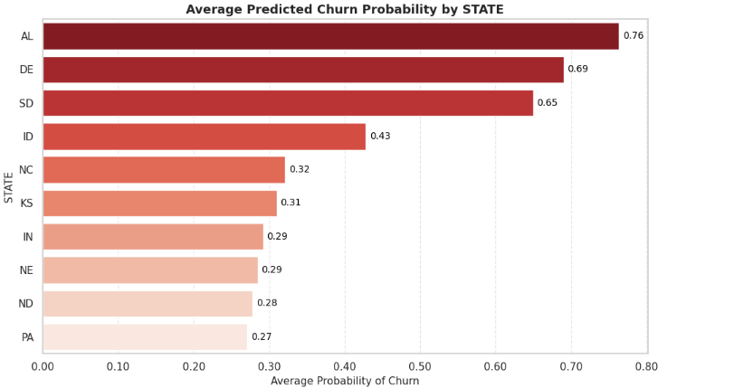
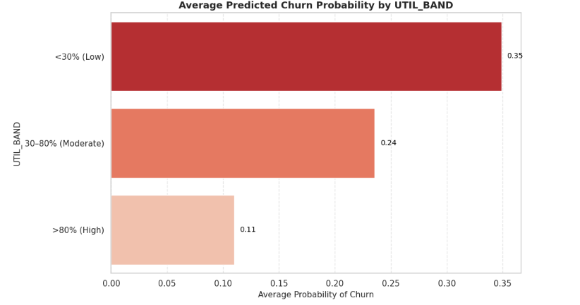
Who may become inactive?

Slide 25
Predictive Insights Summary
Insight | Key Findings
Credit Builders | Younger customers (Gen Z, Millennials) show strong credit improvement potential but higher churn risk
Churn Risk | Silent Gen and Gen Z have the highest churn; Boomers are most stable
Spending Stability | Automotive, entertainment, and travel users churn most
High Utilization | Low-utilization users churn more; high-utilization users stay but face higher balance stress.
Regional Trends | Churn peaks in Alabama, Delaware, and South Dakota, while Tennessee, Alaska, and Virginia show strong improvement potential.
Feature Drivers | Behavioral factors (spend change, credit limit, transaction frequency) drive improvement

Slide 26
Opportunities & Strategic Actions:
Credit Line & Risk
Product & Rewards
Growth & Reactivation
Launch gamified “Credit Boost” programs to strengthen credit growth and engagement
Apply age-specific retention tactics (digital nudges for younger customers, simplified communication for older ones)
Enable real-time behavioral monitoring to detect utilization or risk changes early
Use predictive alerts to guide credit-line adjustments and repayment outreach before balances reach risk thresholds.
Strengthen everyday-spend rewards (Grocery, Gas, Dining) to encourage consistent card usage.
Introduce cashback or spend-based incentives to promote responsible credit use and reduce low-utilization churn.
Design tiered rewards and credit-growth paths that transition customers from building to unsecured products as their credit improves.
Launch regional offers and education campaigns in high-churn states (AL, DE, SD).
Expand reactivation efforts in high-potential markets (TN, AK, VA) and leverage digital onboarding in GA, MT, WI.
Implement graduation campaigns for dormant or maturing accounts to re-engage customers and boost portfolio health.

Slide 27
Research Studies on New customer needs
Rewards are “a major factor” in card choice, but complex or devalued rewards drive complaints; for first-time users, fee transparency and predictable value (e.g., simple cash back, low fees) are important. (Consumer Financial Protection Bureau, Oct 2023)
Word-of-mouth/personal recommendations mattered more than ads for financially stable group. (Elan Credit card research study)
Approval likelihood, initial limits, and upgrade paths shape early issuer choice and long-term loyalty. (Transunion Consumer Pulse Study, Q2 2024)
FICO says Fraud/scam pressure is elevated, pushing security up the priority stack for account opening decisions.(Top factor for 1in 3 Americans)​
Virtual Card options for online purchases is a popular feature that's standing out. (US PaymentsForum)​

Slide 28
Conclusion & Closing Thoughts
Analyzed 10,000 secured card accounts to uncover key spending, utilization, and regional trends.
Identified four customer segments from high-value, low-risk to high-risk, low-spend, enabling FNBO to target engagement strategies .
Built models to predict FICO improvement and churn likelihood.
Outlined a clear roadmap across Credit Line & Risk, Product & Rewards, and Growth & Reactivation.
Insights empower FNBO to reduce risk, boost engagement, and drive sustainable growth for new-to-credit customers.

Slide 29
Discussion, Q/A

Slide 30



FirstMav

