Slide 1
DSA 201 • Final Presentation
AI vs. Human Content
Detection: A Multilingual Analysis
686
3
6
7
text samples
content categories
content domains
languages
Shradha Bhatia
April 2026

Slide 2
The Dataset and why it matters
Why this question?
What's inside
Since 2022, generative AI tools like ChatGPT, Llama, and Gemini have made it harder to tell AI-generated text apart from human writing.
49%
26%
25%
AI
Human
Post-Edited AI
That creates real problems for education, journalism, and hiring but most detection datasets are English-only and tied to a single model.
n = 335
n = 181
n = 170
Coverage
Domains: Social Media, Marketing, Technical Blog, Email, News, Education
AI vs. Human Content Detection Dataset (2026 Edition)
Source: Kaggle — Muhammad Afaq Bhatti
Languages: English, Hindi, Urdu, Arabic, Spanish, French, code-mixed
Generated: Jan 29, 2026
Models: Llama 3.1 8B, Llama 3.3 70B, Gemma 2 9B
Shape: 686 rows × 11 columns
Edit levels: none • light • heavy
AI vs. Human Content Detection • Shradha Bhatia • DSA 201
2 / 5

Slide 3
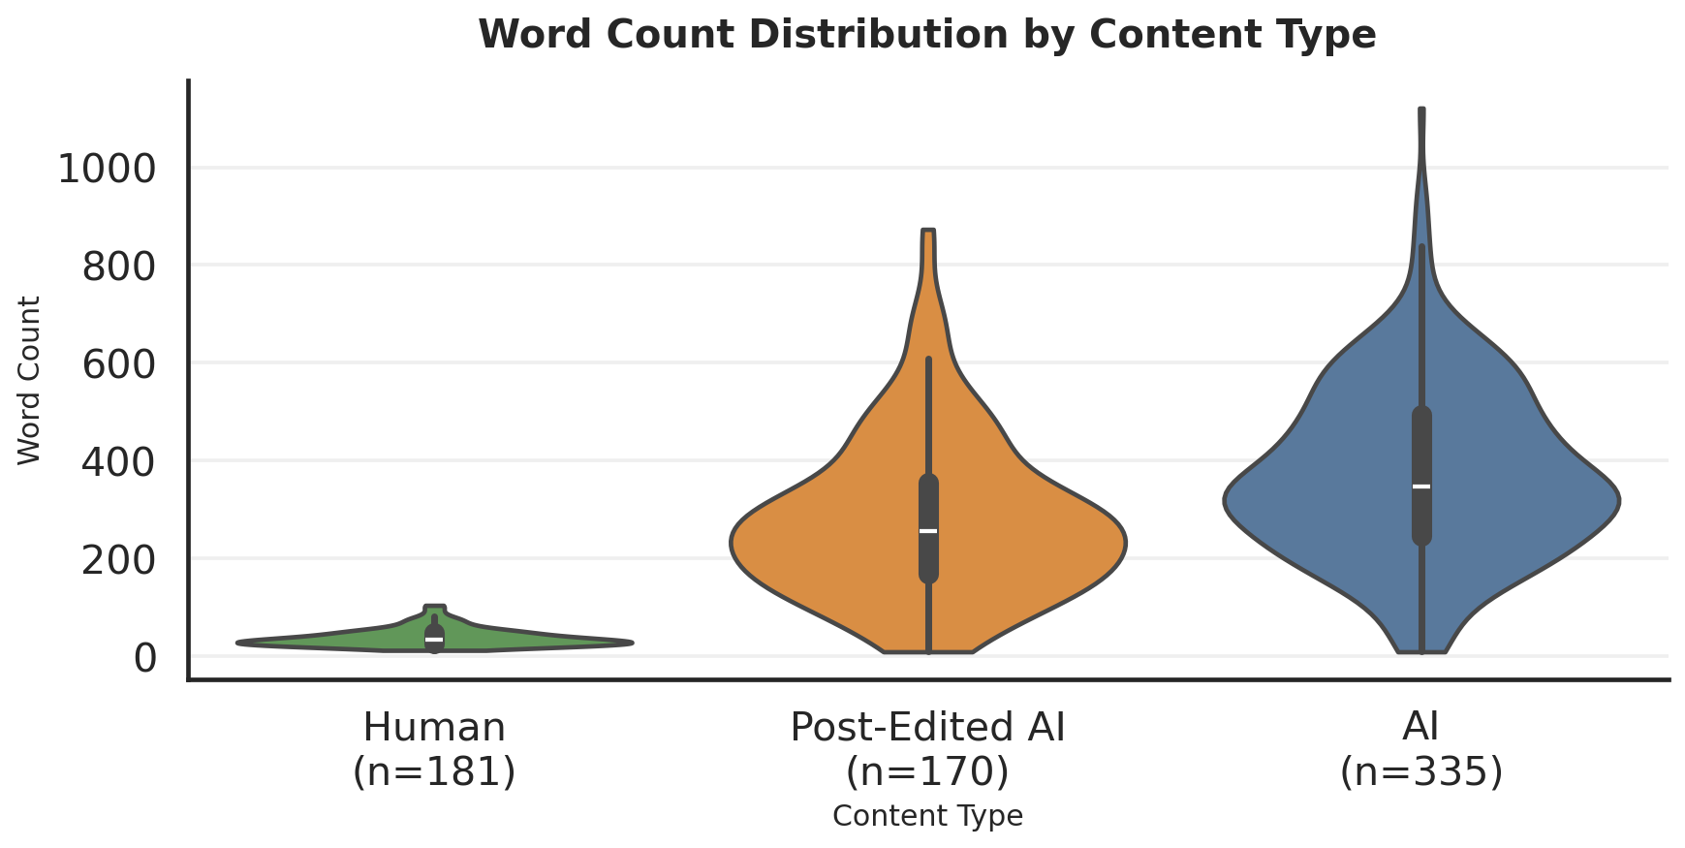
Q1 — Does word count separate AI from human writing?
Median word count
33
Human
256
Post-Edited AI
347
AI-Generated
AI writes ≈10× longer than humans.
Editing narrows the gap, but doesn't close it.
AI vs. Human Content Detection • Shradha Bhatia • DSA 201
3 / 5

Slide 4
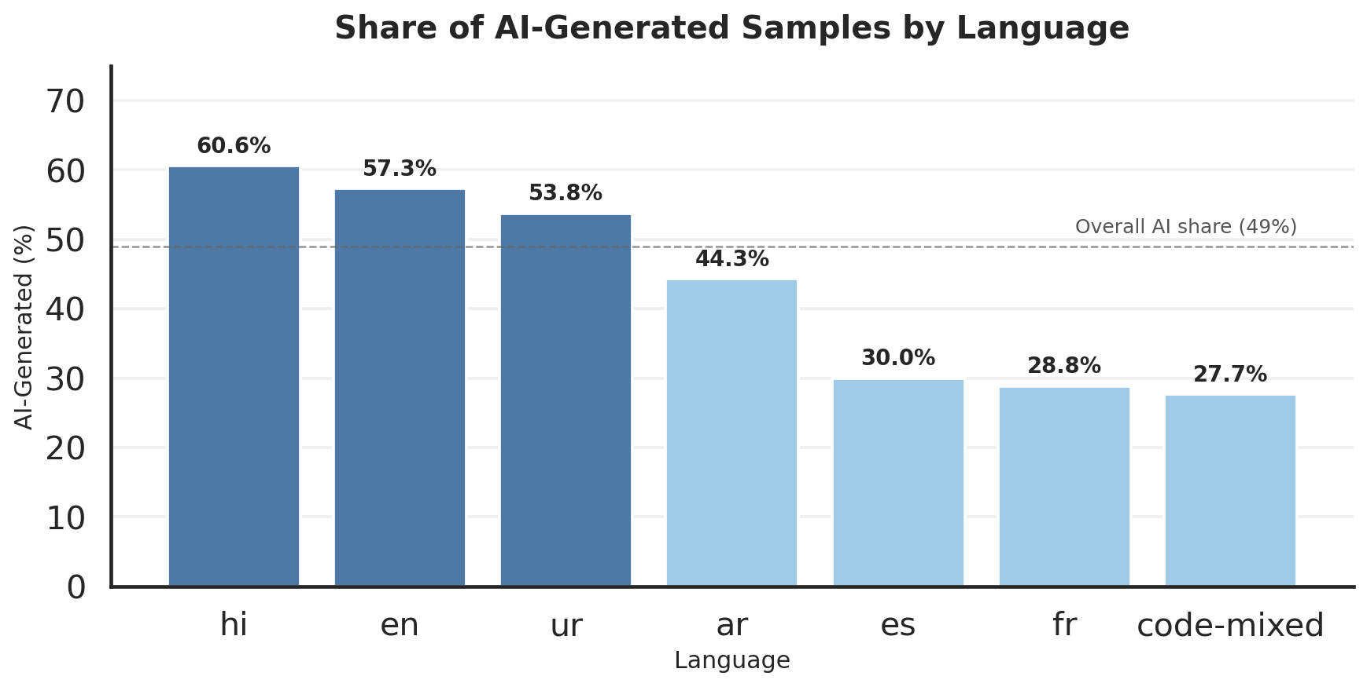
Q2 — Is AI content spread evenly across languages?
What the data shows
AI share is NOT uniform.
It ranges from 28% to 61% depending on the language.
Hindi, English, and Urdu skew AI-heavy.
This likely reflects where researchers could source AI prompts not a linguistic bias in the models.
English-only detectors will under-perform
Highest AI share: Hindi 60.6% · English 57.3% · Urdu 53.8%
Lowest AI share: French 28.8% · Code-mixed 27.7%
on multilingual or code-mixed text.
AI vs. Human Content Detection • Shradha Bhatia • DSA 201
4 / 5

Slide 5
Conclusion
1.
2.
3.
Word count is the signal.
Editing softens, not erases.
Language matters.
Humans wrote ~33-word posts; AI averaged ~347. The gap held across every domain in the dataset.
Post-edited AI lands between the two (~256 words). Human revision reduces AI verbosity but does not hide it.
AI share ranges from 28% to 61% across the seven languages. Detectors trained on English will miss a lot.
Detecting AI in real-world text needs multilingual data, one feature and one language aren't enough.
Thank you — Shradha Bhatia • DSA 201 • April 2026

