Slide 1


TOPIC: SDLC (AGILE MODEL)
Presented By-
Name : Shramana Show
Department : CSE
Section: B
Roll No. : 25500122079
Registration no. : 222550110153

Slide 2

Software Development Life Cycle Models
SDLC stands for Software Development Life Cycle. It's essentially a structured approach to build software, from inception to deployment and maintenance. These models provide a framework to organize the development process, ensuring efficiency, quality, and alignment with project goals
AGILE MODEL:
Agile methodologies were conceived to swiftly adapt projects to evolving requirements. Their core objective is rapid project completion. This necessitates flexibility, achieved by tailoring processes to specific project needs and eliminating non-essential steps. By focusing on efficiency and avoiding waste, Agile delivers value quickly. While sharing fundamental principles, Agile encompasses a variety of development approaches with distinct characteristics.

Slide 3
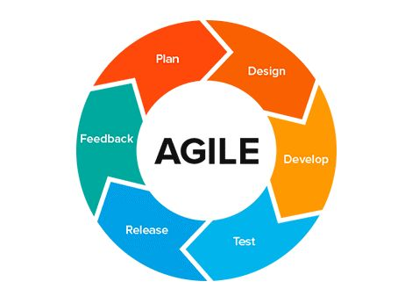
STEPS IN AGILE METHODOLOGY:
Requirement gathering
Design the Requirements
Construction / Iteration
Testing/Quality Assurance
Deployment
Feedback
MODEL

Slide 4

HOW AGILE IS DIFFERENT FROM OTHER MODELS:
Agile stands out from traditional SDLC models due to its emphasis on flexibility, collaboration, and iterative development.
Flexibility: Unlike rigid models like Waterfall, Agile embraces change. It allows for adjustments in requirements and priorities throughout the project lifecycle.
Iterative Development: Agile breaks down projects into smaller iterations or sprints, delivering working software frequently. This enables early feedback and continuous improvement.
Customer Collaboration: Agile prioritizes customer involvement. Customers are active participants, providing input and feedback at every stage.
Customer-centric: Agile is a more adaptive and customer-centric approach to software development, while traditional models tend to be more rigid and plan-driven.
Risk Management: Agile incorporates risk management throughout the project, allowing for quick adaptation to challenges.

Slide 5

ADVANTAGES :
Working through Pair programming produces well-written compact programs which have fewer errors as compared to programmers working alone.
It reduces the total development time of the whole project.
Agile development emphasizes face-to-face communication among team members, leading to better collaboration and understanding of project goals.
Customer representatives get the idea of updated software products after each iteration. So, it is easy for him to change any requirement if needed.
Agile development puts the customer at the center of the development process, ensuring that the end product meets their needs.

Slide 6
LIMITATIONS:
The lack of formal documents creates confusion and important decisions taken during different phases can be misinterpreted at any time by different team members.
It is not suitable for handling complex dependencies.
The agile model depends highly on customer interactions so if the customer is not clear, then the development team can be driven in the wrong direction.
Due to the absence of proper documentation, when the project completes and the developers are assigned to another project, maintenance of the developed project can become a problem.

Slide 7

HOW TO OVERCOME THE LIMITATIONS OF AGILE MODEL:
Plan Ahead: Create high-level roadmaps and architectural blueprints.
Measure Effectively: Use Agile metrics and value-based measures to track progress.
Document Critically: Create essential documentation and foster knowledge sharing.
Build Strong Teams: Invest in team building, clear roles, and continuous improvement.
Balance Workload: Promote work-life balance and sustainable pacing.
CUSTOMERS

Slide 8
THANK
YOU

