Slide 1
Forecasting Antimicrobial Resistance in the EU/EEA
Final Presentation
Shramik Wavekar
Mentor: Vikas S
EARS-Net · ESAC-Net · Eurostat
30 countries · 2000–2024
5 pathogen–drug pairs
Notes:
Student name - 2 marks
Mentor’s name - 2 marks
Topic name - 2 marks
-> automated grading

Slide 2
Executive Summary
Objective & scope: Forecast annual antibiotic-resistance % for five priority pathogen–drug pairs across 30 EU/EEA countries (2000–2024) from lagged consumption plus climate and demographic covariates.
Importance: Resistant infections are linked to 35,000+ attributable deaths a year in the EU/EEA; early warning lets stewardship act before resistance entrenches.
Data: Four authentic open sources — EARS-Net resistance, ESAC-Net consumption, Eurostat climate (degree days) and population density — merged into a 3,257-row country–year panel.
Final results: Resistance follows consumption with a 1–5-year lag; learned models reach 0.55–0.58 directional accuracy vs ~0.01 for the naive baseline.
Usage: An interpretable early-warning aid for national AMR stewardship programmes and ECDC surveillance analysts.

Slide 3
Gap Analysis
Literature establishes antibiotic consumption as the primary modifiable driver of resistance (Goossens et al., 2005; Bell et al., 2014), and shows the effect is delayed rather than contemporaneous (Aldeyab et al., 2008).
Gap 1 — lag ignored: most analyses correlate consumption and resistance within the same calendar year, missing the multi-year selection delay.
Gap 2 — no integrated forecast: few models combine consumption history with demographic and climate covariates to predict future resistance.
Gap 3 — not actionable: existing work quantifies associations but produces no forward, country-level early-warning signal.
This project addresses all three with a lag-aware, covariate-enriched forecasting pipeline.

Slide 4
Research Questions (1 of 2)
RQ1 — optimal lag: best consumption→resistance delay per combo. H0: ρ = 0 at all lags; Ha: ρ ≠ 0 at some lag. Method: Pearson/Spearman cross-correlation (lags 0–5).
RQ2 — predictability: can lagged consumption + covariates forecast future resistance? H0: R² ≤ 0; Ha: R² > 0 on a temporal hold-out.

Slide 5
Research Questions (2 of 2)
RQ3 and RQ4 move from association to attribution and benchmarking — asking not just whether the model works, but which predictors drive it and whether it beats simpler alternatives.
RQ3 — drivers: which predictors matter most? H0: families contribute equally; Ha: at least one dominates. Method: permutation / GBT importance.
RQ4 — pooled vs baselines: does a pooled ML model beat naive and single-country models on unseen years? H0: pooled error ≥ baseline; Ha: pooled better.
Group differences: one-way ANOVA with Kruskal–Wallis check across combos; evaluated at α = 0.05 (n = 3,164, well powered).

Slide 6
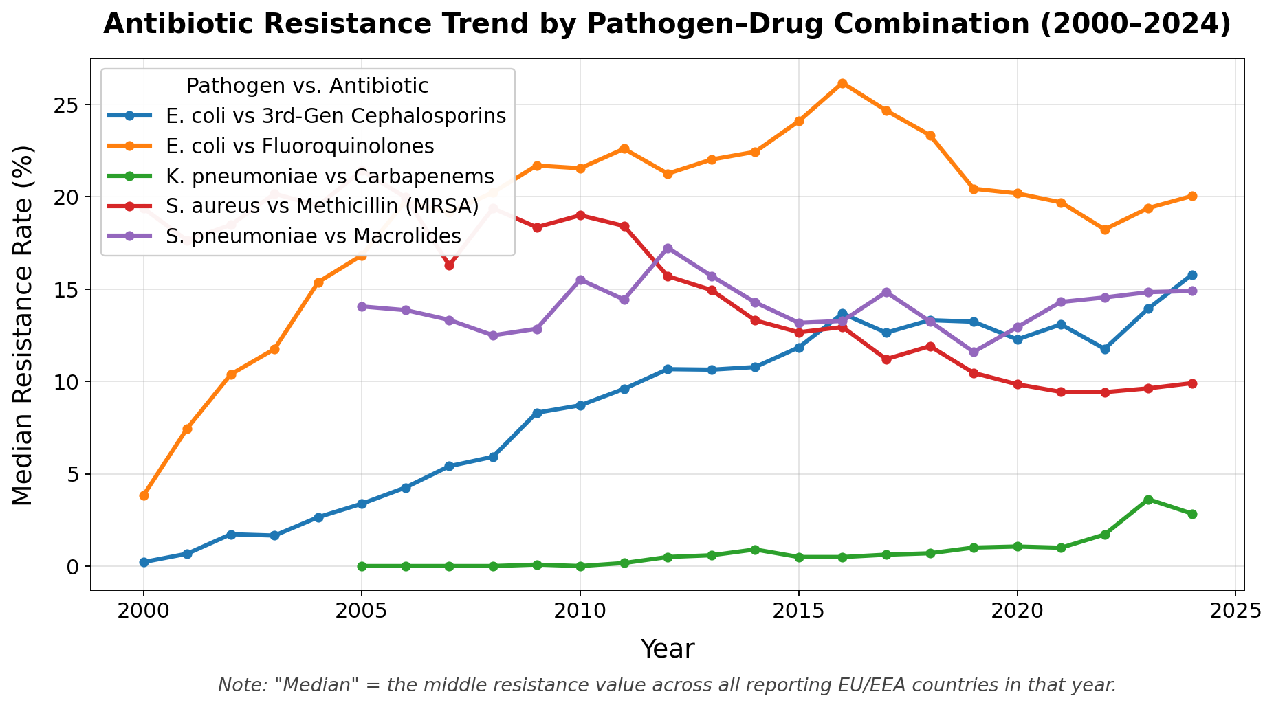
Data Description and EDA
Panel: 3,257 country–year–combo rows; 30 countries; 2000–2024; target resistance_pct (mean 14.8%, right-skewed, skew 1.07).
Five combos: E. coli–fluoroquinolones (highest mean 20.9%), E. coli–3rd-gen cephalosporins, K. pneumoniae–carbapenems (widest spread, max 73.7%), S. aureus–MRSA, S. pneumoniae–macrolides.
Univariate: resistance right-skewed with a long high tail; penicillins (J01C) dominate consumption; population density heavily skewed.
Bivariate: consumption positively correlated with resistance (r ≈ 0.53); degree days negatively correlated; density weakly related.
Trends: E. coli and carbapenem resistance rose over the period while MRSA declined — divergent paths motivate per-combination models. See Figure 1 (next slide) for the full trend chart.
3,257
country–year rows
30
EU/EEA countries
25 yrs
2000–2024
5
pathogen–drug pairs

Slide 7
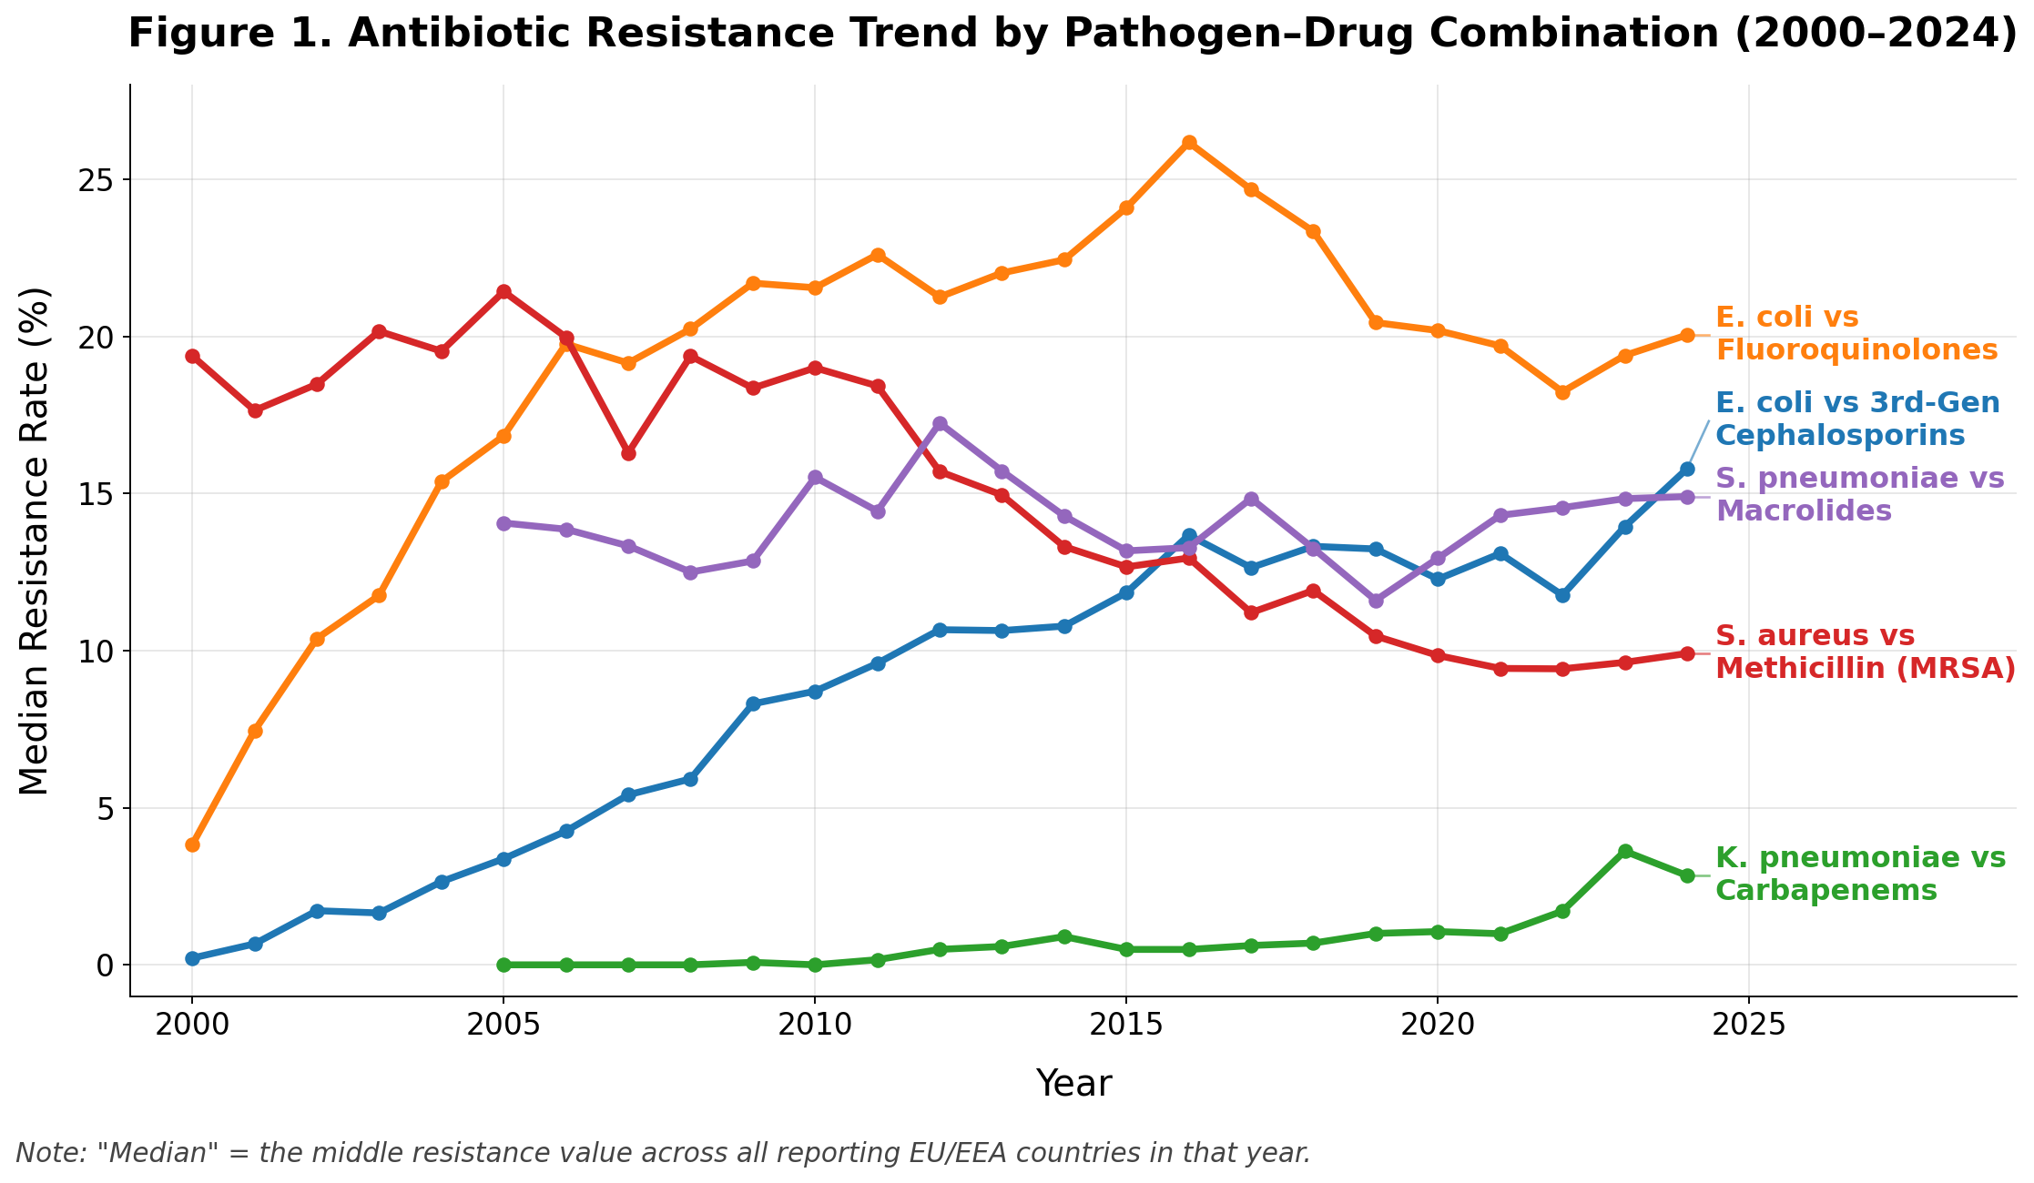
Resistance Trend — Detailed View

Slide 8
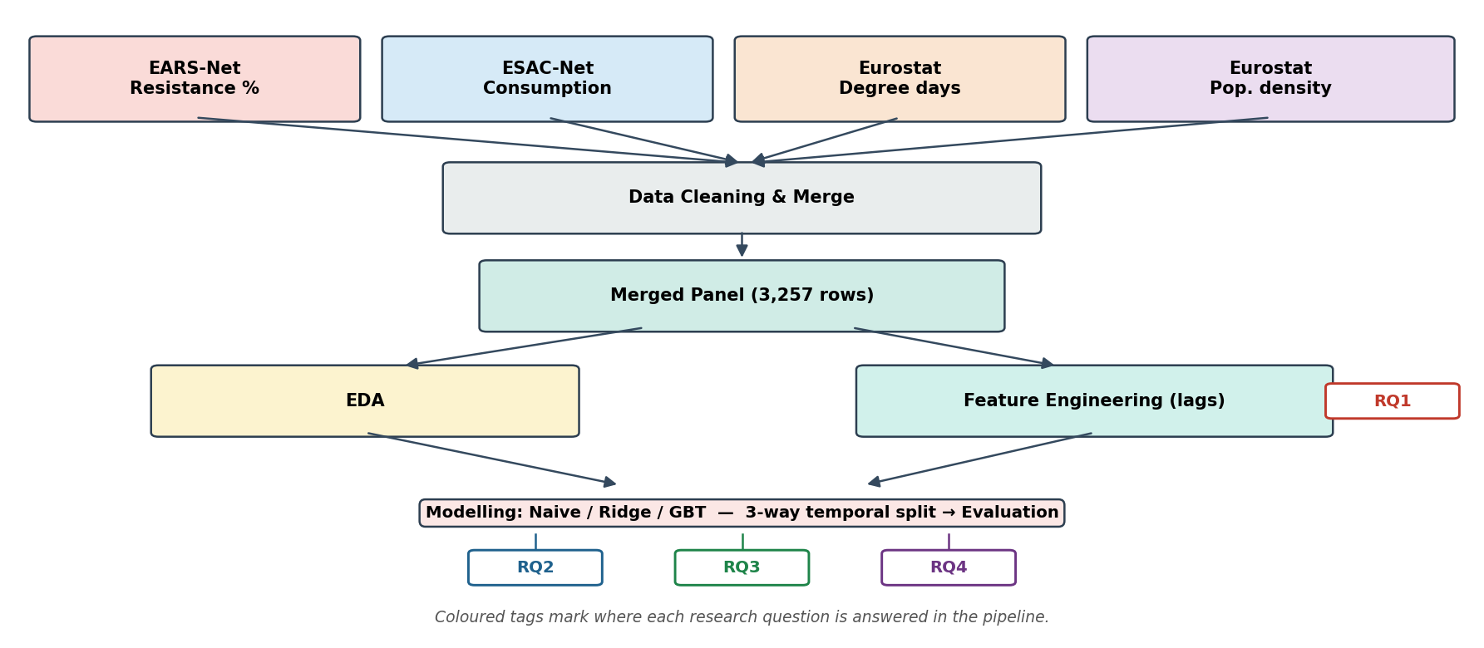
Architecture diagram/Workflow
End-to-end workflow: four public sources are cleaned and merged into one panel, then feature-engineered and modelled with a three-way temporal split.
Figure 2. End-to-end data integration and modelling workflow.

Slide 9
Model building
Naive last-value baseline: predicts next year = current year; the floor any useful model must beat.
Regularised linear regression: interpretable, well supported in the consumption–resistance literature.
Gradient-boosted trees: capture non-linear interactions among lags, climate and demographics; support feature-importance for RQ3.
Feature engineering: consumption lagged 1–5 years (the core signal), plus climate and density covariates.
Validation: strict three-way temporal split — last 3 years held out and scored once; earlier years used for expanding-window CV to grid-search hyperparameters (shallow depth 2 and learning rate 0.1 selected) with no look-ahead leakage.

Slide 10
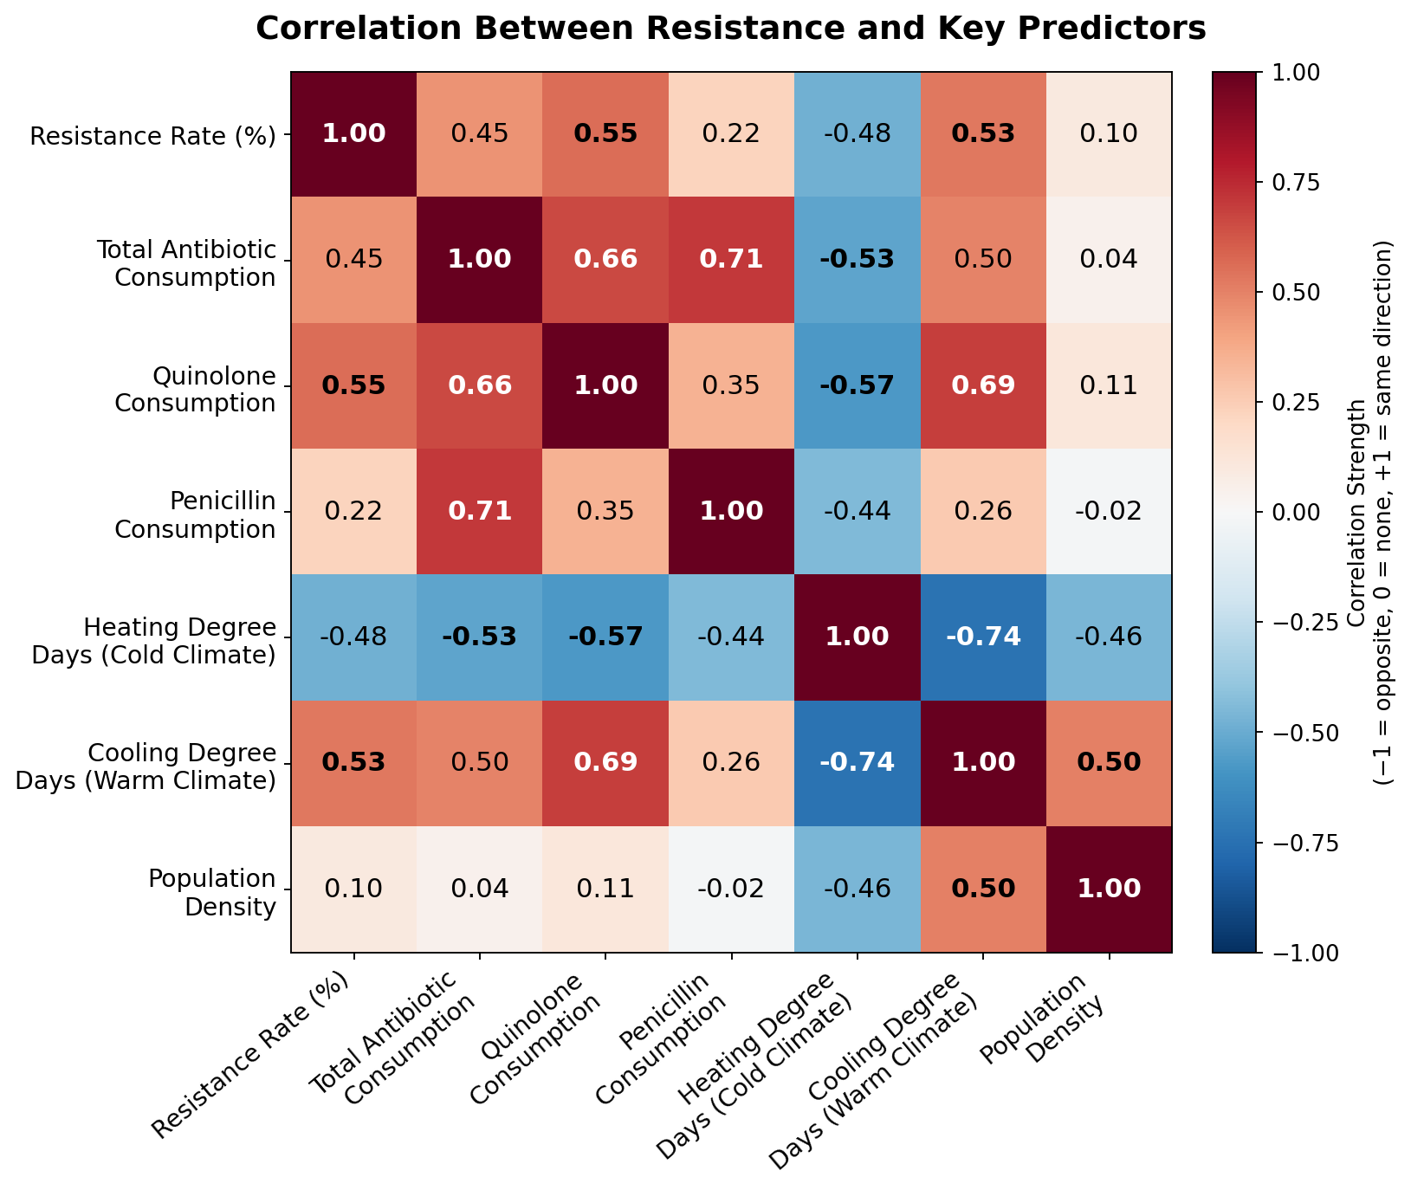
Results
RQ1: positive lag in every combo — E. coli–fluoroquinolones and K. pneumoniae–carbapenems peak at 5 years (r = 0.72, 0.71); S. pneumoniae–macrolides at 1 year (r = 0.55). The spread reflects biology: hospital-associated, slowly-transmitting organisms take years to select and spread, while community respiratory pathogens turn over far faster.
RQ2 / RQ4: naive R² = 0.93 but directional accuracy ≈ 0.01; linear and GBT reach 0.58 and 0.55 directional accuracy — they anticipate change the naive model misses.
RQ3: population density and lagged consumption dominate; the 2- and 5-year lags outweigh current-year use, reinforcing the delayed effect. Density's importance despite a weak linear correlation (Figure 3) shows its effect is non-linear — why a tree-based model was needed.
Takeaway: for stewardship early-warning, directional accuracy matters most — and the learned models clearly win there. See Figure 3 (next slide) for the full correlation heatmap.

Slide 11
Predictor Correlations — Detailed View
Figure 3. Correlation between resistance and key predictor variables.

Slide 12
Model Comparison
Three models were evaluated on a strict temporal hold-out (last three years). Metrics are in percentage points; directional accuracy is the share of country–years whose rise/fall is predicted correctly.
Table 1. Forecast performance comparison across models (temporal hold-out test set).
Model | MAE | RMSE | R² | Dir. Acc.
Naive last-value | 2.04 | 3.46 | 0.928 | 0.01
Linear regression | 8.05 | 10.78 | 0.303 | 0.58
Gradient boosting | 7.50 | 10.30 | 0.364 | 0.55
Takeaway: the naive model’s high R² reflects autocorrelation, not skill (directional accuracy ≈ 0). The learned models trade R² for far better directional accuracy (0.55–0.58) — what matters for early-warning.

Slide 13
Implementation and User Benefit
Deployment: lightweight scheduled job re-run on each ECDC data release; CPU-only Python, deployable as a container or small REST API feeding a dashboard.
Integration: consumes the same EARS-Net / ESAC-Net exports teams already download — no new data collection.
Interaction: analyst selects a country and combo, sees the forecast trajectory, predicted direction, and ranked drivers — no coding needed.
Benefit: prioritises where scarce stewardship attention should go and supports the case for specific prescribing interventions.
Cost & risk: negligible compute cost (CPU-only, annual re-run); the main operational risk is a change to ECDC export formats or the ATC/DDD index, mitigated by a validation step in the cleaning stage.

Slide 14
Use Case in Practice
1. Signal
ESAC-Net shows fluoroquinolone (J01M) consumption climbing in a country — the strongest single predictor identified in RQ3.
2. Forecast
Using the 5-year lag found in RQ1, the model projects continued E. coli resistance growth and flags the expected direction of change.
3. Action
The committee targets fluoroquinolone prescribing now — inside the multi-year window, before resistance becomes entrenched and irreversible.
This is the practical loop the pipeline enables: an early signal in consumption data becomes a
concrete, timed recommendation — not just a retrospective statistic.

Slide 15
Conclusion & Future Work
Conclusion: resistance responds to consumption with a measurable 1–5 year lag in every combination tested (r up to 0.72), and a lag-aware model captures the direction of change (0.55–0.58 accuracy) that a naive baseline cannot (≈ 0.01).
Contribution: an interpretable, lag-aware forecasting pipeline built entirely on open EU surveillance data — giving stewardship programmes a forward early-warning signal rather than a retrospective association.
Future work: extend climate data to the full 2000–2024 period, add SHAP per-pathogen driver analysis, fit a mixed-effects model for rigorous inference, and explore a One-Health extension (animal antibiotic use, travel, hospital density).

Slide 16
Limitations
ATC Granularity
Carbapenems and cephalosporins share ATC group J01D. S. aureus–MRSA has no single clean consumption driver and is excluded from consumption models.
Climate Coverage
Heating/cooling degree-day data only spans 2016–2024, so climate’s role in RQ3 is currently underpowered.
Panel Structure
Repeated yearly measures per country make classical p-values approximate; a mixed-effects model is the rigorous next step.
None of these limitations undermine the core lag finding — each is addressed directly in Future Work (previous slide).

Slide 17
Bibliography
Aldeyab, M. A., et al. (2008). Modelling the impact of antibiotic use and infection control practices on hospital-acquired MRSA: A time-series analysis. Journal of Antimicrobial Chemotherapy, 62(3), 593–600.
Bell, B. G., et al. (2014). A systematic review and meta-analysis of the effects of antibiotic consumption on antibiotic resistance. BMC Infectious Diseases, 14, 13.
Chatterjee, A., et al. (2018). Quantifying drivers of antibiotic resistance in humans: A systematic review. The Lancet Infectious Diseases, 18(12), e368–e378.
Chen, T., & Guestrin, C. (2016). XGBoost: A scalable tree boosting system. Proceedings of the 22nd ACM SIGKDD (pp. 785–794).
Goossens, H., et al. (2005). Outpatient antibiotic use in Europe and association with resistance. The Lancet, 365(9459), 579–587.
Kirby, A., Herbert, A., & Sheridan, E. (2022). Estimating the consumption–resistance relationship for antibiotics using European surveillance data. J. Global Antimicrobial Resistance, 30, 428–434.
Lundberg, S. M., & Lee, S.-I. (2017). A unified approach to interpreting model predictions. NeurIPS 30 (pp. 4765–4774).
MacFadden, D. R., et al. (2018). Antibiotic resistance increases with local temperature. Nature Climate Change, 8(6), 510–514.
Murray, C. J. L., et al. (2022). Global burden of bacterial antimicrobial resistance in 2019. The Lancet, 399(10325), 629–655.
Olesen, S. W., et al. (2018). The distribution of antibiotic use and its association with antibiotic resistance. eLife, 7, e39435.

Slide 18
END

