Slide 1
Swarm Connection Modules
1.SwarmConnectionBuilder Module
2.SwarmChatHandler Module
3.SwarmMessageParsing Module

Slide 2
Swarm Module Classes
1.SwarmConnectionBuilder
a.Peer_Listner
b.Peer_Sender
c.Peer_Handler
d.Peer_MessageProcessing
2.SwarmChatHandler
a.Peer_Chat

Slide 3
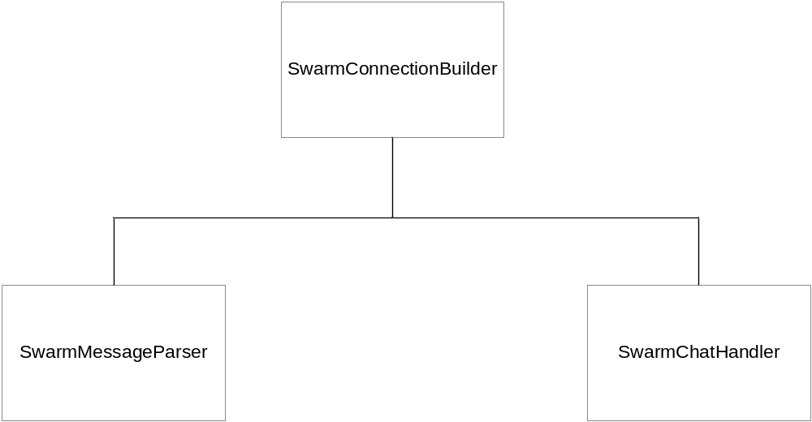
Module Diagram

Slide 4
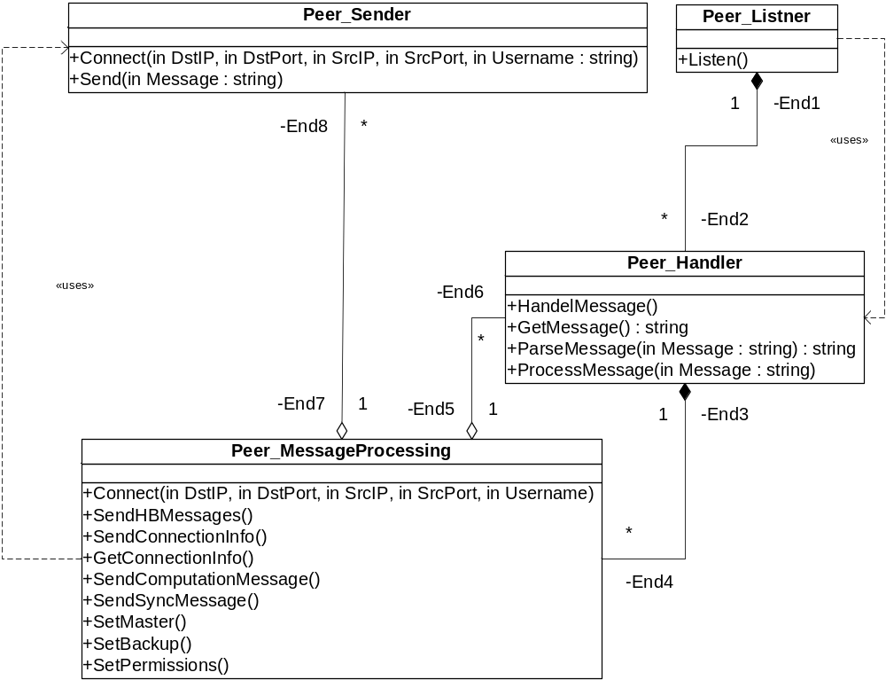
ConnectionBuilder Class Diagram

Slide 5
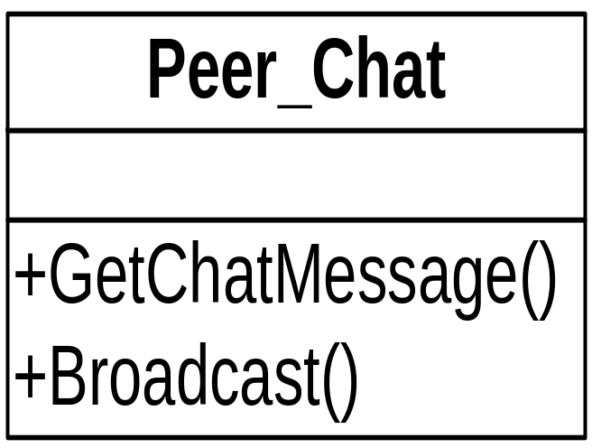
ChatHandler Class

Slide 6
Issues so far
Traffic congestion between the peers on the network.
Network Overloading.
Broadcast Latency.

Slide 7
Status so far
Designed and implementing the C# code for the Peer_MessageProcessing class in the connection builder module.
Successfully established the connection between two or more computers by transmitting and receiving messages.
Currently implementing the heartbeat flow from one end to the other end to ensure the responsiveness of a peer

Slide 8
API for UI
Class
a. SWARMAPI_UI
Methods
1.ConnectionRequest
2.SendChatMessages
3.SetPermissions(Read/Write)

