Slide 1

MACHINE LEARNING PROJECT- ESTIMATING 2nd LAPTOP PRICE
- LINEAR REGESSION MODEL

Slide 2

Business Objective, Understanding and Approach
Business Objective
Understanding
Business Objective
Understanding
A C2B firm is in the process of creating an Online platform where the consumers can sell their used Laptops. This platform should host an automated mechanism that can suggest to a consumer the realistic price of their used laptop when the required details (different features of the laptop) are provided.
An automated price generator model needs to be developed for the C2B firm in order to facilitate its customers by generating the predicted price when the features of their used laptops is provided as an input to the Machine learning model
Approach
Initial step is to collect the data and performing the data quality checks
The next stage involves of analysing the data and finding the key insights through which data-driven solution can be made and Feature Engineering
The predicted feature is of continuous variable so a Regression Machine Learning model has to be used to encounter this problem statement

Slide 3
Analysis/ Modeling Methodology
Data Preparation & EDA
Variable Creation and Selection
Model Development
Model Performance Testing
Sub-setting of the dataset is done by dropping Laptop ID and Product variables
Extensive bi-variate analysis conducted on all meaningful variables
Removed unwanted Features which are not meaningful
10 new variables are created as a part of feature engineering
3 variables are dropped off after Feature Engineering since they had weak correlation with dependent variable
Used one-hot encoding to create dummy variables
Linear Regression is chosen as the preferred modeling technique since the predicted feature is continuous
Developed 3 candidate models
Highest Model accuracy observed of 80%
Conducted k-cross validation for k=10,k=15,k=20
Model performance also assessed on a hold-out sample of size 20% of the original dataset
The Training accuracy and Testing accuracy observed to be of 83.7 and 80.7

Slide 4
Extended Data Dictionary (EDD)
Variable | Variable Type | Min | Pc 1% | Pc 5% | Pc 25% | Pc 50% | Mean | Pc 75% | Pc 95% | Pc 99% | Max | % missing values | % unique values
Ram | int32 | 2 | 2.00 | 4.00 | 4.00 | 8.00 | 8.39 | 8.00 | 16.00 | 32.00 | 64.00 | - | 0.69
Weight | float32 | 0.69 | 0.97 | 1.17 | 1.50 | 2.04 | 2.04 | 2.30 | 3.20 | 4.42 | 4.70 | - | 13.13
Price_euros | float64 | 174 | 229 | 309 | 599 | 978 | 1124.04 | 1488.44 | 2448.80 | 3148.98 | 6099.00 | - | 60.75
Touchscreen | int64 | 0.00 | 0.00 | 0.00 | 0.00 | 0.00 | 0.15 | 0.00 | 1.00 | 1.00 | 1.00 | - | 0.15
IPS | int64 | 0.00 | 0.00 | 0.00 | 0.00 | 0.00 | 0.28 | 1.00 | 1.00 | 1.00 | 1.00 | - | 0.15
SSD | int64 | 0.00 | 0.00 | 0.00 | 0.00 | 256 | 182.89 | 256.00 | 512.00 | 1000.00 | 1000.00 | - | 1.99
PPI | float64 | 90.58 | 100.45 | 100.45 | 127.34 | 141.21 | 146.57 | 157.35 | 210.00 | 210.00 | 210.00 | - | 0.84

Slide 5
Feature Engineering – New variables created
S.no | Variable Name | Variable Type | Description
1 | Touchscreen | Numeric | Dummy(1/0) based on criteria being met or not
2 | CpuProcessor | Object | Extracted from CPU column to minimize the large number of categorical variables
3 | Gpu_brand | Object | Extracted from GPU column to minimize the large number of categorical variables
4 | IPS | Numeric | Dummy(1/0) based on criteria being met or not
5 | Op_sys | Object | Extracted from Op_sys column to minimize the large number of categorical variables
6 | SSD | Numeric | Extracted the required information from SSD
7 | PPI | Numeric | Variable created using Screen resolution and Inches

Slide 6
FEATURE ENGINEERING
In Screen resolution variable, there are 40 unique variables, this feature is divided into 3 new variables without loosing the vital information, Screen resolution is split into Touch Screen , IPS, PPI
The variable named GPU is having 110 unique values, and This feature has the data containing the brand or company name, It doesn't have the specifications like ram capacities, So we can simply taken out the Brand name from this feature as a new variable named Gpu_brand
The information about the Processor used in the laptop is described by the Cpu_Processor
which is the main takeaway from CPU column
Clubbing all the Window variants into one variable named Windows and all the Mac are combined into one Variable named Mac and Other OS variable into Others/No OS/Linux.This made the Analysis easier and efficient
The Memory is of four types, We can fetch only those types and made it as a new features
We Created four columns which are HDD, SSD, Hybrid and Flash storage

Slide 7
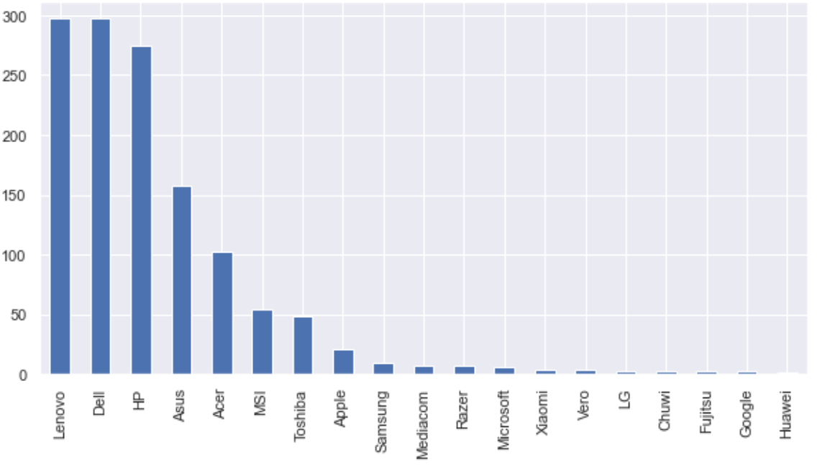
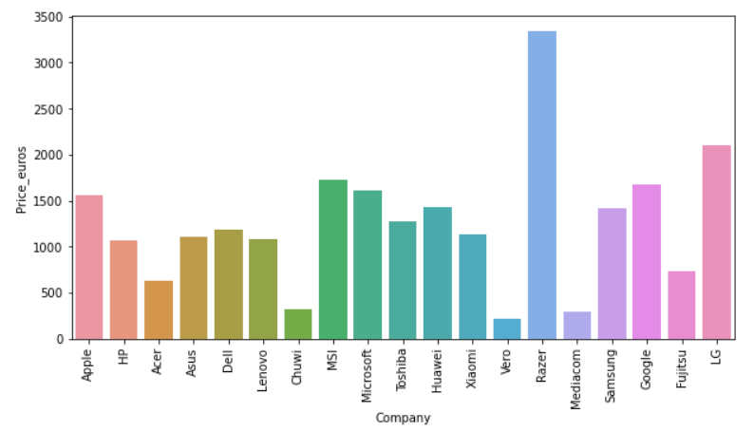
EXPLORATORY DATA ANALYSIS:
Company Column
Average Price of each Brand
Key Findings :
Lenovo, Dell and Hp products more in the data
Key Findings :
Razer, Apple, LG, Microsoft, Google, MSI laptops are expensive, and others are in the budget range

Slide 8
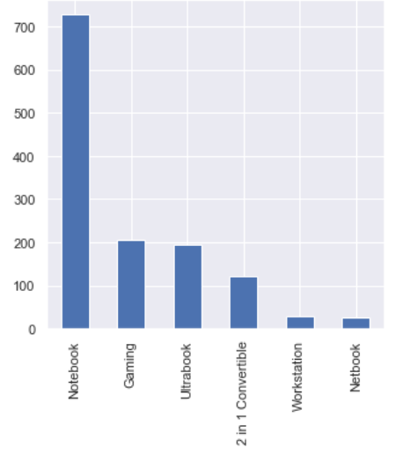
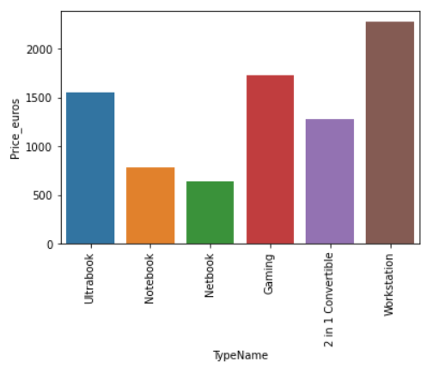
Product Type
Plotting TypeName Against Price
Key Findings :
As major people prefer notebook because it is under budget range and the same can be concluded from our data
Key Findings :
Workstation has the higher Price compared to other types

Slide 9
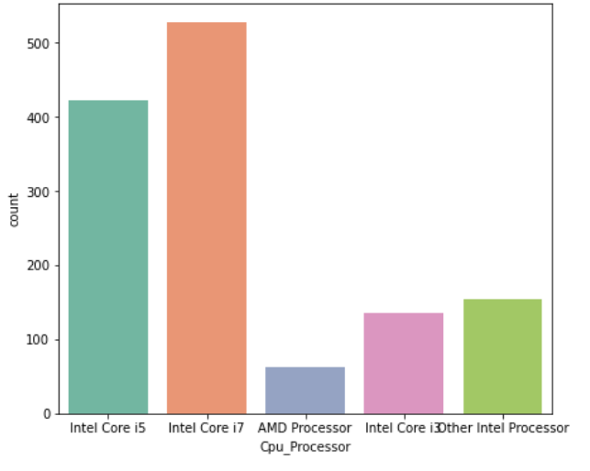
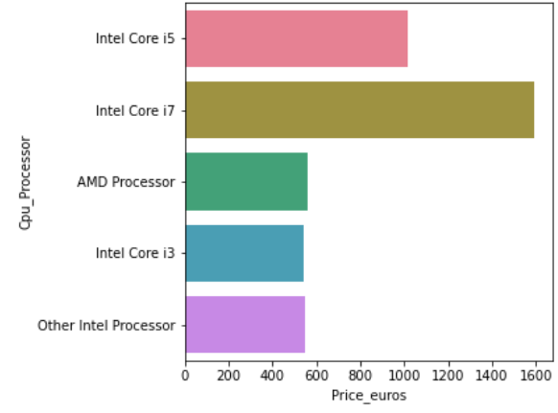
CPU Column
Plotting CPU against Price_euros
Key Findings:
Intel core i7 is the most preferred CPU by the users and intel core i5 is second most used one
Most of the user’s laptops are with intel core i7 and intel core i5 and all other CPU models are less in count of usage
…
Key Findings:
Intel core i7 is the most expensive cpu and it is even the most preferred model by the users
Intel core i3 have the cost moderate amount and AMD processor , intel core i3 and All other intel processors cost same on average and lesser than i5 and i7 models
…

Slide 10
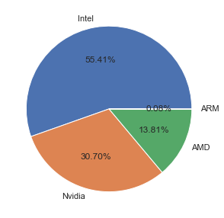
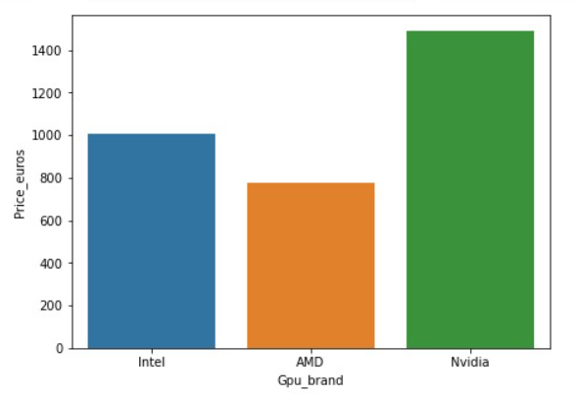
GPU Column
Plotting GPU against Price_euros
Key Findings:
GPU represents the GRAPHIC PROCESSING UNIT and Intel GPU brand is used in more than half of the laptops designs
Nvidia is the second most using GPU brand in the design of the laptops
Key Findings:
Nvidia is the overpriced GPU used in the most of the laptops
Intel is the high-priced one compared with the AMD GPU brand

Slide 11
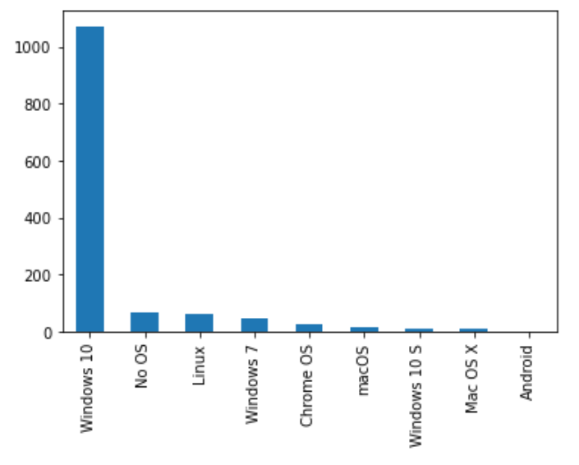
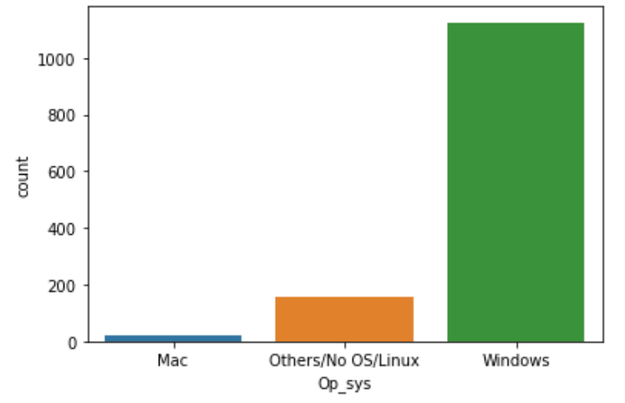
Op_sys Column
Plotting Op_sys column against Price_euros
Key Findings:
Windows 10 is the most chosen operating system by the laptop users
All the other operating systems are selected least in the usage of laptops
Key Findings:
Windows is fancy and expensive operating system and the most chosen os by the users
Mac operating system costs least and all the other operating systems costs more than the mac product

Slide 12
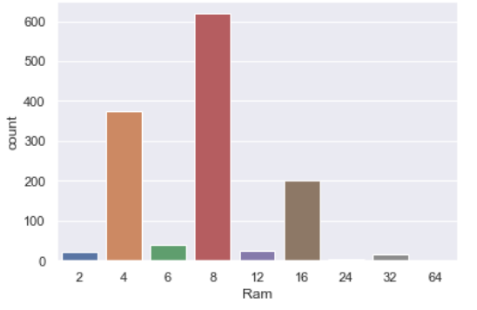
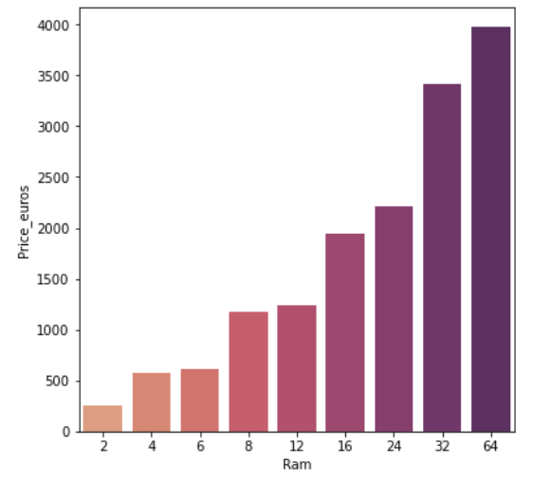
RAM Column
Plotting RAM against Price_euros
Key Findings:
RAM card of 8 GB is the most used memory capacity by most of the users and based on the count 4 GB RAM is the second most used memory unit
Key Findings:
RAM with higher GB memory costs more and 64 GB RAM is the most expensive one and 32 GB RAM is also an expensive one in comparison to various values of memory units

Slide 13
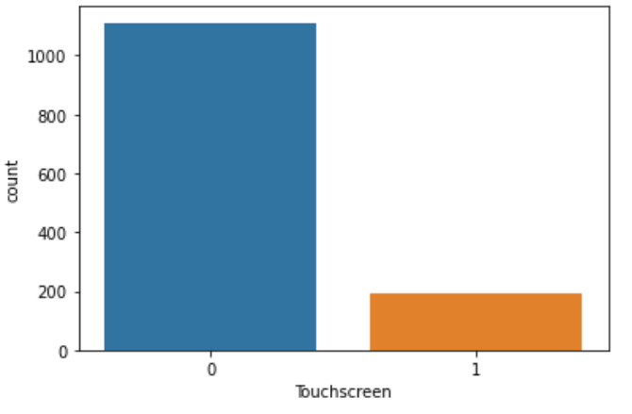
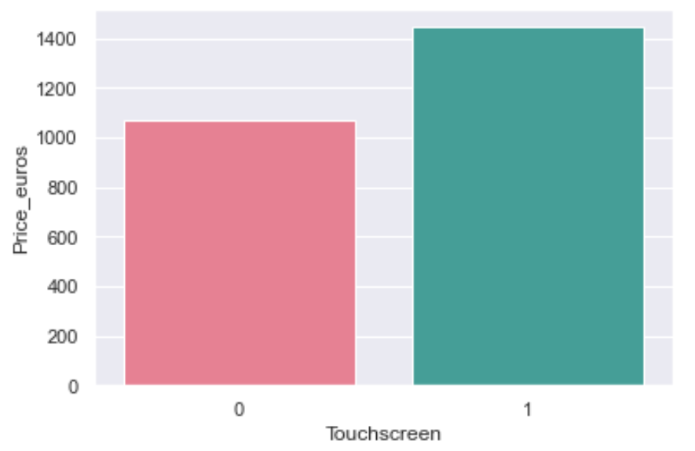
Touchscreen Column
Plotting Touchscreen against Price_euros
Key Findings:
About 85% of the laptops are not with Touchscreen
Key Findings:
laptops with touchscreens are expensive which is true in real life

Slide 14
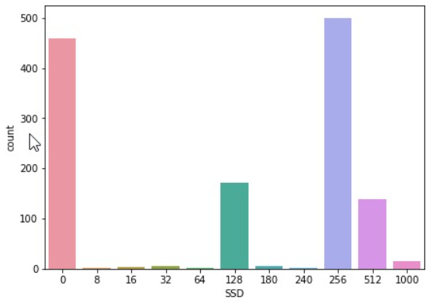
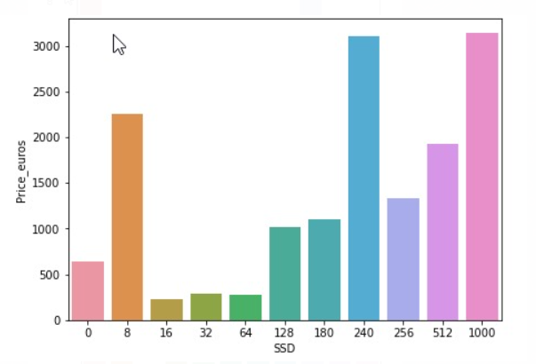
Plotting SSD
Plotting SSD against Price_euros
Key Findings:
solid state drives of 256 gb is picked more as it’s count value is higher than other storage values
Key Findings:
solid state drives of 1000 gb is the most expensive one and 240 GB of ssd id the second expensive when compared to various Quantity of storage capacities

Slide 15
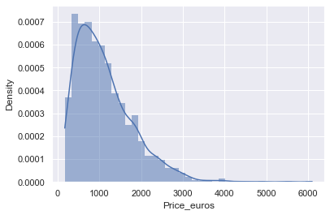
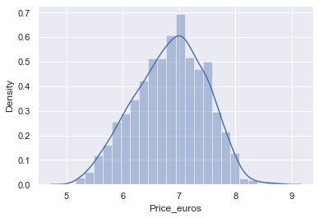
DISTRIBUTION OF DEPENDENT VARIABLE
Key Findings :
The distribution of the target variable is skewed and it is obvious that commodities with low prices are sold and purchased more than the branded ones
It is Right-Skewed Log-Normal Transformation The distribution of the target variable above which was right-skewed. By transforming it to normal distribution performance of the algorithm will increase

Slide 16
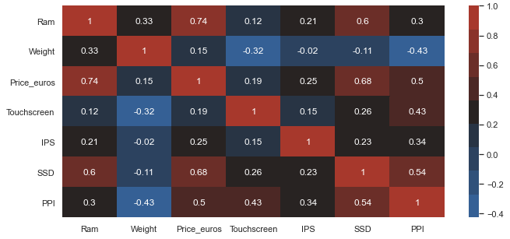
MULTI-COLLINEARITY MATRIX
Key Findings:
There’re no independent variables which shows higher collinearity between them
Ram and SSD has higher collinearity with Price
Touchscreen has weak collinearity with Price

Slide 17
VIF - Variance Inflation Factor
VIF | VARIABLE
2.4518990 | Ram
1.989897 | Weight
2.623777 | SSD
1.871245 | PPI
1.128745 | IPS
1.315016 | Touchscreen
Key Findings :
In the dataset each of the variable do not hold the higher VIF(Variance Inflation factor) values that indicates that the independent variables do not impact any other variable and even they are not impacted by any of the other variables
As there is no variable with high VIF value, In the process of building the model no variable is dropped from the dataset

Slide 18
BETA COEFFICIENTS AND P VALUES
Features | Beta values | p > |t|
Ram | 0.140 | 0.000
Weight | 0.070 | 0.000
Touchscreen | 0.035 | 0.081
IPS | 0.019 | 0.171
SSD | 0.011 | 0.000
PPI | 0.130 | 0.000
Key Findings:
Ram variable has contributed 14% towards the predicted feature
Weight variable has contributed 5% towards the predicted feature
PPI contributes 9% towards the predicted variable

Slide 19
PERFORMANCE COMPARISOM BETWEEN TRAIN AND TEST DATA
After data pre-processing the dataset is divided into 80% and 20% split in which 80% of records of dataset are used as training dataset to build the model and 20% of records dataset is used as testing dataset to test the accuracy of prediction of the model
Coming to the comparison of performance using training dataset and testing dataset, Training dataset has 83.47 as accuracy and Testing dataset has achieved 80.79 as accuracy
The model performed well on both the training and testing datasets
Cross validation:
For the further validation, Cross Validation technique is used with k-Fold values 10,15, and 20
The average score that is obtained is turned out to be around 0.80

Slide 20
KIND OF FEATURE ENGINEERING APPLIED:
The type of Feature engineering applied is the extraction of Main information and clubbing them into lesser number of classes from the features having higher cardinality without loosing out on vital information
Dummy variables technique is applied on the Categorical features
TECHNICAL REQURIEMENTS NEEDED BY THE CLIENT:
The client should have a data sheets in Excel and should use libraries like NumPy, Pandas, Visualization tools for the better understanding of the distribution of the data

Slide 21
The type of data cleaning that the client needs to make is
1) The missing values are needed to be taken care of
2) There shouldn’t be any duplicated records
3) If there are any outliers found they need to be taken care of
4) Fix structural errors
5) Drop irrelevant features
DATA PRE-PROCESSING
The type of data Pre-processing that the client needs to make is
1) Feature extraction and select
2) Transform the data into meaningful variables
3) Feature scaling
4) Encode the categorical variables (dummy variables, one hot encoding)
5) Splitting the dataset into training and testing
DATA CLEANING

Slide 22
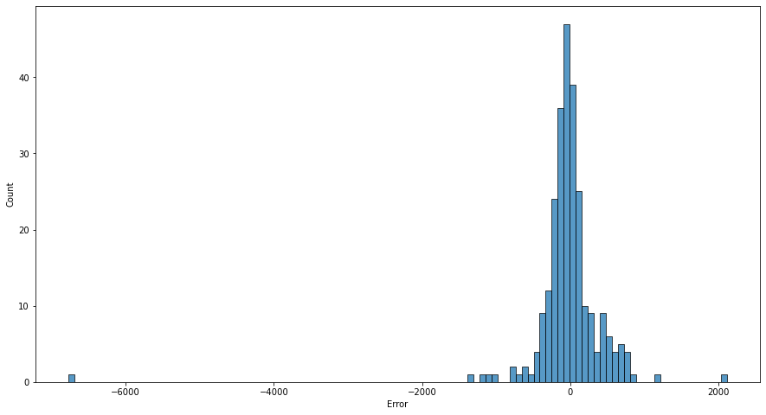
MODEL VALIDATION RESIDUAL DEVIANCE GRAPH
Model’s R-squared = 0.80
Adjusted R-squared values = 0.79
Training Accuracy = 83.47
Testing Accuracy = 80.79
Mean Absolute Error = 0.20
Mean Squared Error = 0.070
Key Findings:
The distribution for the residual deviance is a normal distribution curve which indicates that the errors are random in nature.

Slide 23


