Slide 1
Analysis of various classification algorithms on SUV dataset
Koustubh Masurkar 405082
Abhishek Lavhale 405078
Shravan Honade 405055
Department of Computer Engineering
Sinhgad College of Engineering, Pune-41
Accredited by NAAC with grade ‘A’

Slide 2
Problem Statement
Find out whether a person will buy an SUV or not based on age and salary. Use various classification algorithms to train your data and test the result.

Slide 3
Objective
Train data for :
Naive Bayes Classifier
KNN Classifier
Logistic Regression
Test the algorithms on testing data
Analyse the accuracy

Slide 4
Introduction
In this project, we have a dataset of people who bought a specific SUV and their age and salary. We used this data to train various classifiers and tested them on test data.
Classifiers used :
Logistic Regression
Naive Bayes
K Nearest Neighbour

Slide 5
Software Requirements
1. Operating system: Mac OS, Microsoft Windows 7/10, Ubuntu and all other Linux distributions
2. MS-Excel, Libre-Office etc.
3. Anaconda, Python 3.4 or above
4. Modules required: Numpy, Matplotlib, Pandas, SciKit Learn

Slide 6
Methodology
K Nearest Neighbours
KNN can be used for both classification and regression predictive problems. However, it is more widely used in classification problems in the industry. To evaluate any technique we generally look at 3 important aspects:
1. Ease to interpret output
2. Calculation time
3. Predictive Power

Slide 7
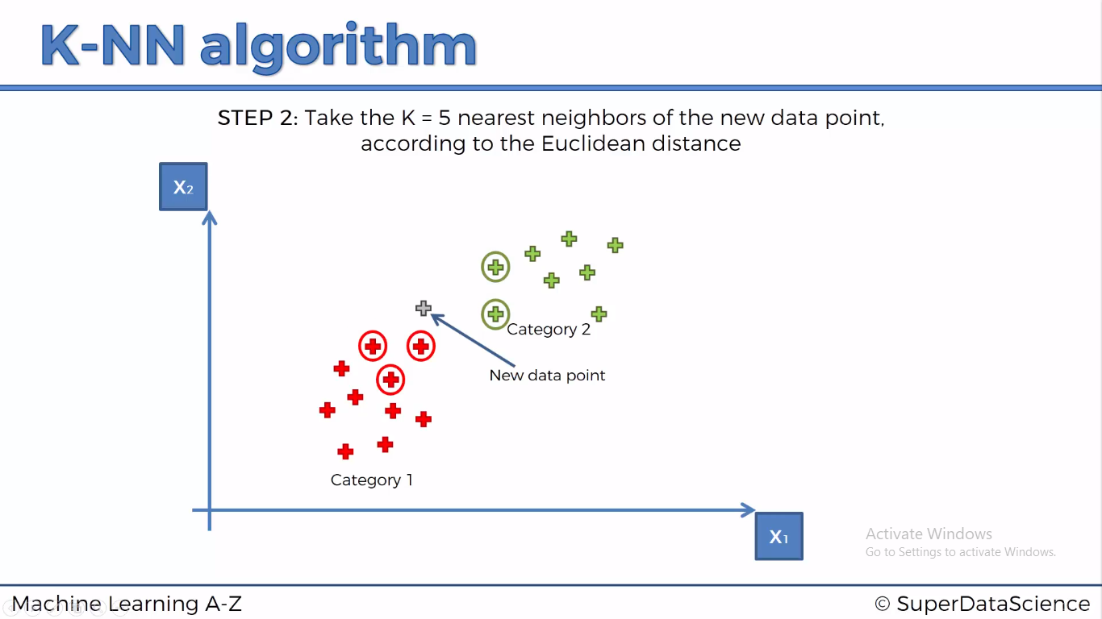

Slide 8
Naive Bayes Classifier
The Naive Bayes Classifier technique is based on the so-called Bayesian theorem and is particularly suited when the dimensionality of the inputs is high. Despite its simplicity, Naive Bayes can often outperform more sophisticated classification methods.

Slide 9
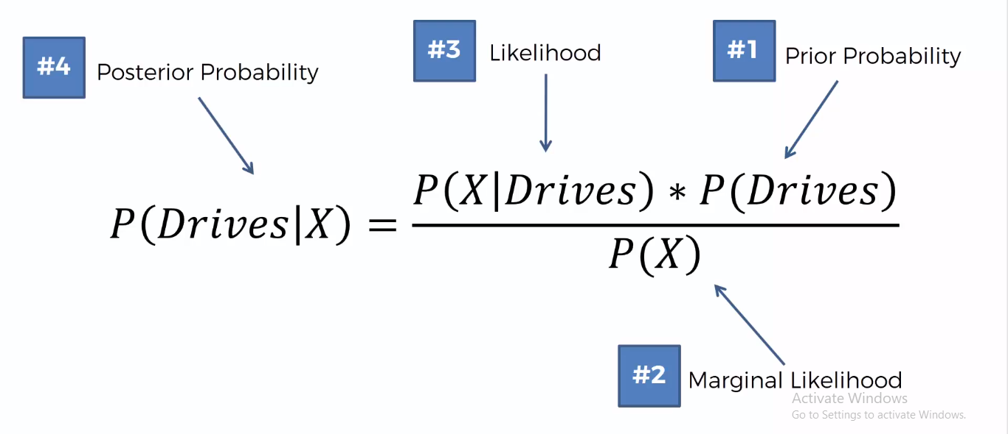

Slide 10
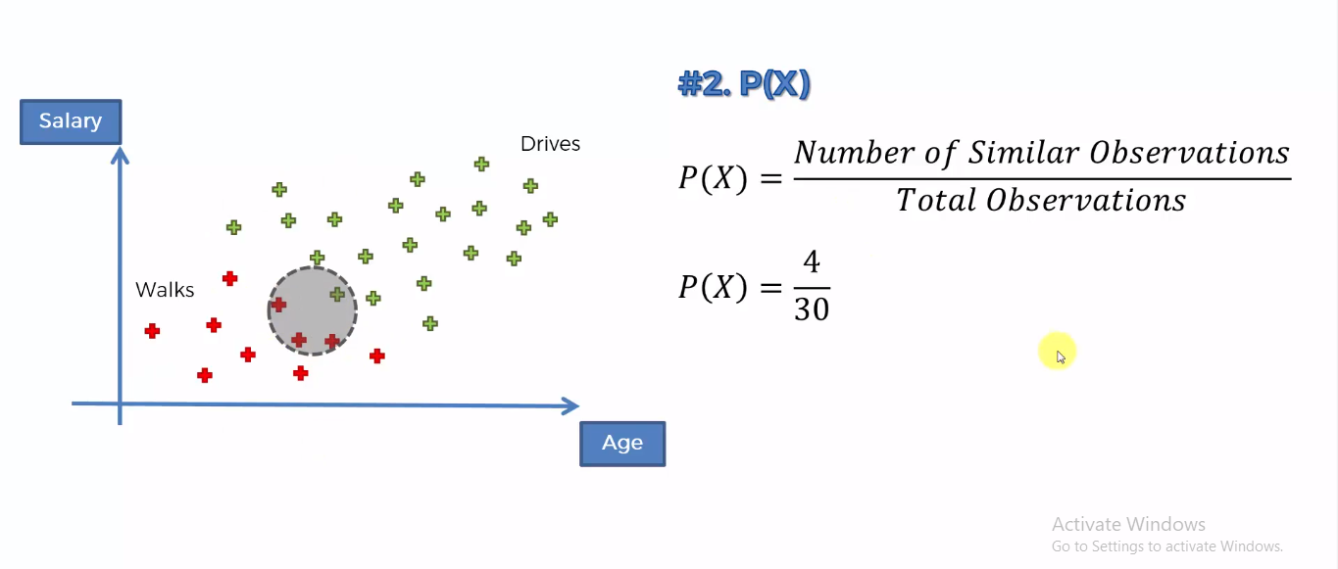

Slide 11
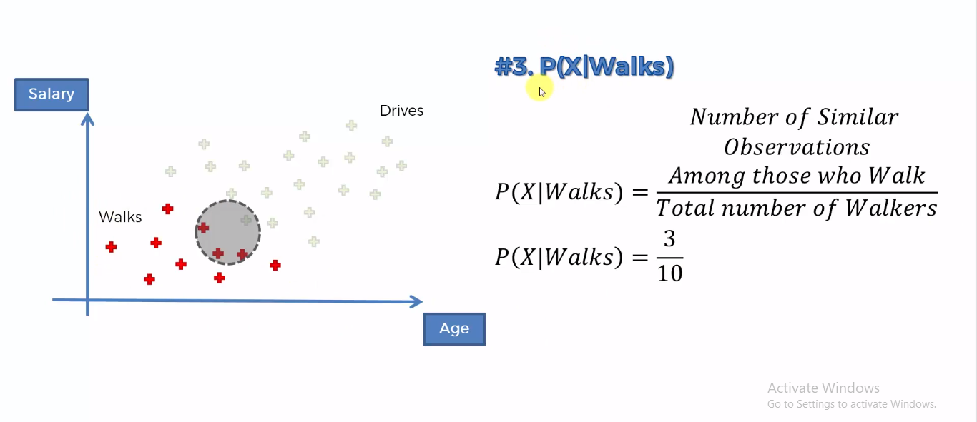

Slide 12
Logistic Regression
Logistic regression is a statistical method for analysing a dataset in which there are one or more independent variables that determine an outcome. The outcome is measured with a dichotomous variable (in which there are only two possible outcomes). It is used to predict a binary outcome (1 / 0, Yes / No, True / False) given a set of independent variables.

Slide 13
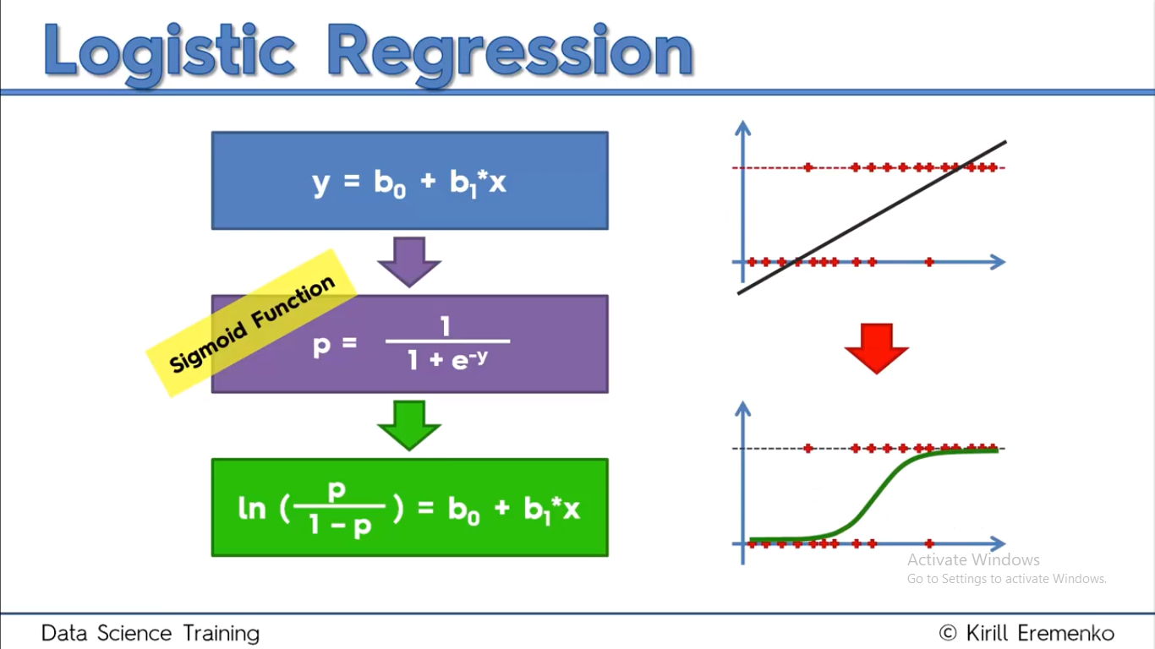

Slide 14
Algorithms
# Fitting Logistic Regression to the Training set
from sklearn.linear_model import LogisticRegression
classifier = LogisticRegression(random_state= 0)
classifier.fit(X_train, y_train)
y_pred = classifier.predict(X_test)

Slide 15
# Fitting KNN to the Training set
from sklearn.neighbors import KNeighborsClassifier
classifier = KNeighborsClassifier(n_neighbors = 5, metric = 'minkowski', p = 2)
classifier.fit(X_train, y_train)
y_pred = classifier.predict(X_test)

Slide 16
# Fitting Naive Bayes to the Training set
from sklearn.naive_bayes import GaussianNB
classifier = GaussianNB()
classifier.fit(X_train, y_train)
y_pred = classifier.predict(X_test)

Slide 17
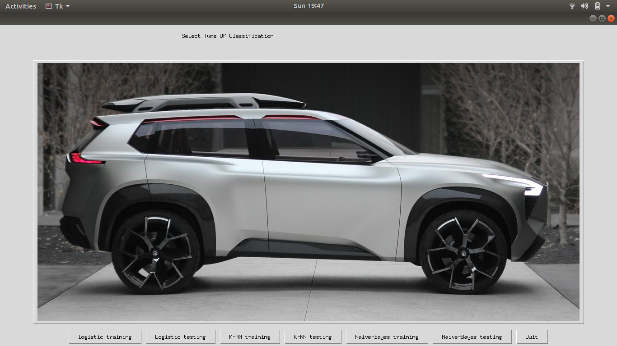
Gui Design

Slide 18
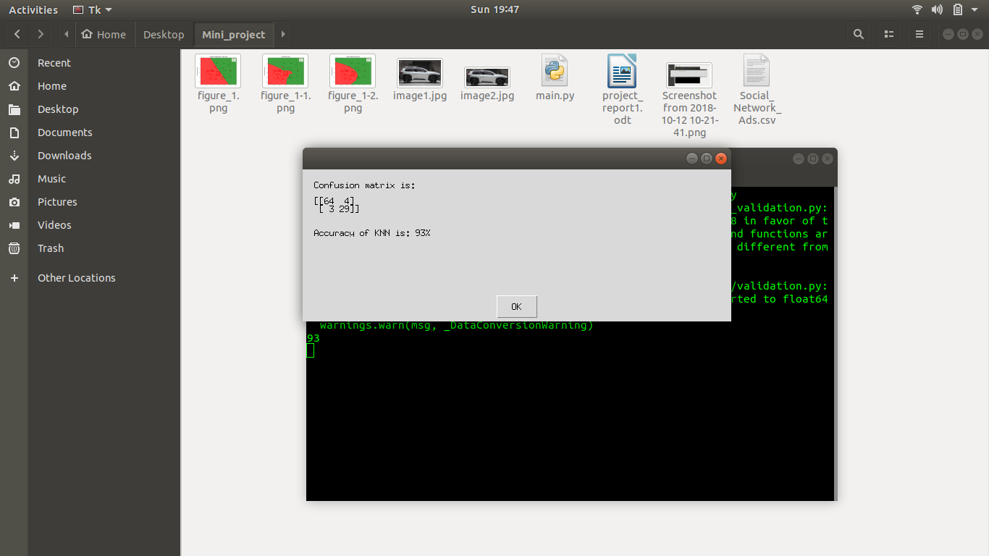
Confusion matrix and accuracy

Slide 19
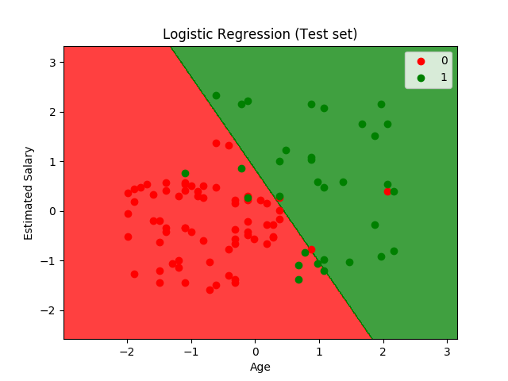
Graphs

Slide 20
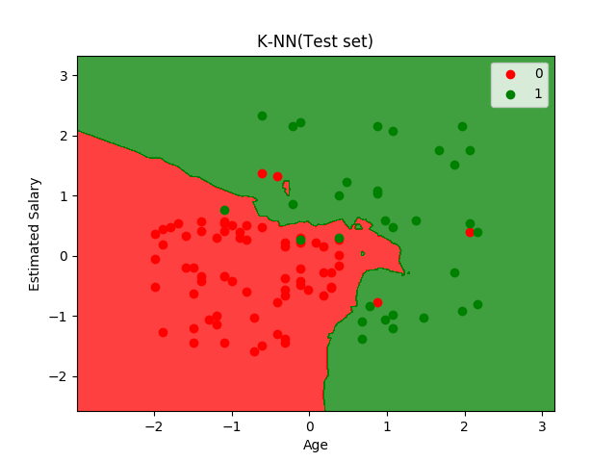

Slide 21


Slide 22
Conclusion
Based on the analysis we found out the whether a person will buy an SUV or not using various classification algorithms.
Accuracy:
Logistic Regression - 89%
Naive Bayes - 90%
K Nearest Neighbour - 93%

Slide 23
References
An introduction to classification algorithms by kevin gurney.
pandas.org
matplotlib.org

