Slide 1
Term project Presentation

Slide 2
Overview
Goals of the project
Where we got our data from – data source
The reason we chose Mongodb
Other technologies that we used
Briefly discuss MongoDB aggregation framework
How we used MongoDB aggregation framework to do our analysis.
Closing comments – how we generalized this job search to take any type of job and do similar analysis.
Reproducible research.

Slide 3
Goals of the project
Understand the demand for data scientists in US
Number of data scientist jobs in US per state.
What are the top 20 companies hiring data scientists in the US ?
Who is hiring more data scientists in your vicinity ?
What is the total number of unique employers in US hiring a data scientist ?
Total number of jobs which require SAS, R, Python, Javascript, Mongodb

Slide 4
Data source
Initially we looked into API’s like
LinkedIn API – needs API key – but limited in scope
CareerBuilder API – needs to be partner
Glassdoor API – needs API key – limited in scope
Indeed API – needs to be partner
Settled on Dice API
Simple, Elegant and decent in scope.
Notes:
Show the github table with a list of available Job website API’s.
We wanted to find API’s that return a JSON response.

Slide 5
Dice API
service.dice.com
http://service.dice.com/api/rest/jobsearch/v1/simple.json?text=mongodb
parameters
direct - (optional) if the value of this parameter is "1" then jobs returned will be direct hire
areacode - (optional) specify the jobs area code
country - (optional) specify the jobs ISO 3166 country code
state - (optional) specify the jobs United States Post Office state code
skill - (optional) specify search text for the jobs skill property
city - (optional) specify the jobs United States Post Office ZipCode as the center of 40 mile radius
text - (optional) specify search text for the jobs entire body
age - (optional) specify a posting age (a.k.a. days back)
page - (optional) specify a page number of the results to be displayed (1 based)
pgcnt - (optional) specify the number of results per page

Slide 6
Sample response
{"count":354,"firstDocument":1,"lastDocument":50,"nextUrl":"/api/rest/jobsearch/v1/simple.json?areacode\u003d\u0026country\u003d\u0026state\u003d\u0026skill\u003d\u0026city\u003d07059\u0026text\u003dR\u0026ip\u003d\u0026diceid\u003d\u0026page\u003d2","resultItemList":[{"detailUrl":"http://www.dice.com/job/result/10378739/050424?src\u003d19","jobTitle":"R Programmer","company":"Atyeti","location":"New York, NY","date":"2017-08-14"},{"detailUrl":"http://www.dice.com/job/result/cybercod/CS9-13868335?src\u003d19","jobTitle":"Data Scientist - Python, R","company":"CyberCoders","location":"New York, NY","date":"2017-08-14"},{"detailUrl":"http://www.dice.com/job/result/cybercod/LF2-137252113?src\u003d19","jobTitle":"Senior Data Scientist - R, Python, Hadoop","company":"CyberCoders","location":"New York, NY","date":"2017-08-14"},{"detailUrl":"http://www.dice.com/job/result/10364413/114295?src\u003d19","jobTitle":"Data Scientist - SQL/R/Python - Capital Markets - up to $300k","company":"Botsford Associates LLC","location":"New York, NY","date":"2017-08-14"},{"detailUrl":"http://www.dice.com/job/result/primusga/datascientistnj?src\u003d19","jobTitle":"Data Scientist, Machine Learning, R, Python, Sparks, Predictive Model","company":"Primus Software Corp","location":"warren, NJ","date":"2017-08-14"},{"detailUrl":"http://www.dice.com/job/result/primusga/deeplearningnj?src\u003d19","jobTitle":"Deep Learning, Python, R, Machine Languague, Scientist, Tensor, Thean","company":"Primus Software Corp","location":"warren, NJ","date":"2017-08-14"}
Notes:
Talk about pagination. And how we handled paginated results.

Slide 7
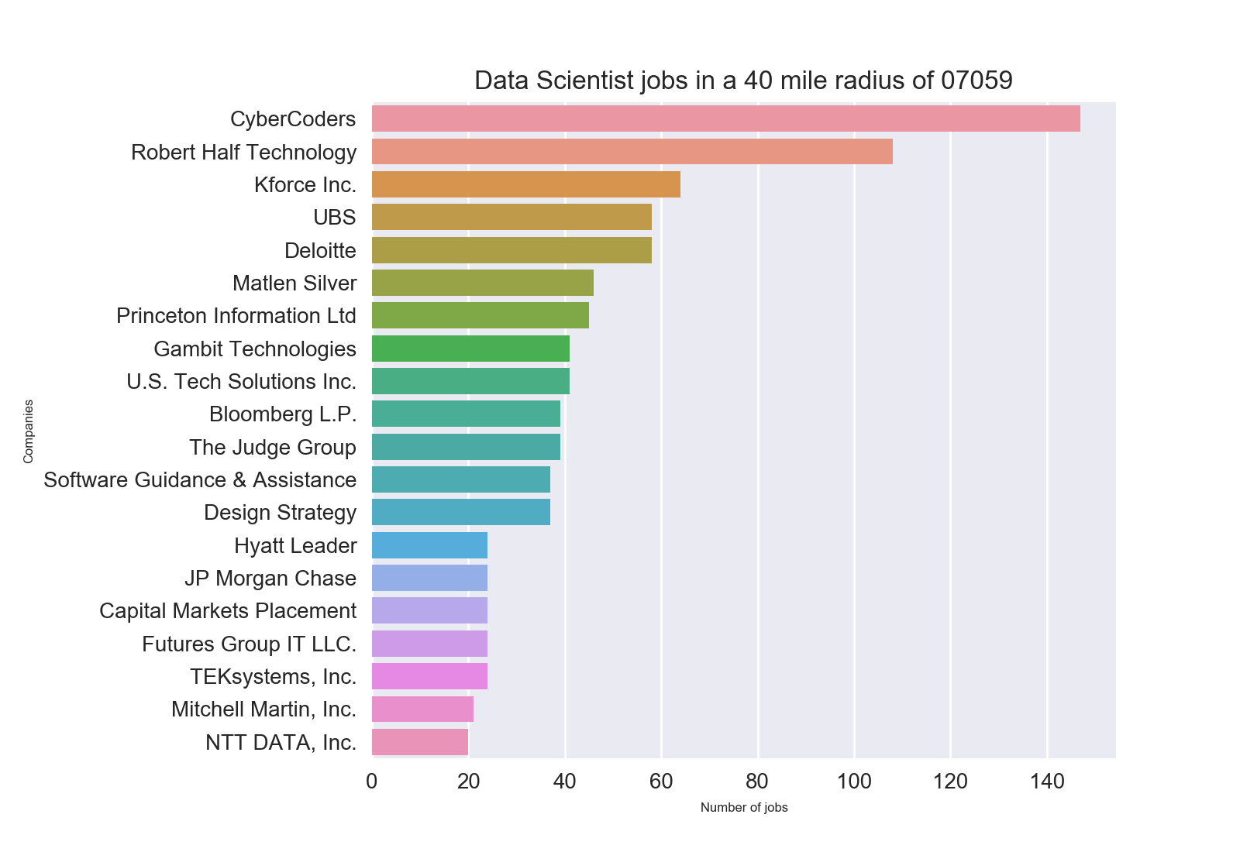
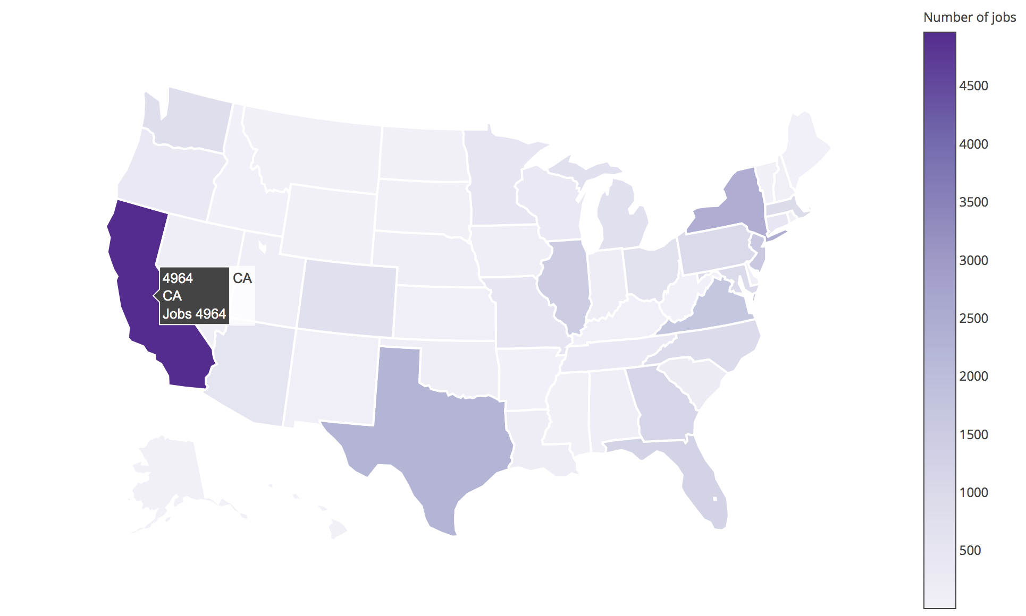
End Result

Slide 8
Technologies Used
MongoDB
Python
Pymongo
Pandas
Matplotlib
Seaborn
Plotly
Notes:
MongoDB is central to make all of this possible.

Slide 9
Visualize the architecture
Dice API
url: http://service.dice.com/
Python
packages: request, json
request.geturl(URL)
Pymongo
insert_one()
MongoDB
Pandas
aggregation pipeline: $match -> $group -> $project -> $sort -> $limit
Seaborn/Plotly
Pymongo
aggregate() find() count()
create a pandas dataframe
use seaborn, matplotlib and plotly to display graphs and maps
Notes:
work in progress

Slide 10
MongoDB aggregation framework
Central to our analysis is MongoDB aggregation framework
collection
result
$match
$group
$project
$sort
Notes:
Aggregation uses a pipeline in MongoDB. All the documents in a collection go through each stage of the pipeline.

Slide 11
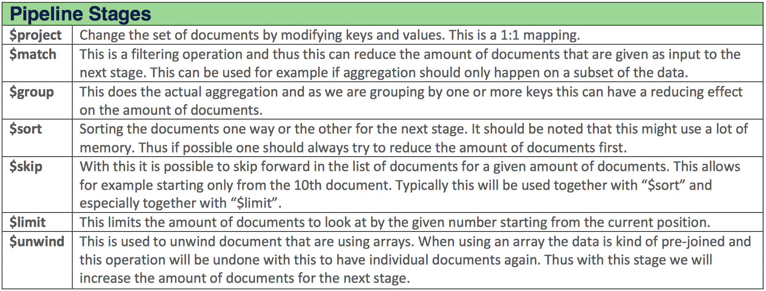
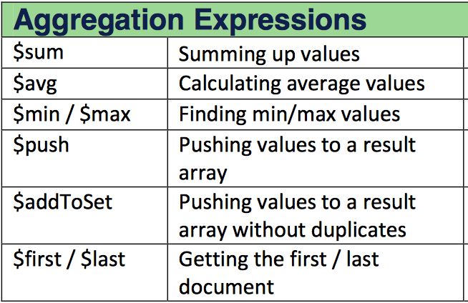
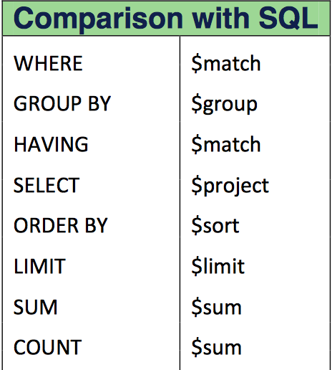
Other Mongodb pipeline stages
Notes:
with $group you can use some of the aggregation expressions like $sum, $avg, $min, $max

Slide 12
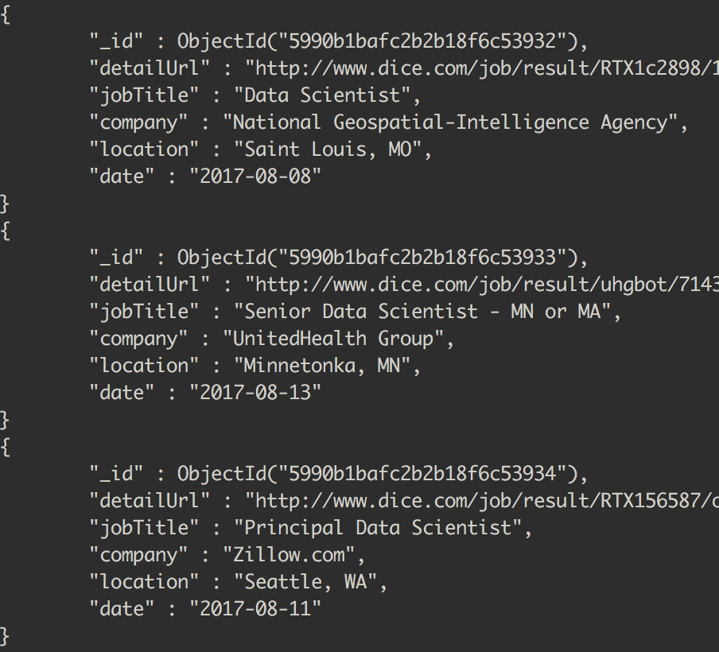
Structure of the inserted document
_id
detailUrl
jobTitle
company
location
date
Notes:
Note here that we don’t have state. We will be deriving the state field from location.

Slide 13
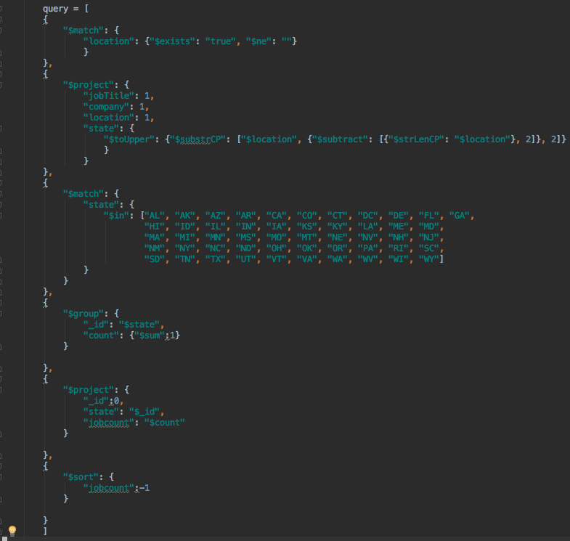
Q1: Data scientist jobs in US per state.
$match
$project
$match
$group
$project
$sort

Slide 14
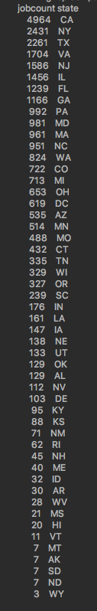
Output:

Slide 15
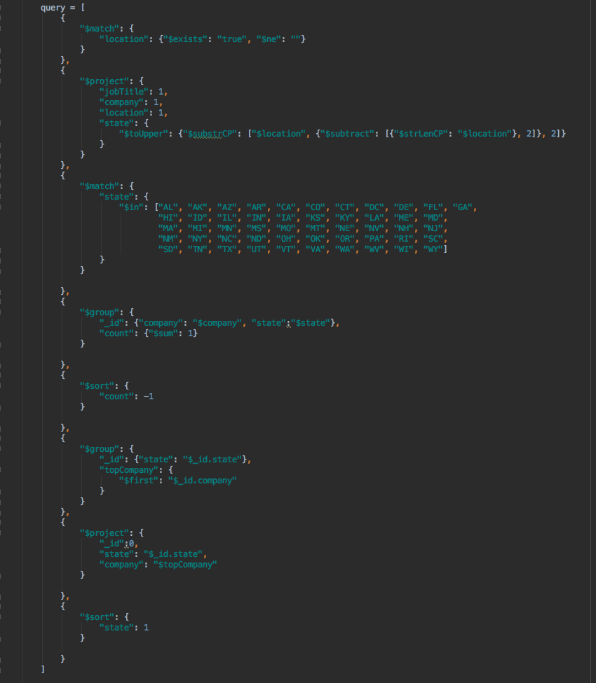
Q2: Top company within each state
$match
$project
$match
$group
$sort
$group
$project
$sort

Slide 16
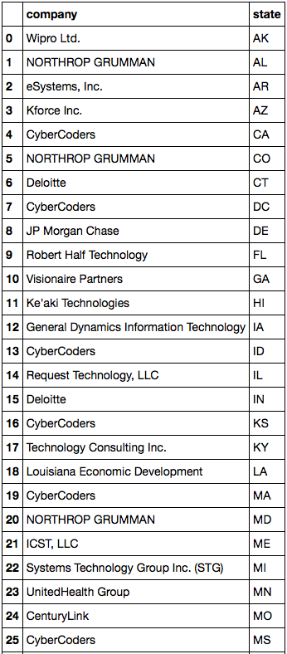
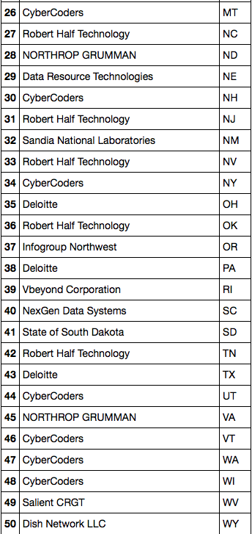
Output

Slide 17
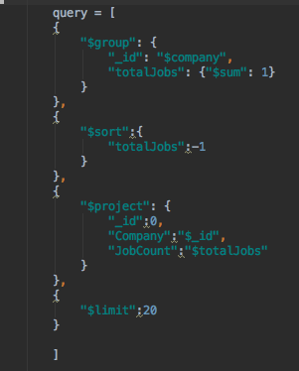
Q3: Who is hiring more DS in your vicinity ?
$group
$sort
$project
$limit

Slide 18
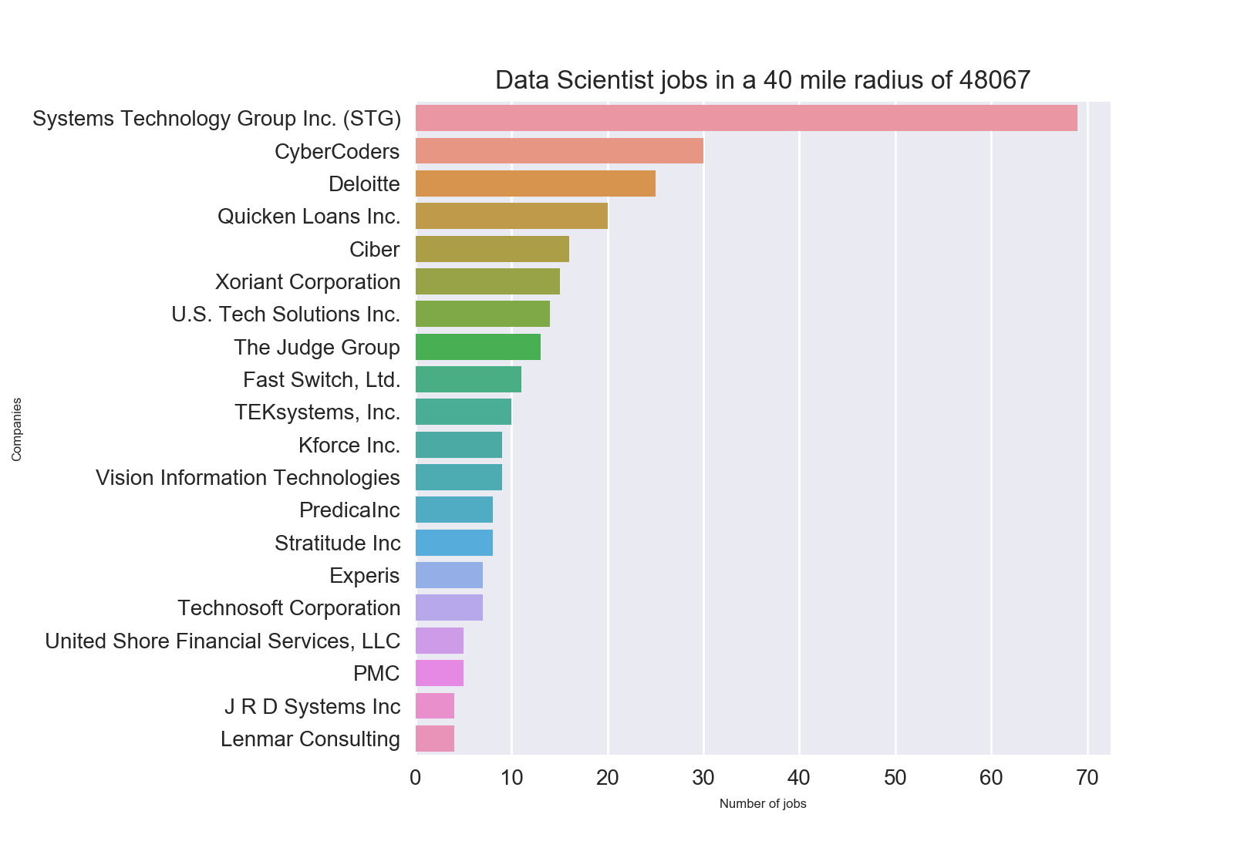
Output

Slide 19
Q4: Number of unique employers hiring DS
Query
Output

Slide 20
Q5: SAS, R, Python, JS, MongoDB
Query
Output

Slide 21
Additional Points
Interesting insights
What other API’s offer
Is there anything similar to this already done
Where does Dice get its information
Closing remarks
Q & A
Notes:
- Good way to explore and store the companies that are hiring data scientists.
Good way to find out which companies are located in your viscinity and what skills they are looking for.

