Slide 1
Term project
An analysis of Data Scientist jobs using MongoDB
Shravan Kuchkula
Jack Nelson
Antonio Garza

Slide 2
Overview
Goals of the project.
Where we got our data from – data source
The reason we chose Mongodb
Other technologies that we used
Briefly discuss MongoDB aggregation framework
How we used MongoDB aggregation framework to do our analysis.
Closing comments – how we generalized this job search to take any type of job and do similar analysis.
Reproducible research.

Slide 3
Goals of the project
Understand the demand for data scientists in US
Number of data scientist jobs in US per state.
What are the top 20 companies hiring data scientists in the US ?
Who is hiring more data scientists in your vicinity ?
What is the total number of unique employers in US hiring a data scientist ?
Total number of jobs which require SAS, R, Python, Javascript, Mongodb

Slide 4
Data source
Initially we looked into API’s like
LinkedIn API – needs API key – but limited in scope
CareerBuilder API – needs to be partner
Glassdoor API – needs API key – limited in scope
Indeed API – needs to be partner
Settled on Dice API
Simple, Elegant and decent in scope.

Slide 5
Dice API
service.dice.com
http://service.dice.com/api/rest/jobsearch/v1/simple.json?text=mongodb
parameters
direct - (optional) if the value of this parameter is "1" then jobs returned will be direct hire
areacode - (optional) specify the jobs area code
country - (optional) specify the jobs ISO 3166 country code
state - (optional) specify the jobs United States Post Office state code
skill - (optional) specify search text for the jobs skill property
city - (optional) specify the jobs United States Post Office ZipCode as the center of 40 mile radius
text - (optional) specify search text for the jobs entire body
age - (optional) specify a posting age (a.k.a. days back)
page - (optional) specify a page number of the results to be displayed (1 based)
pgcnt - (optional) specify the number of results per page

Slide 6
Sample response
{"count":354,"firstDocument":1,"lastDocument":50,"nextUrl":"/api/rest/jobsearch/v1/simple.json?areacode\u003d\u0026country\u003d\u0026state\u003d\u0026skill\u003d\u0026city\u003d07059\u0026text\u003dR\u0026ip\u003d\u0026diceid\u003d\u0026page\u003d2","resultItemList":[{"detailUrl":"http://www.dice.com/job/result/10378739/050424?src\u003d19","jobTitle":"R Programmer","company":"Atyeti","location":"New York, NY","date":"2017-08-14"},{"detailUrl":"http://www.dice.com/job/result/cybercod/CS9-13868335?src\u003d19","jobTitle":"Data Scientist - Python, R","company":"CyberCoders","location":"New York, NY","date":"2017-08-14"},{"detailUrl":"http://www.dice.com/job/result/cybercod/LF2-137252113?src\u003d19","jobTitle":"Senior Data Scientist - R, Python, Hadoop","company":"CyberCoders","location":"New York, NY","date":"2017-08-14"},{"detailUrl":"http://www.dice.com/job/result/10364413/114295?src\u003d19","jobTitle":"Data Scientist - SQL/R/Python - Capital Markets - up to $300k","company":"Botsford Associates LLC","location":"New York, NY","date":"2017-08-14"},{"detailUrl":"http://www.dice.com/job/result/primusga/datascientistnj?src\u003d19","jobTitle":"Data Scientist, Machine Learning, R, Python, Sparks, Predictive Model","company":"Primus Software Corp","location":"warren, NJ","date":"2017-08-14"},{"detailUrl":"http://www.dice.com/job/result/primusga/deeplearningnj?src\u003d19","jobTitle":"Deep Learning, Python, R, Machine Languague, Scientist, Tensor, Thean","company":"Primus Software Corp","location":"warren, NJ","date":"2017-08-14"}

Slide 7
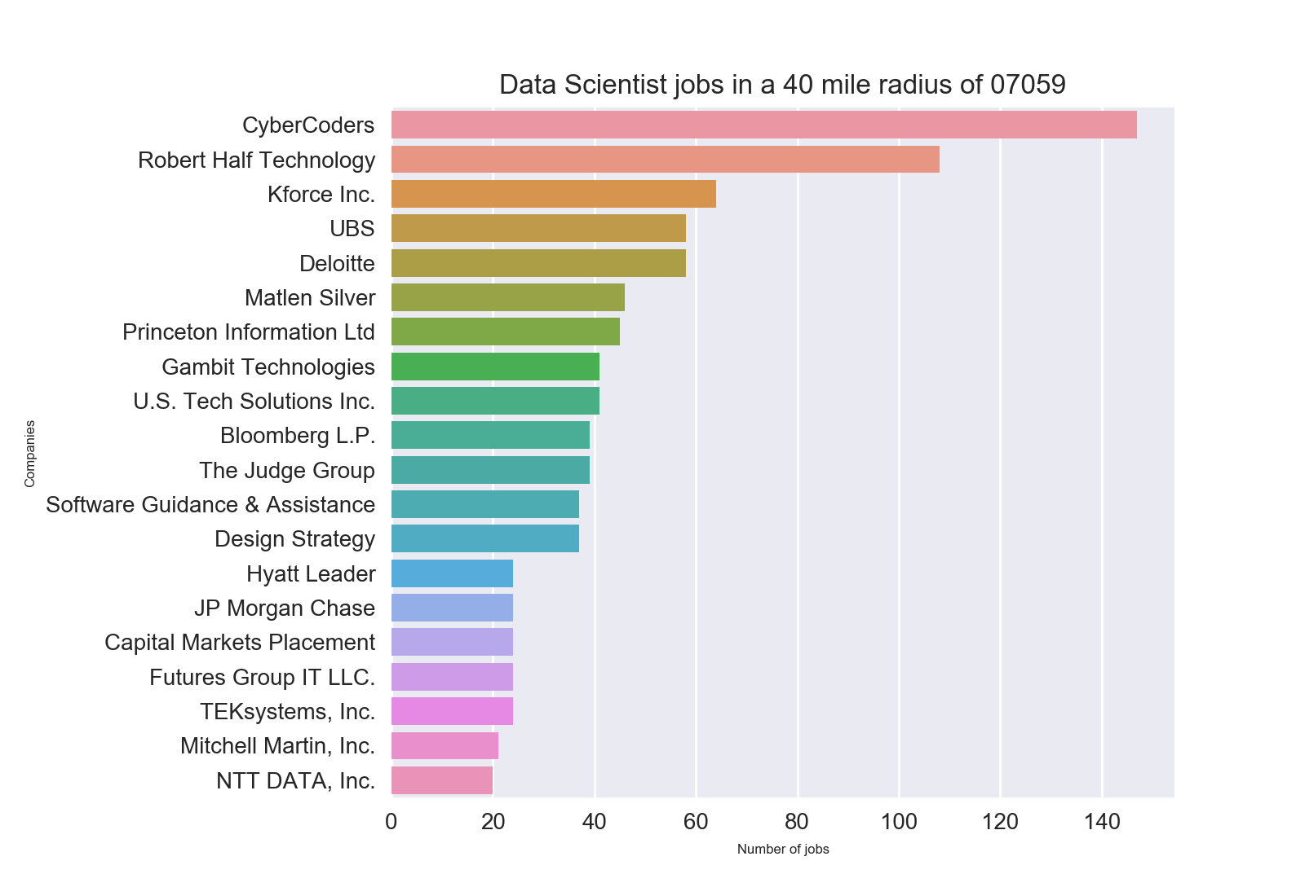
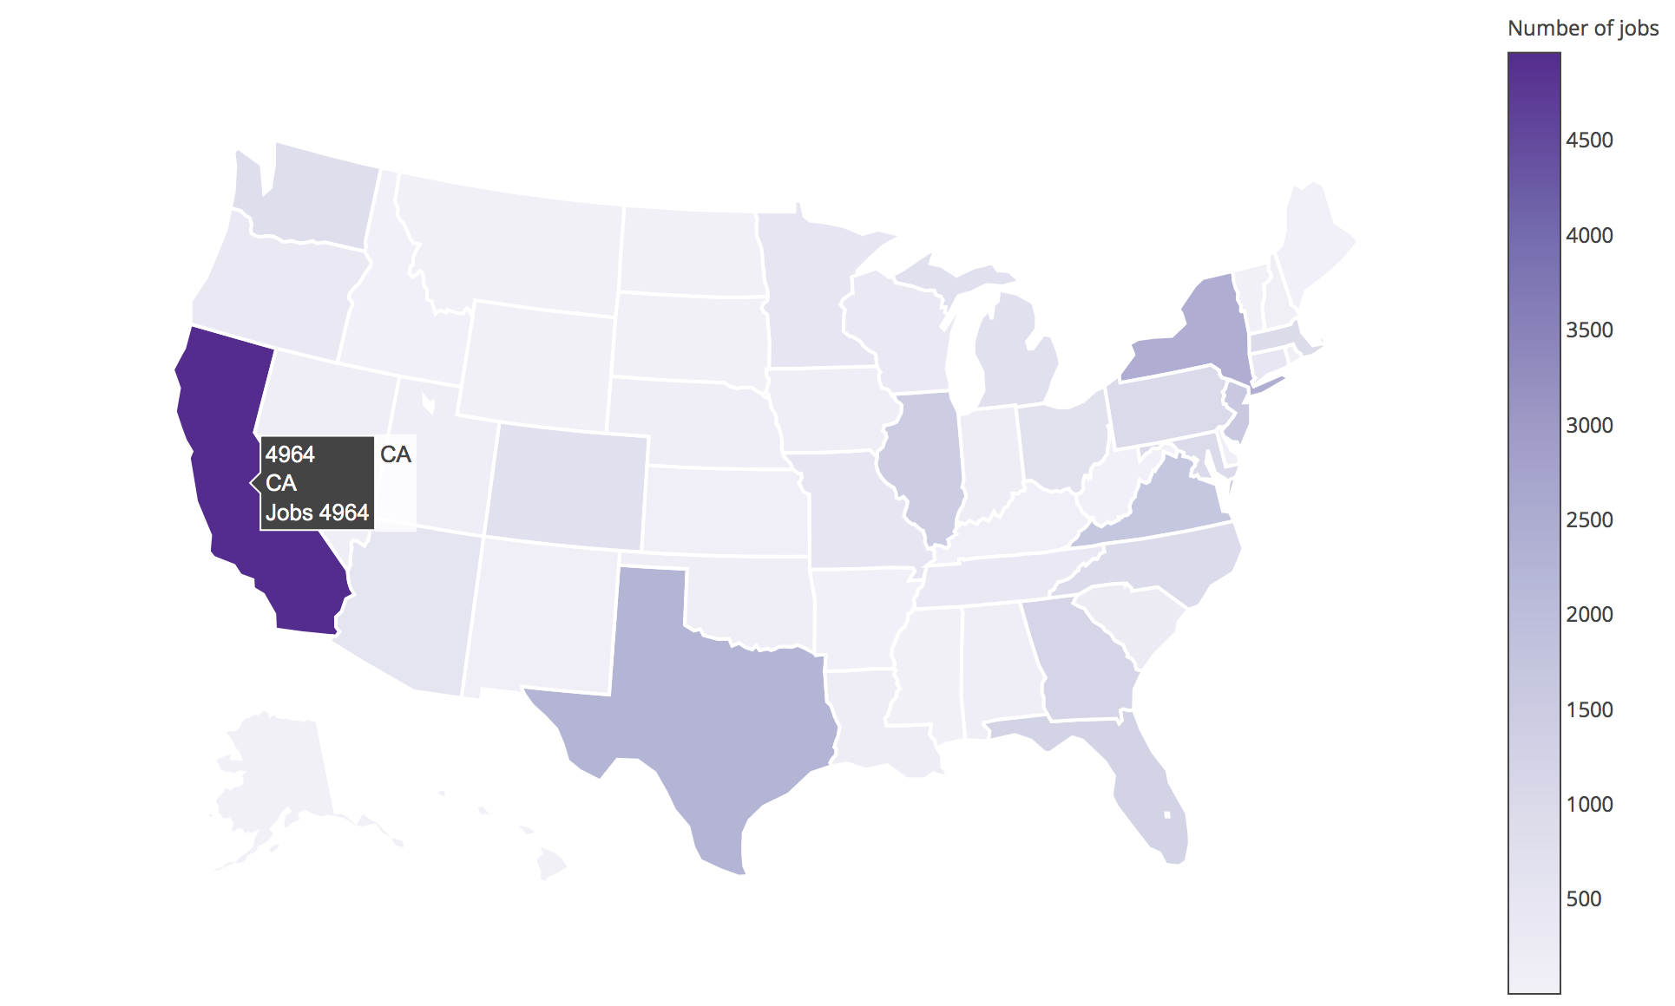
End Result

Slide 8
Technologies Used
MongoDB
Python
Pymongo
Pandas
Matplotlib
Seaborn
Plotly
3.4.4
3.6
3.4
0.19.2
2.0
0.7.1
2.0.14

Slide 9
Visualize the architecture
Dice API
url: http://service.dice.com/
Python
packages: request, json
request.geturl(URL)
Pymongo
insert_one()
MongoDB
Pandas
aggregation pipeline: $match -> $group -> $project -> $sort -> $limit
Seaborn/Plotly
Pymongo
aggregate() find() count()
create a pandas dataframe
use seaborn, matplotlib and plotly to display graphs and maps

Slide 10
MongoDB aggregation framework
Central to our analysis is MongoDB aggregation framework
collection
result
$match
$group
$project
$sort
Notes:
Aggregation uses a pipeline in MongoDB. All the documents in a collection go through each stage of the pipeline.
The documents in the collection enter the pipeline and are passed from one stage to another and returned when the pipeline completes.
$match – is a filtering stage – where you can filter some of the documents based on some criteria.
$group – is the heart of aggregation framework – it has several operators associated with it.
$project – to change the schema of the document, i.e, you can add new items to the document or rename an existing field in the document.
$sort – to sort the documents in the collections based on a field.

Slide 11
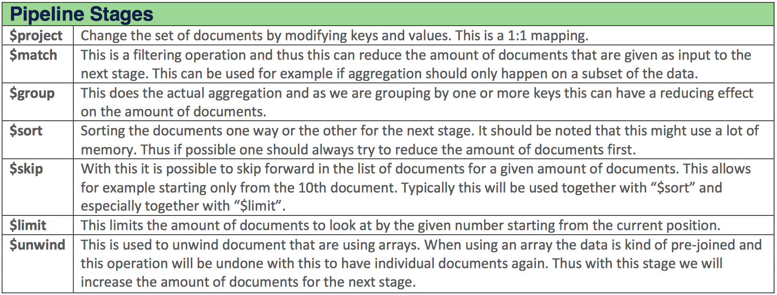
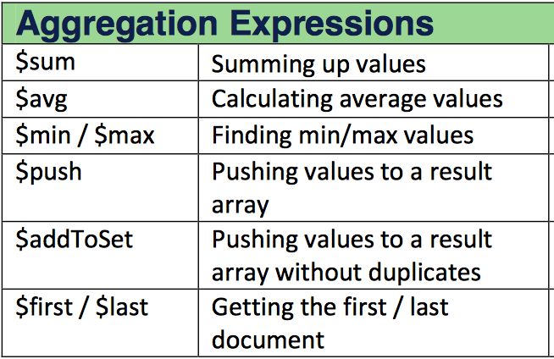
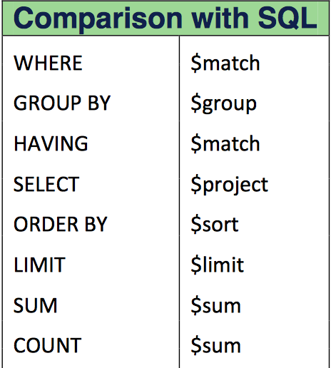
Other Mongodb pipeline stages
Notes:
with $group you can use some of the aggregation expressions like $sum, $avg, $min, $max

Slide 12
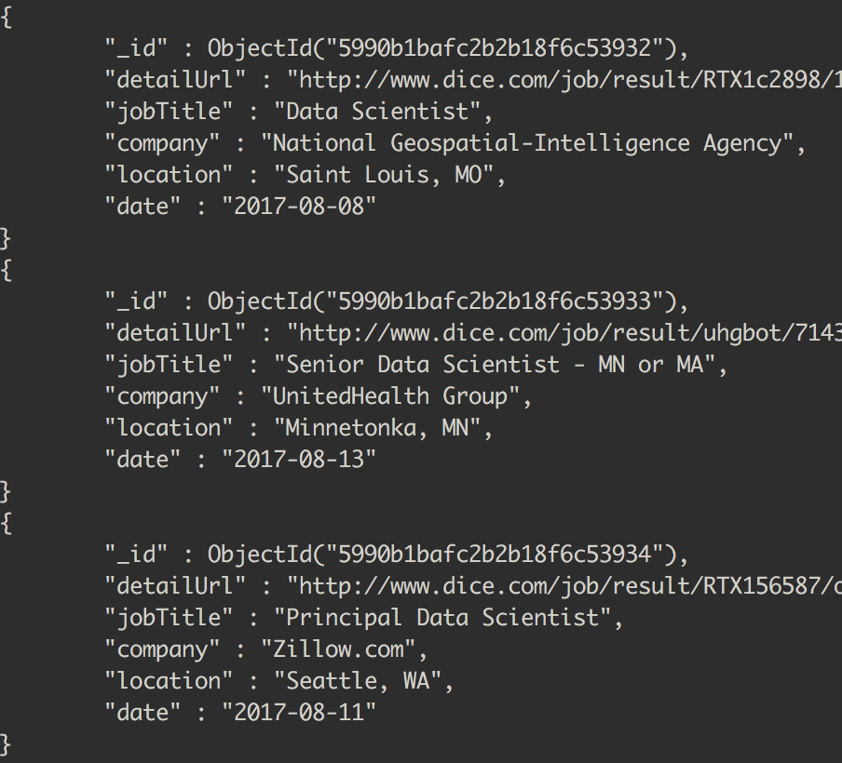
Structure of the inserted document
_id
detailUrl
jobTitle
company
location
date
Notes:
Each document has 5 fields:
- _id – this gets generated automatically for every document.
- detailURL – link to the job on dice
- jobTitle – is the job title
- company – company that posted this job.
- location – where this job is located.
Note here that we don’t have state. We will be deriving the state field from location.

Slide 13
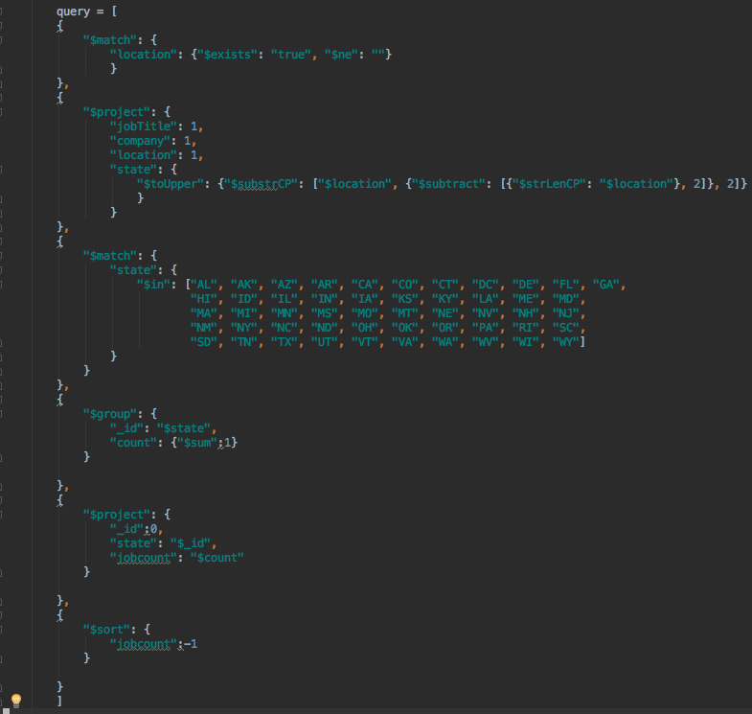
Q1: Data scientist jobs in US per state.
$match
$project
$match
$group
$project
$sort
Notes:
So our first question was:
Number of data scientist jobs per state. To do this, we pass our jobs collection – that I showed in the previous slide – through this aggregation pipeline.
In the first stage $match – I filter out the documents which don’t have location in them.
In the second stage $project – I derive the “state” from location by extracting the last two characters.
In the third stage, I use $match again to match only states which have valid state ID.
In the fourth stage, I use $group to group the documents based on ”state” and count the number of jobs.
In the fifth stage, I use $project to reshape and rename the columns to state and jobCount.
In the last stage, I use $sort to sort the documents based on “jobcount”

Slide 14
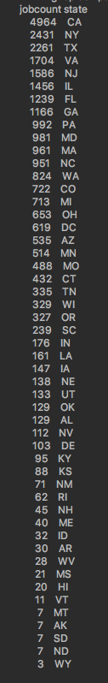
Output:
Notes:
End result will be something like this, we get a data frame which contains 2 columns. ”jobcount” and “state”.
We can then pass this dataframe into any one of the python’s visualization packages. Here, I have used plotly package to display a heat map of US where jobs are located. If you hover over each state, it will show you the number of data scientist jobs in that state. http://plot.ly/~shravan-kuchkula/5 (click X to close the signup window and you can see the plot)

Slide 15
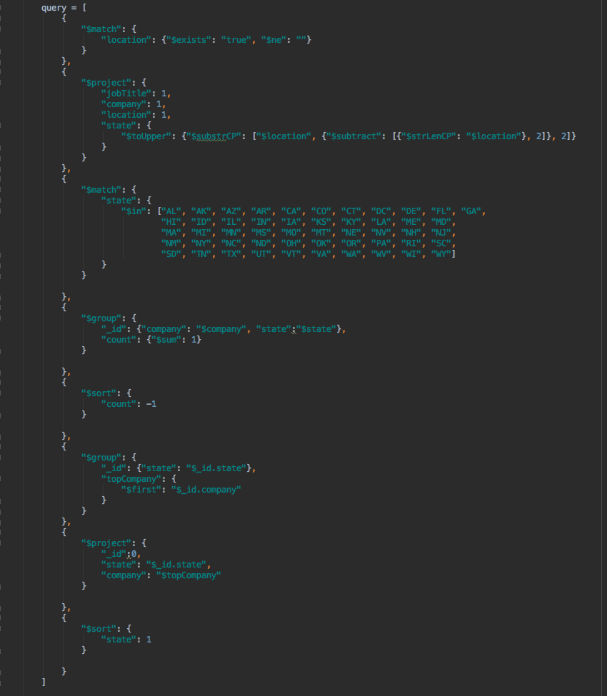
Q2: Top company within each state
$match
$project
$match
$group
$sort
$group
$project
$sort
Notes:
For our second question: We wanted to find out what is the top company hiring data scientists within each state.
The first 3 stages are exactly the same as in the previous query.
In the fourth stage, we use a compound grouping – we group by company and state and count the number of jobs.
In the fifth stage, we sort the result based on the count of the jobs.
In the sixth stage, we pass the collection through another $group, and this time, we group by state and we pick the first element in the group using $first.
In the next 2 stages, we just rename columns and sort by state.

Slide 16
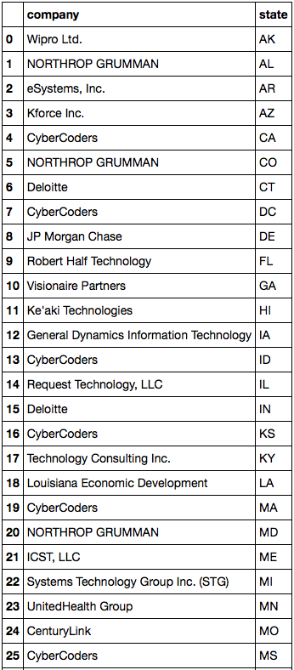
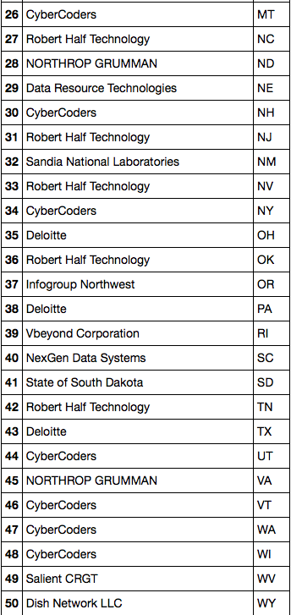
Output
Notes:
Here we can see for every state the employer who is hiring the most data scientists is shown.

Slide 17
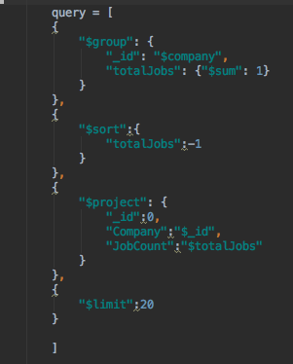
Q3: Who is hiring more DS in your vicinity ?
$group
$sort
$project
$limit
Notes:
For the third question: we wanted to find out the top 20 companies that are hiring in our vicinity (i.e for our zipcode).
Compared to the previous 2, this one only needs 4 stages to get the answer.
In the first stage, we group by ”company” and count the number of jobs.
In the second stage, we sort based on the count.
In the third stage, we reshape the document and prepare it for displaying.
In the fourth stage, we use $limit which limits the number of results to 20.

Slide 18
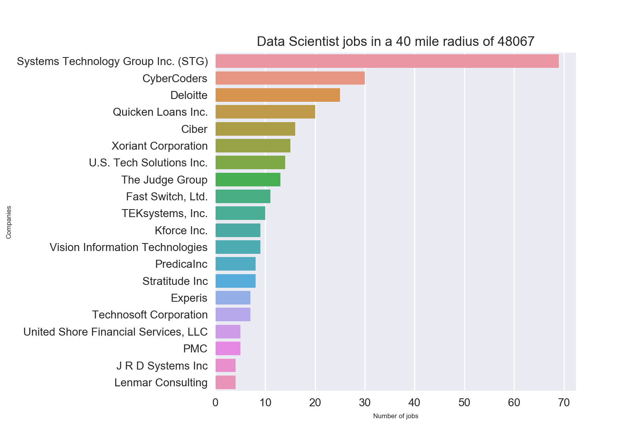
Output
Notes:
We then pass the output to the python visualization library: Seaborn and matplotlib to get the above bar charts.

Slide 19
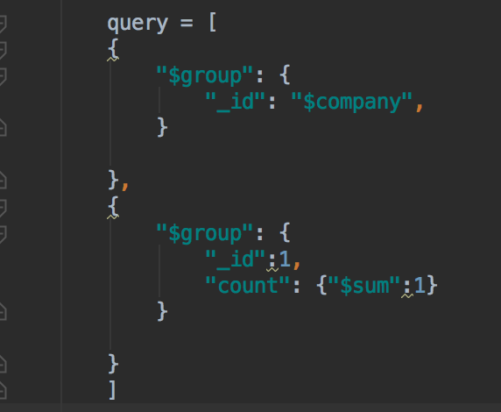
Q4: Number of unique employers hiring DS
$group
$group
Output:
"count" : 4428
Notes:
For the 4th question: To find the number of unique employers hiring DS in US.
We need to use a double grouping stage. In the first $group stage, we group the documents based on company. Since the aggregation framework does not have a $count operator, we need to group the documents second time based on ”_id” and count the number of documents.
In SQL world, this is equivalent to select count(distinct(fieldName)) from tableName

Slide 20

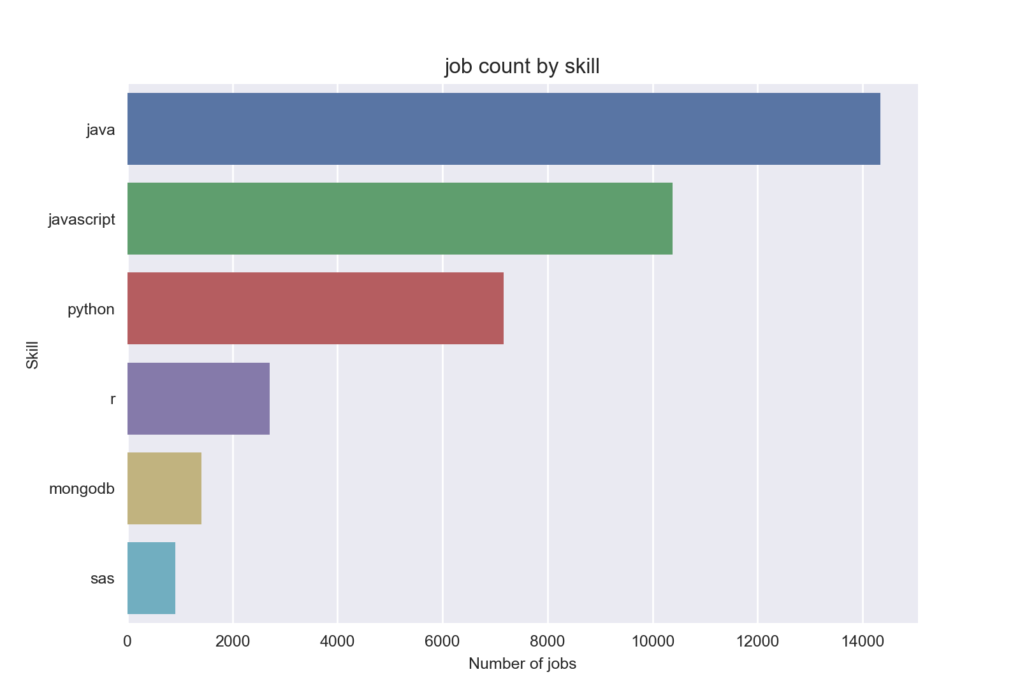
Q5: SAS, R, Python, JS, MongoDB

Slide 21
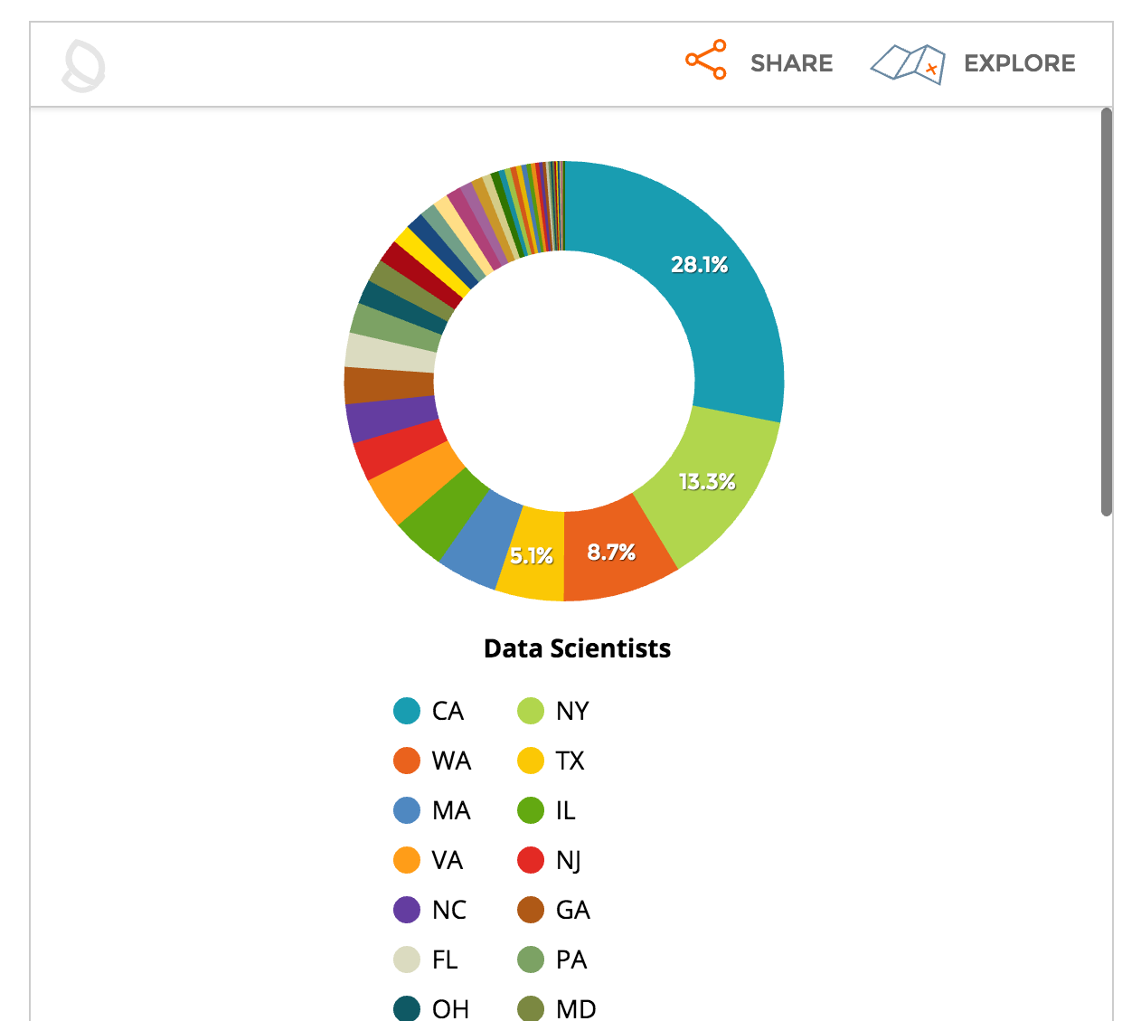
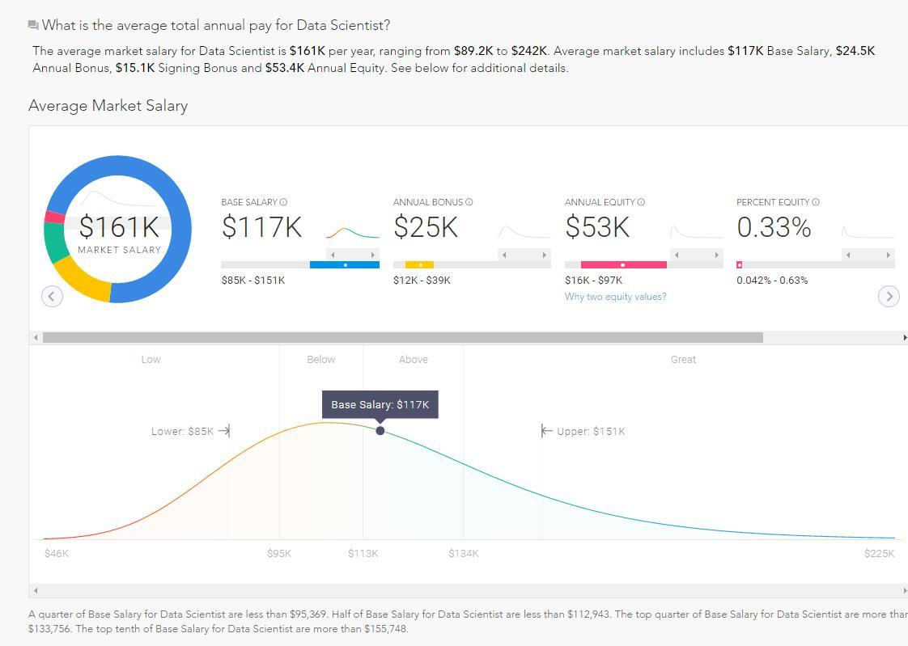
Other On-line Analysis
Wanted to ensure we weren’t recreating anyone’s analysis on-line on the subject
Looked up similar research and found a couple older hits
https://gigaom.com/2014/11/02/where-the-data-science-jobs-are-by-sector-and-by-state/
https://www.forbes.com/sites/louiscolumbus/2016/10/22/15-data-scientist-jobs-that-pay-100k-or-more/#337b76b7626c
“Hack your Career”Feature on Dice.com lets you find out how much your skills are worth
GIGAOM.COM Data from 2014
OCT 2016 FORBES.COM Data using PAYSA.COM

Slide 22
Dice.com Info
Career website based in New York, California and Iowa
Founded in 1990 and became prominently used in Silicon Valley as a job posting bulletin board
Known as “the career hub for tech” it caters to IT and Engineering Professionals
Posts about 80,000 tech job positions daily

Slide 23
Resources, Q&A
Resources:
Code: https://github.com/shravan-kuchkula/TermProject
Plotly US heatmap: http://plot.ly/~shravan-kuchkula/5
Q&A
Notes:
- Good way to explore and store the companies that are hiring data scientists.
Good way to find out which companies are located in your vicinity and what skills they are looking for.

