Slide 1
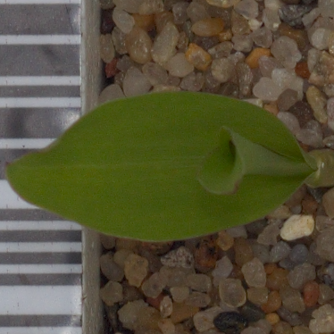
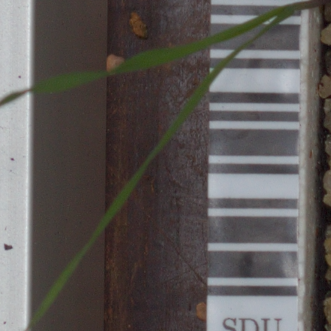
DEEP LEARNING INDIVIDUAL PROJECT
CNN Crop and Weed
Classification using VGG16
ImageNet transfer learning for binary seedling classification
CROP
Nalacherla Shravan Kumar
23EG110C43
Roll Number 43
WEED
Measured results from local CPU training
Notes:
Suggested time: 30 seconds. Introduce the student, project and two binary categories. Sources: outputs/dataset_splits.csv, outputs/training_history.json, outputs/results_summary.json, outputs/test_predictions.csv. Dataset attribution: Giselsson et al. (2017), https://arxiv.org/abs/1711.05458, https://vision.eng.au.dk/plant-seedlings-dataset/, CC BY-SA 4.0.

Slide 2
1. Problem statement
02
Identify crops and weeds from one RGB seedling image
The task
Project objective
Given one plant image, predict Crop or Weed using the project’s species mapping.
Adapt pretrained VGG16 features and evaluate predictions on unseen test images.
Why it is challenging
Binary decision
Young plants share leaf shapes and green colour.
Weed images greatly outnumber crop images.
Controlled backgrounds differ from field conditions.
0 = Crop
1 = Weed
Decision threshold: Weed probability ≥ 0.5
Nalacherla Shravan Kumar 23EG110C43
Notes:
Suggested time: 50 seconds. Explain why crop protection requires reliable recognition, and why seedlings are visually challenging. This experiment studies classification on controlled images.
Sources: outputs/dataset_splits.csv, outputs/training_history.json, outputs/results_summary.json, outputs/test_predictions.csv. Dataset attribution: Giselsson et al. (2017), https://arxiv.org/abs/1711.05458, https://vision.eng.au.dk/plant-seedlings-dataset/, CC BY-SA 4.0.

Slide 3
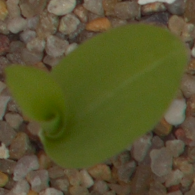
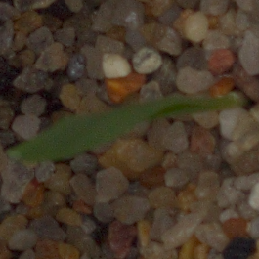
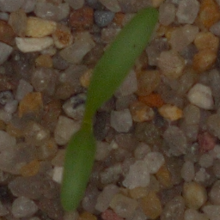
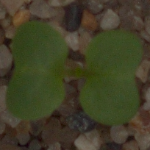
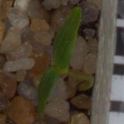
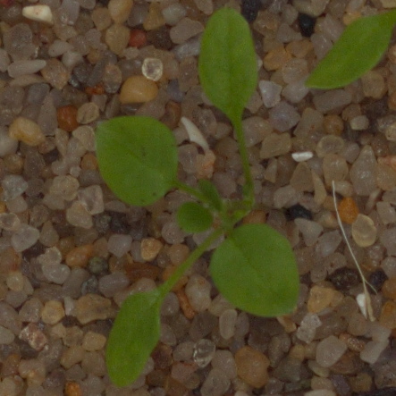
2. Dataset used
03
V2 Plant Seedlings dataset from Kaggle and Aarhus University
Verified RGB images
Plant species
Species | Images
Black-grass | 309
Charlock | 452
Cleavers | 335
Common Chickweed | 713
Common Wheat | 253
Fat Hen | 538
Loose Silky-bent | 762
Maize | 257
Scentless Mayweed | 607
Shepherd’s Purse | 274
Small-flowered Cranesbill | 576
Sugar Beet | 463
5539
12
Original dataset samples
Maize
Common Wheat
Sugar Beet
Crop
Crop
Crop
Charlock
Cleavers
Common Chickweed
Weed
Weed
Weed
CC BY-SA 4.0. Original images recorded at several plant growth stages.
Nalacherla Shravan Kumar 23EG110C43
Notes:
Suggested time: 70 seconds. Explain that the downloaded dataset has twelve species. Point to crop samples and the nine mapped weed species. All counts come from saved splits.
Sources: outputs/dataset_splits.csv, outputs/training_history.json, outputs/results_summary.json, outputs/test_predictions.csv. Dataset attribution: Giselsson et al. (2017), https://arxiv.org/abs/1711.05458, https://vision.eng.au.dk/plant-seedlings-dataset/, CC BY-SA 4.0.

Slide 4
2. Preprocessing and data split
04
Seed 42, binary stratification, augmentation only during training
Image pipeline
01
RGB input
Resize to 224 × 224
02
Training augmentation
Horizontal flip, small rotation, zoom and translation
03
VGG16 preprocessing
Split | Crop | Weed | Total
Training | 681 | 3196 | 3877
Validation | 146 | 685 | 831
Test | 146 | 685 | 831
RGB to BGR, subtract ImageNet channel means
Do not divide pixel values by 255.
Nalacherla Shravan Kumar 23EG110C43
Notes:
Suggested time: 55 seconds. Explain the 70/15/15 split. VGG16 requires raw 0–255 RGB pixels, channel reversal and mean subtraction. Augmentation happens after splitting.
Sources: outputs/dataset_splits.csv, outputs/training_history.json, outputs/results_summary.json, outputs/test_predictions.csv. Dataset attribution: Giselsson et al. (2017), https://arxiv.org/abs/1711.05458, https://vision.eng.au.dk/plant-seedlings-dataset/, CC BY-SA 4.0.

Slide 5
3. VGG16 model architecture
05
ImageNet convolution base with a binary classification head
Input
224 × 224 × 3 RGB pixels
Augment and preprocess
Training transforms, then VGG16 channel means
VGG16 convolution base
13 convolutions, 5 pooling blocks, ImageNet weights
Global average pooling
7 × 7 × 512 feature maps become 512 features
Dense layer
128 neurons with ReLU activation
Dropout
Rate 0.5 to limit overfitting
Output
1 sigmoid neuron: probability of Weed
Phase 1: all VGG16 layers frozen. Phase 2: only block5 trainable.
Nalacherla Shravan Kumar 23EG110C43
Notes:
Suggested time: 85 seconds. Walk through the editable diagram. Explain thirteen convolutions in five blocks, pooled features and one Weed probability. Blocks 1–4 remain frozen in fine-tuning.
Sources: outputs/dataset_splits.csv, outputs/training_history.json, outputs/results_summary.json, outputs/test_predictions.csv. Dataset attribution: Giselsson et al. (2017), https://arxiv.org/abs/1711.05458, https://vision.eng.au.dk/plant-seedlings-dataset/, CC BY-SA 4.0.

Slide 6
4. Hyperparameters
06
Settings used in the measured full-dataset run
Parameter | Configured value
Input size | 224 × 224 RGB
Batch size | 4
Optimizer and loss | Adam, binary cross-entropy
Head training | 3 epochs at learning rate 0.001
Block5 fine-tuning | 2 epochs at learning rate 0.00001
Classification head | Dense 128 ReLU, Dropout 0.5
Class weights | Crop 2.847, Weed 0.607
Early stopping | Validation loss, patience 3
LR reduction | Factor 0.5, patience 2
Random seed | 42
Phase 1
Freeze the convolution base.
Train the new binary head.
Phase 2
Enable block5 only.
Recompile at a lower learning rate.
Reload the checkpoint with the lowest validation loss across both phases.
Laptop run budget shown above. The code also supports maximum budgets of 10 + 5 epochs.
Nalacherla Shravan Kumar 23EG110C43
Notes:
Suggested time: 65 seconds. Describe the settings actually executed, rather than only default maximums. Class weights are calculated from training labels alone.
Sources: outputs/dataset_splits.csv, outputs/training_history.json, outputs/results_summary.json, outputs/test_predictions.csv. Dataset attribution: Giselsson et al. (2017), https://arxiv.org/abs/1711.05458, https://vision.eng.au.dk/plant-seedlings-dataset/, CC BY-SA 4.0.

Slide 7
5. Results: accuracy
07
Measured curves and evaluation on the untouched test set
Held-out test accuracy
97.71%
Test images
831
Evaluation
5 measured epochs.
Threshold: 0.5.
Seed: 42.
Epochs 1–3: frozen VGG16. Epochs 4–5: block5 fine-tuning.
Nalacherla Shravan Kumar 23EG110C43
Notes:
Suggested time: 65 seconds. The line chart is editable and uses the generated epoch history. The test set contains 831 images and was excluded from training and checkpoint selection.
Sources: outputs/dataset_splits.csv, outputs/training_history.json, outputs/results_summary.json, outputs/test_predictions.csv. Dataset attribution: Giselsson et al. (2017), https://arxiv.org/abs/1711.05458, https://vision.eng.au.dk/plant-seedlings-dataset/, CC BY-SA 4.0.

Slide 8
5. Results: loss
08
Validation loss selects the best checkpoint across both phases
Held-out test loss
0.0760
ROC AUC
0.9918
Checkpoint selection
The saved model uses the lowest measured validation loss. Test data never selects the checkpoint.
Epochs 1–3: frozen VGG16. Epochs 4–5: block5 fine-tuning.
Training loss uses class weights. Validation loss is unweighted.
Nalacherla Shravan Kumar 23EG110C43
Notes:
Suggested time: 60 seconds. Explain binary cross-entropy. Discuss the measured training/validation gap without claiming field reliability. AUC measures ranking across thresholds.
Sources: outputs/dataset_splits.csv, outputs/training_history.json, outputs/results_summary.json, outputs/test_predictions.csv. Dataset attribution: Giselsson et al. (2017), https://arxiv.org/abs/1711.05458, https://vision.eng.au.dk/plant-seedlings-dataset/, CC BY-SA 4.0.

Slide 9
5. Results: confusion matrix
09
Rows are actual labels and columns are predicted labels
Actual vs predicted labels
Actual / Predicted | Crop | Weed
Crop | 131 | 15
Weed | 4 | 681
Class | Precision | Recall | F1
Crop | 97.04% | 89.73% | 93.24%
Weed | 97.84% | 99.42% | 98.62%
Errors to inspect
15 crop images predicted as Weed. 4 weed images predicted as Crop.
Nalacherla Shravan Kumar 23EG110C43
Notes:
Suggested time: 45 seconds. Interpret crop images incorrectly predicted as weeds, then compare both classes using precision, recall and F1.
Sources: outputs/dataset_splits.csv, outputs/training_history.json, outputs/results_summary.json, outputs/test_predictions.csv. Dataset attribution: Giselsson et al. (2017), https://arxiv.org/abs/1711.05458, https://vision.eng.au.dk/plant-seedlings-dataset/, CC BY-SA 4.0.

Slide 10
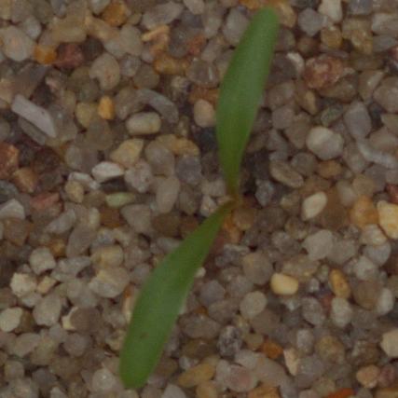
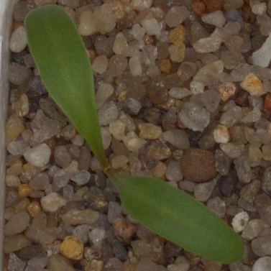
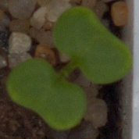

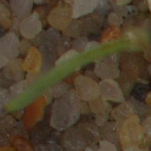
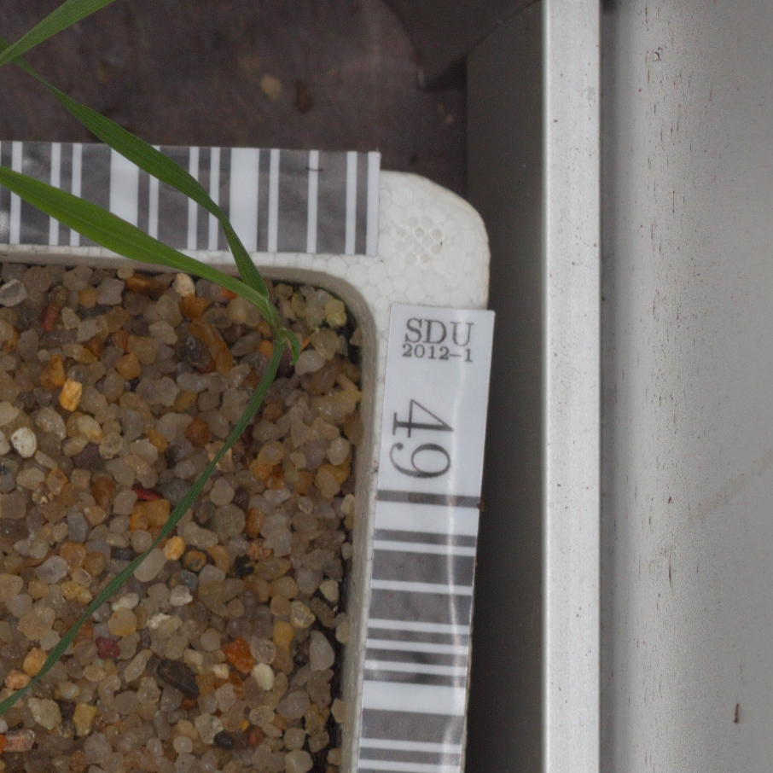
5. Results: sample predictions
10
Original held-out test images and saved model probabilities
Correct: Sugar Beet
Correct: Sugar Beet
Correct: Charlock
Actual Crop / Predicted Crop
Actual Crop / Predicted Crop
Actual Weed / Predicted Weed
Weed probability: 0.00%
Weed probability: 0.00%
Weed probability: 99.89%
Correct: Common Chickweed
Error: Maize
Error: Black-grass
Actual Weed / Predicted Weed
Actual Crop / Predicted Weed
Actual Weed / Predicted Crop
Weed probability: 100.00%
Weed probability: 96.03%
Weed probability: 22.65%
Nalacherla Shravan Kumar 23EG110C43
Notes:
Suggested time: 45 seconds. Show both correct and incorrect examples. Explain that probability is the sigmoid Weed score, not a calibrated guarantee.
Sources: outputs/dataset_splits.csv, outputs/training_history.json, outputs/results_summary.json, outputs/test_predictions.csv. Dataset attribution: Giselsson et al. (2017), https://arxiv.org/abs/1711.05458, https://vision.eng.au.dk/plant-seedlings-dataset/, CC BY-SA 4.0.

Slide 11
6. Conclusion
11
Measured outcome, limitations and future work
What was implemented
A complete local VGG16 transfer-learning pipeline with verified data, disjoint splits, saved checkpoints and test predictions.
Measured outcome
97.71% test accuracy and 0.0760 test loss on 831 images.
Accuracy exceeds the 82.43% majority-Weed baseline on this image split.
Limitations and next steps
Controlled backgrounds and repeated plant identities limit generalization.
Next: verify plant-level splits, collect field images and tune decision thresholds.
Nalacherla Shravan Kumar 23EG110C43
Notes:
Suggested time: 30 seconds. Conclude with actual measured test results. Explain that disjoint image paths do not guarantee independent plant identities across growth stages.
Sources: outputs/dataset_splits.csv, outputs/training_history.json, outputs/results_summary.json, outputs/test_predictions.csv. Dataset attribution: Giselsson et al. (2017), https://arxiv.org/abs/1711.05458, https://vision.eng.au.dk/plant-seedlings-dataset/, CC BY-SA 4.0.

