Slide 1
AIML HONORS · PATTERN RECOGNITION & APPLICATIONS
Anomaly Detection in Financial Transactions using DBSCAN
Unsupervised Pattern Recognition for High-Dimensional Credit Card Fraud Detection
SAP IDs: 60002231063
60002231022
Python, Scikit-Learn, NumPy, Pandas, Matplotlib
Notes:
Frame the project as an unsupervised approach to detecting fraud without relying on labeled examples.

Slide 2


PROBLEM CONTEXT
Fraud is rare, so anomalies matter
Financial fraud represents a very small proportion of transactions.
Objective: identify unusual transactions with DBSCAN and evaluate whether fraud appears as density-based anomalies.
Training is unsupervised; fraud labels are reserved for evaluation.
Notes:
Emphasize that the DBSCAN model never saw the Class feature during clustering; evaluation metrics compare detected noise against actual labels.

Slide 3
DATA PIPELINE & EXPERIMENTAL DESIGN
From 284,807 transactions to a fixed 10,000-row subset
Dataset | Transactions | Fraud cases | Fraud rate
Full source dataset | 284,807 | 492 | 0.1727%
Experimental subset (evaluated) | 10,000 | 16 | 0.16%
Raw Dataset
Feature Selection
Robust Scaling
PCA Compression
Extract 10,000 sampled rows
30 features: Time, Amount, V1–V28
Scale heavy-tailed distributions
Retain 95.02% variance in 23 PCs
Class column removed prior to modeling, excluded from DBSCAN, and used only for evaluation scoring.
Notes:
Taking 10,000 rows preserved the exact 0.16% fraud proportion (16 frauds), while isolating Class from the 30 input features.

Slide 4

DIMENSIONALITY REDUCTION
PCA made density clustering practical
30 → 23
95.02%
Dimensions to principal components
Variance retained
Why PCA
Reduce dimensionality
Improve computational efficiency
Preserve most information
PCA computed across standardized numerical features on the fixed 10,000-transaction subset.
Notes:
23 components preserve 95.02% variance while making neighborhood queries meaningful.

Slide 5
CLUSTERING MECHANICS
DBSCAN groups dense regions and identifies noise
Core Points
Border Point
Noise Point (−1)
neighbours≥ min_samples
Neighbour< min_samples+ Near core
Falls outside clusters
Dense Region
Attached to cluster
Anomaly Candidates (Label −1)
DBSCAN noise points labeled −1 become anomaly candidates.
eps: Maximum neighbourhood radius
min_samples:Maximum no of neighbouring points required for a core point
Notes:
Points with sufficient neighbor density form clusters, while isolated points outside are noise (−1), representing potential fraud.

Slide 6
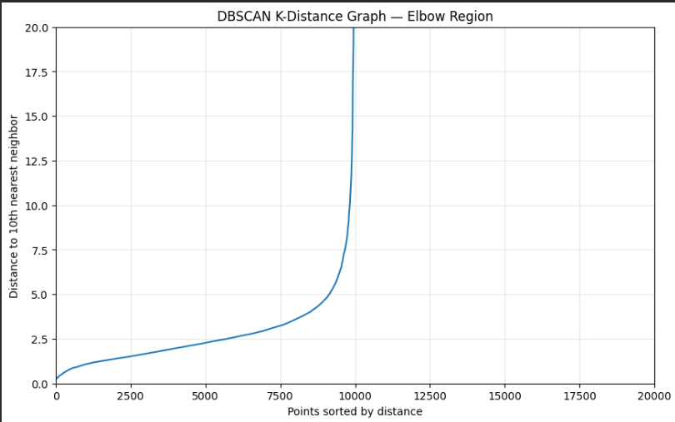
HYPERPARAMETER EXPLORATION
Parameter search narrows the experiment
K-distance graph
Search parameters
min_samples initially set to 10
Tested eps values: 6, 7, 8, 9
The graph guides experimentation; it does not determine a perfect eps.
Notes:
The graph guides experimentation; it does not determine a perfect eps.

Slide 7
BASELINE PERFORMANCE
Baseline: eps 8, min_samples 10 finds 13 of 16 fraud cases
13 / 16
81.25%
172
Fraud cases detected
Recall
Anomaly candidates
Notes:
The baseline configuration, eps 8 with min_samples 10, finds 13 of the 16 fraud cases.

Slide 8
Effect of changing eps while keeping min_samples=10
eps | min_samples | Clusters | Anomalies
6 | 10 | 1 | 374 (3.74%)
7 | 10 | 1 | 256 (2.56%)
8 | 10 (Baseline) | 1 | 172 (1.72%)
9 | 10 | 1 | 134 (1.34%)
Recall | Precision | F1-score
81.25% | 3.48% | 0.0667
81.25% | 5.08% | 0.0956
81.25% | 7.56% | 0.1383
50.00% | 5.97% | 0.1067
Effect of changing eps and min_samples together
eps | min_samples | Clusters | Anomalies
8 | 5 | 1 | 151
8 | 10 | 1 | 172
7 | 5 | 1 | 220
9 | 10 | 1 | 134
Recall | Precision | F1-score
81.25% | 8.61% | 0.1557
81.25% | 7.56% | 0.1383
81.25% | 5.91% | 0.1102
50.00% | 5.97% | 0.1067
Notes:
eps 8, min_samples 5 retained 81.25% recall while shrinking false positives to 151.

Slide 9

EXPERIMENTAL CONCLUSION & SCOPE
Final result: useful recall, low precision
151
13 / 16
8.61%
0.1557
Anomaly candidates
Fraudulent transactions detected
Recall 81.25%
Precision
F1-score
Limitations
Fixed 10,000-row subset
Many false positives
Parameter sensitivity
No direct generalization to the full dataset
Notes:
Unsupervised fraud isolation is feasible with 81.25% recall, but low precision requires practical operational safeguards.

Slide 10
EXPERIMENTAL CONCLUSION & SCOPE
DBSCAN can surface fraud without labels, but needs refinement
DBSCAN identified a substantial portion of fraud without using fraud labels during model training, while low precision showed that many legitimate transactions were also classified as anomalies.
Thank You · Questions?
Notes:
Unsupervised density clustering is a valuable first-stage filter, with HDBSCAN and Isolation Forests as natural next steps to improve precision.

