Slide 1
Subject :
Memory Architecture - 3
Copyright 2003 - ATR Labs - All Rights Reserved.

Slide 2
How Linux uses Segmentation
The 2.4 version of the kernel uses segmentation only when required ( by the underlying architecture, such as x86 ).
All processes use the same logical addresses.
Total number of segments defined is very limited. Can be all stored in the GDT.
LDTs are not used by the kernel. ( However, a system call modify_ldt() exists that allows processes to create their own LDTs. WINE uses this feature to execute Windows programs under Linux ).

Slide 3
Linux Segments
Kernel Code segment ( Addresses from 0 to 2³² - 1 ) DPL = 0
Kernel Data segment ( identical to above. Overlap in the linear address space ) DPL = 0.
User Code segment ( DPL = 3 ).
User Data segment ( DPL = 3 ).
Task State Segment ( for each process, size = 236 bytes ). The linear address space is a small subset of the address space of the Kernel Data Segment ). User processes cannot access the TSS.
Default LDT segment.
4 segments related to APM ( Advanced Power Management ) support
When switching from User Mode to Kernel Mode or vice versa, linux ensures that the relevant segment registers point to the “correct” segments.

Slide 4
Paging in x86
1. Paging unit translates linear addresses into physical addresses.
2. Linear addresses are grouped into fixed-length intervals called as “pages”. Contiguous linear addresses within a page are mapped to contiguous physical addresses.
3. This way, kernel can specify physical address & access rights of a page instead of each individual address inside the page.
4. All RAM is partitioned into fixed length page sizes known as Page Frames. Each page frame can contain a page. Length of page frame = length of page.
5. A page is a block of data. It can be stored in any page frame..
6. Data structures that map linear to physical addresses are known as Page Tables.
7. The page tables need to be properly initialized by the kernel before enabling the paging unit.
8. Paging is enabled in x86 processors by setting PG flag of CR0. If the flag = 0 then linear addresses are interpreted as Physical Addresses ( I.e NO PAGING ).

Slide 5
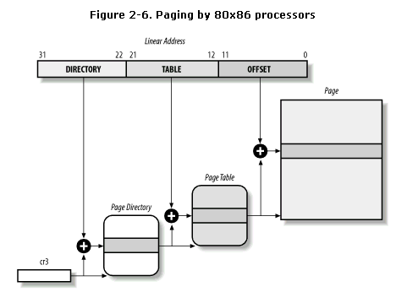
Regular Paging

Slide 6
Example of Regular Paging
Assume that a user process requires 256 KB memory (code & data ).
This is equal to 256 KB / 4 KB per page = 64 pages.
The kernel allocates the linear address space ( say, for example ) 0x20000000 to 0x2003ffff ( exactly = 64 pages ) to this process.
Address: 0x20000000 = 0010 0000 0000 0000 0000 0000 0000 0000 Address: 0x2003FFFF = 0010 0000 0000 0011 1111 1111 1111 1111
Break this into 3 groups: 0010 0000 0000 0011 1111 1111 1111 1111
The Directory field = 128 ( decimal ), PTE = 0-63 and offset = 0 to 4096.
The process pages are allocated between 00h to 03fh = 63 pages. Thus only the first 64 entries of Page Table are significant. All other values are filled with zeroes.
Assume the process wants to access byte address 0x20021406.
Address: 0x20021406 = 0010 0000 0000 0010 0001 0100 0000 0110
The 129th entry of the Page Directory Table contains the physical address of the Page Table. All other entries of this table = 0.
The Table field 0x21 is used to select entry 0x21 of the Page Table, which points to the page frame containing the desired page.
The offset field 0x406 is used to select the byte at offset 0x406 in the page frame.

Slide 7
The Physical Address Extension ( PAE ) Paging Mechanism
The amount of RAM on a processor is limited by the number of address pins connected to the address bus.
Older Intel processors from the 386 to the Pentium used 32-bit physical addresses. In theory this meant a maximum of 4 GB RAM could be installed on such systems. In practice the kernel could not access more than 1 GB RAM.
Demanding user applications required more RAM.
From the Pentium Pro onwards, Intel provided 36-pins on the CPU, which means that upto 64 GB could be installed on such systems.
However, linear addresses are still 32-bit. Which means that the extended physical RAM could be viewed only through a “window”. This is what the PAE paging mechanism supports, basically translating 32-bit linear addresses into 36-bit physical addresses.
PAE is activated by setting the PAE flag in cr4. This enables large page sizes ( 2 MB ) when enabled..
When the PAE paging mechanism is enabled, the processor supports 2 page sizes - 4 KB as well as 2 MB. AS with 32-bit addressing, both page sizes can be addressed within the same set of paging tables ( I.e a page directory entry can point to a 2-MB page or point to a page table that in turn points to a 4-KB page ).

Slide 8
1. The paging table entries are increased to 64-bits to accommodate 36-bit base physical addresses. Each 4 KB page directory and page table can thus have 512 entries instead of the earlier 1024 entries.
2. A new table called as PDPT ( Page Directory Pointer Table ) has been added to the linear address translation hierarchy. This table has 4 entries of 64-bits each.
3. The 20-bit page directory base address field in CR3 is replaced with a 27-bit page directory pointer table base address field. In this case Register CR3 is called as PDPTR.
4. Linear addresses are changed to allow mapping 32-bit linear addresses into the larger physical address space.

Slide 9
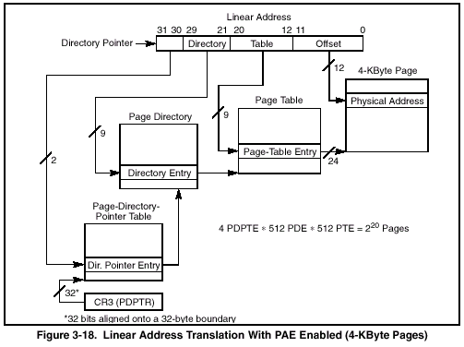

Slide 10
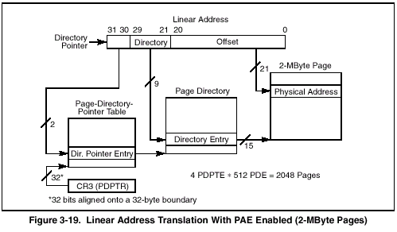

Slide 11
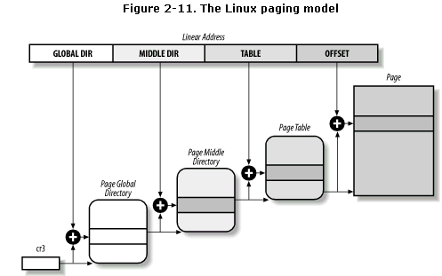
The linear address is split into 4-parts. The size of each part is architecture-specific.

Slide 12
Mapping the 3-level paging hierarchy of linux.
1. Linux’s handling of processes relies heavily on paging. The automatic translation of linear addresses into physical ones makes it possible to assign a different physical address space to each process.
2. When the 3-level hierarchy is applied to the Pentium ( 2 levels ), Linux eliminates the Page Middle Directory by saying it contains 0 bits. However, position of pointer kept to enable code to work on both 32-bot as well as 64-bit machines.
3. When PAE is used in Pentium Pro and above, Linux maps the Page Global Directory to PDPT, the PMD to Page directory and Linux’s Page Tables to 8086’s Page Tables.

Slide 13
Reserved Page Frames
The kernel’s code and data structures are stored in a group of reserved page frames.
A page contained in a reserved page frame can never be dynamically assigned or swapped to disk.
Linux kernel is installed in RAM starting from physical address 0x00100000 - i.e from the 2nd MB of RAM ( Page frame 0 used by BIOS, and ISA devices map to < 1 MB range ).

Slide 14
Process Page Tables
The linear address of a process is divided into two parts:
a) Linear addresses from 0x00000000 to 0xbfffffff can be addressed by the process when the process is in User or Kernel Mode ( 0 to 3 GB ).
b) Linear addresses from 0xc0000000 to 0xffffffff can be addressed ONLY when the process is in kernel mode ( 3 to 4 GB ).

Slide 15
Kernel Page Tables
Initializing this is a 2-phase process.
In the 1st phase, the kernel creates a limited 8-MB address space which is sufficient to install itself in RAM ( Provisional kernel page tables ).
In the 2nd phase, the kernel takes advantage of all existing RAM and sets up the paging tables appropriately.
The objective of 1st phase is to allow 8 MB to be easily addressed in both Real Mode as well as Protected Mode. The kernel therefore creates a mapping from both the linear addresses 0x00000000 to 0x007fffff and the linear addresses 0xc0000000 to 0xc07fffff into the physical addresses 0x00000000 through 0x007fffff.

Slide 16
Kernel Page Tables (Continued…)
The highest 128 MB of linear addresses are left available for several kinds of mappings. The kernel address space left for mapping RAM is therefore 1 GB - 128 MB = 896 MB.
Three cases possible:
1. Computer has < 896 MB of physical RAM 32-bit physical addresses sufficient to address all available RAM. No need to activate PAE mechanism.
2. Computer has between 896 MB to 4 GB of physical RAM. 32-bit physical addresses sufficient to address RAM. However, RAM cannot be mapped entirely into kernel linear address space. Specific page table entries are “reserved” for mapping a window of high memory into the kernel linear address space ( known as temporary kernel mapping )
3. Computer has over 4 GB of physical RAM. PAE enabled. Uses large page sizes to reduce page table entries. Linux maps an 896 MB RAM window into kernel linear address space.

Slide 17
Fix-Mapped Linear Addresses
A Fix-mapped linear address is a constant linear address whose corresponding physical address can be set up in an arbitrary manner.
Each fix-mapped linear address maps one page frame of physical memory.
The initial part of the last 4 GB of linear addresses ( 896 MB ) is used by the kernel to map physical memory. However, at least 128 MB of linear addresses are available therefore for non-contiguous / fix-mapped linear addresses.

Slide 18
Page Frame Management
The kernel needs to keep track of every page frame.
It needs to know if a page frame is free or occupied. It needs to know if a page frame contains user code or kernel code.
State information of a page frame is kept in a page descriptor of type struct page.
All page descriptors are stored in the mem_map array.
Since each descriptor size < 64 bytes, we require 4 page frames ( of 4 KB size each ) for each MB of RAM.
4 KB / 64 bytes/descriptor = 64 entries to describe 64 x 4 KB = 256 KB Therefore 4 Page Frames required per MB.

Slide 19
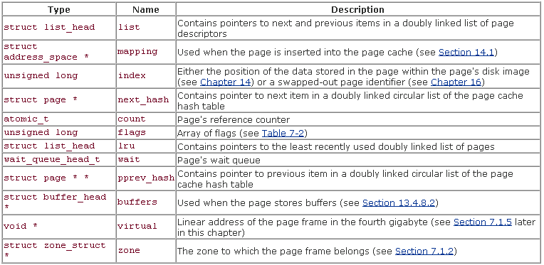
The fields of the page descriptor.

Slide 20
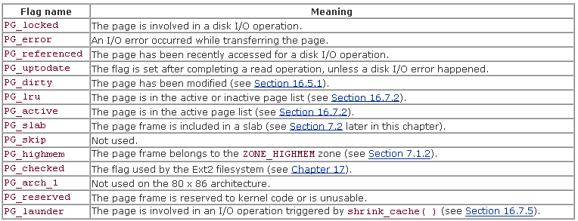
Flags describing the status of a page frame

Slide 21
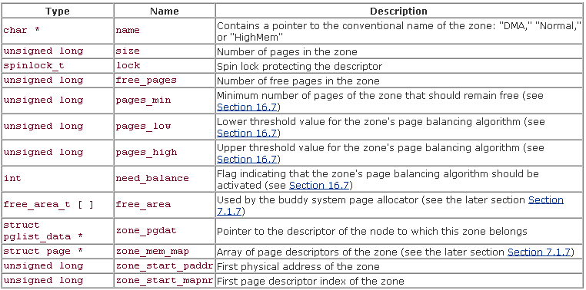
Memory Zones
ZONE_DMA : Contains pages of RAM < 16 MB ( ISA limitation )
ZONE_NORMAL : 16 MB to 896 MB
ZONE_HIGHMEM : > 896 MB.
Fields of the Zone Descriptor

Slide 22
Dealing with external fragmentation - The Buddy System Algorithm
All FREE page-frames are grouped into 10 lists of blocks that contain groups of 1, 2, 4, 8, 16, 32, 64, 128, 256, 512 contiguous page frames.
The physical address of the 1st page frame of a block is a multiple of that group size.
Linux uses a different buddy system for each zone. In the x86 architecture there are 3 buddy systems - one for DMA, one for Normal Memory and one for High-Memory page frames.
Each buddy system uses the mem_map array, an array having 10 elements of type free_area_t, stored in free_area field of the zone descriptor, and ten binary bit maps, one for each group size.

Slide 23
Internal Fragmentation - Dealing with Memory Areas
Mismatch between size of memory request & size allocated.
Early linux versions used the “power of 2” approach , ensuring that internal fragmentation is always smaller than 50%.
Running a memory allocation algorithm on top of buddy algorithm not efficient.
Linux has copied & implemented the slab allocator schema from Solaris. There are some differences, though.

Slide 24
The Slab Allocator
Following assumptions:
1. Type of request may affect allocation - For example zeroing of entries of memory before allocation.
2. Kernel functions tend to request / release constant size memory areas ( e.g process table, driver structures etc. )
3. Requests can be classified according to frequency. More frequent requests for non-standard objects can use a special technique, whereas less-frequent can use geometrical-methods.
4. Allocator footprint is very small for slab allocator as compared to buddy algorithms etc. This implies better utilization of hardware caches and TLBs by slabs.

Slide 25
Slab allocator views memory areas as “objects”.
These “objects” have data structures and methods operating on them.
The methods include “constructors” and “destructors”.
Constructors initialize the memory area, destructors deinitializes it.
The slab allocator groups objects into caches. Each cache is a store of objects of the same type.
For example, when a new file is opened, the memory area needed to store the corresponding “open file” object is taken from a slab allocator cache nqamed “filp”. The slab allocator caches used by linux can be viewed at runtime by reading /proc/slabinfo.
Cache_Name, Number of Active Objects, Total Objects, Object Size, Num_of_active_slabs, Total_slabs, Num_pages_per_slab.

Slide 26
Memory that contains a cache is divided into slabs.
Each slab consists of 1 or more contiguous page frames that contain both allocated and free objects.
The slab allocator NEVER releases page frames of an empty slab on its own. ( It would not know when memory is needed, and, there is no benefit of releasing object’s memory when there is still plenty of free memory for new objects )
Releases occur ONLY when kernel is looking for additional free page frames.

Slide 27
Cache Descriptor
Each cache is described by a table of struct kmem_cache_t. Important fields are:
name : Character array storing the name of the cache
slabs_full : Doubly linked circular list of slab descriptors with no free objects
slabs_partial : Doubly linked circular list of slab descriptors with both free/nonfree objects
slabs_free : Doubly linked circular list of slab descriptors with free objects only.
Spinlock : Protects the cache from concurrent access in multiprocessor systems
num : Number of objects packed into a single slab
objsize : Size of the objects included in the cache
gfporder : Log of contiguous page frames included in a single slab
ctor, dtor : Pointers to constructor & destructor methods.
Next : Pointers for the doubly linked list of cache descriptors
flags : These describe the permanent properties of the cache
dflags : These describe the dynamic properties of the cache.
gfpflags : A set of flags passed on to the Buddy system when allocating page frames.

Slide 28
Slab Descriptor
Each slab of a cache is described by a struct slab_t. Important fields are:
inuse : Number of objects in the slab that are currently allocated
s_mem : Points to the first object inside the slab ( either allocated or free )
free : Points to the first free object in the slab
list : Pointers for one of the 3 doubly linked lists of slab descriptors.

Slide 29
Caches are created by the kmem_cache_create() function.
Caches are destroyed using kmem_cache_destroy().
Allocating slabs to caches -> A newly created cache does not contain slab New slabs are assigned to a cache when a request has been issued to allocate a new object, and the cache does not include a free object. The kmem_cache_grow() assigns a new slab to a cache.
Releasing a slab from the cache -> The slab allocator never releases page frameson its own. A slab is released only when the buddy system is unable to satisy a new request for a group of page frames, and the slab is empty ( all objects in it are unused ). The kmem_slab_destroy() function removes the slab.
Objects managed by a slab allocator are aligned in memory.

Slide 30
Slab Coloring
The same hardware cache line maps many different blocks of RAM.
Objects of the same size tend to to be stored at the same offset within a cache.
Objects of the same offset within different slabs will with a relatively high probability end up mapped in the same cache line. The cache hardware may therefore waste memory cycles transferring two objects from the same cache line back & forth to different RAM locations, while other cache lines go underutilized.
The slab allocator tries to reduce this unpleasant behaviour by a policy known as slab coloring: different arbitrary values called colors are assigned to the slabs.
Coloring works only when the number of free ( unused bytes ) inside the slab is large enough to help in aligning the objects.
The term “color’ is used to simply subdivide the slabs and allow the memory allocator to spread objects out among different linear addresses.

Slide 31
#include <linux/slab.h>
void *kmalloc(size, priority); /* size = min 32 bytes, max 128 kB. Prio: GFP_KERNEL, GFP_ATOMIC void kfree(void *memPtr);
#include <linux/slab.h>
kmem_cache_t * kmem_cache_create(const char *name, size_t size, size_t offset,unsigned long flags, void (*constructor)(…),void (*destructor)(…) ); /* name max 20 chars, size max 128 kB contiguous, offset= 0 normally, flags = SLAB_NO_REAP or SLAB_HWCACHE_ALIGN etc., */ void *kmem_cache_alloc(kmem_cache_t *cache, int flags); /* flags same as passed to kmaloc() */ void kmem_cache_free(kmem_cache_t *cache, const void *obj); int kmem_cache_destroy(kmem_cache_t *cache);
#include <linux/slab.h>
unsigned long get_zeroed_page(int flags); /* flags same as used in kmalloc() */ unsigned long __get_free_page(int flags); unsigned long __get_free_pages(int flags, unsigned long order); /* order between 0 to 9 ( 1 to 512 pages) void free_page(unsigned long addr); void free_pages(unsigned long addr, unsigned long order);
#include <linux/vmalloc.h>
void * vmalloc(unsigned long size); void vfree(void * addr); void *ioremap(unsigned long offset, unsigned long size); void iounmap(void * addr);

Slide 32
Practical Examples
1. create_file.c : Creates a file with 1000,000 integers between 1000 to 9999, each between 1000 to 9999.
2. add_numbers.c : Reads file in userspace into an array and then sums the array
3. 01_kmalloc.c : Kernel module that uses kmalloc() & kfree() 01_frontend.c : Frontend program that transfers data into the kernel
4. 02_slab.c : Demonstrates use of the cache/slab allocator. 02_frontend.c : Frontend program that transfers data into the kernel
5. 03_page.c : Demonstrates use of the __get_free_pages() function. 03_frontend.c : Frontend program that transfers data into the kernel
6. 04_vmalloc.c : Demonstrates use of the vmalloc() function. 04_frontend.c : Frontend program that transfers data into the kernel.
7. 05_ioremap.c : Demonstrates usage of the ioremap() call that allows access from user space into device mapped memory. 05_frontend.c : Frontend program that demonstrates mmap() call.

