Slide 1
Hardware Basics
How to use the device’s control and status registers
What causes the device to generate interrupt
How the device transfers data
Whether the device uses any dedicated memory
Whether the device can be autoconfigured

Slide 2
Device Registers: command, status and data buffer
Accessing device Registers: (i) address of the device’s first register (ii) address space where these registers live
I/O Space Registers: (i) inb() Read a single value from I/O Port (ii) outb() Write a single value to I/O Port
Memory-mapped registers: (i) readb() Read a single value from I/O register (ii) writeb() Write a single value to I/O register

Slide 3
Memory-mapped device registers and I/O space ports
Memory
Device
I/O Space
Register
Register
Register
CPU
LOAD/STORE
IN/OUT

Slide 4
Device Interrupts- device interrupts for (i)has completed I/O operation (ii) A buffer or FIFO is full (iii) encounters some kind of error
Interrupt priorities
Interrupt vectors
Signalling mechanism: edge triggered(or latched) interrupts and level-sensitive (or level triggered(level-triggered) interrupt
Processor affinity: multiprocessor platform contains special interrupt routing hardware

Slide 5
Data transfer mechanisms
Three basic options: Programmed I/O, Direct memory access, Shared buffers
PIO - need help of CPU for each byte transfer
DMA- special hardware DMA Controller, System DMA and Bus Master DMA
Device Dedicated Memory - such as video adapter board.

Slide 6
Paths followed by data in DMA and
programmed I/O transfers
DMA Controller
Memory
Count Register
Address Register
I/O
Device
Buffer
Data Register
CPU

Slide 7
Autoconfiguration
Ports, IRQs and DMA channel assignment
Device resource lists: Manufacturer id, device type id, I/O space, interrupt requirement, DMA channels, device memory
No jumpers or switches - change resource dynamically
Change Notification

Slide 8
Buses
Bus is a collection of data, address and control lines that allows a peripheral device to communicate with memory and CPU
ISA - Industry Standard Architecture
MCA - Micro Channel Architecture
EISA - Extended Industry Standard Architecture
PCI - Peripheral component Interconnect

Slide 9
Layout of an ISA system
Local Bus
Memory
CPU
PIC
System
DMAC
ISA Bus
ISA Card
ISA Card
ISA Card

Slide 10
The ISA bus clock rate is 8.33 MHz, the maximum transfer rate is
about 8MB/sec.
The I/O Address range is 0x0000 to 0x03FF.
ISA Bus supports 16 interrupts. Multiple cards can not share the
interrupt.
Upto 8 DMA channels, Can access below 16 MB of memory.
Any device dedicated memory must live with in 16 MB space.
No Auto-Configuration facility, set by DIP switches and jumpers

Slide 11
Layout of a PCI Bus system
CPU
Cache Controller &
PCI Bridge
Memory
PCI Bus
EISA
Bridge
PCI
Device
PCI
Device
. . .
EISA Bus
Function 0
Function 0
.
.
.
.
EISA
Slot 0
. . .
Function 7
Function 7

Slide 12
Fast Transfer
Fast bus clock (33MHz), the PCI architecture can hit 132 mega
bytes/sec for 32 bit transfers.
Every transfer is a burst operation
Supports multiple bus masters and permits direct device to device
transfers. Overlap between I/O and CPU operation.
A central bus arbiter reduces latency by overlapping arbitration
with data transfer.
An intelligent bridge between the host CPU and PCI bus performs
caching and read-ahead functions.
Register Access
I/O register access is still limited to 64 kilobyes in x86 architecture.

Slide 13
Interrupt Mechanisms
The PCI has four equal-priority interrupt request lines (INTA-INTD)
which are active-low, level-triggered, and shareable.
DMA capabilities
The native PCI functions are either bus masters doing their own
DMA or they use programmed I/O.
Device Memory
Dedicated memory used by PCI functions can live anywhere in a
32-bit address space.
Autoconfiguration
Each function on the PCI bus has 256 byte storage space for
configuration data.

Slide 14
The PCI Interface
The PCI architecture was designed as a replacement for the ISA
standard, with three main goals:
To get better performance when transferring data between the
computer and its peripherals,
To be as platform independent as possible,
To simplify adding and removing peripherals to the system.

Slide 15
PCI Addressing
Each PCI peripheral is identified by a ‘Bus’ number,
a ‘device’ number, a ‘function’ number.
PCI specification permits a system to host upto 256 buses,
each bus hosts upto 32 devices and each device can be a
multifunction board within a maximum of eight functions.
Thus each PCI peripheral can be identified by a 16- bit
( 8 + 5 + 3 ) address .

Slide 16
The 16 bit hardware addresses associated with PCI peripherals
are visible as output of lspci and the layout of information in
/proc/pci and /proc/bus/pci.
When the hardware address is displayed, it can either be shown
as a 16-bit value, as two values (an 8-bit bus number and an 8-bit
device and function number) or as three values (bus, device, and
function).
For example, /proc/bus/pci/devices uses a single 16-bit field,
while /proc/bus/busnumber splits the address into three fields.
#lspci | cut -d: -f1-2
#cat /proc/bus/pci/devices | cut -d\ -f1,3

Slide 17
The hardware implements the three address spaces: memory location,
I/O ports and configuration space. The first two address spaces are
shared by all the devices on a PCI bus. Configuration transactions
address only one slot at a time.
The memory and I/O regions are accessed in the usual ways via
inb, readb etc. Configuration transactions are performed by calling
specific kernel functions to access configuration registers. Every
PCI slot has 4 interrupts pins, and each device function can use one
of them.
The I/O space in a PCI bus uses 32-bit address bus while the memory
space can be accessed with either 32-bit or 64-bit addresses.
Every memory and I/O address region offered by interface board
can be remapped by means of configuration transactions.

Slide 18
Boot time address assignment
When the power is applied to a PCI device, the hardware remains
inactive. That is device has no memory and no I/O ports mapped
in the computer’s address space. Interrupt reporting is disabled
as well.
The firmware (BIOS) offers access to the device configuration
address space by reading and writing registers in the PCI
controller. At system boot, the firmware performs configuration
transactions with every PCI peripheral in order to allocate at
safe place for any address regions it offers. By the time a device
driver accesses the device, its memory and I/O regions have
already been mapped into the processor’s address space.

Slide 19
PCI Configuration space
The PCI configuration space consists of 256 bytes for
each device function.
First 64 bytes are standardized and device independent .
Always little – endian.

Slide 20
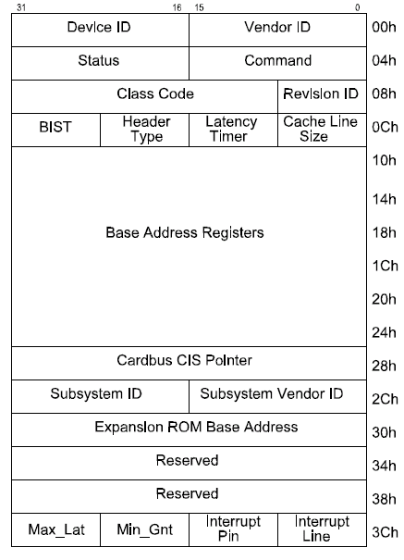

Slide 21
Some of the PCI configuration registers are required and some are
optional.
Three or five PCI registers identify a device: vendorID, deviceID
and class are always used. Every PCI manufacturer assigns proper
values to these read only registers. The driver can use them to look
for the device. The fields subsystem vendorID and subsystem
deviceID are sometimes set by vendor to further differentiate
similar devices.
vendorID - The 16 bit register identifies the hardware manufacturer.
deviceID - Selected by vendor to identify the device.
class - Every peripheral device belongs to a class. This is a 16-bit
value whose top 8 bits identify the “base class” (or group).
For example, “ethernet” and “token ring” are two classes
belonging to the network group.

Slide 22
Detecting the device
Using vendor-id and device-id, you can detect and get info of
your device.
CONFIG_PCI
This macro is defined if the kernel includes support for PCI
calls.
#include <linux/pci.h>
Declares all prototypes.
int pci_present(void);
Check if PCI functionality is available or not.
struct pci_dev;
This data structure is used as a software object to represent
a PCI device.
struct pci_dev *pci_find_device (UINT vendor, UINT device,
const struct pci_dev *from ) ;
struct pci_dev *pci_find_class ( UINT class,
const struct pci_dev *from);

Slide 23
Accessing PCI configuration space :
After the driver has detected the device, it usually needs to read
from or write to the three address spaces: memory, port and
configuration. This is the only way to find out where the device is
mapped in memory and in the I/O space.
To access the configuration space, the CPU must write and read
registers in the PCI controller. The Linux offers a standard interface
to access the configuration space.
int pci_read_config_byte ( struct pci_dev *dev, int where, u8 *ptr);
int pci_read_config_word (struct pci_dev *dev, int where , u16 *ptr);
int pci_read_config_dword (struct pci_dev *dev, int where, u32 *ptr);
int pci_write_config_byte (struct pci_dev *dev, int where , u8 *ptr);
int pci_write_config_word (struct pci_dev *dev, int where, u16 *ptr);
int pci_write_config_dword(struct pci_dev *dev, int where, u32 *ptr);

Slide 24
Accessing the I/O and Memory Spaces
A PCI device implements up to six I/O address regions. Each region
consists of either memory or I/O locations. Most devices implement
their I/O registers in memory regions.
An interface board reports the size and current location of its
regions using configuration registers - the six 32-bit registers,
whose symbolic names are PCI_BASE_ADDRESS_0 through
PCI_BASE_ADDRESS_5.
The lower bits of returned base address have different meanings
depending if the address is I/O or memory mapped. On an I/O
address bit 0 is always 1 and bit 1 is always 0. On a memory
mapped address the lower 4 bits have following meaning:
Bit 0 always 0
1-2 address type 00 = arbitrary 32-bits
01 = below 1M
10 = arbitrary 64-bits
3 prefetchable

Slide 25
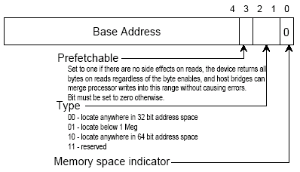
Base Address Register for Memory

Slide 26
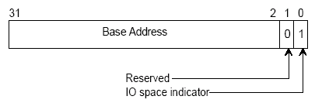
Base Address Register for I/O

Slide 27
PCI I/O resources in Linux 2.4
The I/O regions of PCI devices have been integrated in the generic
resource management. The following functions are used to get
region information:
unsigned long pci_resource_start(struct pci_dev *dev, int bar);
unsigned long pci_resource_end(struct pci_dev *dev, int bar);
unsigned long pci_resource_flags(struct pci_dev *dev, int bar);
All resource flags are defined in <linux/ioport.h>, the most
important are:
IORESOURCE_IO, IORESOURCE_MEM
If the associated I/O region exists, only one flag is set.
IORESOURCE_PREFETCH, IORESOURCE_READONLY
The flags tell whether a memory region is prefetchable and/or
write protected.

Slide 28
PCI Interrupts
By the time Linux boots, the computer’s firmware has already
assigned a unique interrupt number to the device, and the driver
just needs to use it. The interrupt number is stored in configuration
register 0x3c (PCI_INTERRUPT_LINE).
If the device does not support interrupts, register 0x3d (PCI_
INTERRUPT_PIN) is 0.
Thus the PCI specific code for dealing with interrupts just needs
to read the configuration byte to obtain the interrupt number.
Res=pci_read_config_byte(dev, PCI_INTERRUPT_LINE, &myirq);

Slide 29
Handling Hot-Pluggable Devices
The kernel version 2.4 supports hot pluggable devices, that is
those devices that can be added to or removed from the system
while the system runs (such as CardBus devices).
The hot pluggable device driver must register an object with the
kernel, and the probe function for the object will be asked to check
any device the system to take hold of it or leave it alone.
The design is built around struct pci_driver defined in <linux/pci.h>
The structure defines operations it implements, and also includes
a list of devices it supports.

Slide 30
How initialization and cleanup are handled, for a hypothetical
“hot plug PCI module” (HPPM):
struct pci_driver hppm_driver = { /* ….. */};
int hppm_init_module(void)
{
return pci_module_init(&hppm_driver);
}
int hppm_cleanup_module(void)
{
pci_unregister_driver(&hppm_driver);
}

Slide 31
int pci_register_driver(struct pci_driver *drv);
This function inserts the driver in a linked list maintained
by the system.
int pci_module_init (struct pci_driver *drv);
This function is meant to be called by modularized
initialization code. It returns 0 for success and –ENODEV
if no device has been found.
void pci_unregister_driver(struct pci_driver *drv);
This function removes the driver from liked list of known
drivers.

Slide 32
The pci_driver structure
The pci_driver data structure is the core of hot-plug support. It is
made of just a few methods and a device ID list.
struct list_head node;
Used to manage a list of drivers.
char *name;
The name of the driver, it has informational value.
const struct pci_device_id *id_table;
An array that lists which devices are supported by this driver.
int (*probe) (struct pci_dev *dev, const struct pci_device_id *id);
The function must initialize the device it is passed and
return 0 in case of success or a negative error code.
int (*remove) (struct pci_dev *dev);
Is used to tell the device driver that it should shut down.

