Slide 1
The Linux Device Model
The 2.6 device model provides the abstraction of unified device model
for the kernel describing the structure:
Power Management and system shutdown
Communications with user space
Hotpluggable devices
Device classes
Object lifecycles

Slide 2
LDM data structure
The Linux device model is a complex data structure. For example, the next slide
shows (in simplified form) a tiny piece of the device model structure associated
with a USB mouse. Down the center of the diagram, we see the part of the core
“devices” tree that shows how the mouse is connected to the system. The “bus”
tree tracks what is connected to each bus, while the subtree under “classes”
concerns itself with the functions provided by the devices, regardless of how they
are connected.

Slide 3
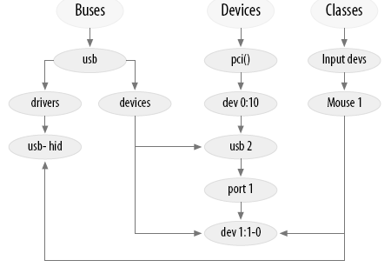
A small piece of the device model

Slide 4
Kobjects, Ksets and Subsystems
The kobject is the fundamental structure that holds the device model together.
Reference counting of objects
Sysfs representation
Data structure glue
Hotplug event handling
A kset is a collection of kobjects embedded within structures of the same type.
A subsystem is a representation for a high-level portion of the kernel as a whole.
Subsystems usually (but not always) show up at the top of the sysfs hierarchy.

Slide 5
Low-Level Sysfs Operations
Kobjects are the mechanism behind the sysfs virtual filesystem. For every directory
found in sysfs, there is a kobject lurking somewhere within the kernel. Every kobject
of interest also exports one or more attributes, which appear in that kobject’s sysfs
directory as files containing kernel-generated information.

Slide 6
Hotplug Event Generation
A hotplug event is a notification to user space from the kernel that something has
changed in the system’s configuration. They are generated whenever a kobject is
created or destroyed. Such events are generated, for example, when a digital camera
is plugged in with a USB cable, when a user switches console modes, or when a disk
is repartitioned. Hotplug events turn into an invocation of /sbin/hotplug, which can
respond to each event by loading drivers, creating device nodes, mounting partitions,
or taking any other action that is appropriate.

Slide 7
Buses, Devices, and Drivers
Buses
A bus is a channel between the processor and one or more devices. For the purposes
of the device model, all devices are connected via a bus, even if it is an internal,
virtual, “platform” bus.
Devices
At the lowest level, every device in a Linux system is represented by an instance of
struct device.
Device Drivers
The device model tracks all of the drivers known to the system. The main reason for
this tracking is to enable the driver core to match up drivers with new devices.

Slide 8
Buses, Devices, and Drivers…
Classes
A class is a higher-level view of a device that abstracts out low-level implementation
details. Drivers may see a SCSI disk or an ATA disk, but, at the class level, they are
all simply disks. Classes allow user space to work with devices based on what they
do, rather than how they are connected or how they work.
Almost all classes show up in sysfs under /sys/class. Thus, for example, all network
interfaces can be found under /sys/class/net, regardless of the type of interface. Input
devices can be found in /sys/class/input, and serial devices are in /sys/class/tty.

