Slide 1
Block Device Drivers
Description

Slide 2
Block Drivers
Block drivers provide access to block oriented devices – those
that transfer data in randomly accessible, fixed size blocks.
The classic block device is a disk drive.
Like char drivers, block drivers in the kernel are identified by major
numbers.
Block refers to a block of data as determined by the kernel. The size
of blocks can be different in different disks.
A sector is a fixed-size unit of data as determined by the underlying
hardware. Sectors are 512 bytes long.

Slide 3
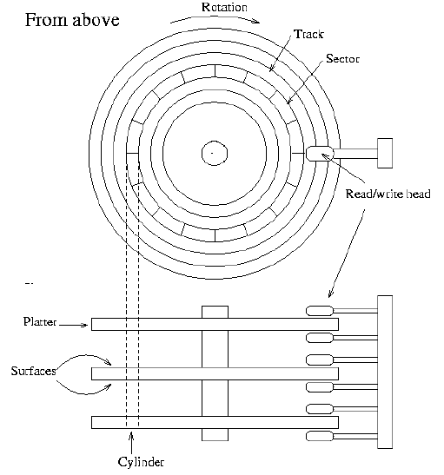
A schematic view of a hard disk

Slide 4
Device Nodes
Each hard disk is represented by a separate device file.
There can (usually) be only two or four IDE hard disks. These are
known as /dev/hda, /dev/hdb, /dev/hdc, and /dev/hdd, respectively.
SCSI hard disks are known as /dev/sda, /dev/sdb, and so on.

Slide 5
Registering the Driver
A block device registers its features with the kernel, and it then
transmits and receives blocks on the request.
The function for registering a block device is:
#include <linux/fs.h>
int register_blkdev(unsigned int major, const char *name);
The function for unregistering a block device is:
int unregister_blkdev(unsigned int major, const char *name);
Major numbers can also be assigned dynamically.
The only tasks performed by this call at this point are
(1) allocating a dynamic major number if requested, and
(2) creating an entry in /proc/devices.

Slide 6
Registering a Block Device Driver
Module
Kernel
insmod
init_module( )
register_blkdev( )
blk_init_queue( )
blk_dev[ ]
request( )
default queue
blkdevs[ ]
rmmod
cleanup_module( )
unregister_blkdev( )
blk_cleanup_queue( )
KEY
One Function
Data
Data pointer
Function call
Assignment to data
Multiple Functions
Function pointer

Slide 7
        Disk Registration
While register_blkdev can be used to obtain a major number, it does
not make any disk drives available to the system. There is a separate
registration interface that you must use to manage individual drives.
Using this interface requires familiarity with a pair of new structures:
  Block device operations
  The gendisk structure

Slide 8
block_device_operations
struct block_device_operations {
int (*open) (struct inode *inode, struct file *filp);
int (*release) (struct inode *inode, struct file *filp);
int (*ioctl) (struct inode *inode, struct file *filp,
unsigned command, unsigned long argument);
int (*media_changed) (struct gendisk *gd);
int (*revalidate_disk) (struct gendisk *gd);
};
The open, release and ioctl methods are same as char device. The
other two methods are specific to block devices.
There are no read or write operations provided in bdops structure.
All I/O to block device is normally buffered by the system, user
processes do not direct I/O to these devices. User mode access to
block devices is implicit in filesystem operations they perform.

Slide 9
Block I/O to a Device
The method used for these I/O operations is called request, it is the
equivalent of the “strategy” function found on many Unix systems.
The request method handles both read and write operations.
This method is not kept in bdops, instead, it is associated with the
queue of pending I/O operations for the device. By default, there
is one such queue for each major number.

Slide 10
The gendisk structure
struct gendisk (<linux/gendisk.h>) is the kernel’s representation of
an individual disk driver.
Fields :
int major
int firstminor
int minors
char disk_name[32]
struct block_device_operations *fops
struct request_queue *queue
structure used by kernel to manage I/O
requests for this device
int flags
sector_t capacity
void *private_data

Slide 11
Disk Registration
A set of functions working with gendisk structure.
struct gendisk *alloc_disk(int minors);
When a disk is no longer need, it should be freed.
void del_gendisk(struct gendisk *gd);
You must initialize the structure and call add_disk
void add_disk(struct gendisk *gd);

Slide 12
The Block Device Operations
The Open method
Block devices can be mounted on the filesystem. When a filesystem
is mounted, there is no process holding the file structure.
When the kernel mounts a device in the filesystem, it invokes the
normal open method to access the driver. However, both filp and
inode arguments to open are dummy variables. In the file structure,
only the f_mode and f_flags fields hold anything meaningful, in the
inode structure only i_rdev may be used. The value of f_mode tells
the driver whether the device is to be mounted read-only or read-
write.
The open method can still be called normally by a process that
accesses the device directly - the mkfs, fsck utility.
The device is opened and then the request method is invoked to
transfer blocks back and forth. The driver can not tell the difference
between the operations originated by user process or filesystem

Slide 13
The release method
Unmount flushes the buffer cache and calls the release driver method
There is no meaningful filp to pass to the release method, the kernel
uses NULL.
The driver uses inode->i_rdev to differentiate between devices.

Slide 14
The ioctl method
The block devices can be acted on by using the ioctl system call.
The block drivers share a number of common ioctl commands
that most drivers are expected to support.
The commands that block drivers usually handle are the following
declared in <linux/fs.h>
BLKGETSIZE - Retrieve the size of current device
BLKFLSBUF - Flush buffers
BLKRRPART - Reread the partition table.
BLKSSZGET - Returns the sector size of this block device

Slide 15
Removable Devices
The two file operations: media_changed and revalidate_disk in
the bdops structure, deal with devices that support removable media.
media_changed is used to find out if the device has changed since the
last access.
revalidate_disk reinitializes the driver’s status after a disk change.

Slide 16
media_changed
The checking function receives gendisk structure as a single argument
that identifies the device. The return value is 1 if the medium has been
changed and 0 otherwise. A block driver that doesn’t support
removable devices can avoid declaring the function by setting bdops->
media_changed to NULL.
revalidate_disk
The revalidate_disk function is called when a disk change is detected.
It is also called by the various stat system calls implemented in the
kernel. The return value is currently unused, to be safe, return 0 to
indicate success and a negative error code in case of error.
The action performed by revalidate is device specific, but revalidate
usually updates the internal status information to reflect the new
device.

Slide 17
        Request processing
The most important function in a block driver is the request function,
which performs the low level operations related to reading and
writing data.

Slide 18
The request method
When the kernel schedules data transfer, it queues the request in
a list. The queue of requests is then passed to the driver’s request
function
void request_fn(request_queue_t *queue);
The request function performs the following tasks for each request
in the queue:
Check the validity of the request.
2. Perform the actual data transfer. elv_next_request can be used
to retrieve the details of the current request.

Slide 19
3. Clean up the request just processed. This operation is performed
by end_that_request_last. end_that_request_last handles the
management of the request queue and wakes up processes waiting on
the I/O operation. The driver passes the function a single argument,
which is 1 in case of success and 0 in case of failure.
4. Loop back to the beginning to consume the next request.
The request function has one very important constraint: it must be
atomic, request is not usually called in direct response to user
requests, and is not running in the context of any particular process.

Slide 20
Request Queues
In the simplest sense, a block request queue is exactly that:
a queue of block I/O requests.
Request queues keep track of outstanding block I/O requests. But they
also play a crucial role in the creation of those requests. The request
queue stores parameters that describe what kinds of requests the
device is able to service: their maximum size, how many separate
segments may go into a request, the hardware sector size, alignment
requirements, etc.

Slide 21
Queue creation and deletion
The function to create and initialize a request queue is:
#include <linux/blkdev.h>
request_queue_t *blk_init_queue(request_fn_proc *request,
spinlock_t *lock);
To return a request queue to the system (at module unload time,
generally), call blk_cleanup_queue:
void blk_cleanup_queue(request_queue_t *);

Slide 22
Queueing functions
There is a small set of functions for the manipulation of requests on
queues.
The function that returns the next request to process is
elv_next_request:
struct request *elv_next_request(request_queue_t *queue);
To actually remove a request from a queue, use
blkdev_dequeue_request:
void blkdev_dequeue_request(struct request *req);

Slide 23
Queue control functions
The block layer exports a set of functions that can be used by a
driver to control how a request queue operates. These functions
include:
void blk_stop_queue(request_queue_t *queue);
void blk_start_queue(request_queue_t *queue);
void blk_queue_max_sectors(request_queue_t *queue,
unsigned short max);
void blk_queue_hardsect_size(request_queue_t *queue,
unsigned short max);

Slide 24
The anatomy of a request
Each request structure represents one block I/O request, although it
may have been formed through a merger of several independent
requests at a higher level. The sectors to be transferred for any
particular request may be distributed throughout main memory,
although they always correspond to a set of consecutive sectors on the
block device. The request is represented as a set of segments, each of
which corresponds to one in-memory buffer.
A request structure is implemented, as a linked list of bio structures
combined with some housekeeping information to enable the driver
to keep track of its position as it works through the request. The bio
structure is a low-level description of a portion of a block I/O request.

Slide 25
The bio structure
The basic container for block I/O with in the kernel is the bio
structure, which is defined in <linux/bio.h>.
This structure represents block I/O operations that are active, as a
list of segment. A segment is a chunk of a buffer that is contiguous
in memory (vector I/O is called scatter-gather I/O).
The most important fields are bi_io_vecs, bi_vcnt, and bi_icb.

Slide 26
/* main unit of I/O for the block layer and lower layers (ie drivers and
* stacking drivers) */
struct bio {
sector_t bi_sector; /* device address in 512 byte
sectors */
struct bio *bi_next; /* request queue link */
struct block_device *bi_bdev;
unsigned long bi_flags; /* status, command, etc */
unsigned long bi_rw; /* bottom bits READ/WRITE,
* top bits priority */
unsigned short bi_vcnt; /* how many bio_vec's */
unsigned short bi_idx; /* current index into bvl_vec */
/* Number of segments in this BIO after
* physical address coalescing is performed.
*/
unsigned short bi_phys_segments;

Slide 27
/* Number of segments in this BIO after
* physical address coalescing is performed. */
unsigned short bi_phys_segments;
/* Number of segments after physical and DMA remapping
* hardware coalescing is performed. */
unsigned short bi_hw_segments;
unsigned int bi_size; /* residual I/O count */
/* To keep track of the max hw size, we account for the
* sizes of the first and last virtually mergeable segments in this bio */
unsigned int bi_hw_front_size;
unsigned int bi_hw_back_size;
unsigned int bi_max_vecs; /* max bvl_vecs we can hold */
struct bio_vec *bi_io_vec; /* the actual vec list */
bio_end_io_t *bi_end_io;
atomic_t bi_cnt; /* pin count */
void *bi_private;
bio_destructor_t *bi_destructor; /* destructor */
};

Slide 28
The bi_io_vecs field points to an array of bio_vec structures. These
structures are used as list of individual segments in the specific block
I/O operations.
struct bio_vec {
/* pointer to the physical page on which this buffer resides */
struct page *bv_page;
/* the length in bytes of this buffer */
unsigned int bv_len;
/* the byte offset within the page where the buffer resides */
unsigned int bv_offset;
};

Slide 29
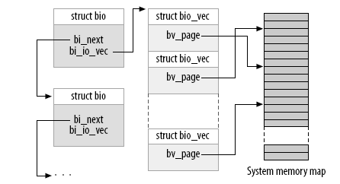
The bio structure

Slide 30
Request structure fields
By accessing the fields in the request structure, the driver can retrieve
all the information needed to transfer data between the buffer and
the physical block device.
The following fields of a request hold information:
int cmd_type; Operation (READ or WRITE) to be performed
unsigned long sector; The number of the first sector to be transferred
in the request
unsigned long nr_sectors; The number of sectors to transfer for the
current request
struct bio *bio; bio is the linked list of bio structures for this
request.
char *buffer; The area in the buffer cache to which data
should be written or read

Slide 31
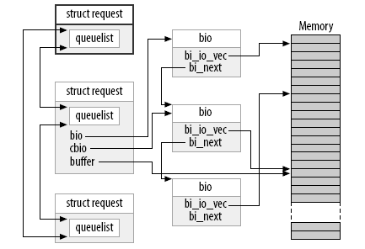
A request queue with a partially processed request

Slide 32
Request Completion Functions
A couple of common functions, however, which handle the
completion of an I/O request or parts of a request. Both of these
functions are atomic and can be safely called from an atomic context.
When your device has completed transferring some or all of the
sectors in an I/O request, it must inform the block subsystem with:
int end_that_request_first(struct request *req, int success, int count);
If the I/O was successful, pass success as 1; otherwise pass 0.
The return value from end_that_request_first is an indication of all
sectors in this request have been transferred or not. A return value
of 0 means that all sectors have been transferred and that the request
is complete. At that point, you must dequeue the request with
blkdev_dequeue_request and pass it to:
void end_that_request_last(struct request *req);

Slide 33
Working with bios
Now, you can write a block driver that works directly with the bio
structures that make up a request.
Using another macro: rq_for_each_bio simply steps through each
bio structure in the request, giving us a pointer that we can pass
to the data transfer.

Slide 34
Handling Requests: The detailed View
Performance enhancement by understanding I/O request queue and
writing a faster or more efficient driver.
The I/O Request Queue:
The queue is designed with physical disk drives in mind. With disk,
the amount of time required to transfer a block of data is quite small.
The amount of time required to position the head (seek) to do that
transfer, however can be large. The Linux kernel works to minimize.
There are two things to meet these goals: (1) clustering of requests
to adjacent sectors on the disk. (2) kernel also applies an ‘elevator’
algorithm to the requests. The kernel tries to keep disk head moving
in the same direction to minimize seek times, while ensuring that
all requests get satisfied.

Slide 35
Interrupt Driven
When a driver controls a real hardware device, operation is usually
interrupt driven. In order for interrupt driven I/O to work, the device
being controlled must be able to transfer data asynchronously and to
generate interrupts.
The request function spawns a data transfer and returns immediately
without calling end_request. Therefore, the top-half or bottom-half
interrupt handler calls end-request when the device signals that the
data transfer is complete.
New requests can accumulate while the device is dealing with the
current one. The interrupt handler is responsible for getting the next
one started.

Slide 36
Writing Dirty Buffers to Disk
Unix systems allow the deferred writing of dirty buffers into
block devices , since this strategy improves system
performance.
A dirty buffer stay in the main memory until the last possible
moment. This has two drawbacks:
If a hardware or power supply failure occurs, so a lot of file
updates made, are lost
The size of buffer cache, and hence of the RAM required to
contain it, would have to be huge.

Slide 37
Flushing Buffers
The dirty buffers are flushed (written) to disk under the
following conditions:
The buffer cache gets too full and more buffers are needed,
or the number of dirty buffers becomes too large.
Too much time has elapsed since a buffer stayed dirty.
A process request all the buffers of block devices or of
particular files to be flushed, it does this by invoking the
sync(), fsync etc.

Slide 38
The pdflush kernel thread
First, the pdflush threads need to flush dirty data to disk, when
the amount of free memory shrinks beyond a specified level.
Second, the pdflush periodically wakes up and writes out
very old dirty pages.
pdflush settings
dirty_background_ratio As a percentage of total memory, the
number of pages at which the pdflush
will begin writeback of dirty data.
dirty_expire_centisecs In hundredths of a second, how old
data must be to be written out next time.
The sys admin may set these values either in /proc/sys/vm or via
sysctl.

