Slide 1
inter-IC sound (i2s)

Slide 2
Introduction
Many digital audio systems are being introduced into the consumer audio market,
including compact disc, digital audio tape, digital sound processors, and digital
TV-sound. The digital audio signals in these systems are being processed by a
number of (V)LSI ICs, such as:
• A/D and D/A converters;
• digital signal processors;
• error correction for compact disc and digital recording;
• digital filters;
• digital input/output interfaces.
To this end, Philips developed the inter-IC sound (I2S) bus – a serial link especially
for digital audio.

Slide 3
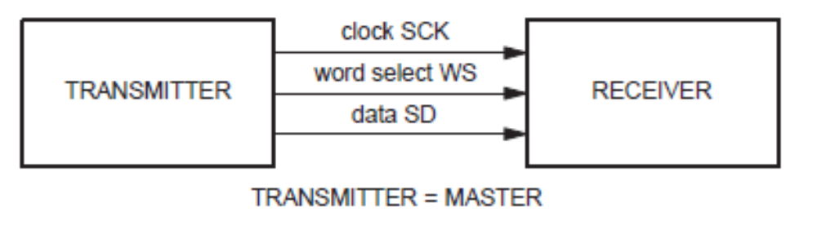
Simple System Configurations
To minimize the number of pins required and to keep wiring simple, a 3-line serial
bus is used consisting of a line for two time-multiplexed data channels, a word
select line and a clock line.

Slide 4
THE I2S BUS
As shown in previous slide, the bus has three lines:
• continuous serial clock (SCK);
• word select (WS);
• serial data (SD);
and the device generating SCK and WS is the master.

Slide 5
Serial Data
Serial data is transmitted in two’s complement with the MSB first.
The MSB is transmitted first because the transmitter and receiver
may have different word lengths. It isn’t necessary for the transmitter
to know how many bits the receiver can handle, nor does the
receiver need to know how many bits are being transmitted.

Slide 6
Word Select
The word select line indicates the channel being transmitted:
• WS = 0; channel 1 (left);
• WS = 1; channel 2 (right).
WS may change either on a trailing or leading edge of the serial clock,
but it doesn’t need to be symmetrical.

