Slide 1
Board Support Package(BSP)
In embedded systems, a Board Support Package (BSP) is an
implementation specific support code for a given board that conforms
to a given operating system. It is commonly built with a bootloader
that contains the minimal device support to load the operating system
and device drivers for all the devices on the board.
Some suppliers also provide a root file system, a toolchain for making
programs to run on the embedded system (which would be part of the
architecture support package), and configurators for the devices
(while running).

Slide 2
Board Support Package(BSP)…
There are 3 separate views of what a BSP defines:
A BSP is the kernel’s interface to device drivers.
A BSP is a set of libraries offering a hardware abstraction layer
to kernel
3. A BSP supports a host/target cross development environment

Slide 3
A BSP is a set of libraries offering a hardware abstraction layer
to kernel.
The BSP enforces a modular design by isolating hardware-specific
functionally into a set of libraries that provide an identical software
interface to the hardware functions available on an embedded
system.
The BSP includes facilities for hardware initialization when power
is first applied or when a hardware reset has been initiated.
BSP also includes support for interrupt handling, device drivers.

Slide 4
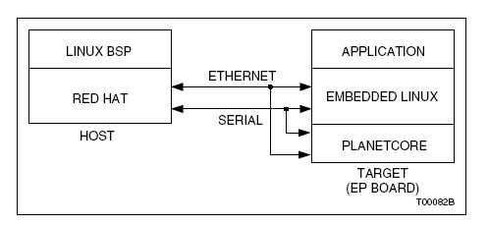
Development Environment
The ARM embedded development environment consists of two
systems: a host system and a target system. The host system is used
for compiling, linking, remote debugging, and associated development
activities. The target system, is used for application development and
testing.

Slide 5
The BSP provides support for developers using tools on a host
computer for engineering development such as an editor, compiler,
linker, and debugger through a client/server communications
protocol between the developer's host computer and the embedded
target’s CPU, hardware devices and on-board memory.

Slide 6
Description of BSP Technical features
Boot Monitor
Default Ram size
Additional supported memory options
Cache support
Flash and ROM memory
Timer support in additional to system clock
Devices supported:
Memory Map
Shared Memory
Interrupts
Serial Ports
SCSI Support
Ethernet Support

Slide 7
Linux BSP for ColdFire M547X/M548XEVB
The ColdFire M547X/M548XEVB BSP is designed for use with
LTIB. Once the BSP is installed and running with its basic
configuration, you can use LTIB to customize your project.
The BSP components provide the tools, device drivers, and additional
features needed for your embedded Linux project.
Linux 2.6.10 kernel
- On-chip Serial ports
- Loadable modules
- Memory devices, including flash and DRAM
- TCP/IP stack & Ethernet support
- DSPI device support
- I2C device support
- IRDA
- Cryptographics/Secure Encryption Controller

Slide 8
Linux BSP for ColdFire M547X/M548XEVB…
- CAN bus support
- DMA
- Frame buffer support
- USB Host (Host Interface Devices)
- Wireless LAN (PCI)
- NFS and JFFS2 file systems support
- Colilo bootloader
- dBUG Bootloader
- Integration of AppTRK for CodeWarrior
- GDB/gdbserver
- Many target applications
- Documentation - see START_HERE.html on this CD
- M547X/M548XEVB specific documentation
- gcc 4.1, glibc 2.3.6, binutils 2.17 supporting the v4e core

