Slide 1
The Bootloader’s Job
One main mission: load the operating system(s)
Tasks
Initialize the machine properly (the kernel can do part of this
later too).
Access the kernel and initrd files in their storage medium
(need to support the corresponding filesystem too)
Because of the above 2 tasks, bootloaders are often platform specific!
Load the kernel and initrd files
Execute the kernel file with the right command line

Slide 2
Two Stage bootloaders
At startup, the hardware automatically executes the
bootloader from a given location, usually with very little
space (such as the boot sector on a PC hard disk)
Because of this lack of space, 2 stages are implemented:
  1st stage: minimum functionality. Just accesses the second stage
on a bigger location and executes it.
  2nd stage: offers the full bootloader functionality. No limit in
what can be implemented. Can even be an operating system itself?

Slide 3
Setting Up the Bootloader
Because hardware architectures differ greatly among each other and
because boards based on the same architecture differ greatly among
themselves, the selection, set up, and configuration of a bootloader
depend largely on the hardware you are using.
The bootloader/boot setup combinations most commonly used in
embedded systems to load Linux.
The GRUB is used to load Linux from DOC devices.
The use of LILO with disk devices, the use of GRUB with DOC
devices, and the use of U-Boot

Slide 4
Linux-capable open source bootloaders and the architectures they support
Bootloader | Monitor | Description | X86 | ARM | PPC | MIPS | M68K
Lilo | No | Disk booloader | x
Grub | No | GNU’s | x
LoadLin | No | Loads from DOS | x
Etherboot | No | Ethernet | x
Blob | No | LART |  | x
PMON | Yes |  |  |  |  | x
CoLilo | No |  |  |  |  |  | x
U-boot | Yes | ppcboot & armboot | x | x | x
Redboot | Yes | ecos loader | x | x | x | x | x

Slide 5
Linux Initialization for Intel Platforms – Boot Process
1. A boot loader finds the kernel image on the disk, loads it into
memory, and starts it.
2. The kernel initializes the devices and its drivers.
3. The kernel mounts the root filesystem.
4. The kernel starts a program called init.
5. init sets the rest of the processes in motion.
6. The last processes that init starts as part of the boot sequence
allow you to log in.

Slide 6
The Linux Boot Process
Power-up/Reset
System startup
BIOS/BootMonitor
Stage1 bootloader
Master Boot Record
Stage2 bootloader
LILO, GRUB etc
Kernel
Linux
Operation
Init
User Space

Slide 7
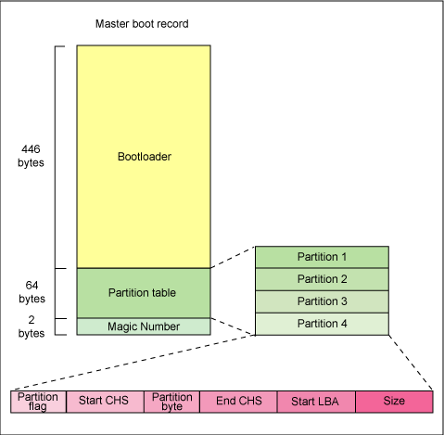
Anatomy of the MBR

Slide 8
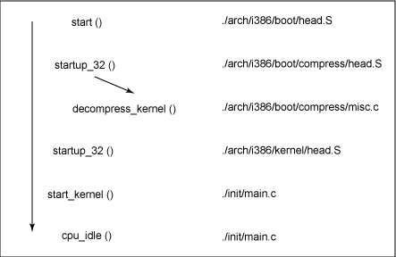

Slide 9
Boot Loaders
Before the kernel runs init, a boot loader starts the kernel. Sometimes,
you need to tell the boot loader to load different kernels or operating
systems, and to start in different modes.
The boot loader loads a kernel image into memory and hands control
of the CPU to the new image, possibly supplying it with some
parameters.

Slide 10
LILO
LILO can load the kernel from a variety of media, including floppy
disks, hard disks and some flash devices (configured to operate as
hard disks).
LILO can be configured to pass startup parameters to the Linux
kernel during the bootstrap process. Depending on the configuration,
you can customize the startup screens for embedded device, and
control other aspects of the initialization and runtime configuration
that LILO boots.
LILO can also be configured to load a special filesystem , referred
to as an initial RAM disk, or initrd, that can augment the bootstrap
sequence in certain ways

Slide 11
GRUB
GRUB stands for Grand Unified Bootloader, a system that is slowly
replacing LILO.
The most important feature is its ability to navigate filesystems, so
you can read files without loading a kernel.
GRUB has a menu interface that’s easy enough to navigate, but if
you need to boot from a different kernel, change the root partition,
or supply extra kernel parameters, you should get into the mini-shell.

Slide 12
Initialization Overview
When the operating system starts, the kernel runs /sbin/init. This can
be either a script or a program, but typically it is a program that
processes the statements in /etc/initab.
The default inittab file tells init to run the commands in the file
/etc/rc.d/rcS. In addition, init spawns programs to present login
prompts on two virtual terminals.

Slide 13
Init Runlevels: The idea behind operating different services at different runlevels essentially revolves around the fact that different systems can be used in a different ways.The following runlevels are defined in Red Hat Linux :
0 - Halt
1 - Single-user mode
2 - Multi-user mode, without networking
3 - Full multi-user mode
4 - Not used
5 - Full multi-user mode (with an X-based login screen)
6 - Reboot; The default runlevel for a system to boot to and stop is configured in /etc/inittab.

Slide 14
U-Boot Overview
Universal boot loader is richest, most flexible and open source boot
loader based on PPCboot and ARMboot.
Supports PPC boards, ARM based boards and X86 boards
U-boot is capable of booting a kernel through TFTP, from a IDE or
SCSI disk and from a doc includes read only support for JFFS2
Extensive command set
Compiling and installing
Booting with U-boot

Slide 15
U-Boot for Discovery board (AT91SAM926EJS)
When a u-boot starts, it copies the environment variables from the
persistant storage into memory.
Some of the important environment variables are:
autoload, baudrate, ethaddr, ipaddr, loadaddr, serverip, rootpath etc.
Environment variable commands:
printenv, setenv,
Commands for loading Linux kernel, root image and booting:
bdinfo, tftpboot, tftp, bootm, loadb

Slide 16
Server Setup for Network Boot
Setting up a target for network boot is ideal during the early stages of
development.
The simplest way to boot your target from the network is to use
BOOTP/DHCP, TFTP, and NFS.

