Slide 1
        Root Filesystem setup
Select a filesystem type for root filesystem.
Convert the root filesystem's content to the selected filesystem
format or install the root filesystem on a device formatted for the
selected filesystem type.

Slide 2
Filesystem Characteristics
Characteristics of the filesystem in embedded linux:
Write
Can the filesystem be written to?
Persistent
Does the filesystems preserve modifications across reboot?
Power down reliability
Can a modified filesystem recover from a power failure?
Compression
Is the content of the mounted filesystem compressed?
Lives in RAM
Is the filesystem's content first extracted from the storage
device into RAM before being mounted?

Slide 3
Filesystem characteristics
Filessystem | Write | Persistent | Power down reliability | Compression | Lives in RAM
CRAMFS | No | N/A | N/A | Yes | No
JFFS2 | Yes | Yes | Yes | Yes | No
JFFS | Yes | Yes | Yes | No | No
Ext2 over NFTL | Yes | Yes | No | No | No
Ext3 over NFTL | Yes | Yes | Yes | No | No
Ext2 over RAM disk | Yes | No | No | No | Yes

Slide 4
Guidelines for selecting filesystem
Selecting a filesystem configuration for MTD compatible storage
devices.
Small amount of flash, large RAM, use RAM disk.

Slide 5
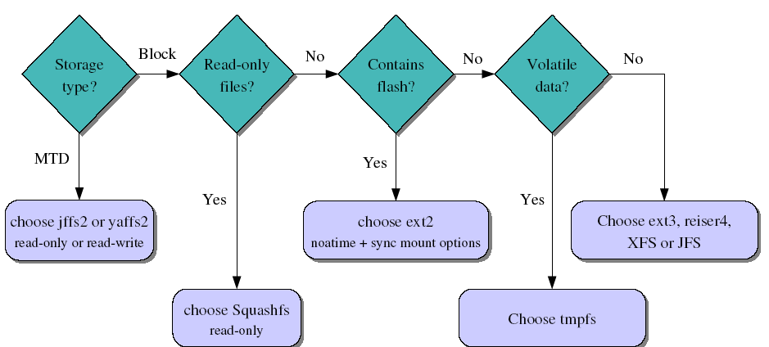
Filesystem choice summary

Slide 6
Using an NFS-Mounted Root Filesystem to Write a Filesystem
Image to Flash
The use of an NFS-mounted root filesystem during early
development stages simplifies the development process by allowing
quick modification of the files used by the target
Later, the target needs to have a filesystem stored in its flash in
order to be self-hosting.

Slide 7
Usefulness of rootfs on NFS
Once networking works, your root filesystem could be a directory on
your GNU/Linux development host, exported by NFS (Network File
System). This is very convenient for system development:
Makes it very easy to update files (driver modules in particular) on
the root filesystem, without rebooting. Much faster than through the
serial port.
Can have a big root filesystem even if you don't have support for
internal or external storage yet.
The root filesystem can be huge. You can even build native compiler
tools and build all the tools you need on the target itself (better to
Cross-compile though).

Slide 8
NFS Boot Setup
On the PC (NFS server)
Add the below line to your /etc/exports file:
/home/rootfs 192.168.0.202(rw,no_root_squash, sync)
If not running yet, you may need to start portmap
/etc/init.d/portmap start
Start or restart your NFS server:
Fedora Core:
/etc/init.d/nfs restart

Slide 9
NFS Boot Setup
On the target (NFS client)
Compile your kernel with CONFIG_NFS_FS=y,
CONFIG_IP_PNP=y (configure IP at boot time)
and CONFIG_ROOT_NFS=y
Boot the kernel with the below command line options:
root=/dev/nfs
virtual device
ip=192.168.1.111:192.168.1.110:192.168.1.100:255.255.255.0:at91:eth0
local IP addr server IP add gateway netmask hostname device
nfsroot=192.168.1.110:/home/nfsroot
NFS server IP address Directory on the NFS server

Slide 10
CRAMFS
CRAMFS has the following limitations:
• The maximum size a file can have is 16 MB.
• There are no current (.) or parent (..) directory entries.
• The UID field for files is 16 bits wide and the GID field is 8 bits
wide. Normal filesystems usually support either 16- or 32-bit UIDs
and GIDs.
All file timestamps are set to epoch (00:00:00 GMT, Jan 1, 1970).
• CRAMFS images can be read only by kernels using 4096-byte
page sizes.
• All files, whether they are linked or not, have a link count of 1.
To create a CRAMFS image of your root filesystem, you first need
to create and install the CRAMFS tools, cramfsck and mkcramfs.

Slide 11
jffs2: Journaling Flash File System v2
Designed to write flash sectors in an homogeneous way.
Flash bits can only be rewritten a relatively small number of times
(often < 100 000).
Compressed to fit as many data as possible on flash chips. Also
compensates for slower access time to those chips.
Power down reliable: can restart without any intervention
Shortcomings: low speed, big RAM consumption (4 MB for 128
MB of storage).

Slide 12
JFFS2…
Use the mkfs.jffs2 utility to create JFFS2 filesystem.
The creation of a JFFS2 image is fairly simple:
$ mkfs.jffs2 -r rootfs/ -o images/rootfs-jffs2.img
Mounting:
mount -t jffs2 /dev/mtdblock0 /mnt/jffs2/

Slide 13
Disk Filesystem over NFTL
The most widely used disk filesystem with NFTL is ext2. However,
that ext3 over NFTL does provide power down reliability
Create a filesystem on the designated NFTL partition for the
selected filesystem type:
# mke2fs /dev/nftla1
Then, mount the partition and copy the root filesystem to it:
# mkdir /mnt/doc
# mount -t ext2 /dev/nftla1 /mnt/doc
# cp -a rootfs/* /mnt/doc

Slide 14
Disk Filesystem over RAM disk
RAM disks, as their name indicates, live in RAM and act like block
devices. Because they act like block devices, any disk filesystem can
be used with them.
RAM disks are usually populated using compressed images of disk
filesystems, such as ext2,
The kernel is capable of extracting an initial RAM disk (initrd) image
from a storage device for use as its root filesystem.
First, create a blank filesystem image for the root filesystem:
$ cd ${PRJROOT}
$ mkdir tmp/initrd
$ dd if=/dev/zero of=images/initrd.img bs=1k count=8192

Slide 15
Disk Filesystem over RAM disk …
# /sbin/mke2fs -F -v -m0 images/initrd.img
# mount -o loop images/initrd.img tmp/initrd
# cp -av rootfs/* tmp/initrd
# umount tmp/initrd
The images/initrd.img file now contains the complete root
filesystem for your target. The final step is to compress this
filesystem to obtain a compressed RAM disk:
$ gzip -9 < images/initrd.img > images/initrd.bin

Slide 16
Mounting Directories on TMPFS
TMPFS is a virtual memory-based filesystem that can grow and
shrink according to its content. Although its content is not saved
across reboots, it is quite useful for storing temporary files.
Hence, instead of mounting all the directories from a single
filesystem, you can choose to mount directories that do not
require permanent storage, such as /tmp, on TMPFS.

