Slide 1
Linux History
1991: Linux kernel written from scratch in 6 months by Linus
Torvalds in his Helsinki University room, to overcome
limitations of his 80386 PC.
1991: Linus shares his kernel on the net. Programmers from
the whole world join in and contribute to coding and testing
1992: Linux released under the GNU General Public License
1994: Linux 1.0 released
1994: Red Hat founded by Bob Young and Marc Ewing, creating a
new business model.
1995: GNU/Linux and free software developing in Internet servers.
2001: IBM invests $1 billion in Linux
2002: GNU/Linux wide adoption starts in many industry sectors.
2005: Linux Kernel 2.6

Slide 2
Linux Kernel 2.6 Features
Performance and Determinism
A Preemptible Kernel
An Efficient Scheduler
New Synchronization Primitives
Sharing Memory with Less Contention
POSIX Threads, Signals, and Timers
Support for Custom Designs
Devices, Busses, and I/O
No Keyboard, No Monitor, No Wires
Linux on 64-bit Machines
Linux on Microcontrollers

Slide 3
Linux Distribution
Consists of boot diskette and other diskettes or CD-ROM
Popular distribution: RedHat, Debian, Slackware, Caldera and SuSe.

Slide 4
Linux Versioning Scheme
Releases are versioned as x.y.z
Stable versions
  x.y: main release number
  y: even number
  z: identifies the exact release version number
  Examples: 2.0.40, 2.2.26, 2.4.27, 2.6.7 ...
Development versions
  y: odd number
  Examples: 2.3.42, 2.5.74 ...

Slide 5
LINUX Architecture
Microkernel : Minimum functionality – IPC, MM and scheduler
Remaining functions as autonomous processes
Communicating to kernel via a well defined interface
Advantage – Individual components work independently
Less trouble to maintain
Drawbacks – Slow, prevents optimizations
Trend : Microkernel architecture. E.g., Mach Kernel or kernel of Windows NT
MINIX and Hurd System, examples of microkernel
Linux – Classical monolithic architecture, most components accessed via
accurately defined interfaces.

Slide 6
Architecture of generic linux
Applications
Libraries
Linux Kernel
High Level abstractions
File systems
Network protocols
Low level interfaces
Hardware

Slide 7
Supported hardware architectures
See the arch/ directory
Minimum: 32 bit processors, with or without MMU
32 bit architectures:
alpha, arm, cris, h8300, i386, m68k, m68knommu, mips,
parisc, ppc, s390, sh, sparc, um, v850
64 bit architectures:
ia64, mips64, ppc64 sh64, sparc64, x86_64
See arch/README or Documentation/arch/README for details

Slide 8
Linux Key Features
Portability and hardware support
Scalability
Can run on super computers as well as on tiny devices
Compliance to standards and interoperability
Networking
Security
Stability and reliability
Modularity

Slide 9
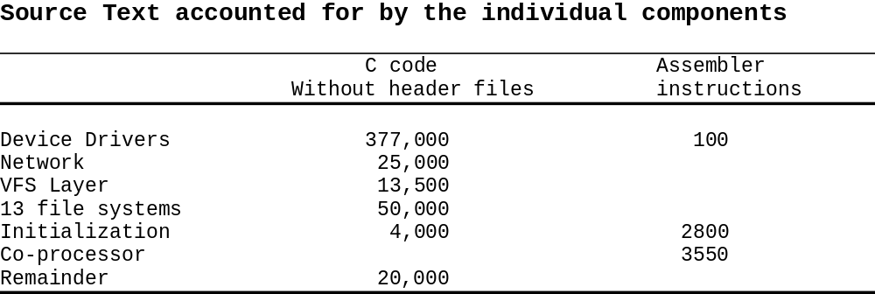

Slide 10
The Kernel Source
arch - This subdirectory contains all of the architecture specific code
for each supported architecture (MIPS, ARM, 386 and so on), there
is subdirectory under "arch". Each supported architecture subdirectory
has four major subdirectories:
kernel - which contains the architecture specific kernel code
mm - which contains the architecture specific memory mgmt code.
lib - which contains architecture specific library code (vsprintf...)
target platform directory - which contains platform specific code
Note: Linux ports to processors without memory management units
(MMU) are also available.

Slide 11
documentation - This subdirectory contains the documentation for
the kernel.
drivers - This subdirectory contains the code for the device drivers.
Each type of device has subdirectories, such as char, block, net...
fs - This directory contains the file system code. This has further sub
directories for each supported file system (ext2, proc, ...)
include - The include subdirectory contains the include files for the
kernel. It has further subdirectories for common include files for all
architectures), one for every architecture supported.
init - This directory contains the initialization code for the kernel.
kernel - This directory contains the main kernel code.
lib - This directory contains the library code of the kernel.
mm - This directory contains the memory management code.

Slide 12
The directory structure of the LINUX sources
/usr/src/linux
modules
mm
net
kernel
init
lib
include
ipc
unix
inet
linux
fs
arch
drivers
mips
asm-alpha
ext
nfs
net
alpha
asm-i386
ext2
proc
char
sparc
asm-m68k
xiafs
minix
ppc
block
asm-generic
isofs
msdos
i386
scsi
asm-mips
hpfs
sysv
sound
asm-sparc
kernel
boot
mm
Math-emu
umsdos

Slide 13
Kernel Development on x86 platform
The Linux kernel development requires following steps:
Selecting kernel
Configuring kernel
Compiling kernel
Installing the kernel

Slide 14
Access to the kernel sources
Download sources from http://kernel.org/:
http://kernel.org/pub/linux/kernel/v2.6/linux2.6.7.tar.bz2
http://kernel.org/pub/linux/kernel/v2.6/linux2.6.7.tar.bz2.sign
Or get a patch vs the x.y.<z1> version:
ftp://ftp.kernel.org/pub/linux/kernel/v2.6/patch2.6.7.bz2
ftp://ftp.kernel.org/pub/linux/kernel/v2.6/patch2.6.7.bz2.sign
Check the integrity of sources:
gpg –verify linux2.6.7.tar.bz2.sign linux2.6.7.tar.bz2
GnuPG details: http://www.gnupg.org/gph/en/manual.html
Kernel source signature details: http://www.kernel.org/signature.html

Slide 15
Using the Patch command
patch command: uses the output of the diff command to apply a set
of changes to a source tree.
patch basic usage:
patch -pn < diff_file
  n: number of directory levels to skip
Linux patches:
  Always to apply to the x.y.<z1> version
  Always produced for n=1
patch -p1 < linux_patch

Slide 16
Kernel Configuration
The Linux kernel configuration is usually found in the kernel source
in the file: /usr/src/linux/.config .
The kernel can be configured using text mode or graphical
configurator.
      make config - starts a character based questions and
      answer session
      make menuconfig - starts a terminal-oriented
      configuration tool (using ncurses)
      make xconfig - starts a X based configuration tool

Slide 17
Kernel Configuration…
Makefile edition
Setting the version and target architecture if needed
Kernel configuration: defining what features to include in the kernel:
  make xconfig
  or make menuconfig
  or make oldconfig
  Kernel configuration file (Makefile syntax) stored in the .config
file at the root of the kernel sources
  Distribution kernel config files usually released in /boot/

Slide 18
Makefile Changes
To identify your kernel image with others build from the same
sources, use the EXTRAVERSION variable:
  VERSION = 2
  PATCHLEVEL = 6
  SUBLEVEL = 7
  EXTRAVERSION = -acme1
  uname –r will return: 2.6.7-acme1

Slide 19
Kernel Configuration…
When the kernel configuration runs, it reads the main kernel
configuration file, located in arch/i386/Kconfig.
This configuration file also includes other configuration files as
needed.
For example arch/i386/Kconfig file includes
source “sound/core/Kconfig”
Which includes
source “sound/core/Kconfig”
source “sound/drivers/Kconfig”

Slide 20
Compiling and installing Kernel
make
make install
make modules_install

Slide 21
Building Kernel
The "make" command (with no arguments) now automatically
(and silently) generates dependency information, compiles the kernel,
and compiles any drivers that you have selected for installation as
modules.
Once you have configured your kernel, simply issuing the make
command, followed by the make install and
make modules_install commands, is the most common build
and install procedure for 2.6-based kernels.
Makes changes in the grub.conf file.
Copies modules to /lib/modules/<kernel version>/

Slide 22
Linux Initialization for Intel Platforms – Boot Process
1. A boot loader finds the kernel image on the disk, loads it into
memory, and starts it.
2. The kernel initializes the devices and its drivers.
3. The kernel mounts the root filesystem.
4. The kernel starts a program called init.
5. init sets the rest of the processes in motion.
6. The last processes that init starts as part of the boot sequence
allow you to log in.

Slide 23
The Linux Boot Process
Power-up/Reset
System startup
BIOS/BootMonitor
Stage1 bootloader
Master Boot Record
Stage2 bootloader
LILO, GRUB etc
Kernel
Linux
Operation
Init
User Space

Slide 24
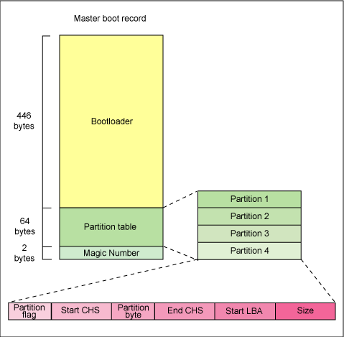
Anatomy of the MBR

Slide 25
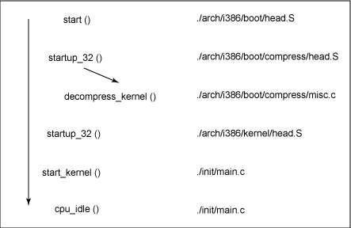

Slide 26
Boot Loaders
Before the kernel runs init, a boot loader starts the kernel. Sometimes,
you need to tell the boot loader to load different kernels or operating
systems, and to start in different modes.
The boot loader loads a kernel image into memory and hands control
of the CPU to the new image, possibly supplying it with some
parameters.

Slide 27
LILO
LILO can load the kernel from a variety of media, including floppy
disks, hard disks and some flash devices (configured to operate as
hard disks).
LILO can be configured to pass startup parameters to the Linux
kernel during the bootstrap process. Depending on the configuration,
you can customize the startup screens for embedded device, and
control other aspects of the initialization and runtime configuration
that LILO boots.
LILO can also be configured to load a special filesystem , referred
to as an initial RAM disk, or initrd, that can augment the bootstrap
sequence in certain ways

Slide 28
GRUB
GRUB stands for Grand Unified Bootloader, a system that is slowly
replacing LILO.
The most important feature is its ability to navigate filesystems, so
you can read files without loading a kernel.
GRUB has a menu interface that’s easy enough to navigate, but if
you need to boot from a different kernel, change the root partition,
or supply extra kernel parameters, you should get into the mini-shell.

Slide 29
Initialization Overview
When the operating system starts, the kernel runs /sbin/init. This can
be either a script or a program, but typically it is a program that
processes the statements in /etc/initab.
The default inittab file tells init to run the commands in the file
/etc/rc.d/rcS. In addition, init spawns programs to present login
prompts on two virtual terminals.

Slide 30
Init Runlevels: The idea behind operating different services at different runlevels essentially revolves around the fact that different systems can be used in a different ways.The following runlevels are defined in Red Hat Linux :
0 - Halt
1 - Single-user mode
2 - Multi-user mode, without networking
3 - Full multi-user mode
4 - Not used
5 - Full multi-user mode (with an X-based login screen)
6 - Reboot; The default runlevel for a system to boot to and stop is configured in /etc/inittab.

Slide 31
Adding a new module (hello) to the Build process
1. Make a directory - drivers/hello
Create or Copy file - Kconfig, Makefile, hello.c
hello.c - A simple kernel module
Kconfig - Add following statements
#
# hello module configuration
#
menu "Hello Module support"
config HELLO
tristate "Include Hello module?"
---help---
Linux Kernel Module demonstration - Hello
endmenu
Makefile - Add foloowing statement
obj-$(CONFIG_HELLO) += hello/

Slide 32
Adding a new module (hello) to the Build process…
2. Add the following statement before endmenu statement:
source "drivers/hello/Kconfig"
And add the following statement at the end of file in Makefile:
obj-$(CONFIG_HELLO) += hello.o
3. Config, Build and Deploy the kernel.
make xconfig
Look at the menu item displayed under drivers.
Select and save the configuration and exit.
Look for CONFIG_HELLO in .config file.

