Slide 1
Building Linux Kernel Image for KB9202 board
Download Linux kernel source from kernel.org
Follow, by these below mentioned commands
# tar xvf linux-2.6.xx
# make ARCH=arm menuconfig

Slide 2
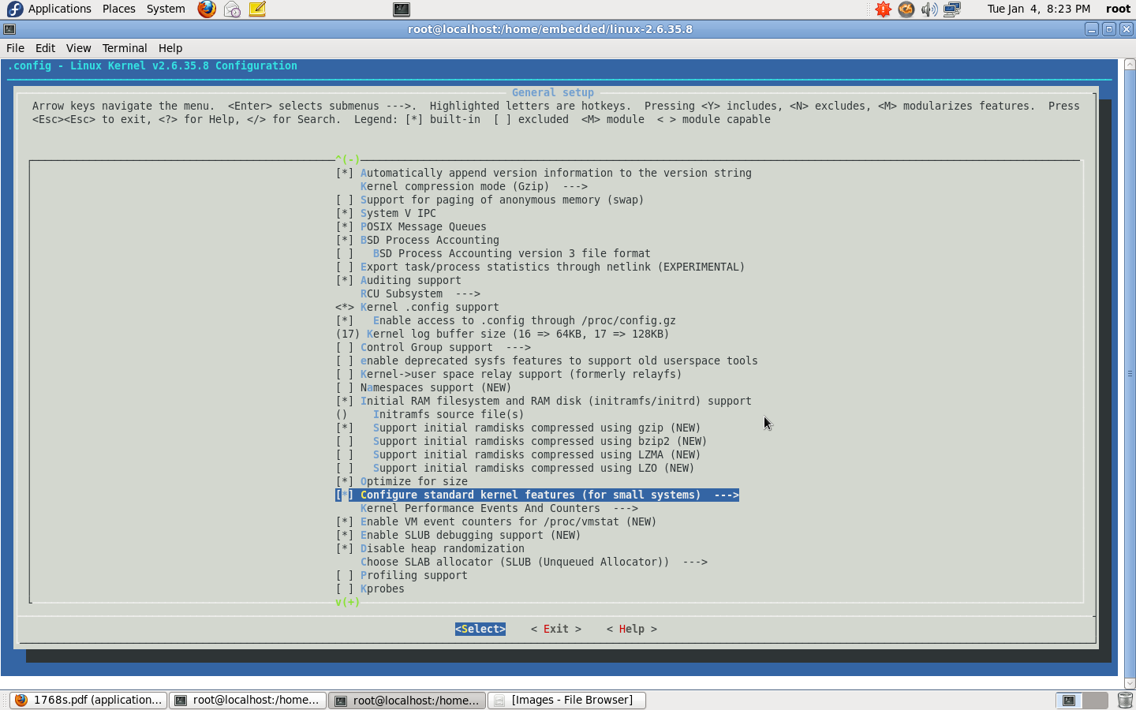

Slide 3
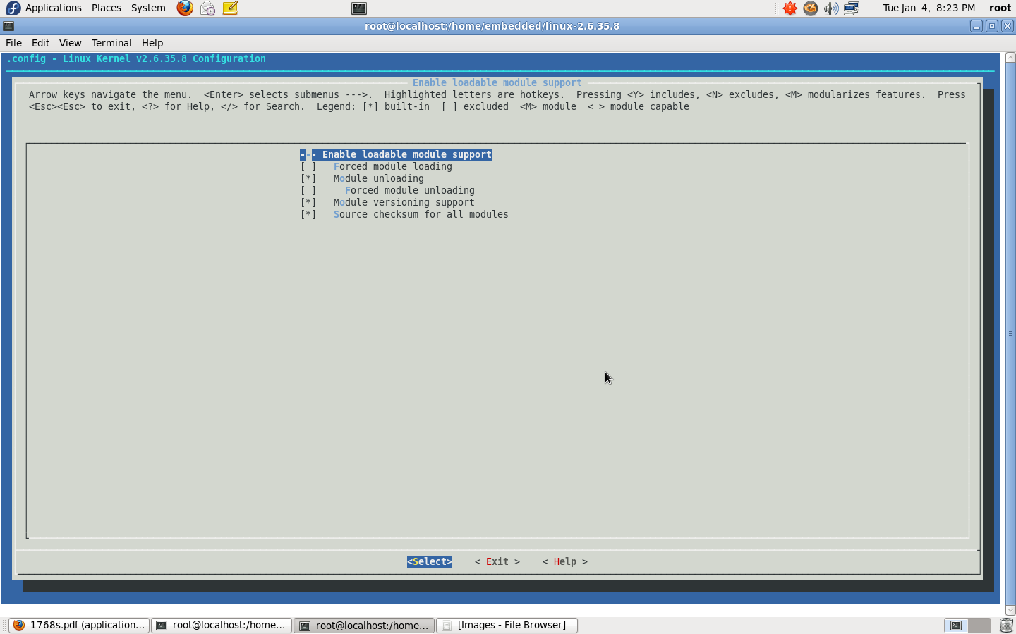

Slide 4
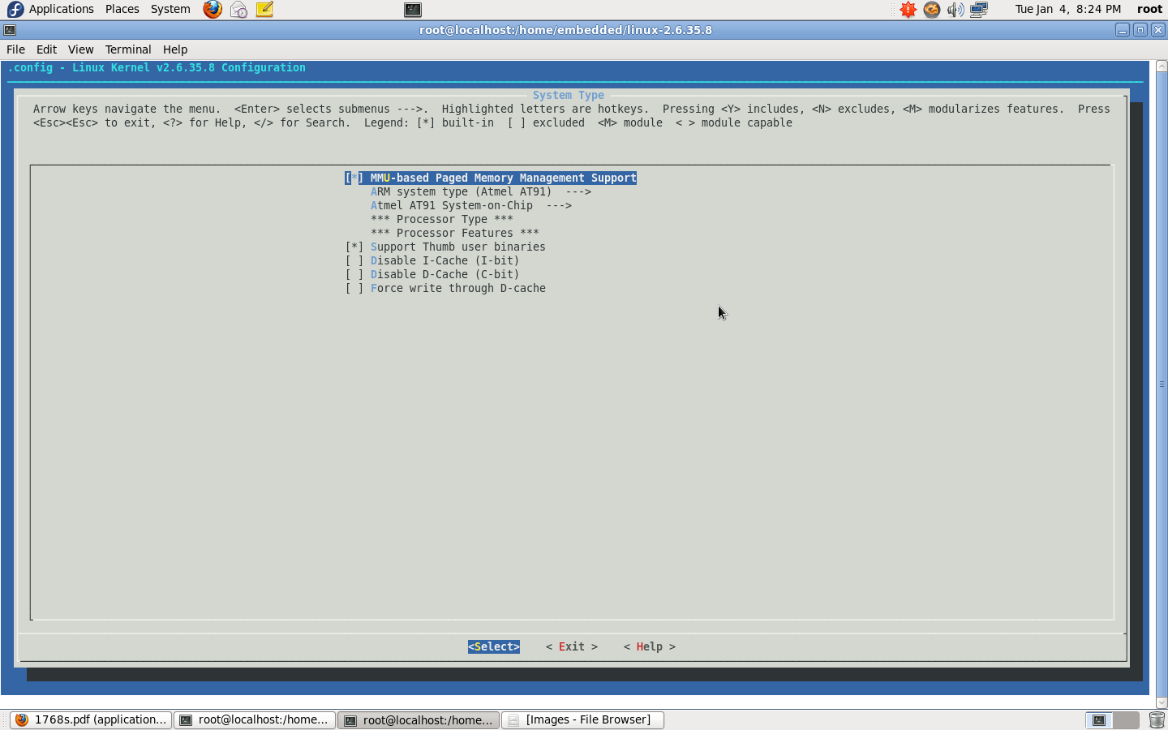

Slide 5
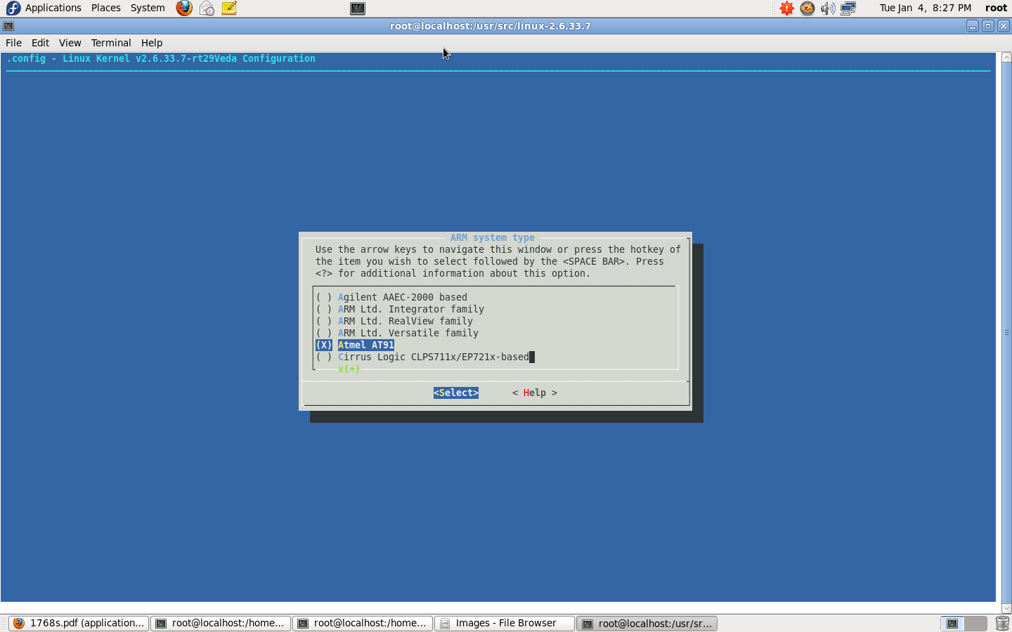

Slide 6
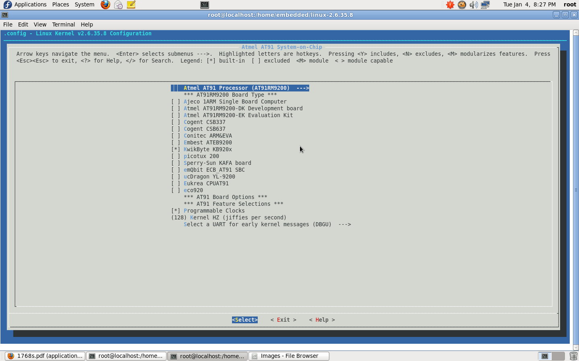

Slide 7
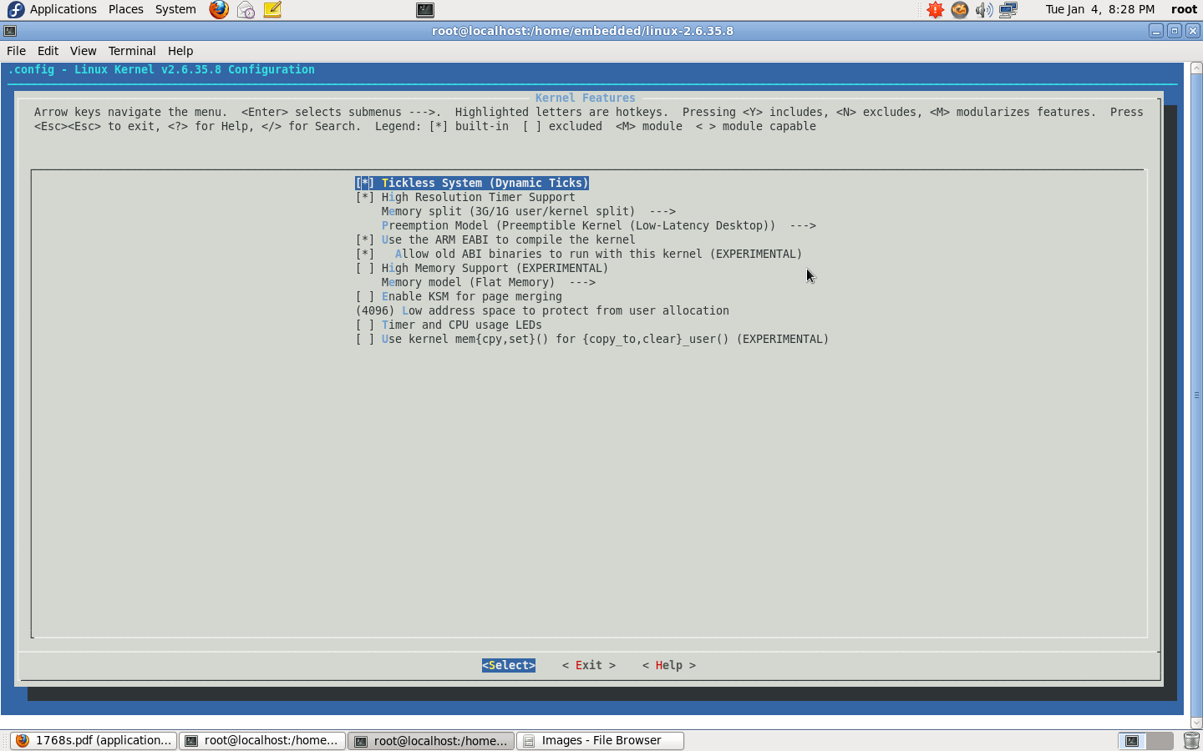

Slide 8
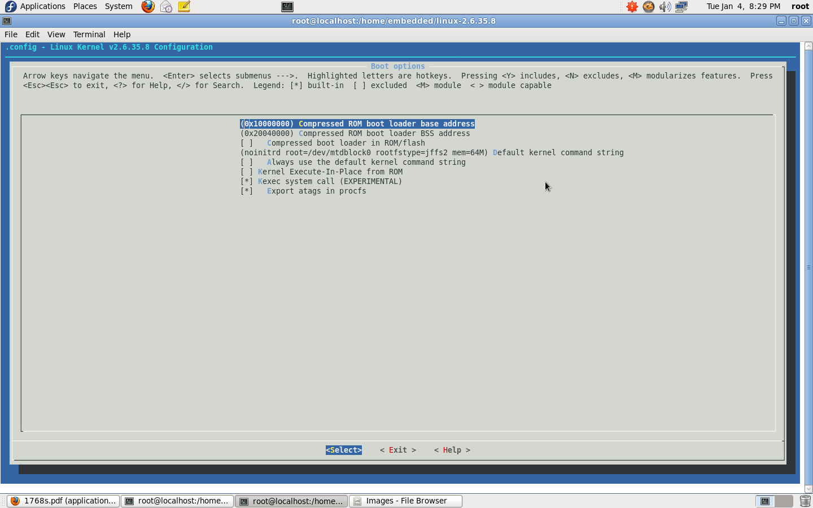

Slide 9


Slide 10
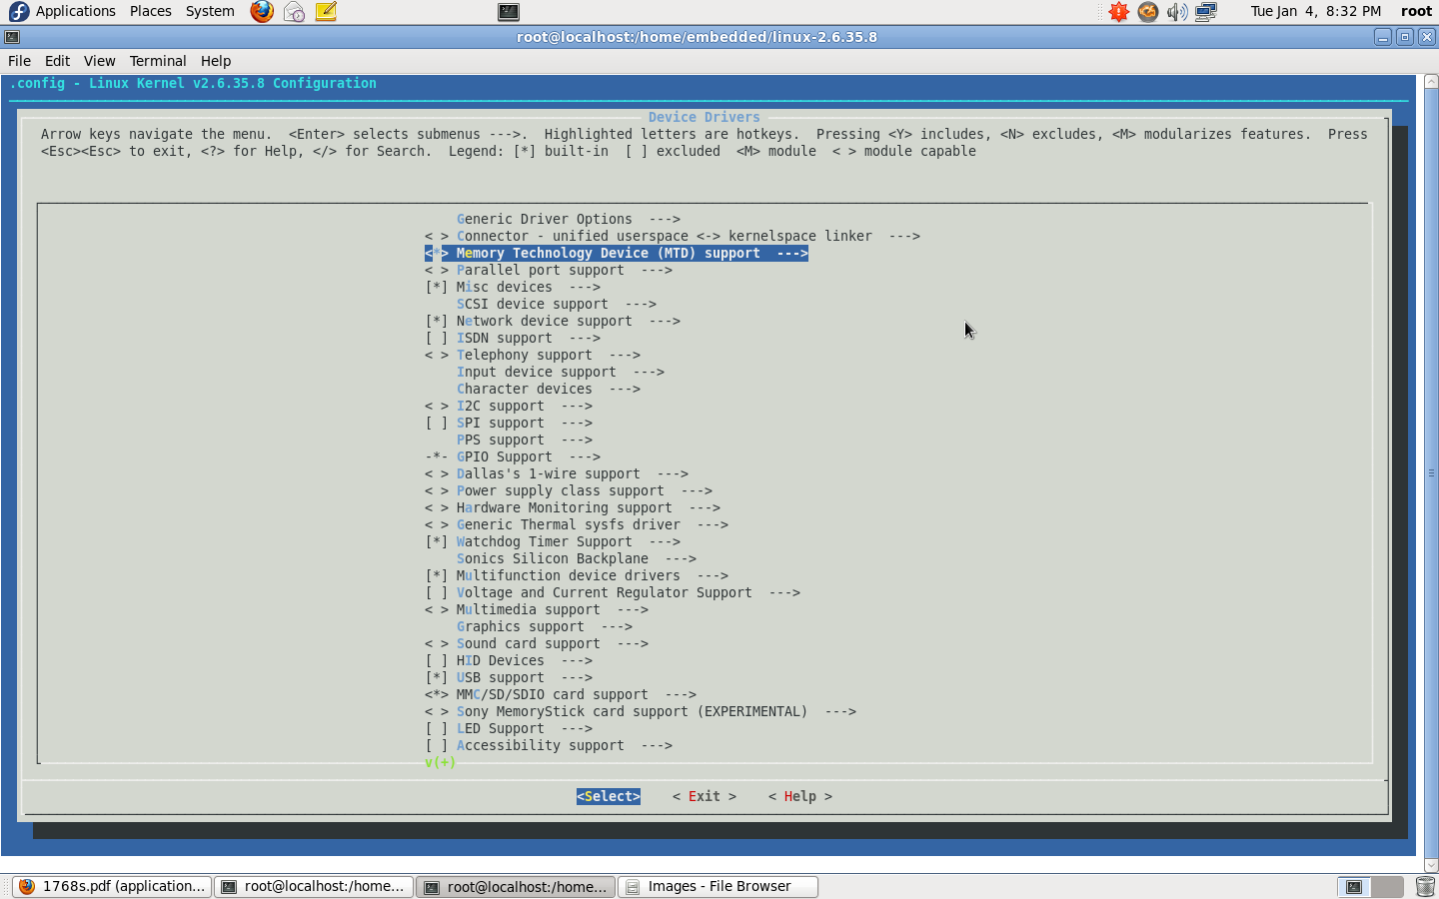

Slide 11
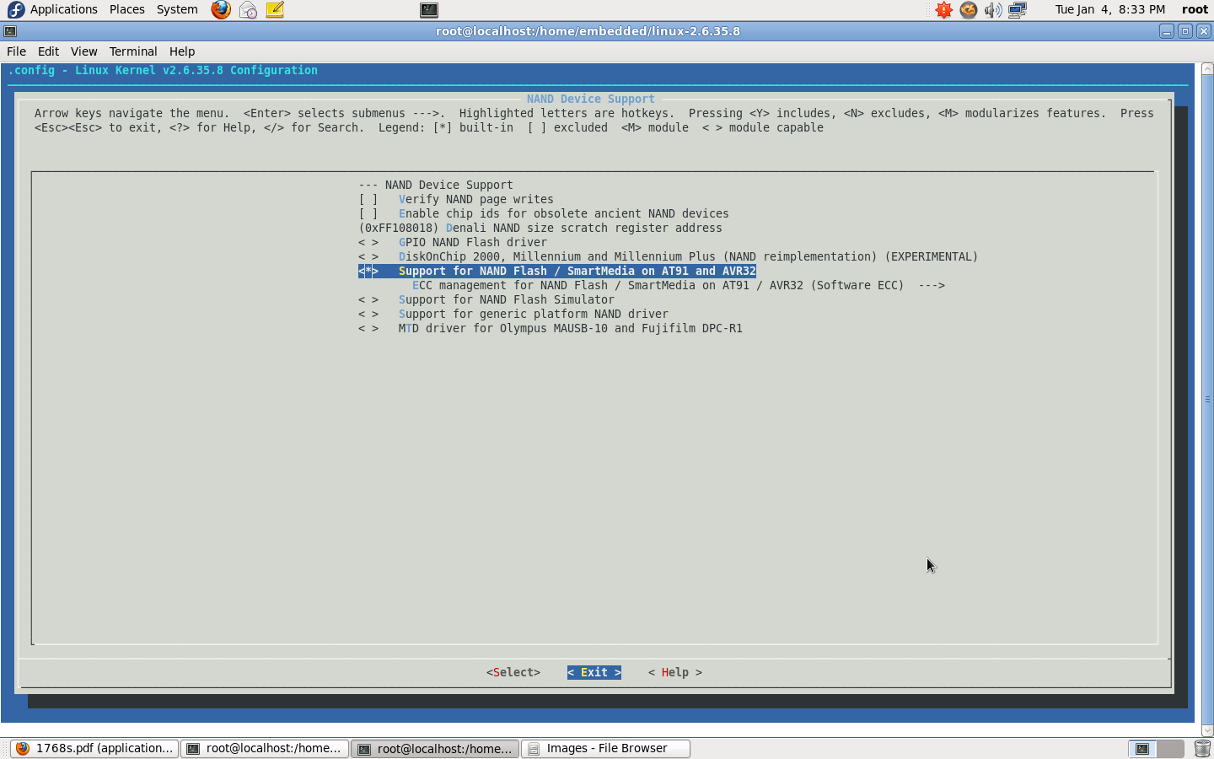

Slide 12
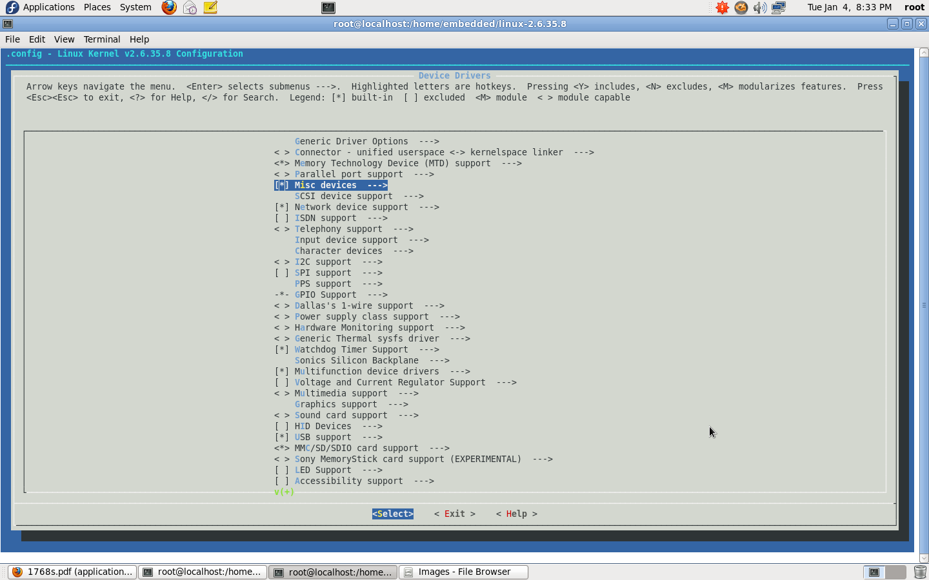

Slide 13
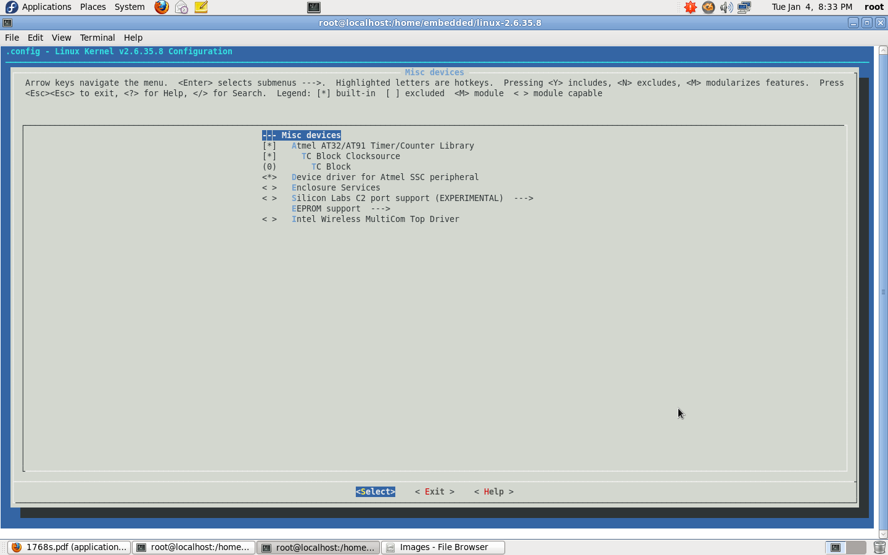

Slide 14
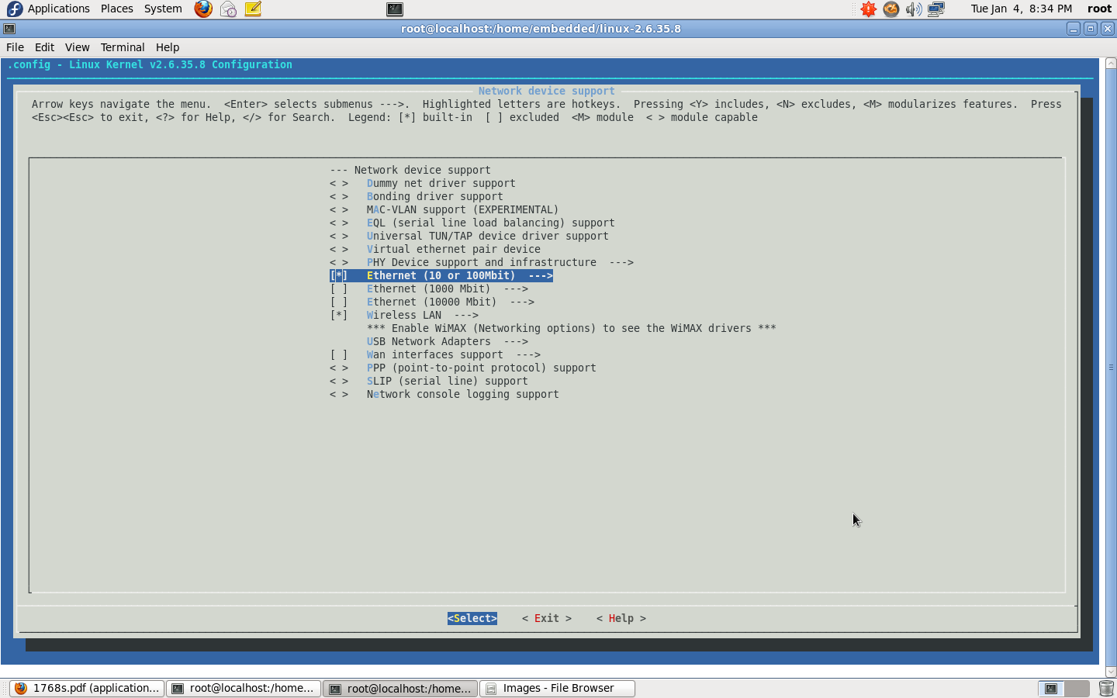

Slide 15
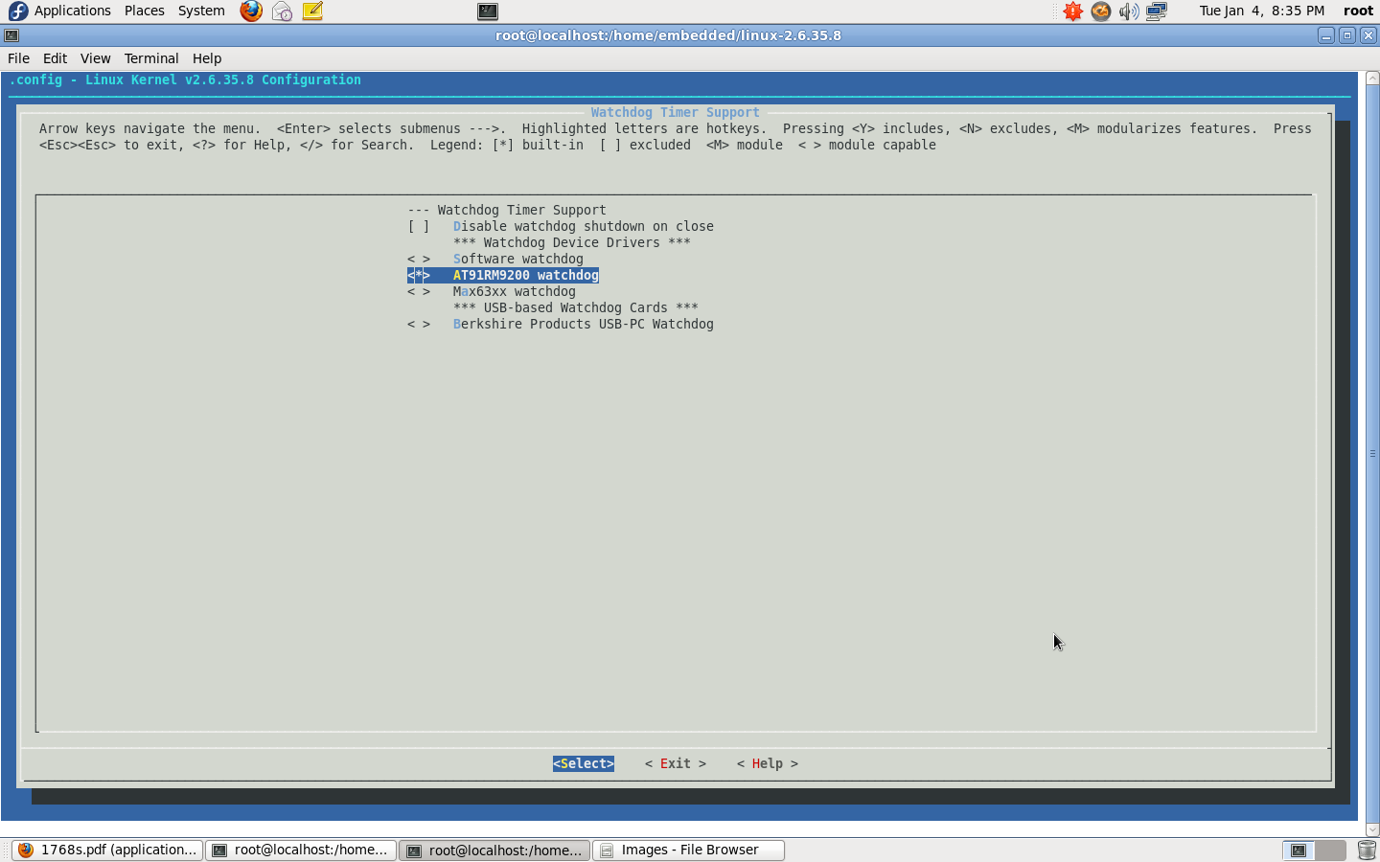

Slide 16
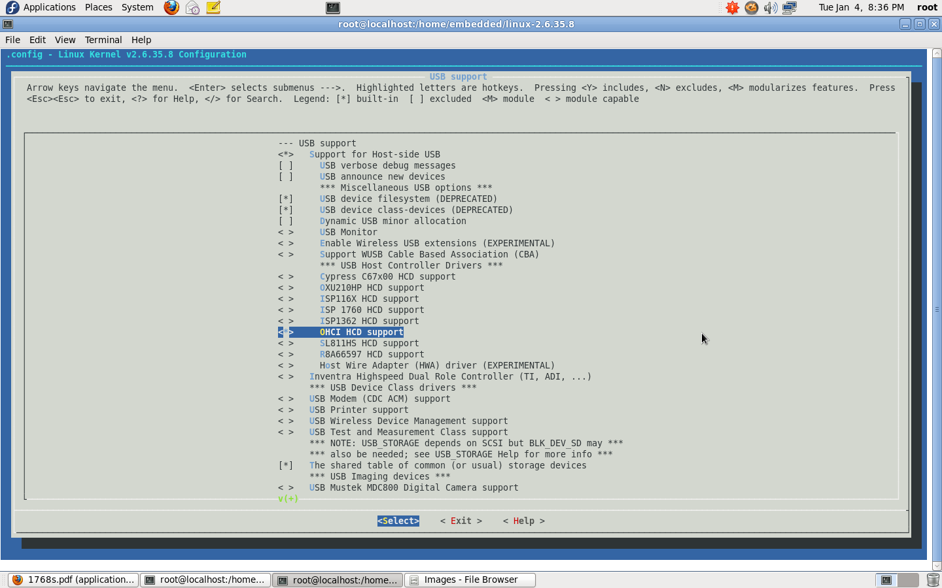

Slide 17
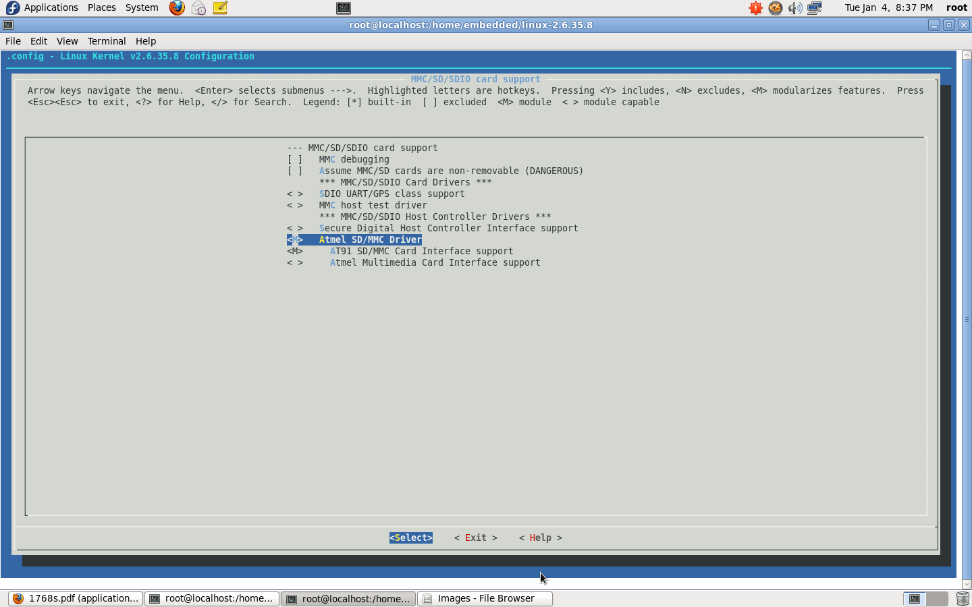

Slide 18
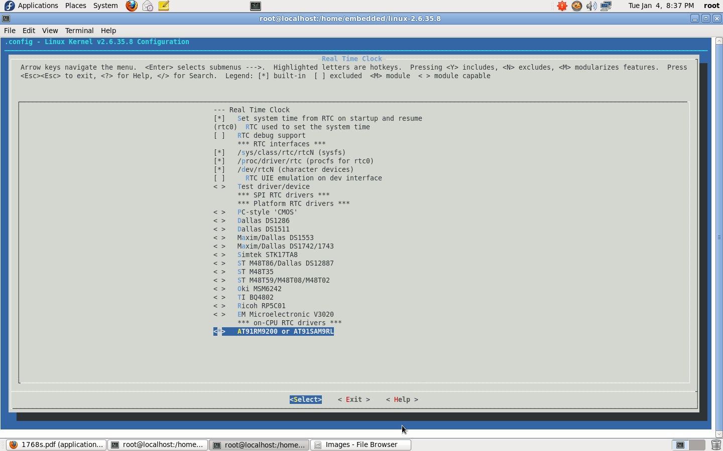

Slide 19
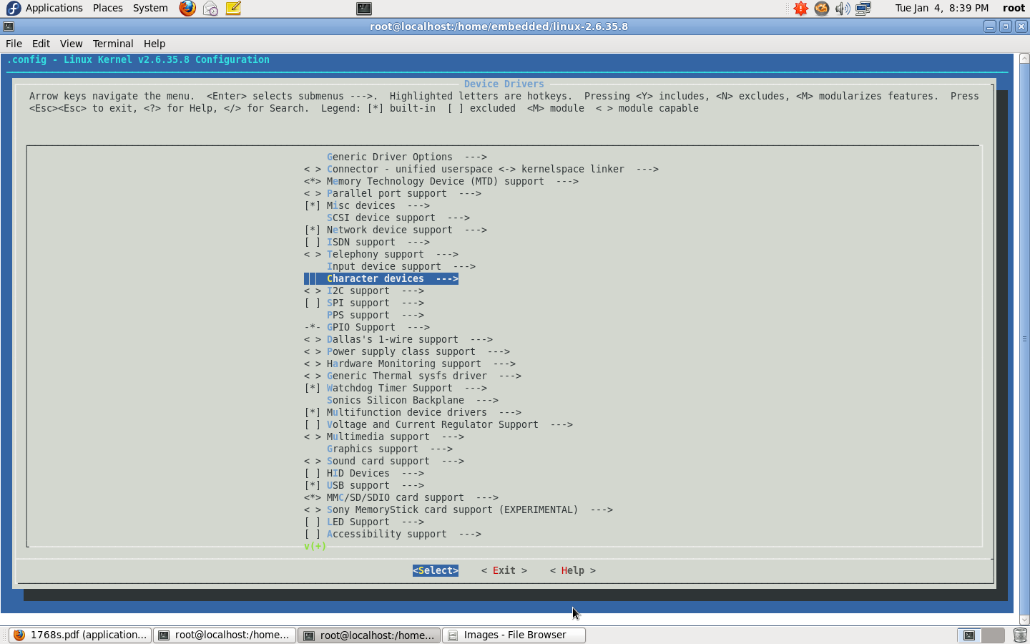

Slide 20
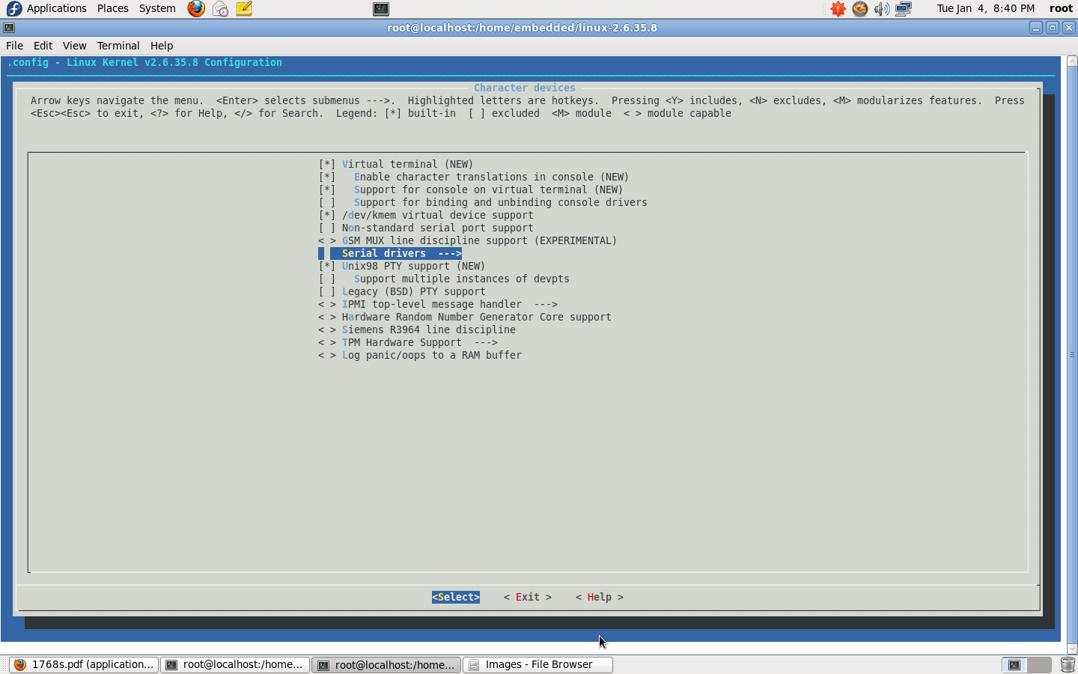

Slide 21
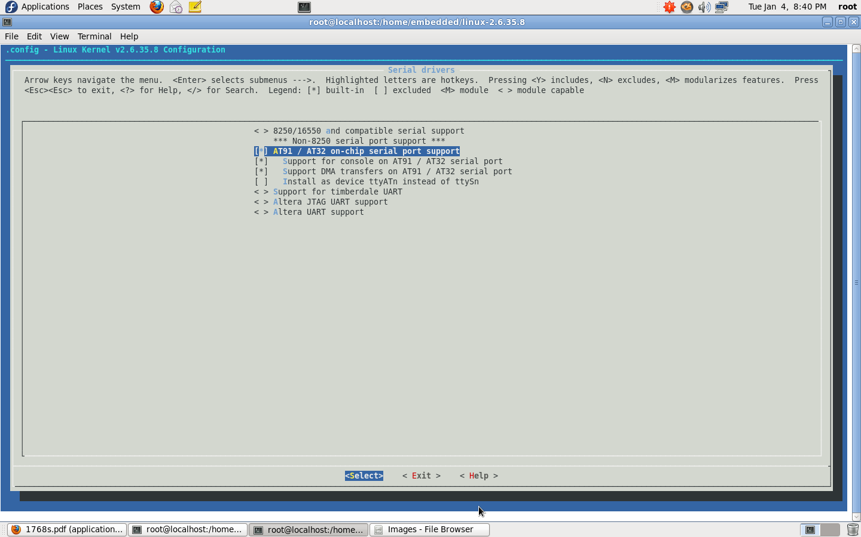

Slide 22
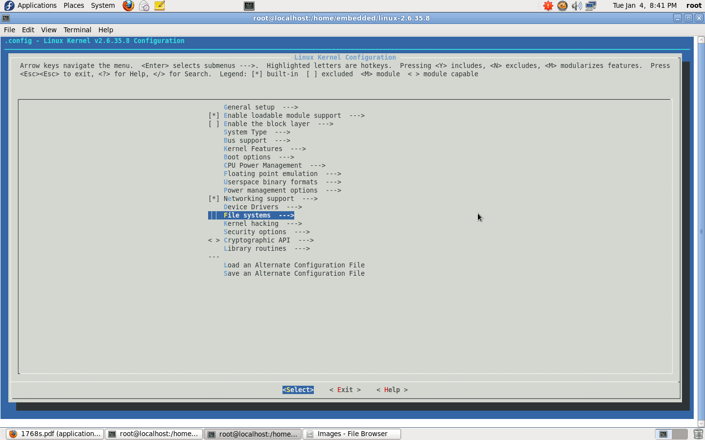

Slide 23
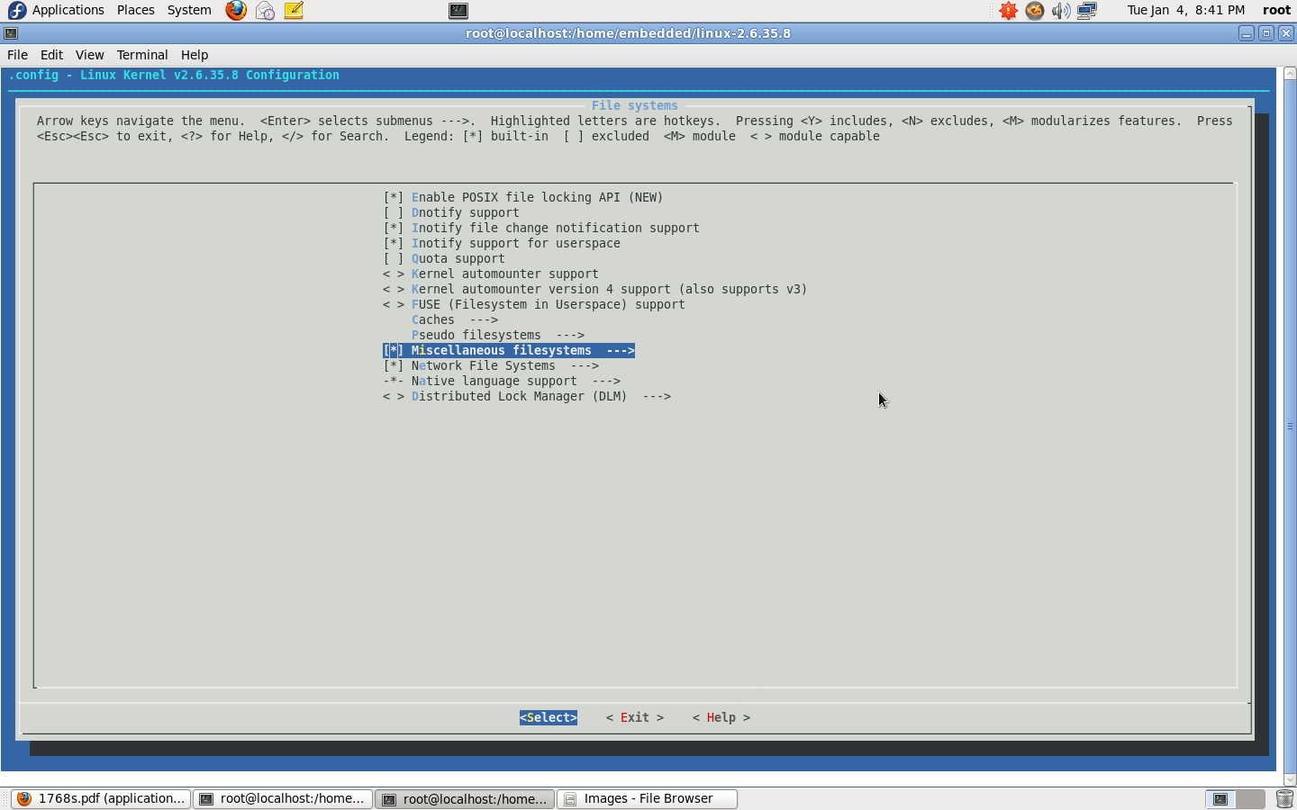

Slide 24
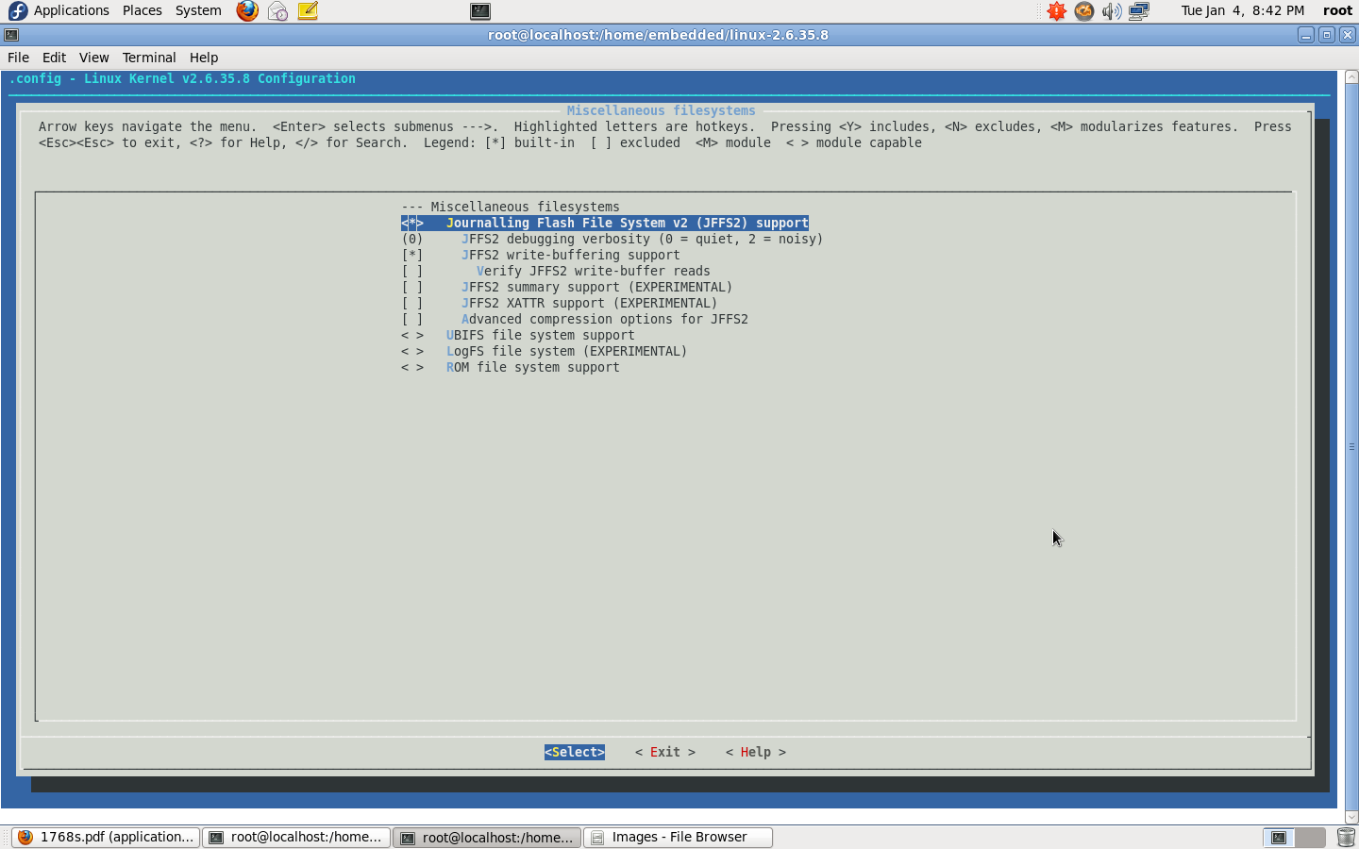

Slide 25
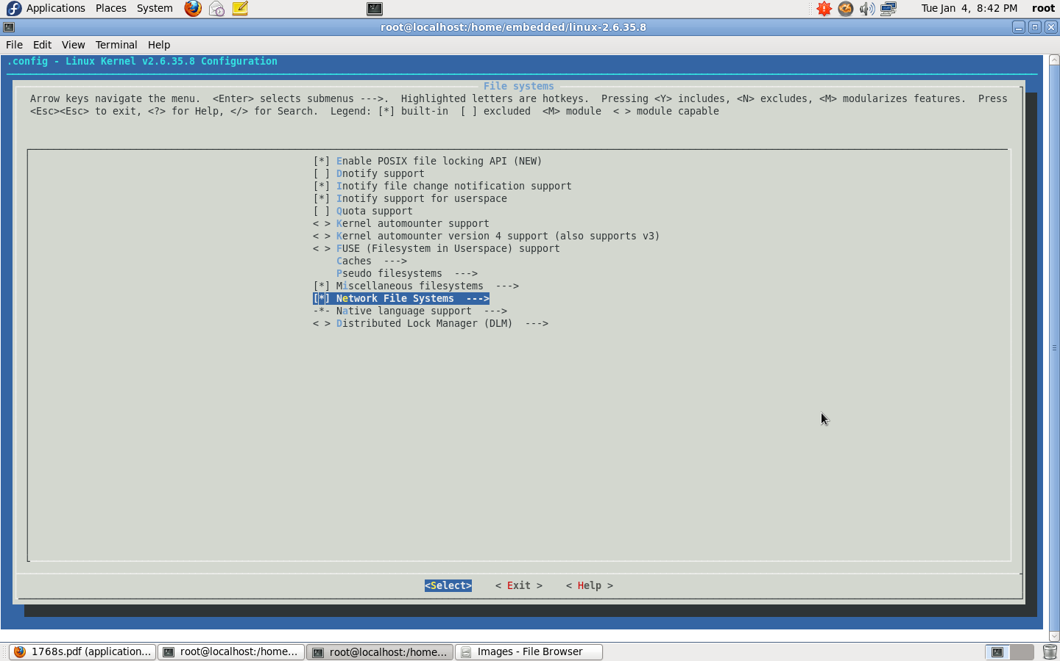

Slide 26
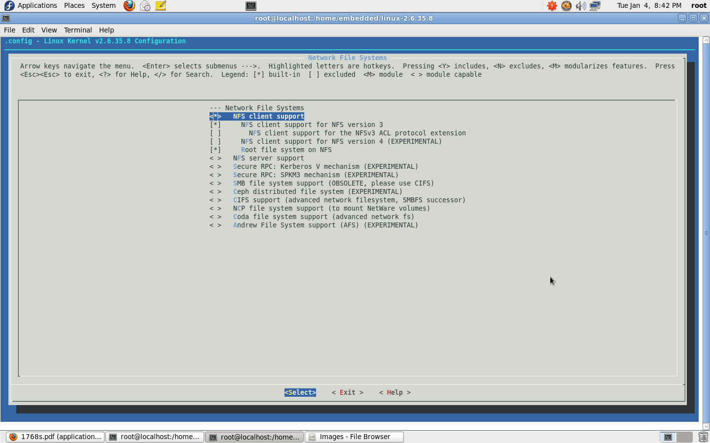

Slide 27
# make ARCH=arm CROSS_COMPILE=$(CROSSTOOL_PATH)
Post execution of the above cmd., kernel image gets created under $(LINUX_SRC)/arch/arm/boot directory
Add 64 byte uboot header to kernel image
  mkimage
  -A arm
  -O linux
  -T kernel
  -C none
  -a 0x20008000
  -e 0x20008000
  -n "Modified Kernel 30"
  -d arch/arm/boot/Image uImage

Slide 28
Thank you

