Slide 1
Creating the Root file system
In order to build a root filesystem, you need a device that is large enough to hold all the files
If you have an unused hard disk space than use a loopback device, which allows a disk file to be treated as a block device
Creating a loopback device
dd if=/dev/zero of=/tmp/myfs bs=<block_size> count=<no_blocks>
losetup /dev/loop0 /tmp/myfs
Format the loopback device
mkfs.ext2 /dev/loop0
Mount the loopback device
mount -t ext2 /dev/loop0 /media

Slide 2
Creating the Root file system
Populate your root filesystem with minimum set of directories
Populating /bin, /sbin, /usr/bin, /usr/sbin directories with busybox
Why busybox
Most Unix command line utilities within a single executable!
Sizes less than < 500 KB (statically compiled with uClibc) or less than
1 MB (statically compiled with glibc).
Easy to configure which features to include.
The best choice for Small and medium size embedded systems

Slide 3
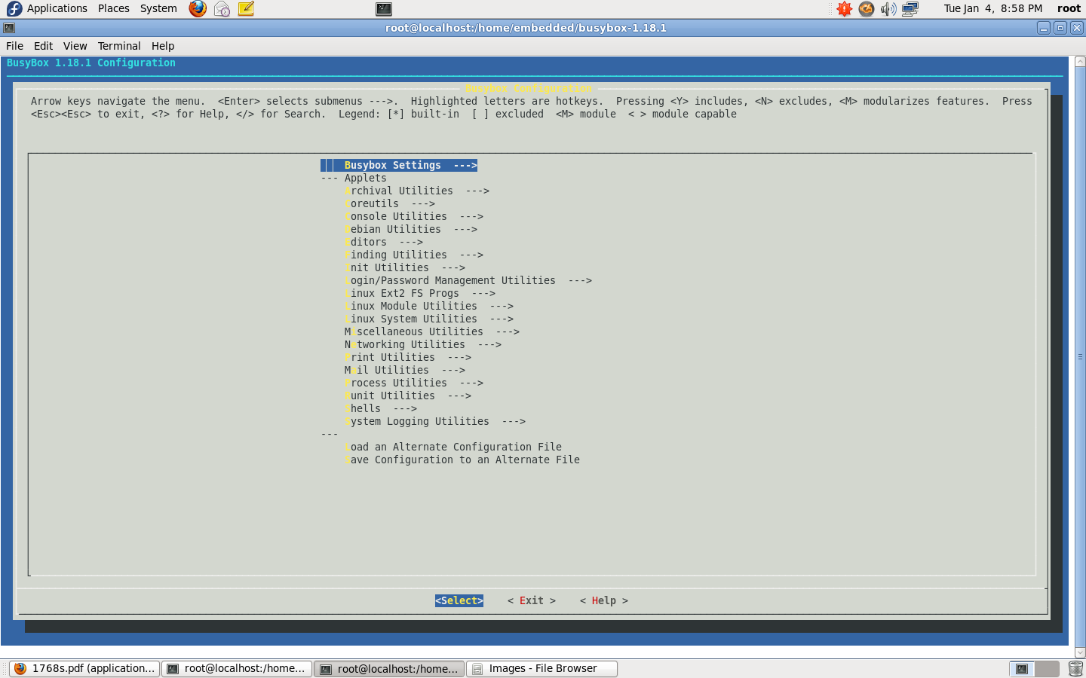
Download busybox from http://www.busybox.net/
# tar xvf BusyBox 1.18.1.tar.bz2
# make menuconfig
# export CROSS_COMPILE=$(CROSSTOOL_PATH)/arm-linux-
# make

Slide 4
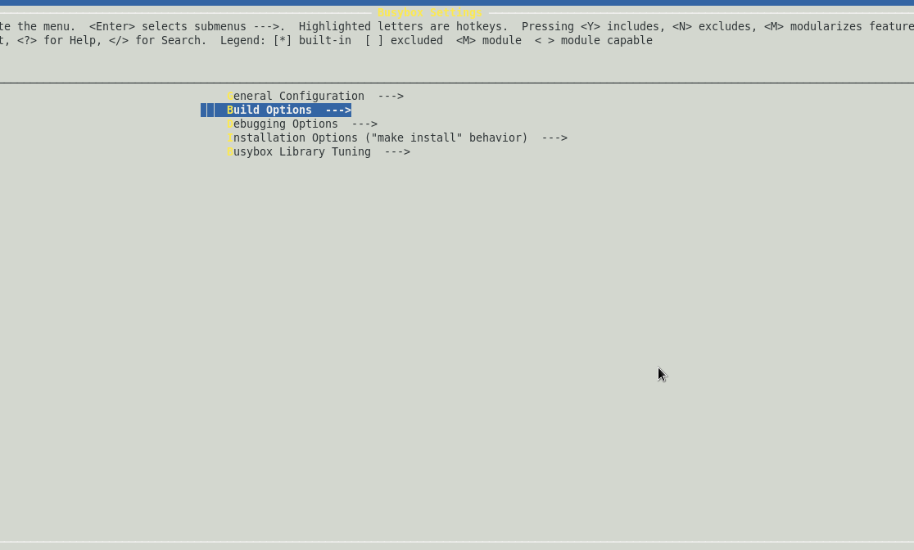

Slide 5
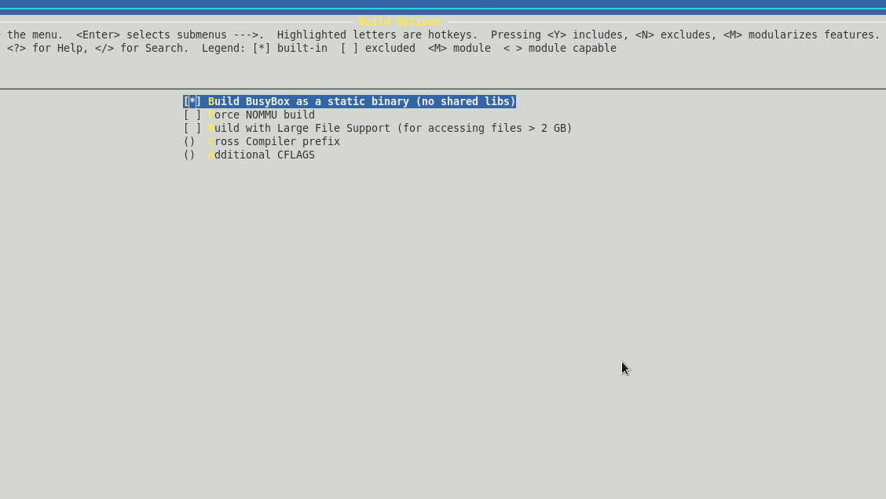

Slide 6
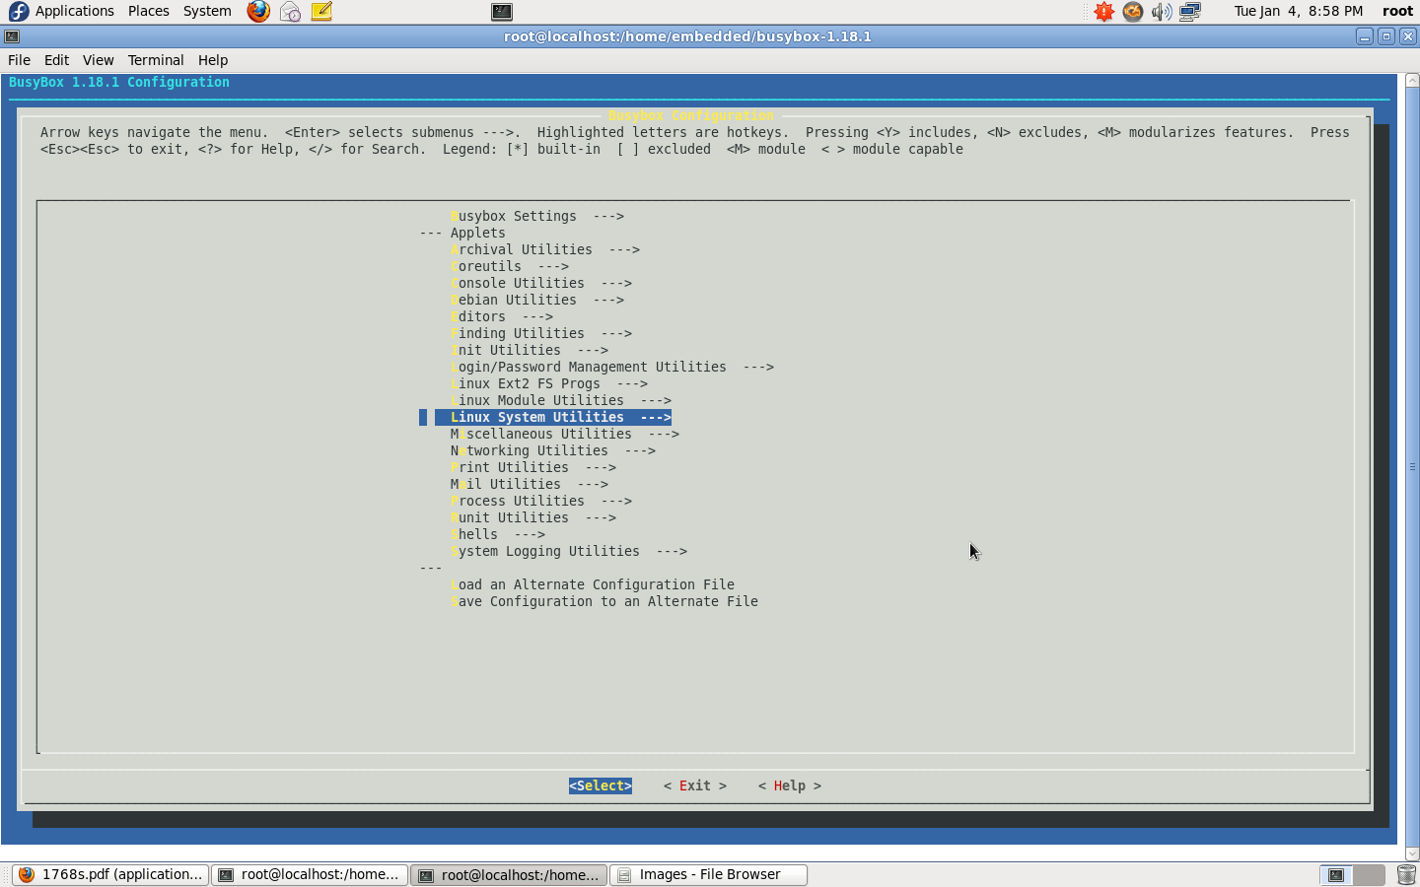

Slide 7
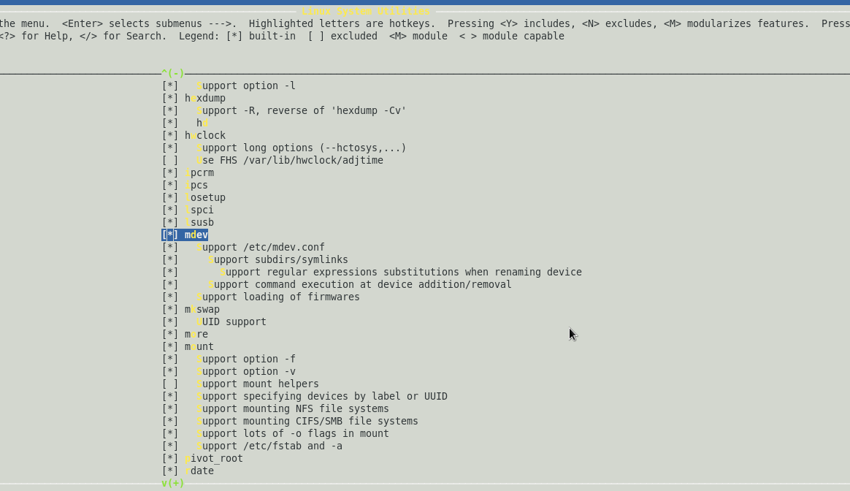

Slide 8
# make install
Copy the output folders of bustbox to the root filesystem using
rsync –a _install/* /media
Create the following directories
# mkdir dev, etc, lib, proc, root, sys, tmp
# chmod 766 dev, etc, lib, proc, root, sys, tmp
Create the inittab file under /etc directory
#vi inittab and type the following
# Startup the system
null::sysinit:/etc/init.d/rcS
ttyS0::respawn:-/bin/sh
# Stuff to do before rebooting
null::shutdown:/bin/umount -a -r

Slide 9
Create the following directories under /etc
# mkdir etc/init.d
Create rcS file under etc/init.d directory
# vi rcS and type the following
#!/bin/sh
echo -n " Mounting /proc : "
mount -n -t proc /proc /proc
echo -n " Mounting /sys : "
mount -n -t sysfs sysfs /sys
echo -n " Mounting /dev : "
mount -n -t tmpfs mdev /dev

Slide 10
# vi rcS
# ---------------------------------------------
# Enabling hot-plug
# ---------------------------------------------
echo "/sbin/mdev" > /proc/sys/kernel/hotplug
mdev -s
# ---------------------------------------------
# Set PATH
# ---------------------------------------------
export PATH=/bin:/sbin:/usr/bin:/usr/sbin:/usr/local/bin
# ---------------------------------------------
# Set ip address
# ---------------------------------------------
/sbin/ifconfig lo 127.0.0.1 up
/sbin/ifconfig eth0 192.168.1.1 up

Slide 11
Create the following device files under /dev
# mknod console c 5 1
# mknod null c 1 3
# mknod ttyS0 c 4 64
Converting ext2 files system to jffs2 file system
# mkfs.jffs2 --pad=0x4000
--eraseblock=0x4000
-l --root=/media –o my_file.bin

Slide 12
Thank you

