Slide 1



Cross-compiling toolchains

Slide 2
Cross-compiling toolchains
The usual development tools available on a GNU/Linux workstation is a native toolchain
This toolchain runs on your workstation and generates code for your workstation, usually x86
For embedded system development, it is usually impossible or not interesting to use a native toolchain
  The target is too restricted in terms of storage and/or memory
  The target is very slow compared to your workstation
  You may not want to install all development tools on your target.
Therefore, cross-compiling toolchains are generally used. They run on your workstation but generate code for your target.

Slide 3
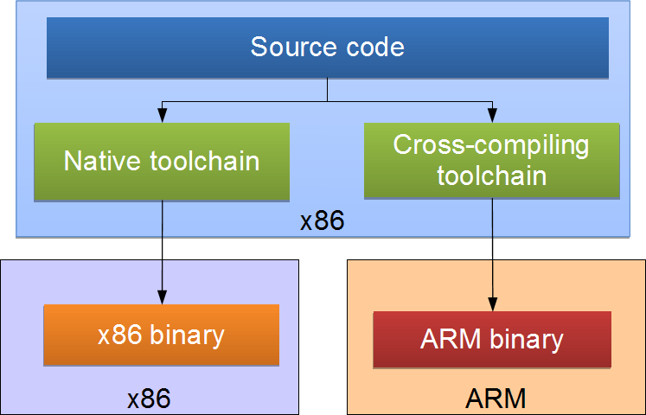
Cross-compiling toolchains
Compilation
machine
Execution machine

Slide 4
Cross-compiling toolchains
Components
Binutils
Kernel headers
C/C++ libraries
GCC compiler
GDB debugger
(optional)

Slide 5
Binutils
Binutils is a set of tools to generate and manipulate binaries for a given CPU architecture
  as, the assembler, that generates binary code from assembler source code
  ld, the linker
  ar, ranlib, to generate .a archives, used for libraries
  objdump, readelf, size, nm, strings, to inspect binaries. Very useful analysis tools !
  strip, to strip useless parts of binaries in order to reduce their size
http://www.gnu.org/software/binutils/
GPL license

Slide 6
Kernel headers
Kernel
The C library and compiled programs needs to interact with the kernel
  Available system calls and their numbers
  Constant definitions
  Data structures, etc.
Therefore, compiling the C library requires kernel headers, and many applications also require them.
Kernel headers
C Library
Applications
Available in <linux/...> and <asm/...> and a few other directories corresponding to the ones visible in include/ in the kernel sources

Slide 7
Kernel headers
System call numbers, in <asm/unistd.h>
#define __NR_exit 1
#define __NR_fork 2
#define __NR_read 3
Constant definitions, here in <asm-generic/fcntl.h>, included from <asm/fcntl.h>, included from <linux/fcntl.h>
#define O_RDWR 00000002
Data structures, here in <asm/stat.h>
struct stat {
unsigned long st_dev;
unsigned long st_ino;
[...]
};

Slide 8
Kernel headers
The kernel-to-userspace ABI is backward compatible
  Binaries generated with a toolchain using kernel headers older than the running kernel will work without problem, but won't be able to use the new system calls, data structures, etc.
  Binaries generated with a toolchain using kernel headers newer than the running kernel might work on if they don't use the recent features, otherwise they will break
  Using the latest kernel headers is not necessary, unless access to the new kernel features is needed
The kernel headers are extracted from the kernel sources using the headers_install kernel Makefile target.

Slide 9
GCC compiler
GNU C Compiler, the famous free software compiler
Can compile C, C++, Ada, Fortran, Java, Objective-C, Objective-C++, and generate code for a large number of CPU architectures, including ARM, AVR, Blackfin, CRIS, FRV, M32, MIPS, MN10300, PowerPC, SH, v850, i386, x86_64, IA64, Xtensa, etc.
http://gcc.gnu.org/
Available under the GPL license,
libraries under the LGPL.

Slide 10
C library
The C library is an essential component of a Linux system
  Interface between the applications and the kernel
  Provides the well-known standard C API to ease application development
Several C libraries are available:
glibc, uClibc, eglibc, dietlibc, newlib, etc.
The choice of the C library must be made at the time of the cross-compiling toolchain generation, as the GCC compiler is compiled against a specific C library.
Kernel
C Library
Applications

Slide 11
glibc
http://www.gnu.org/software/libc/
License: LGPL
C library from the GNU project
Designed for performance, standards compliance and portability
Found on all GNU / Linux host systems
Of course, actively maintained
Quite big for small embedded systems: approx 2.5 MB on arm (version 2.9 - libc: 1.5 MB, libm: 750 KB)

Slide 12
uClibc
http://www.uclibc.org/ from CodePoet Consulting
License: LGPL
Lightweight C library for small embedded systems
  High configurability: many features can be enabled or disabled through a menuconfig interface
  Works only with Linux/uClinux, works on most embedded architectures
  No stable ABI, different ABI depending on the library configuration
  Focus on size rather than performance
  Small compile time

Slide 13
uClibc
Most of the applications compile with uClibc. This applies to all applications used in embedded systems.
Size (arm): 4 times smaller than glibc!
uClibc 0.9.30.1: approx. 600 KB (libuClibc: 460 KB, libm: 96KB)
glibc 2.9: approx 2.5 MB
Used on a large number of production embedded products, including consumer electronic devices
Actively maintained, large developer and user base
Now supported by MontaVista, TimeSys and Wind River.

Slide 14
uClibc
After compilation and installation, the following components are available
Standard headers, stdio.h, stdlib.h, unistd.h and others, and Linux kernel headers, integrated with the C library headers.
The libraries themselves, with mainly
  libuClibc, the C library itself
  ld-uClibc, the dynamic loader, responsible for loading the shared libraries at the beginning of a program's execution
  librt, the library implementing the real-time related functions
  libstdc++, the C++ standard library
  libpthread, the threads library
  libm, the mathematic library

Slide 15
eglibc
« Embedded glibc », under the LGPL
Variant of the GNU C Library (GLIBC) designed to work well on embedded systems
Strives to be source and binary compatible with GLIBC
eglibc's goals include reduced footprint, configurable components, better support for cross-compilation and cross-testing.
Can be built without support for NIS, locales, IPv6, and many other features.
Supported by a consortium, with Freescale, MIPS, MontaVista and Wind River as members.
http://www.eglibc.org

Slide 16
Other smaller C libraries
Several other smaller C libraries have been developed, but none of them have the goal of allowing the compilation of large existing applications
They need specially written programs and applications
Choices :
  Dietlibc, http://www.fefe.de/dietlibc/. Approximately 70 KB.
  Newlib, http://sources.redhat.com/newlib/
  Klibc, http://www.kernel.org/pub/linux/libs/klibc/, designed for use in an initramfs or initrd at boot time.

Slide 17
Building a toolchain
Three machines must be distinguished when discussing toolchain creation
  The build machine, where the toolchain is built.
  The host machine, where the toolchain will be executed.
  The target machine, where the binaries created by the toolchain will be executed.
Four build types are possible

Slide 18
build
host
target
build
host
target
Native build
used to build the normal gcc of a workstation
Cross build
used to build a toolchain that runs on your workstation but generates binaries for the target
The most common solution in embedded
build
host
target
build
host
target
Cross-native build
used to build a toolchain that runs on your target and generates binaries for the target
Canadian build
used to build on architecture A a toolchain that runs on architecture B and generates binaries for architecture C

Slide 19
Toolchain building utilities
Another solution is to use utilities that automate the process of building the toolchain
Same advantage as the pre-compiled toolchains: you don't need to mess up with all the details of the build process
But also offers more flexibility in terms of toolchain configuration, component version selection, etc.
They also usually contain several patches that fix known issues with the different components on some architectures
Identical principle: shell scripts or Makefile that automatically fetch, extract, configure, compile and install the different components

Slide 20
Toolchain building utilities
Many root filesystem building systems also allow the construction of cross-compiling toolchain
Buildroot
  Makefile-based, uClibc only, maintained by the community
  http://buildroot.uclibc.org
PTXdist
  Makefile-based, uClibc or glibc, maintained mainly by Pengutronix
  http://www.pengutronix.de/software/ptxdist/index_en.html
OpenEmbedded
  The feature-full, but complex building system
  http://www.openembedded.org/

Slide 21
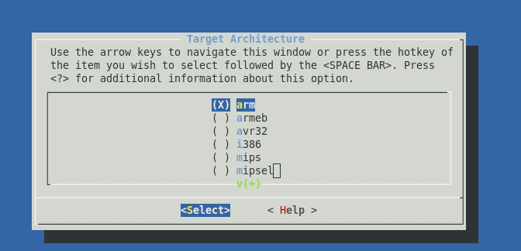
Buildroot
Steps to build cross toolchain for arm AT920T using buildroot
untar buildroot source
tar xvf buildroot-2010.11.tar.gz
make menuconfig

Slide 22
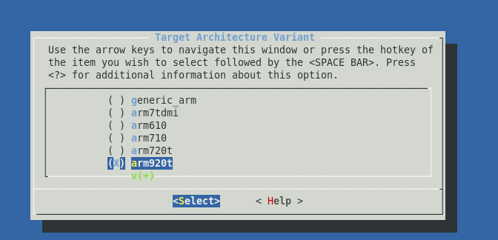
Buildroot

Slide 23
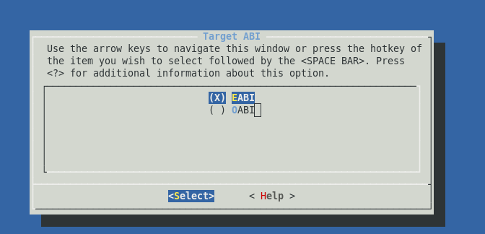
Buildroot

Slide 24
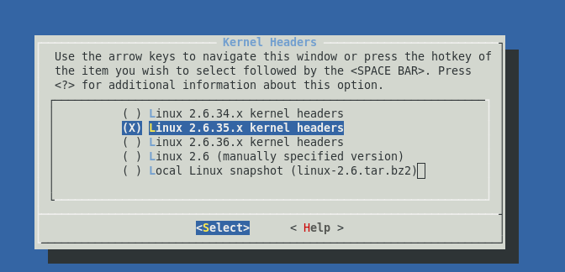
Buildroot

Slide 25

Buildroot

Slide 26

Buildroot

Slide 27

Buildroot

Slide 28
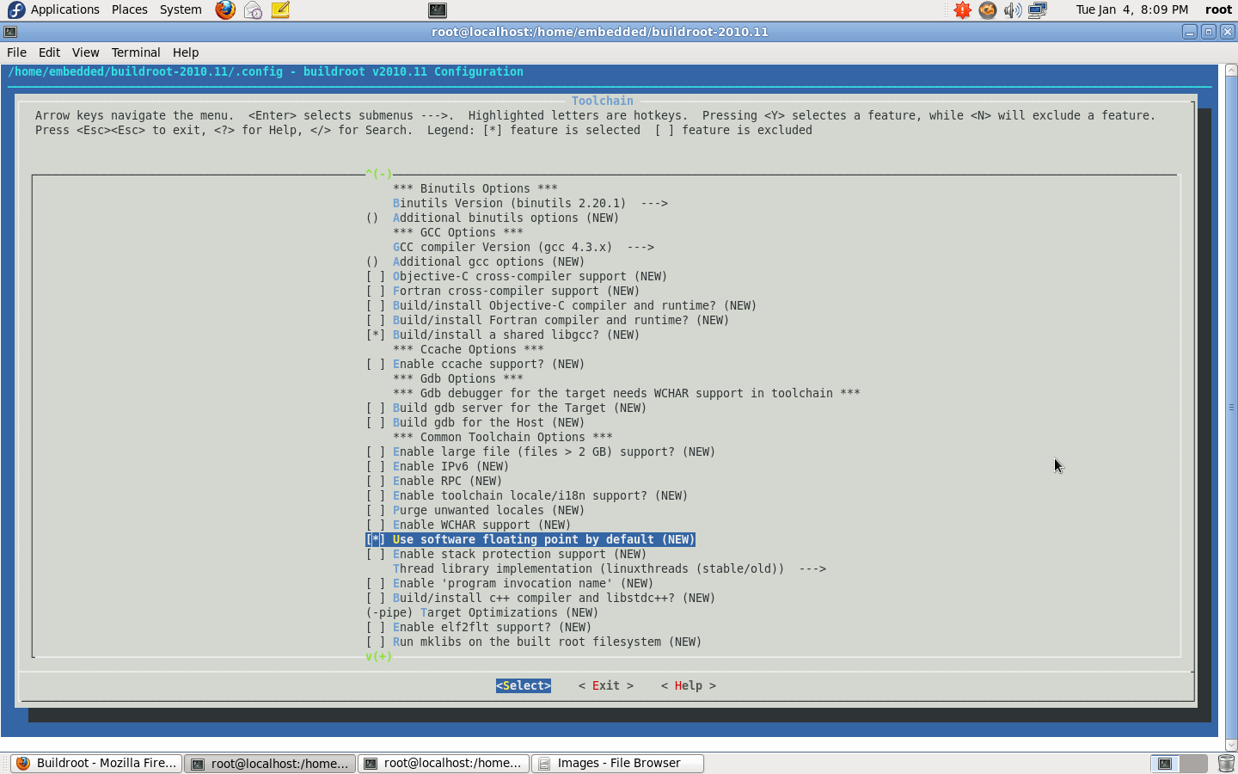
Buildroot

Slide 29
# make
On success, cross-tool-chain gets installed under $<buildroot_src>/output/staging/usr/bin/ directory with a “arm-linux-” prefix

Slide 30
Thank you

