Slide 1

Tuljaram Chaturchand College of Arts, Science and Commerce Baramati
Department of BBA(CA)
A Project report on “Online Bakery Store ”
Submitted in partial fulfillment of the requirements For the award of degree of
BBA(CA)
Submitted by
Navale Shravani Roll No: -13168
Navale Sanjana Roll No: -13170
Under the guidance of Prof.

Slide 2
Project Title : Online Bakery Store
INTRODUCTION
Welcome to the future of delectable delights, where flavor meets flair, and every bite you take is a culinary statement. "Bakery Shop" is not just an online bakery; it's a haven for dessert enthusiasts, trendsetters, and those who savor the perfect blend of sweetness and style.
In an era where indulgence is paramount, we present the ultimate virtual bakery experience right at your fingertips.
We understand that baked goods are more than just a treat –
they're a delightful expression of taste, a reflection of celebration, and a crucial component of culinary enjoyment. Our mission is to redefine the way you savor sweet delights, offering an extensive collection curated with precision, flavor, and your unique preferences in mind.

Slide 3
Existing System
The existing system of an online shoe store typically involves several components:
Website Interface:
Customers access the online bakery through a website where they can explore a variety of baked goods. The website provides a visually appealing layout with high-quality images of each product, a user- friendly navigation menu, and details about the bakery's story and commitment to quality.
Product Database:
A database stores information about available baked goods, including product names, descriptions, images, prices, ingredients, and availability. It may also include additional information such as dietary preferences (e.g., gluten-free, vegan) and customer reviews.
User-Friendly Interface:
The bakery website offers an intuitive and user-friendly interface, allowing customers to easily browse through different categories of baked goods, apply filters based on preferences (e.g., type of pastry, dietary restrictions), and read customer reviews. The website may also have a section showcasing special offers, seasonal items, or personalized recommendations.

Slide 4
NEED OF THE SYSTEM
Customer Convenience:
Enables 24/7 access, allowing customers to order at their convenience. Eliminates the need for physical store visits, offering flexibility.
Sales Enhancement:
Broadens the customer base, leading to increased sales opportunities. Facilitates impulse purchases through a user-friendly online platform.
Efficient Operations:
Streamlines the ordering process for customers. Enhances transparency and trust through order tracking.
Effective Marketing:
Allows targeted marketing based on customer preferences. Communicates promotions and discounts seamlessly.
al.

Slide 5
SCOPE OF THE SYSTEM
Basic Necessity Fulfillment:
Addresses the fundamental human need for food through the provision of bakery products.
Ensures accessibility to a diverse range of baked goods for a wide
audience.
Quality of Life Enhancement:
Elevates the quality of life by offering a convenient and enjoyable way for customers to access freshly baked goods.
Adapts to varying levels of customer needs and preferences.
Market Presence:
Expands market presence by catering to a global audience through an online platform.
Embraces the evolving trends of digital commerce, aligning with the needs of a tech-savvy consumer base.
Economic Viability:
Contributes to economic activities by providing a platform for buying and selling bakery products.
Creates opportunities for employment and sustains business growth.

Slide 6
HARDWARE & SOFTWARE REQUIREMENTS
HARDWARE:
Processor:
Hard Disk:
RAM:
E5430 Intel Core i5-3340 Processor
256 GB
2 GB
Operating System: Windows 10
SOFTWARE:
Front End: HTML, CSS, Bootstrap
Back End: PHP.
Database: MySQL
Applications: Sublime Text Editor, XAMP server

Slide 7
System analysis and design

Slide 8
Fact finding technique
At the time of the analysis of the system or before starting actual work of system the system analyst has to collect information about the manual system from the user department for which the system is going to be developed. In order to collect this information, system analyst prefers anyone of the following fact finding technique or prefers two or more fact finding techniques according to situation:
Interview.
2. Record Review.
3. Observation

Slide 9
1)Interviewing : - System investigation has been done, by taking interview of the concerned person, higher officials & users. By asking then about manual process, problems regarding system, they requirements, any they’re valuable suggestions and guidance regarding the system. After taking their interviews regarding the system and studying pointes crucial for system, and for any further need, inter – views ware taken again & the pointes were discussed & covered which previously ware not understood. This interview technique proved beneficial regarding preliminary investigation but requires much time than the other techniques.
2)Record Review: - This technique proves in finding facts of system and pointes must be covered while designing the current system. Observing documents, register and files, which are prepared manually by the department, carries out the technique of record review. It helps the design of inputs and output required for the system, the database, screen –designing etc. Thus, this technique proves very helpful for analyzing about the system
3)Observation: - Observation allows analyst to gain information, they cannot obtained by any other technique through it analyst can obtain first and observation about how activities are carried out.

Slide 10
Feasibility study
Technical Feasibility : The system must be evaluated from the technical point of view first. The assessment of this feasibility must be base on outline design of system requirements in this term input, output and program procedure are concern. The project should be developing such that the necessary function and performance are achieved within the constraints. The project developed within latest technology available.
Operational Feasibility : It is measure of hoe well a proposed system solved problems and taken advantage of the opportunity identified during bakery management system. How it satisfies the requirement and analysis of system development by checking system work cyclically such as purchase. It also prefers to the measure of solving problems with the help of new proposed system. It help if advantage to fulfill the requirement.
Economical Feasibility: The proposed system must be justifying be const and benefits criteria to ensure that effort is concentrated project which will give best return earliest. since the system is developing as part of project work there is no mutual cost to spend for proposed system also all resources bare already available. It gives a conduct of system is economically possible for development. Hardware and Software Requiremen

Slide 11
Diagrams

Slide 12
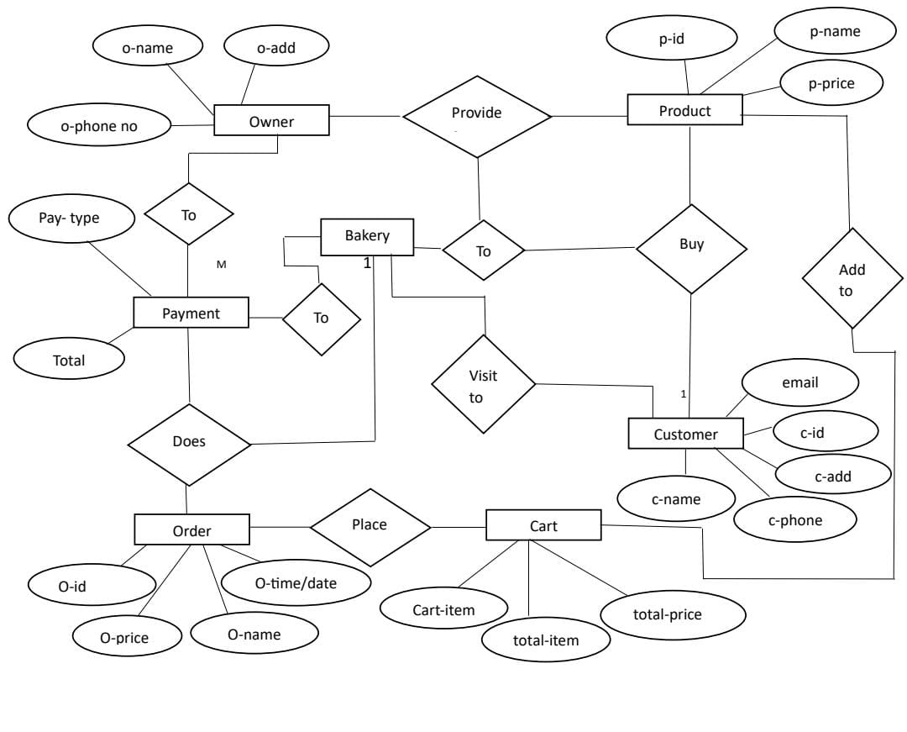
Er diagram

Slide 13
Context level diagram

Slide 14
Zero level dfd
cc
view
o
cc
customer
owner
Online
bakery
Order proceed
cc
Gives order
order
order
cc
Paid payment
cc
cc
payment
owner
gives bill

Slide 15
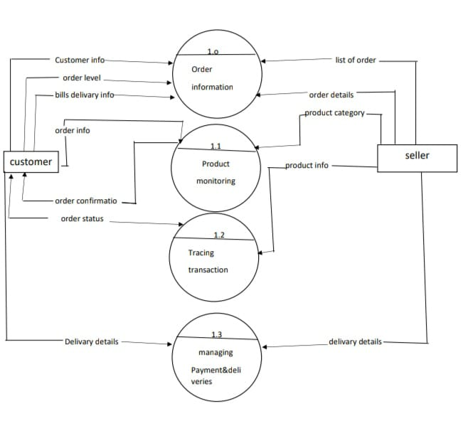
1^{st level dfd}

Slide 16
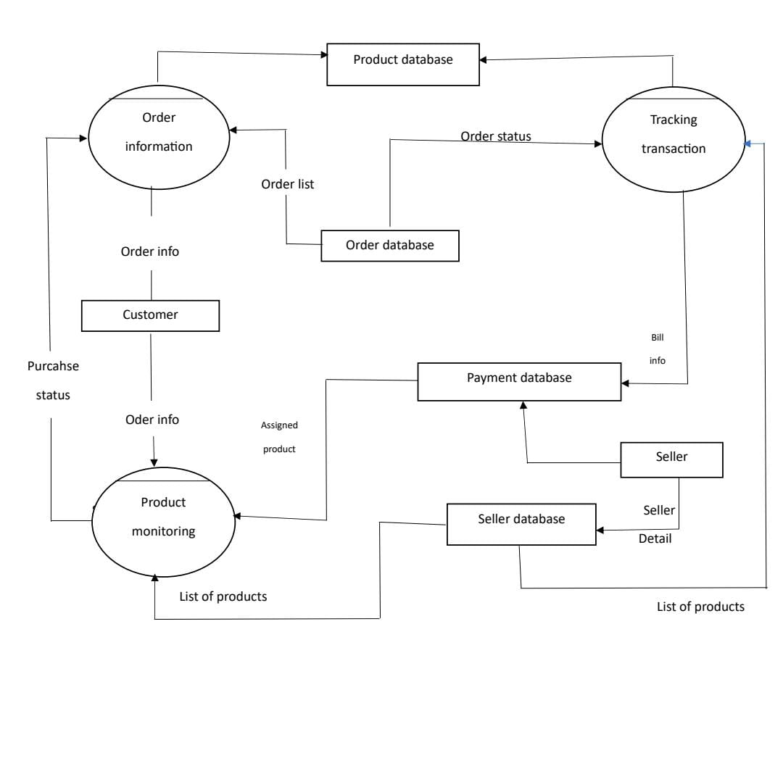
2nd level dfd
2nd level dfd
2.1
2.2
2.3

Slide 17
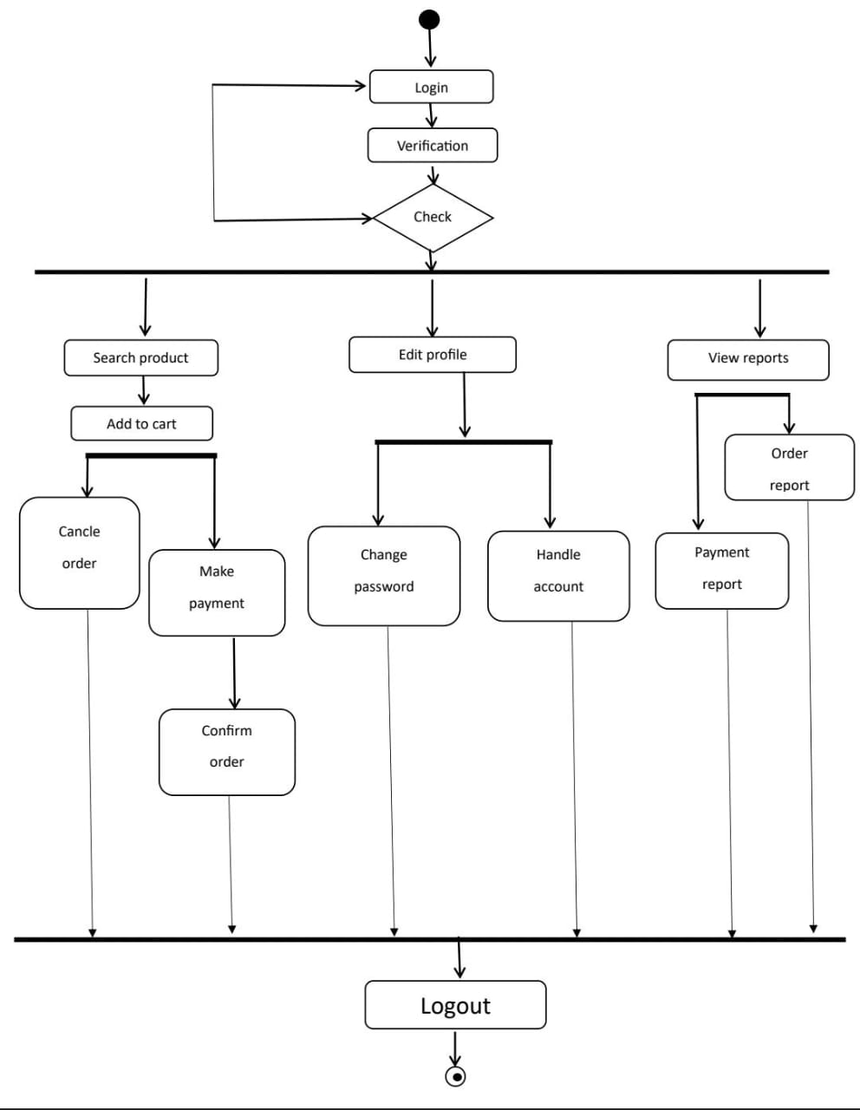
Activity diadram

Slide 18
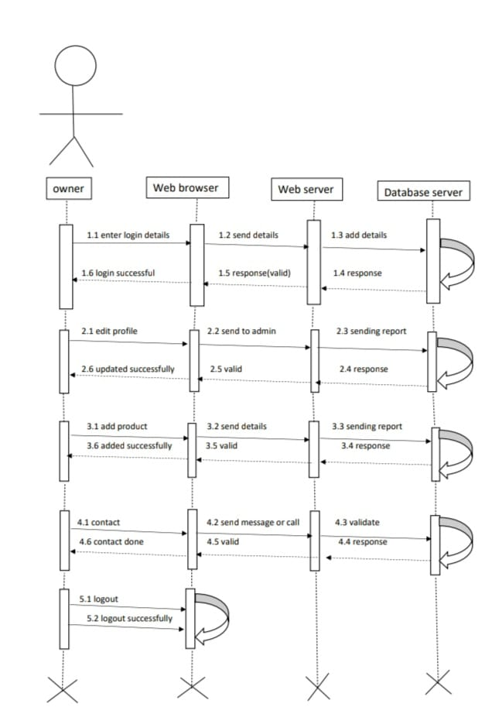
Sequence diagram

Slide 19
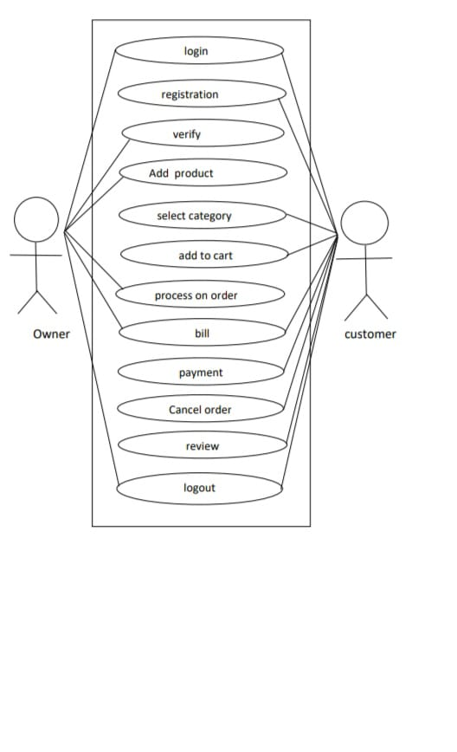
Combine Use case diagram

Slide 20
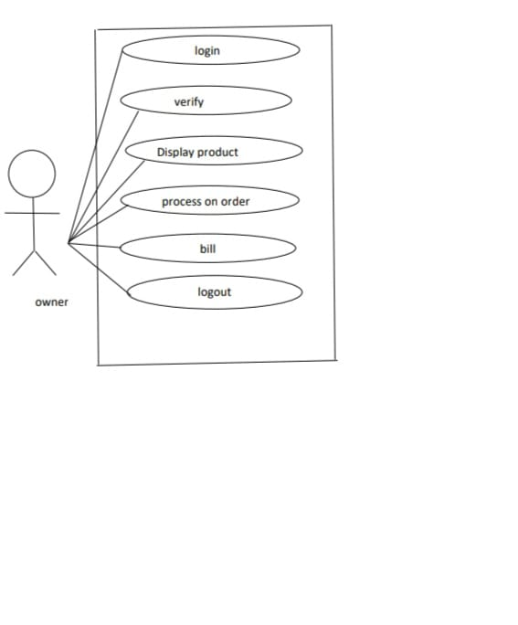
Use case diagram for owner

Slide 21
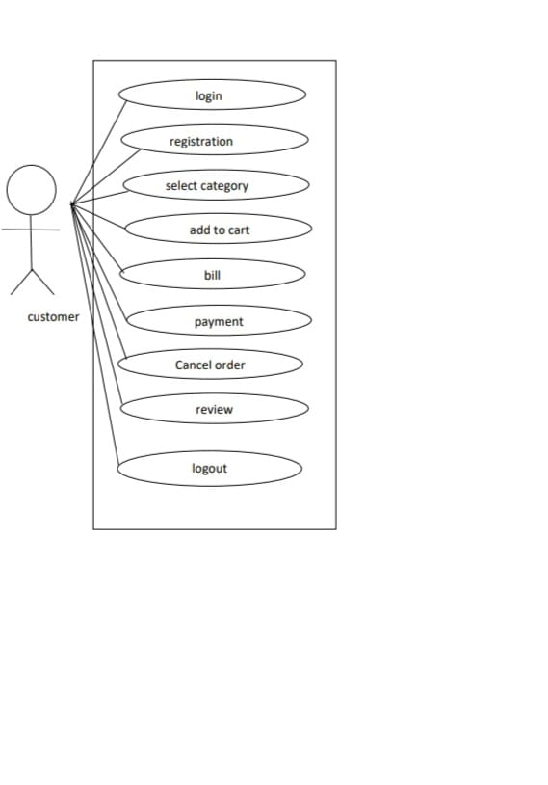
Use case diagram for customer

Slide 22
Deployment diagram

Slide 23
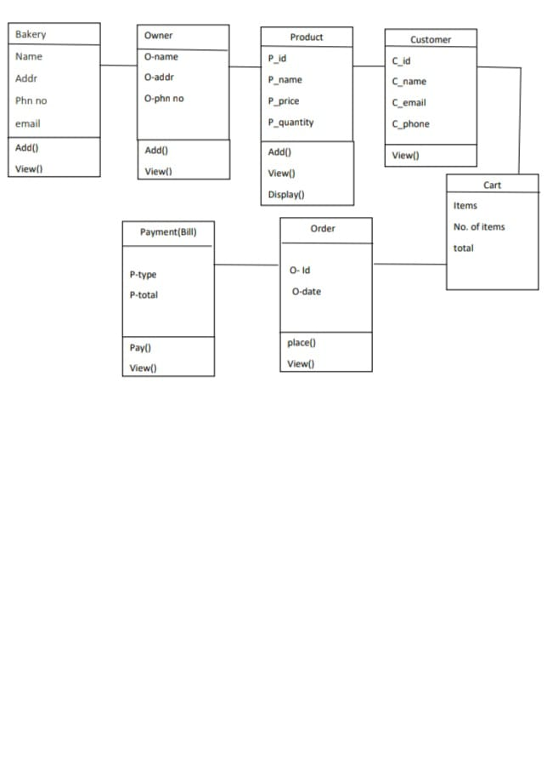
Class diagram

Slide 24
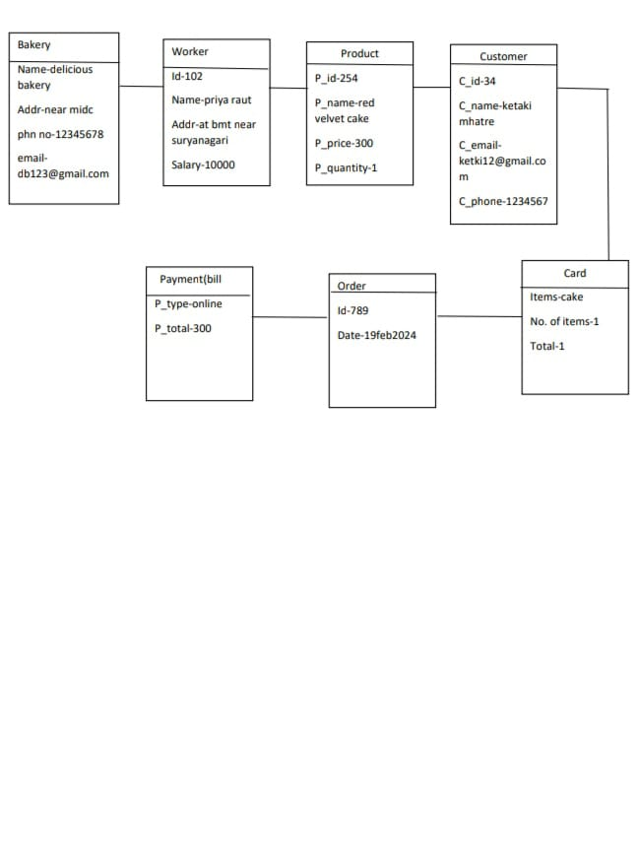
Object diagram

Slide 25
Data dictionary

Slide 26
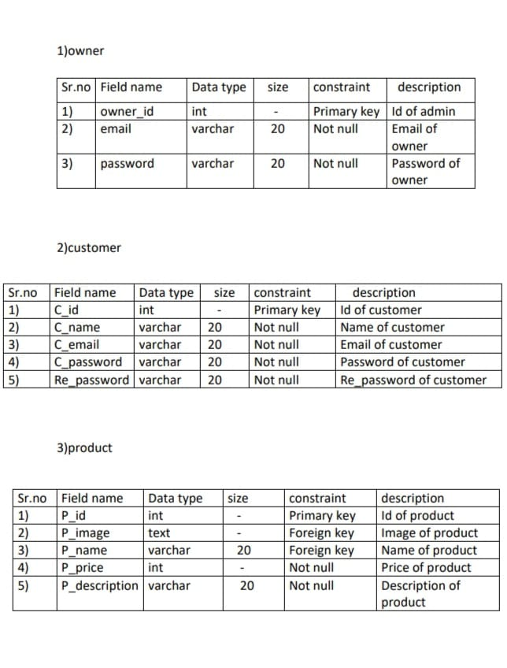

Slide 27
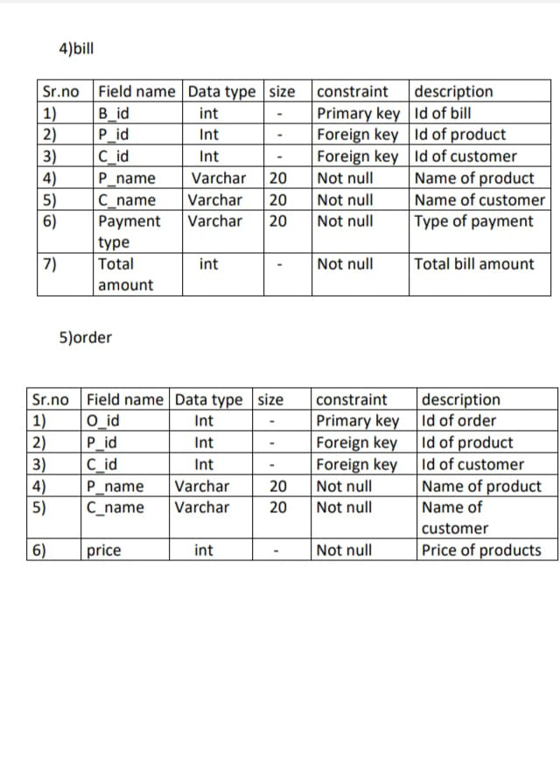

Slide 28
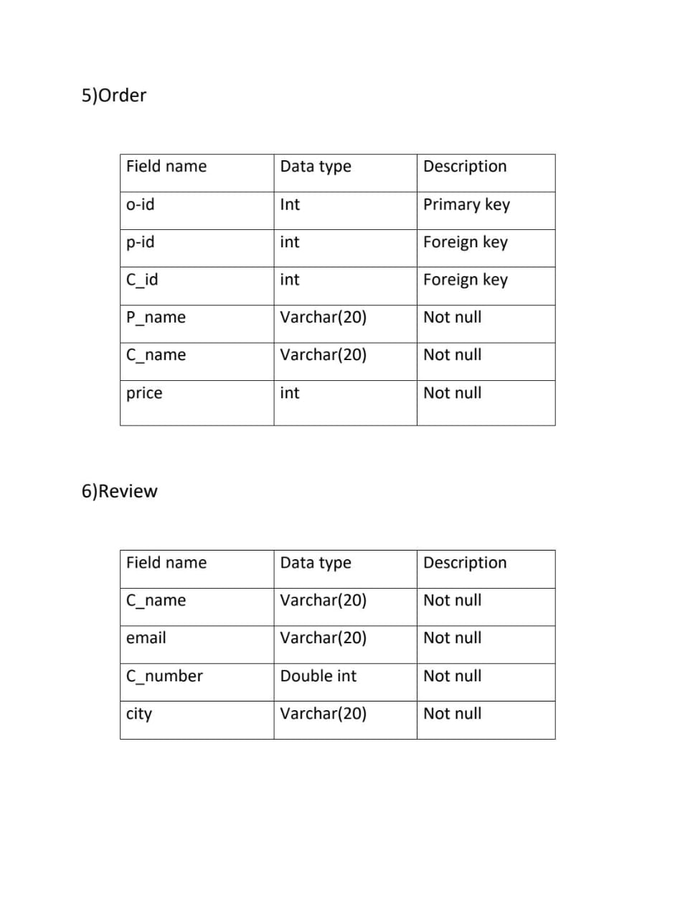

Slide 29
🫷🙏🫸
Thnak you

