Slide 1
Exploratory Data Analysis and Visualization with Python
Presentation by Jaydeep Biswas
Manager, PwC India
Learning Carnival 2023

Slide 2
Topics
01
Data Handling & Pre-processing with Python
Data Ingestion
Data Cleaning
02
Exploratory Data Analysis with Python
Data Manipulation
Statistical Computing
03
Data Visualization using Python
Visualizing statistical relationships
Visualizing distributions of data
Visualizing categorical data
2

Slide 3
Data Handling & Pre-processing
Exploratory Data Analysis
Data Ingestion
Data Cleaning
Data Manipulation
1
read_excel()
dataframe.info()
df.describe()
2
read_csv()
dataframe.head()
df[“column”].value_counts()
3
read_json()
dataframe.drop()
df.groupby()[“column”].mean()
4
read_clipboard()
df.dropna() / df.fillna()
df.groupby()[“column”].aggregate()
5
read_html()
df.duplicated()
df.corr(numeric_only=True)

Slide 4
Data Visualization Using Python
Statistical relationships
Data Distribution
Categorical Data
1
seaborn.relplot()
seaborn.displot()
seaborn.catplot()
2
scatterplot()
seaborn.joinplot()
seaborn.swarmplot()
3
lineplot()
seaborn.pairplot()
seaborn.boxplot()
4
seaborn.violinplot()
5
seaborn.barplot()

Slide 5
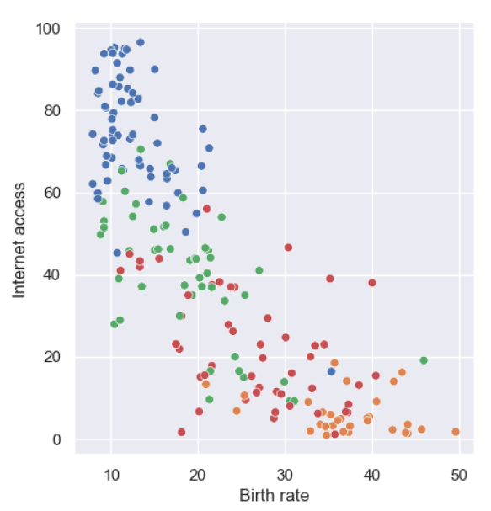
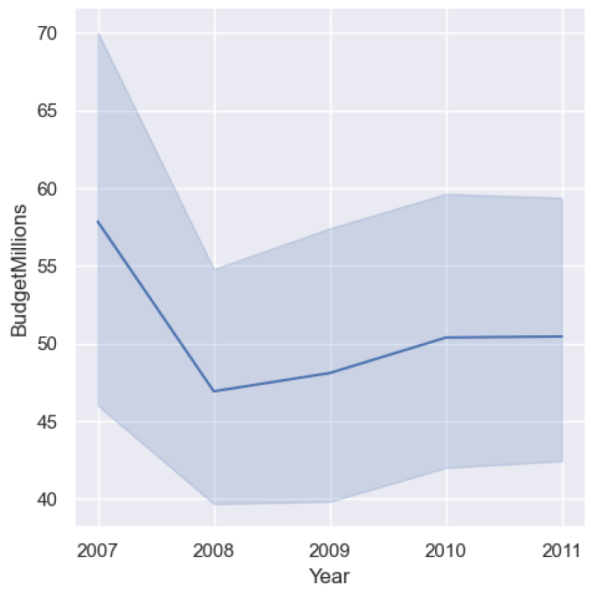
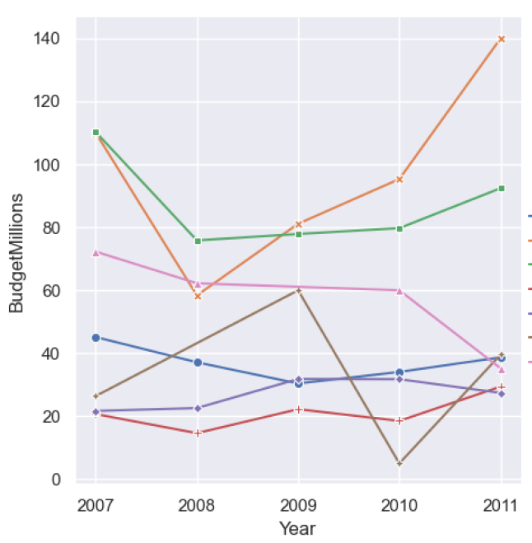
Statistical Relationships
1
2
3
relplot() , kind="scatter“
scatterplot()
relplot() , kind=“line“
lineplot()
relplot() , kind=“line“
lineplot()
5

Slide 6
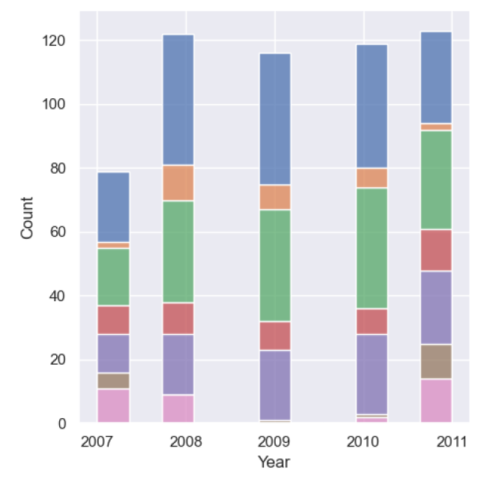
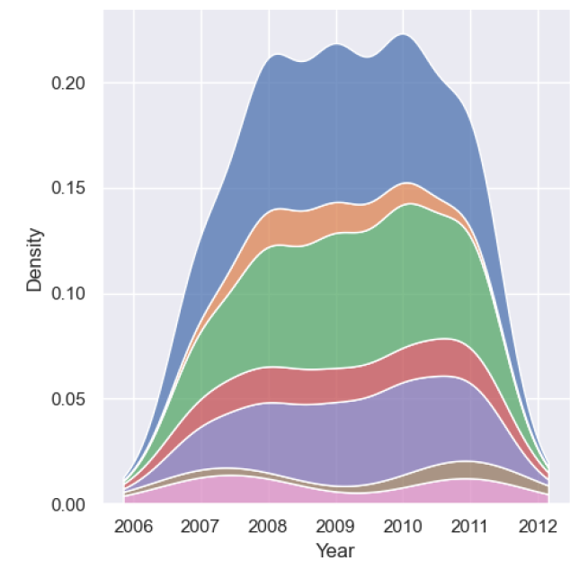
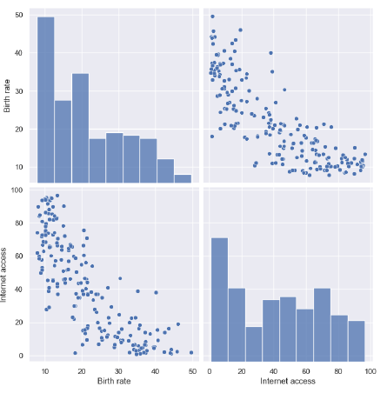
Data Distribution : distplot() & pairplot()
1
2
3
displot() , kind="hist"
histplot()
displot() , kind=“kde"
pairplot()
6

Slide 7
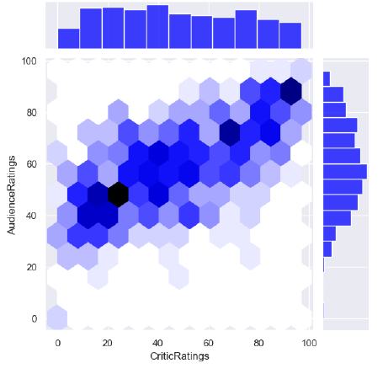
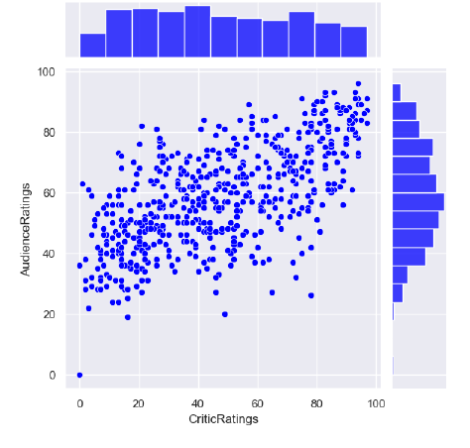
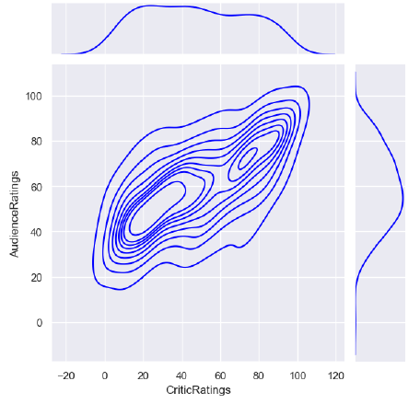
Data Distribution : jointplot()
4
5
6
joinplot() , kind=“scatter"
joinplot() , kind=“kde"
joinplot() , kind=“hex"
7

Slide 8
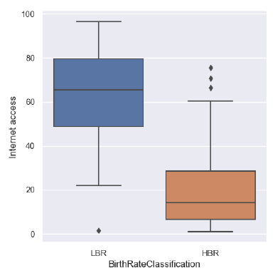
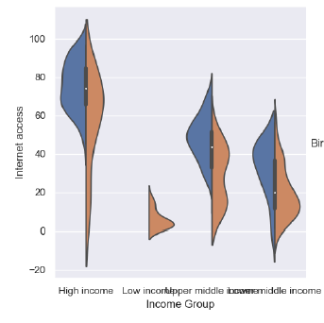
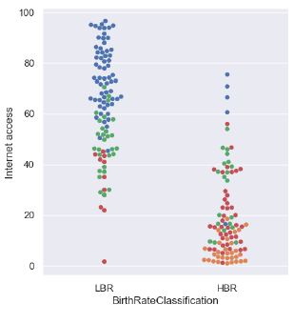
Categorical
1
2
3
catplot() , kind=“swarm“
swarmplot()
catplot() , kind=“box“
boxplot()
catplot() , kind=“violin“
violin()
8

Slide 9
Thank you
© 2023 PwC. All rights reserved. Not for further distribution without the permission of PwC. “PwC” refers to the network of member firms of PricewaterhouseCoopers International Limited (PwCIL), or, as the context requires, individual member firms of the PwC network. Each member firm is a separate legal entity and does not act as agent of PwCIL or any other member firm. PwCIL does not provide any services to clients. PwCIL is not responsible or liable for the acts or omissions of any of its member firms nor can it control the exercise of their professional judgment or bind them in any way. No member firm is responsible or liable for the acts or omissions of any other member firm nor can it control the exercise of another member firm’s professional judgment or bind another member firm or PwCIL in any way.

