Slide 1

DevOps Pipeline Using Google Cloud Platform Native Services

Slide 2
DevOps Pipeline
Set of automated processes and tools.

Slide 3
GCP Native Services
Cloud Source Repository
Cloud Build
Container Registry
App Engine

Slide 4
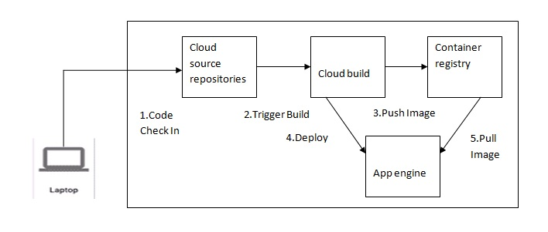
Architecture

Slide 5
Implementation Steps
Create Cloud Source Repository
Two ways to create source repository are as follows:
Create a new(empty) source repository
Connect to external GitHub repository

Slide 6
Create a new(empty) source repository
gcloud source repos create REPOSITORY_NAME
Use nano command to create files in repository for e.g. ,
nano main.py
gcloud source repos clone REPOSITORY_NAME
git add .
git commit -m “COMMIT MESSAGE
git push origin master

Slide 7
Deploy an application to App Engine
gcloud app deploy app.yaml
gcloud app browse

Slide 8
Connect to external GitHub repository
Connect external git repository through console
cd GIT_REPOSITORY_NAME
gcloud app deploy app.yaml
gcloud app browse

