Slide 1

ProComp: A Problem-Driven Multi-Agent Framework for Comparative Paper Ranking
Master’s Thesis by Laxmi Shravani Mamidala
Committee Members
Dr. Ting Xiao, Major Professor
Dr. Jing Yuan, Committee Member
Dr. Yuan Li, Committee Member

Slide 2
AGENDA
Background
Problem Statement
Limitations of Peer Review
Role of AI in Evaluation
Motivation for ProComp
Objectives of ProComp Framework
Overview of ProComp Framework
Multi-Agent Architecture
Retrieval-Augmented Generation
Prompt Engineering Strategy
Experimental Dataset
Model Configurations
Evaluation Metrics
Baseline Frameworks Analysis
Evaluation Metric Performance Comparison
Ablation Study Results
Conclusions, Future Work & Challenges

Slide 3
Background
Evolution of Peer Review
Scalability Challenges
The concept of peer review began in the 17th century as an informal mechanism for assessing academic research findings. It has developed to a complex regulatory system involving more than one layer of responsibility. With this framework in mind, scientific peers have a means of checking whether research at the academic level meets the highest standards.
As scientific publishing has exploded, the peer review system hasn’t kept up. Most reviewers are simply burned out and falling behind on their deadlines for too long. As peer review is often an add-on from the authors, with no extra time for them to get proper attention to their research, and no time for them to check it out as well.
Bias and Subjectivity
Inconsistency in Evaluations
Despite anonymity, the reviewer's evaluation is affected by subjective factors such as language, perceived innovation, or the institute's status. Many of these factors influence the review process and can lead to bias.
Such low inter-reviewer reliability suggests that the validity and reliability of the evaluation criteria may be subjective rather than objective. This is undermining the independence and authority of a peer review system.

Slide 4
Limitations of Peer Review Systems
Reviewer Fatigue
The exponential increase in manuscript submissions has resulted in many reviewers facing mental and time constraints in their review process, leading to much longer evaluation times, much less investigation time, and therefore a lower-quality peer-review process.
Inconsistency in Evaluation
Variability in reviewer skill levels and subjective interpretation in the analysis can lead to different review scores and feedback for similar papers, resulting in inconsistencies and limited reliability across peer-review scores
Subjectivity and Bias Writing style, perceived novelty, and institutional affiliation are two aspects of reviewers that can bias them (resulting in biased decisions) in the peer-review process.

Slide 5
Research problem
The current peer-review system is constrained by limited scalability, inherent subjectivity, and a lack of standardized evaluation protocols, leading to inconsistent, biased, and non-reproducible assessment outcomes, thereby impeding the fairness, reliability, and efficiency of scientific manuscript evaluation.

Slide 6



Role of AI in Scientific Evaluation
Introduction to LLMs Large language models (LLMs) like GPT and LLaMA are deep neural models, trained on high-level scientific corpora so that they perform semantic comprehension, contextual summarization and reasoning over challenging research.
Applications in Scientific Analysis Large Language Models (LLMs) empower automated literature analysis: the study of literature can not only extract key insights but discover its methodological limitations and construct structured evaluations and thereby reduce reviewers’ workload and enhance the quality of their assessment to better demonstrate the reliability of its insights as well.
Enhancing Peer Review With the help of such experts as expert reviewers, LLMs are able to generate rapid, standardized feedback with both quantitative and qualitative evaluations, which facilitates the way data is processed and peer-review is robust.

Slide 7
Challenges in Traditional LLM Peer Review Systems
Lack of Structural Decomposition In single-agent models, all aspects of a manuscript are evaluated under one’s own evaluation simultaneously, and shallow and general assessments are made. Without the need for task decomposition to form special parts, analysis and understanding of a manuscript are much less simple, interpretable, and thorough.
Hallucination and Limited Context Such models may produce plausible but factually incorrect outputs due to poor domain grounding and inadequate integration of external knowledge, resulting in low assessment accuracy.
Poor Ranking and Discrimination However, in the absence of structured scoring mechanisms and a joint evaluation system or other mechanisms (from peer-review methods), single-agent systems lack the capability to objectively evaluate research findings, leading to biased ranking and limited effectiveness for peer-review purposes.

Slide 8

Motivation for PROCOMP Framework
The growth in the number of scientific publications has pushed peer review systems to the brink, with reviewers feeling fatigued and unreliable.
We established ProComp because we need a system that serves as a framework for high-volume, science-written reviews with ethical, robust evaluation. ProComp uses expert professionals to test diverse aspects of the research, thereby minimizing bias and variation.
ProComp provides a structured results system that lets readers compare relevant information and make quick decisions, making science processes more manageable and reliable. In practice, human reviewers have time to make accurate decisions.

Slide 9
Objectives
Multi-Agent Decomposition
Structured Review Outputs
Retrieval-Augmented Reasoning
Consistency and Robustness
Scalability and Flexibility

Slide 10
PROPOSED PROCOMP NETWORK (A Problem-Driven Multi-Agent Framework )

Slide 11


Overview of ProComp Framework
Modular Multi-Agent Pipeline
Retrieval and Meta-Review Integration

Slide 12
Multi-Agent ProCOMP Architecture
Figure: Modular Pipeline Architecture of ProComp Incorporating Structured Preprocessing, Specialized Evaluation Agents, Meta-Review Fusion, and Retrieval-Augmented Reasoning

Slide 13




Agents Architecture
Problem Analysis Agent: Evaluates clarity, relevance, and motivation of the research problem. Focuses on how well the paper frames its scientific questions and research goals, providing numerical scores and explanations.
Methodology Agent : Assesses technical soundness, experimental rigor, and reproducibility of methods used. Ensures the methodology aligns with research objectives and is validated with appropriate experiments
Contribution Agent : Measures novelty, significance, and potential impact of the research. Distinguishes high-impact work by evaluating the originality and broader relevance of the contributions
Meta-Review Agent: Aggregates scores and qualitative feedback from other agents to produce a final, coherent evaluation. Resolves conflicts and provides overall ranking and recommendations.

Slide 14
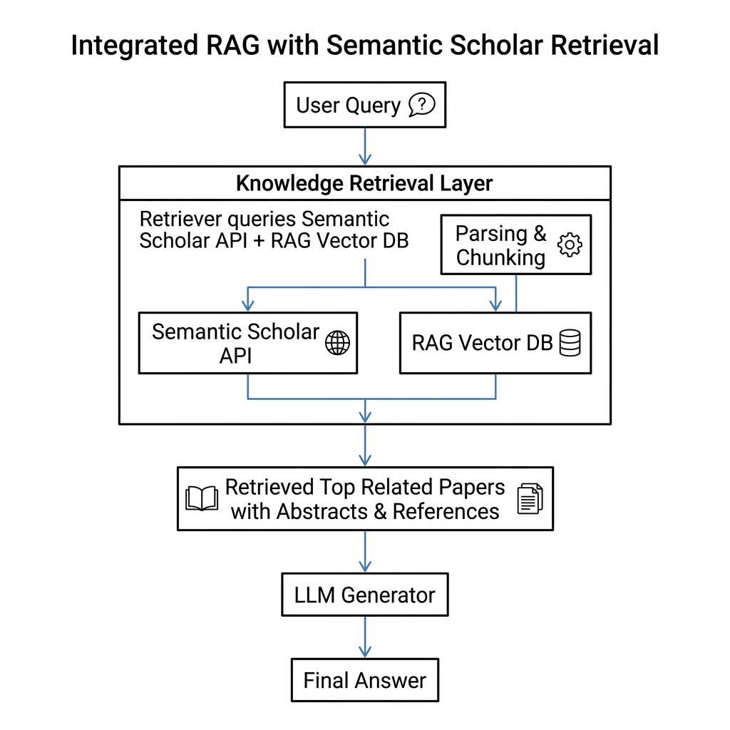
RAG
Figure :Integrated Retrieval-Augmented Generation Pipeline with Semantic Scholar API for Academic Query Resolution

Slide 15


Prompt engineering Strategy
Role-Specific Structured Prompts
Chain-of-Thought Reasoning
Integration of Retrieval Context

Slide 16
Experimental setup
Curated Peer-Review Corpus
Heterogeneous Research Domains
The dataset comprises 194 scientific manuscripts modeled after conference-style peer review, with structured summaries and detailed human-evaluation scores across key dimensions such as soundness, presentation, and contribution.
Papers cover a broad spectrum of fields, including computer vision, robotics, optimization, causal inference, recommender systems, fairness, and large language model systems, ensuring the robustness and generalizability of the proposed system across diverse scientific domains and distribution shifts
Multi-Dimensional Annotations
Each paper includes normalized human scores for various criteria, enabling fine-grained analysis of quality. Annotations cover methodological rigor, clarity, novelty, and overall impact, reflecting the complexity of academic evaluation.

Slide 17

Model Configurations
LLM Models Tested
Inference Settings
Execution Environment
The framework was tested on GPT-based, LLaMA-based, NVIDIA Nemotron, and Qwen models accessed via OpenRouter API to compare capabilities across architectures.
Controlled inference with low temperature, fixed token limits, standardized sampling, and consistent request frequency ensured reproducibility and minimized output variability.
Pipeline orchestration and evaluation metrics ran locally while model inference leveraged cloud-based OpenRouter API, enabling efficient large-scale testing.

Slide 18
Evaluation metrics
Error-Based Metrics
Mean Absolute Error (MAE)
Root Mean Squared Error (RMSE)
Correlation-Based Metrics
Pearson Correlation
Spearman Correlation
Ranking-Based Evaluation
Pairwise Ranking
Kendall’s Tau
Variance for Within-Group
Standard Variance

Slide 19
Comparative analysis of Muti-Agent framework
Baselines Frameworks
Holistic Ranking Evaluation
Correlation analysis
Ablation study

Slide 20
Baselines Framework
Rule-Based Semantic Evaluation
SEA-E: Uses heuristic scoring and semantic similarity to evaluate research papers based on predefined rules. It offers consistent outputs but lacks a nuanced understanding of novelty and methodology.
Structured Pre-Agentic Review Frameworks
TreeReview : Organizes paper review as a hierarchical decision tree with clear modularity and interpretability but is limited by rigid rules and lacks advanced reasoning capabilities.

Slide 21
Baselines Framework
Early Single-Agent LLM Reviewer
Zero-Shot Prompting : It enables a model to perform evaluation tasks without relying on task-specific training examples, instead leveraging its pre-trained knowledge and generalization capability. In the context of peer review, it generates direct assessments based solely on the input manuscript but may lack depth and consistency due to the absence of guided reasoning or structured decomposition.
Chain-of-Thought (CoT) Prompting: It encourages the model to produce explicit intermediate reasoning steps before arriving at a final decision, thereby improving performance on complex analytical tasks. In evaluation settings, it enhances interpretability and reasoning quality; however, it can still produce inconsistent or verbose outputs without structured control mechanisms.

Slide 22
Baselines Framework
Agent Review
Agent Review uses structured prompting to simulate multiple evaluation dimensions within a single framework, enabling a more organized, criterion-based assessment than basic prompting methods.
Deep Reviewer
The reviewer focuses on generating detailed, in-depth analytical feedback by encouraging comprehensive reasoning, aiming to improve evaluation quality through richer, more elaborate review outputs.
Cycle Reviewer
Uses multiple evaluation iterations to refine outputs, improving consistency, but is limited by scalability and unable to incorporate independent agent-based cross-validation.

Slide 23
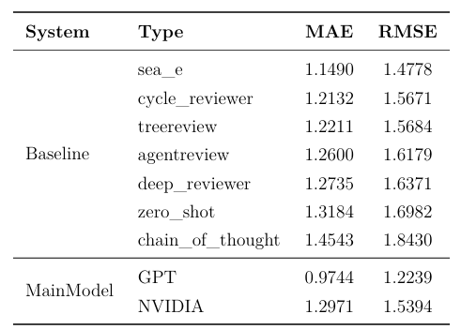
Interpretation of Baselines evaluated with Error-Based Metrics
Table : Performance metrics (MAE and RMSE) for all evaluated systems on the 194-sample review dataset.

Slide 24
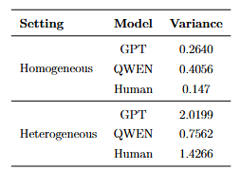
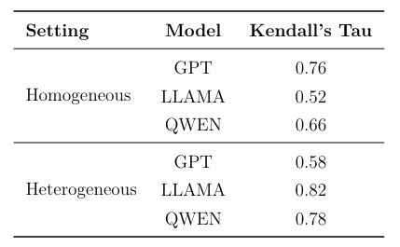
HOLISTIC RANKING EVALUATION
Score Variance Analysis Across Group Type
Ranking Correlation with Human Judgments (Kendall’s Tau)
Table: Score Variance Across Homogeneous and Heterogeneous Groups
Table : Kendall’s Tau Correlation with Human Rankings

Slide 25
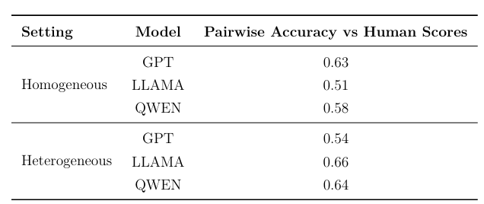
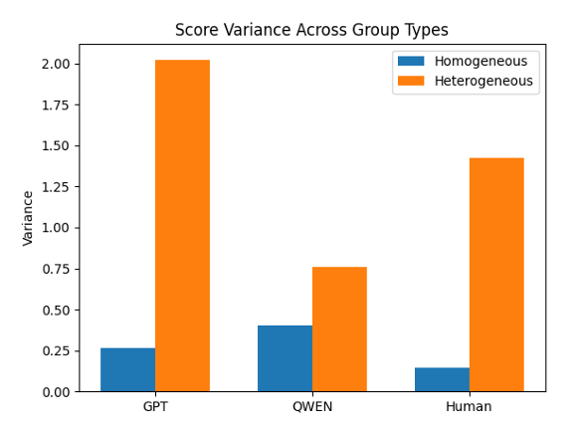
HOLISTIC RANKING EVALUATION
Pairwise Ranking Accuracy
Within-Group Ranking Analysis
Table: Pairwise Ranking Accuracy Across Homogeneous and Heterogeneous Groups
Figure: Score variance across homogeneous and heterogeneous group types.

Slide 26
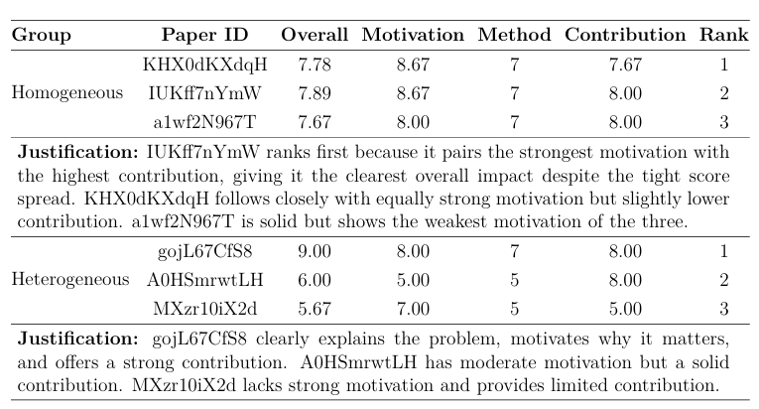
Within-Group Ranking Analysis
Comparative Group-Wise Rankings with Dimensional Scores and Justifications

Slide 27
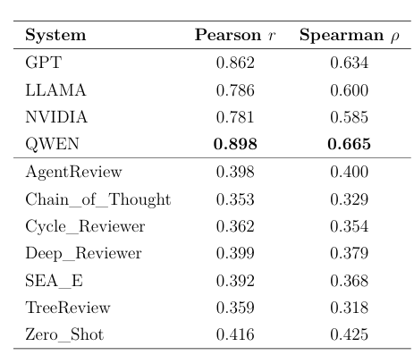
CORRELATION ANALYSIS EVALUATION
Table: Correlation of Model Predictions with Human Scores Across Main Models and Baselines

Slide 28
ABLATION STUDY
The following are the ablation experiments performed to understand each agent’s influence on our multi-agent framework results.
With Problem Analysis Agent only
With Methodology Agent only
With Contribution Agent only
Without Problem Analysis Agent
Without Methodology Agent
Without Contribution Agent
Without Meta-Review Agent
Impact of Retrieval Augment Generation (RAG)

Slide 29
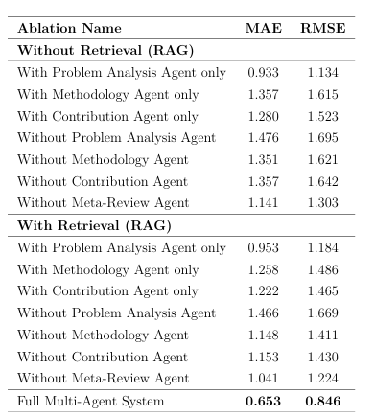
Ablation Study Result
Ablation Study of Multi-Agent Components With and Without Retrieval (RAG) Using MAE and RMSE Metrics

Slide 30
Conclusion
The proposed ProComp framework addresses the most important challenges present in existing and existing peer-review based practices and introduces it through a multi-agent evaluation paradigms through a structured and multi-agent evaluation framework that can be used effectively to decompose the review process into distinct components that make different research aspects in a way that would allow for the more granularity, interpretability and alignment through multiple research aspects of the entire reviews process.
ProComp is supported by Retrieval-Augmented Generation (RAG), which supports strong factual grounding, reduces hallucinations, and helps to reinforce automated evaluations. JSON-based outputs are more usable for accurately assessing an automated review, with the benefit of being easily peer-reviewed and easily compared with a human.
ProComp outperforms existing baselines in accuracy, reliability, data quality, and ranking ability, and also demonstrates a significant difference in research quality. Our framework works well alongside human judgment, which supports its use.
ProComp offers a scalable, robust peer-review solution with high in-house automation and interpretability, helping an intelligent review team support human reviewers in making fair, efficient, and high-quality decisions throughout the process.

Slide 31
Limitations and Challenges
ProComp is dependent on underlying LLM capabilities, making it vulnerable to issues such as hallucinations, prompt sensitivity, and variability across different models.
The effectiveness of Retrieval-Augmented Generation (RAG) is contingent on the quality and relevance of retrieved sources, which may introduce noise or bias into the evaluation process.
The multi-agent architecture increases computational overhead and system complexity, resulting in higher latency and resource consumption for large-scale deployment.
Alignment with human judgment is not perfect, and maintaining consistency across diverse and highly specialized research domains remains a challenging task

Slide 32
Future work
We plan to improve the robustness and generalization of ProComp by leveraging advanced LLMs and employing prompt design strategies to ensure consistent, accurate evaluation.
Improvements to the Retrieval-Augmented Generation (RAG) component, with domain-specific and dynamically updated knowledge sources, could provide more solid grounding in the field and reduce incorrect evaluations.
We will also explore advanced judge mechanisms and competitive discussion protocols among agents, incorporating agreement-based scoring, consensus modeling, and pairwise ranking strategies to improve reliability, calibration, and discriminative ranking performance.
Trying to optimize the multi-agent architecture to reduce computational overhead, latency, and resource consumption for large-scale implementation.
Extending the framework to various research domains and multilingual evaluation will broaden the scope and the size of that methodology in real-world peer-review scenarios.

Slide 33
References
[1] T. Brown et al., “Language Models are Few-Shot Learners,” in Advances in Neural Information Processing Systems (NeurIPS), 2020.
[2] H. Touvron et al., “LLaMA: Open and Efficient Foundation Language Models,” arXiv preprint arXiv:2302.13971, 2023.
[3] J. Wei et al., “Chain-of-Thought Prompting Elicits Reasoning in Large Language Models,” in NeurIPS, 2022.
[4] Y. Liu et al., “Retrieval-Augmented Generation for Knowledge-Intensive NLP Tasks,” in Advances in Neural Information Processing Systems (NeurIPS), 2020.
[5] S. Yasunaga et al., “Self-Refine: Iterative Refinement with Self-Feedback,” arXiv preprint arXiv:2303.17651, 2023.
[6] L. Zheng et al., “Judging LLM-as-a-Judge with MT-Bench and Chatbot Arena,” in NeurIPS Datasets and Benchmarks Track, 2023.
[7] X. Wang et al., “Self-Consistency Improves Chain of Thought Reasoning in Language Models,” in ICLR, 2023.
[8] G. Wang et al., “AgentVerse: Facilitating Multi-Agent Collaboration and Exploration,” arXiv preprint arXiv:2308.10848, 2023.
[9] S. Kovačević et al., “Automating Scientific Peer Review: A Survey,” ACM Computing Surveys, 2024.
[10] M. Wadden et al., “Fact-Checking Scientific Claims with Retrieval-Augmented Language Models,” in ACL, 2023.

Slide 34


Thank you

