Slide 1
IBM University Engagement Project Submission
“CareerMate AI – Agentic Career Counseling Companion”

Slide 2

Project Tile – [CareerMate AI – Agentic Career Counseling Companion]
Domain of Project – [Education Technology (EdTech), Career Guidance, Agentic AI]
Student Name | Recent Passport Photo | Email ID | Mobile number [WhatsApp]
Shravani Gourishanker Nigudge |  | shravaninigudge20@gmail.com | 8485054160

Slide 3
Problem Statement -
Problem Statement No.15 – Agentic Career Counseling Companion
The Challenge
Students often struggle to make informed career decisions due to fragmented access to guidance, limited awareness of their strengths, and rapidly evolving industry requirements.
Traditional counseling methods are:
Time-consuming
Not personalized
Difficult to scale
As a result, students often face:
Career confusion
Skill gaps
Poor learning paths
Missed job opportunities
There is a need for an intelligent AI system that continuously analyzes student profiles, skills, interests, and industry trends to provide personalized career recommendations and future-ready learning pathways.

Slide 4
Technology Used
Tech Stack (Mandatory)
I used:
LangFlow + IBM watsonx.ai + IBM Granite Models
Additional Technologies:
FastAPI
React.js
Tailwind CSS
ChromaDB
SQLite
Python
RAG (Retrieval-Augmented Generation)

Slide 5
Proposed Solution -
Proposed Solution: CareerMate AI
CareerMate AI is an Agentic AI-powered career guidance platform built using IBM Granite Models and LangFlow.
The system helps students discover suitable career paths by analyzing:
Skills
Academic performance
Interests
Career aspirations
A Retrieval-Augmented Generation (RAG) pipeline retrieves information from curated career frameworks, industry reports, technology roadmaps, certification guides, and skill matrices.
The retrieved knowledge is combined with IBM Granite reasoning capabilities to generate personalized career recommendations.
Agents
1. Profile Analysis Agent
Analyzes student profile and resume.
2. Career Recommendation Agent
Suggests suitable career paths.
3. Skill Gap Agent
Identifies missing competencies.
4. Roadmap Agent
Generates personalized learning plans.
5. Interview Preparation Agent
Creates tailored interview preparation content.

Slide 6
Langflow component Used -
COMPONENTS USED
1. Chat Input
Student enters profile information and career goals.
2. IBM Watsonx AI Agent
Processes student information using IBM Granite.
3. IBM Granite Model
Granite-4.0-8B-Instruct
4. ChromaDB Vector Store
Stores career knowledge and roadmaps.
5. Retriever Component
Retrieves career-related information.
6.Prompt Template
Structures agent prompts.
7.Agent Coordinator
Orchestrates multiple specialized agents.
8.Chat Output
Displays recommendations and roadmaps.

Slide 7
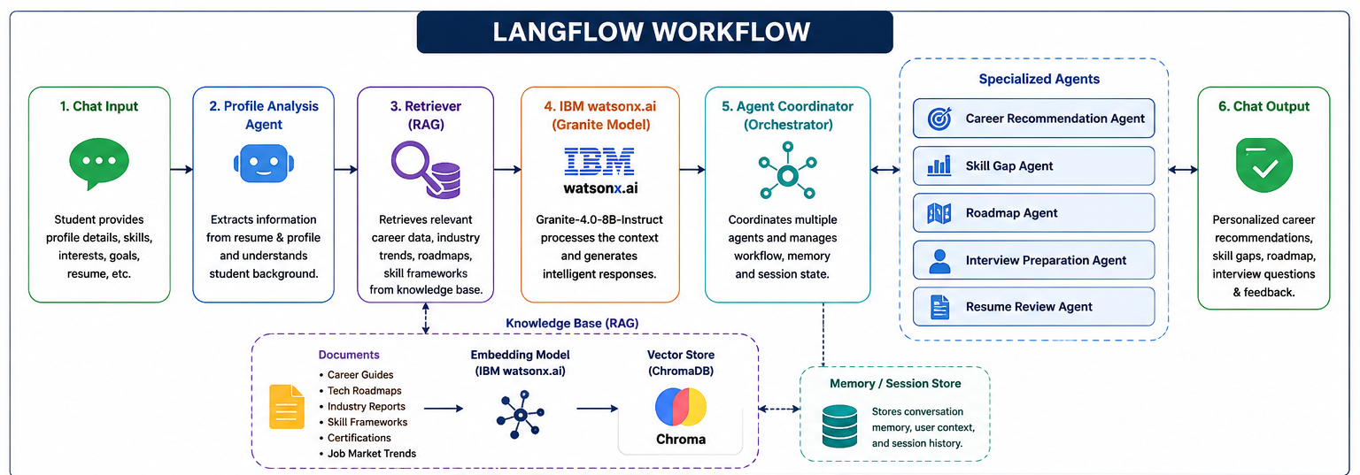
Langflow workflow -

Slide 8
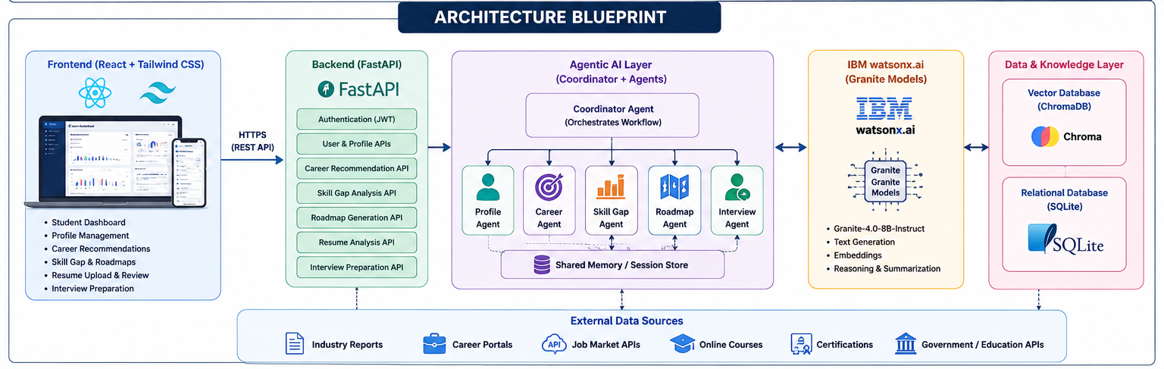
Architecture blueprint

Slide 9

Role of Agentic AI in the solution
Role of Agentic AI in CareerMate AI
Agentic AI enables CareerMate AI to operate as an autonomous and goal-driven career advisor.
Each agent performs a specialized function:
1.Profile Agent
Understands student background and achievements.
2.Career Agent
Recommends suitable career options.
3.Skill Gap Agent
Identifies missing skills.
4.Roadmap Agent
Generates learning plans.
5.Interview Agent
Prepares students for placements.
The agents collaborate to provide personalized and continuously evolving career guidance.

Slide 10
Technology Used
Technology | Purpose
IBM Granite 4.0 | Career reasoning and recommendations
IBM watsonx.ai | Model deployment and inference
LangFlow | Agent orchestration
ChromaDB | Vector database
RAG | Career knowledge retrieval
FastAPI | Backend APIs
React.js | Frontend UI
SQLite | User profile storage
Tailwind CSS | Responsive UI

Slide 11
Novelty and Uniqueness
Multi-Agent Intelligence
Multiple specialized agents collaborate.
RAG-Based Career Guidance
Retrieves accurate information from trusted career resources.
Hyper-Personalization
Recommendations tailored to individual profiles.
Dynamic Learning Roadmaps
Adaptive roadmaps generated according to goals.
Resume + Career + Interview Ecosystem
Single platform covering the entire career preparation journey.
IBM Granite Powered
Uses enterprise-grade IBM foundation models.
Explainable Recommendations
Provides reasoning behind every career suggestion.

Slide 12
Git Hub Link
shravaninigudge20/CareerMate-AI-agentic-career-counselor
·
·
·

Slide 13
Future Scope
1. Real-Time Job Market Integration
Integrate LinkedIn and job portals for live trends.
2. AI Mock Interviews
Voice-based interview simulation.
3. Skill Progress Tracking
Continuous monitoring of learning progress.
4. Personalized Internship Recommendations
Suggest internships matching career goals.
5. Multi-Language Support
Support regional languages for broader accessibility.
6. Mobile Application
Android and iOS deployment.
·
·
·

Slide 14


